Slide 1
South Lanarkshire’s Care Opinion Journey
A Justice Perspective
By
Claire Borden
Fieldwork Manager
Children and Justice Services

Slide 2
Aims of this presentation
To discuss our approach and use of care opinion in a justice social work context in South Lanarkshire.
To discuss the development of our care opinion champions group.
What care opinion has helped us do and how we have used it.
To showcase some of the innovative and creative approaches being used across South Lanarkshire.

Slide 3
How it Started:
Justice Services started using care opinion in December 2023.
Notes:
Prior to our introduction to Care Opinion there was a level of apprehension- Would using Care Opinion have a negative impact – create more complaints?
How would it work with people who are required to be involved with services as a result of statutory court orders.
Started scoping use in Justice SEPT/OCT 2023 and operational in December 2023. Considerations of how to support teams to understand the value and opportunity Care Opinion brings.

Slide 4
Our involvement and setting up:
Notes:
It became apparent very quickly that Care Opinion provided a wealth of opportunity and a different way of engaging with our service users that enabled our service to receive vital information as well as provide an opportunity to provide a response whilst considering the information being received and how this fits with our service delivery and any required changes we need to make to provide the best service to those who come into contact with us.

Slide 5
Our approaches:
Top-down approach at all levels of the service.
Training to senior managers and team leaders.
Developed “care opinion champions” in each of our Justice teams.
Care opinion is now a standing item on team meeting agendas.
We embedded tablets in each team to promote the use of care opinion.
A systematic approach using our internal review structure to gather feedback.
Notes:
Also used posters, leaflets, team QR codes, meetings, development days.

Slide 6
Development of the “Care Opinion Justice Champions”:
Each team was asked to provide a designated care opinion champion.
The care opinion champions are tasked with promoting the use of care opinion within their teams and attend the relevant training to then share with colleagues.
The champions group meets on a quarterly basis and shares experience and knowledge and discussions about team responses.

Slide 7
Where we are now:
Notes:
Care opinion is providing a host of valuable information that is having a direct impact on how we deliver services.

Slide 8
Stories so far 24/25:
Notes:
43 stories between July 24 and April 25

Slide 9
The way people are sharing their stories with us:
Notes:
Use of tablets available within teams to support those who may experience digital poverty.

Slide 10
Criticality rating:

Slide 11
Common tags:

Slide 12
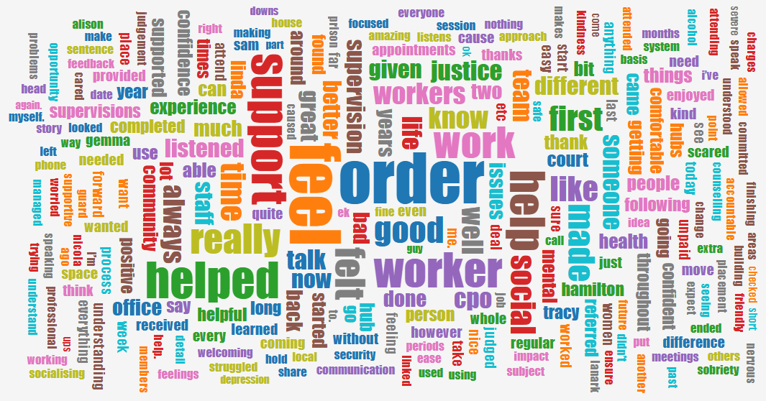
Story word cloud based on our stories:

Slide 13
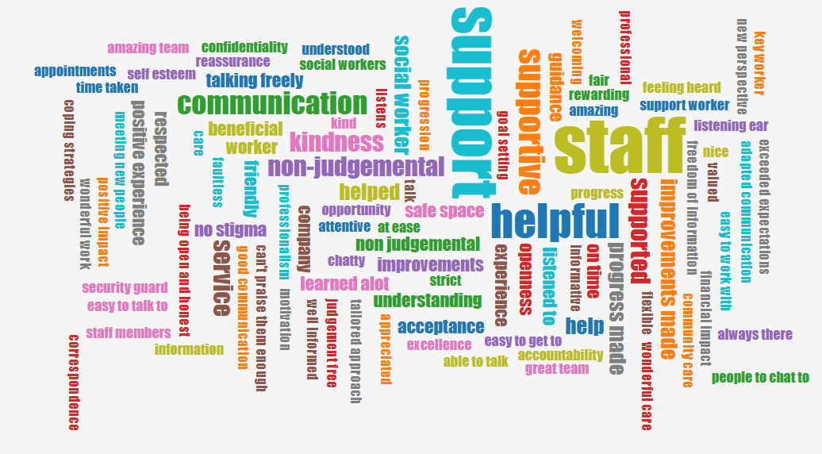
Word cloud on what was good?

Slide 14
Word cloud on what could be improved:

Slide 15
How we are using information provided via care opinion:
Featured in care inspectorate quality assurance thematic review as an evidence measure.
Yearly service development day with Justice Services staff group.
Developing services- We are taking action on what people tell us- promoting key strengths and addressing areas of development.
Developing feedback week at unpaid work in September using care opinion.

Slide 16
Showcase examples in our wider area:

Slide 17
East Kilbride treatment rooms:
The treatment rooms in East Kilbride have consistently received a number of regular stories from patients.
This has been achieved as a result of regular promotion by senior managers in the area and the dedication and commitment of the team to ask patients to complete care opinion following treatment.
Internal fun competitions have also taken place between teams to help promote the use of care opinion.

Slide 18
Cambuslang locality support service feedback week:
Situation:
Due to changes in management structure, increase staff absence and new recruits CamGlen locality had seen a declining number of care opinions being submitted for services within the locality.
Action:
Working with team leaders, senior nurse and service manager the locality decided to run a care opinion focus week in the last week of April 2025. The aim of the focus week was to help build awareness within locality about care opinion, build staff confidence in raising the care opinion topic with patients and for service areas to review their care opinion materials (ensuring it was fit for purpose, that all staff knew how to access etc and come up with any other ideas on how to raise care opinion).
Outcome :
From the focus week staff have reported feeling more confident in speak to patients about care opinion, a review of the care opinion material has taken place for the locality resulting in fresh promotional materials being displayed in waiting rooms and new ideas on how to raise the care opinion topic with patient groups (text messages to our FNP clients, the use of the care opinion bear for school nursing, stickers in red books by health visitors) etc. Before the focus week the locality had only received 4 stories for the previous quarter, during the five days of focus week the locality received 15 stories, with stories continuing to come into locality as the month progresses.
Future plans:
We plan to continue to run a focus week once a quarter in the locality, to help keep the topic fresh with staff, ensure that staff have time to access the care opinion training resources and provided dedicated support to staff in engaging with patients around care opinion.

Slide 19
Our commitment to providing a voice and to us taking action:
The examples highlighted I hope evidence our commitment and passion about the use of care opinion in South Lanarkshire.
We value people’s voice and opinion through the telling of their stories in their own words.
We are committed to listening ( and really listening) as well as acting upon the stories people tell us so we can provide the best possible services.

Slide 20
Thank you
Thank you to the Care Opinion team for the continued support to South Lanarkshire. In particular to Fraser Gilmour and Charlotte Borthwick who have provided fabulous continued support to our teams.
Thank you also to South Lanarkshire’s Giulianna Gustinelli who is our very own Care Opinion guru, who we could not do without !!

