Slide 2
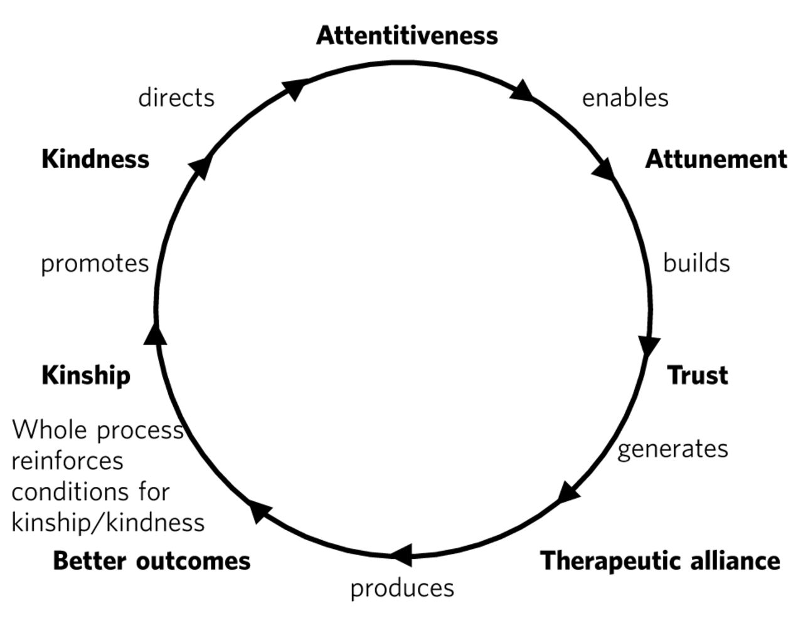
Intelligent Kindness: reforming the culture of healthcare (Ballat & Campling)

Slide 3
“The other thing I didn’t raise and I should have done because it does annoy me intensely, the time you have to wait for a bedpan... elderly people can’t wait, if we want a bedpan it’s because we need it now. I just said to one of them; “I need a bedpan please” and it was so long in bringing it out it was too late. It’s a very embarrassing subject, although they don’t make anything of it, they just say “Oh well, it can’t be helped if you’re not well.” And I thought, “Well, if only you’d brought me the bedpan you wouldn’t have to strip the bed and I wouldn’t be so embarrassed”.
Q. Overall did you feel you were treated with respect and dignity while you were in hospital?
A. Yes, always
Q. Overall, how do you rate the care you received?
A. Excellent

Slide 4
Notes:
Give your curiosity a test tickle….

Slide 5
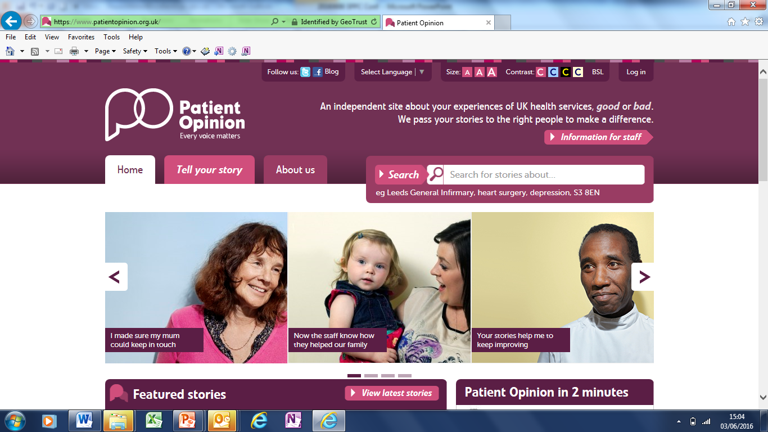
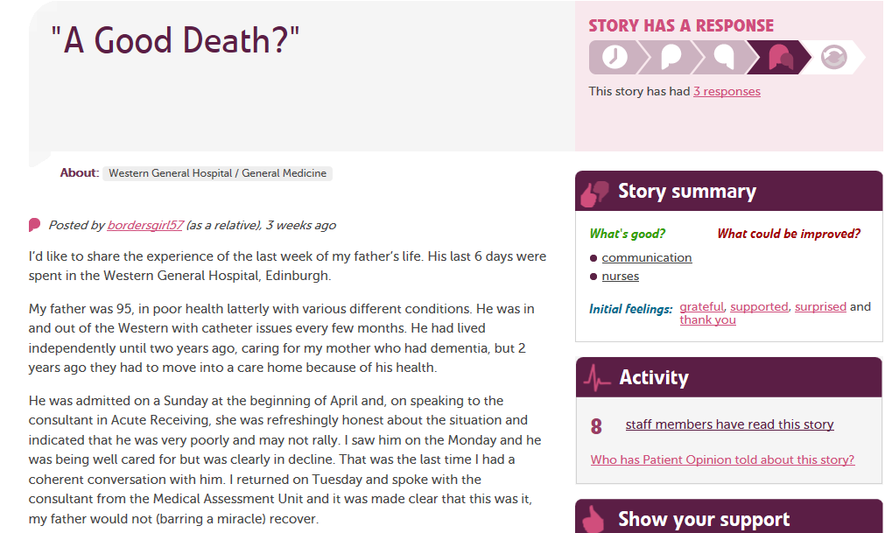
Notes:
We can see that these people are human beings just like us – they aren’t an alien species from Mars or Uranus…

Slide 6
The 3 Patient Opinion questions
What was good?
What could be improved?
How did you feel?

Slide 7
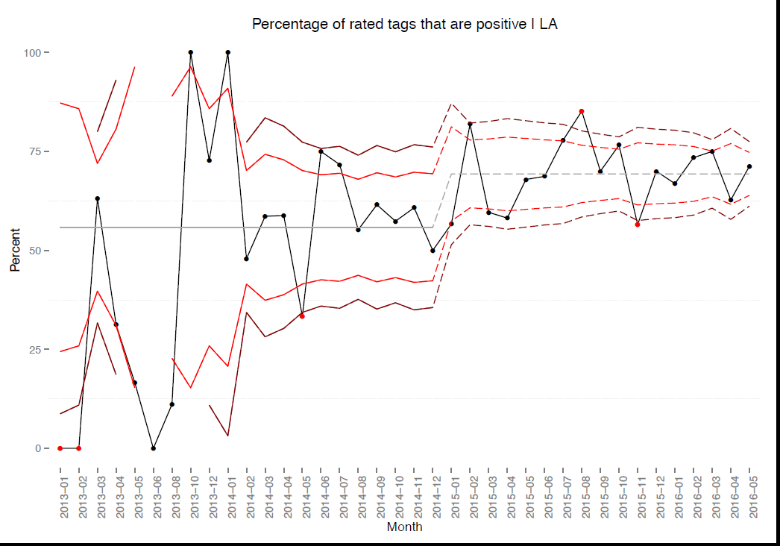
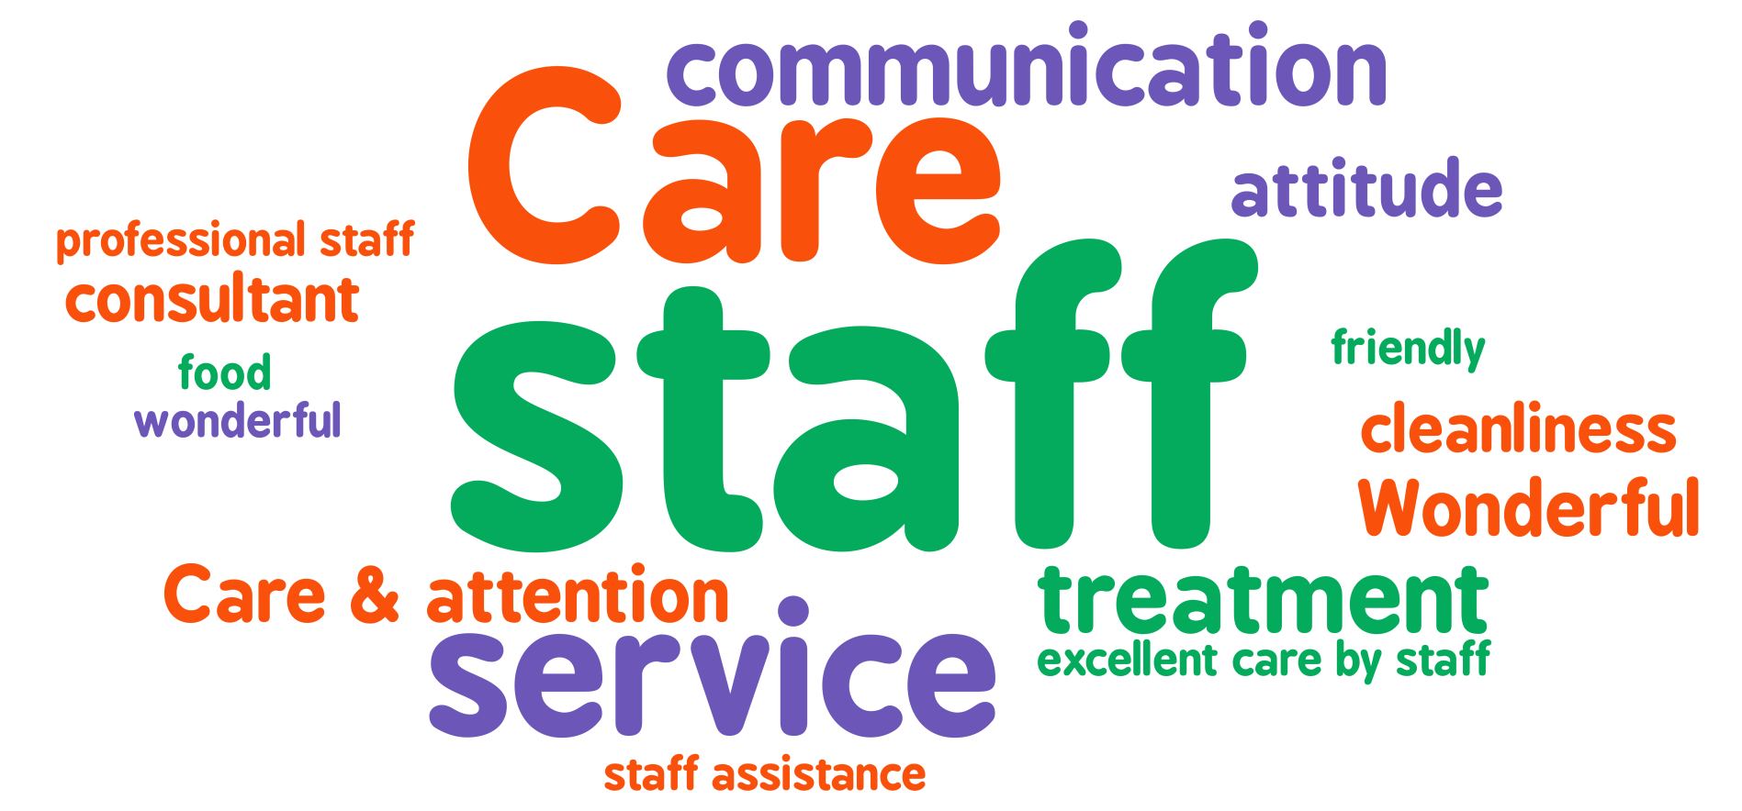
NHS Lanarkshire June 2016: what’s good?
Notes:
Same board level data for Lanarkshire plus board level tags in response to the ‘what was good?’ question

Slide 8
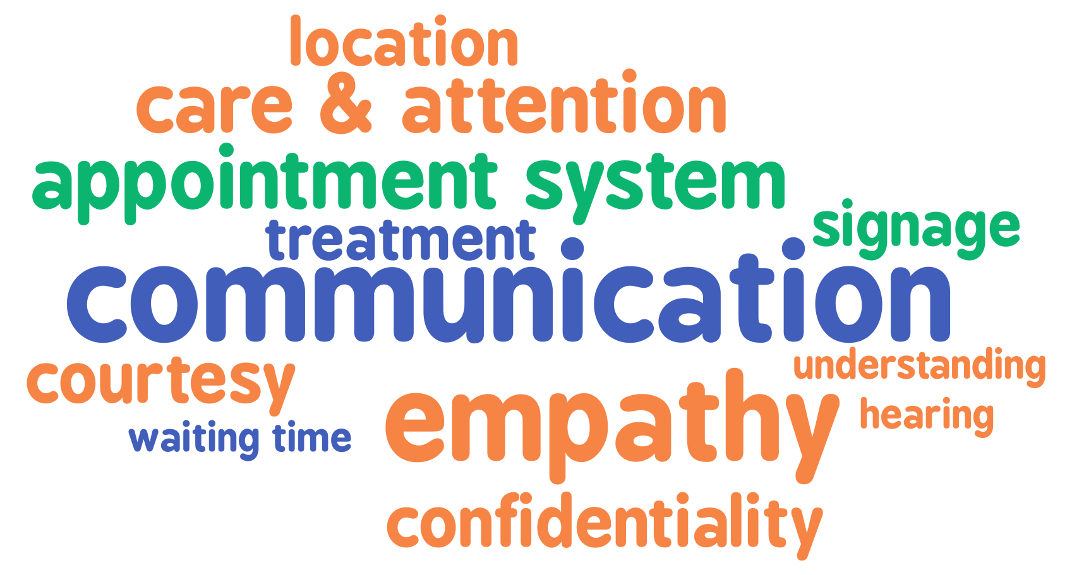
NHS Lanarks June 2016: what’s could be improved?

Slide 9
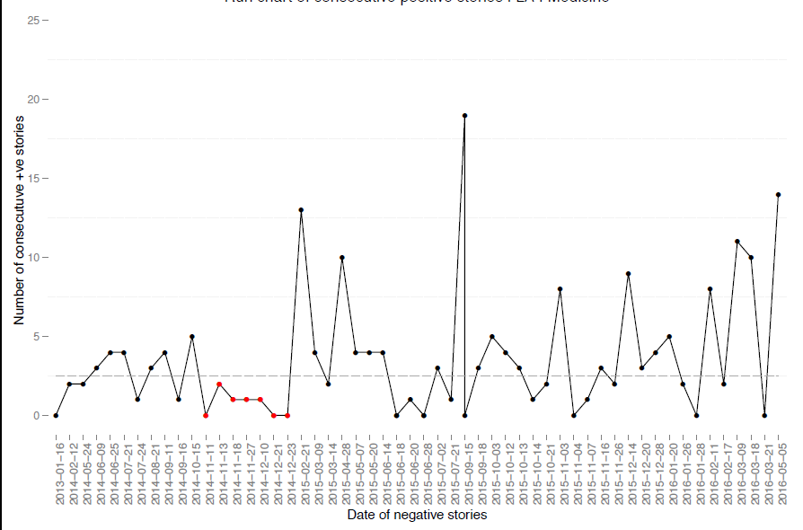
Wishaw Maternity: no. of consecutive +ve stories
Notes:
But board level data, whilst useful for a general overview, doesn’t really let you know where things are good bad or indifferent. Using PO data in this way provides us with a laser guided approach to identifying improvement opportunities as well as celebrating success.
When we get down to service or team level we think the g chart is more useful. This shows the number of positive stories between each negative story. This unit is getting up to 20 positive stories between each negative story (important to note for comparison with second unit)

Slide 10
Wishaw maternity : what’s good?
Notes:
Add in the tag cloud for ‘good’ stuff. Strong ‘midwife’ theme and lots of positive relational tags.

Slide 11
Wishaw maternity: what could be improved?
Notes:
Here’s “What could be improved?” about the same service. Some good suggestions for the team to reflect on: ‘class times’ ‘aftercare’
How critical are these improvements? How urgent? The “feelings” will help us to discern…….

Slide 12
Lanarkshire maternity: how are people feeling?
Notes:
Pretty damn good. Only one negative term.

Slide 13
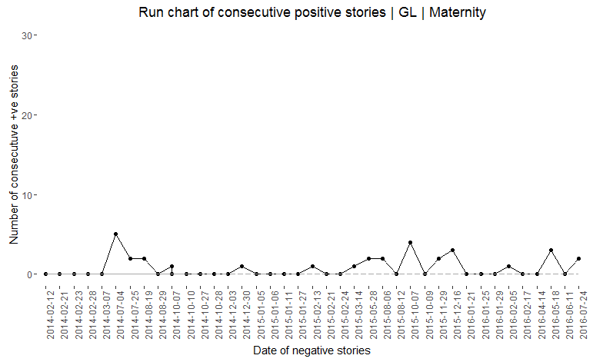
Mat. unit 2: no. of consecutive +ve stories
Notes:
Another similar maternity service in board Z for comparison. Just to show that this data can reveal variation between similar services.
Important: the software has automatically reduced the scale on the vertical axis. The upper limit on Wishaw axis was 25, but this one is 6. So the spikes are much lower and there are lots of zeroes which indicates not so many runs of consecutive positive stories. This unit has never gone more than 5 positive stories between negative stories.

Slide 14
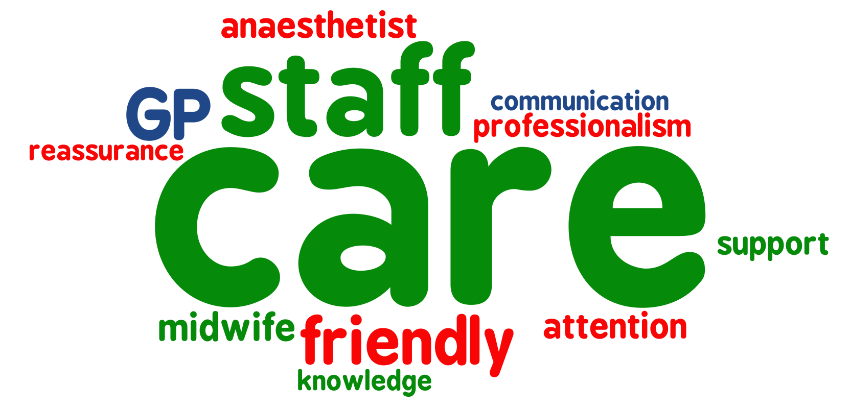
Mat. unit 2: What’s good?
Notes:
Looks different to Wishaw straight away. No big ‘midwife’ theme here. ‘Anaesthetist’ and ‘GP’ have appeared as positive themes along with ‘care’. So although its different we can’t tell yet whether its better or worse.

Slide 15
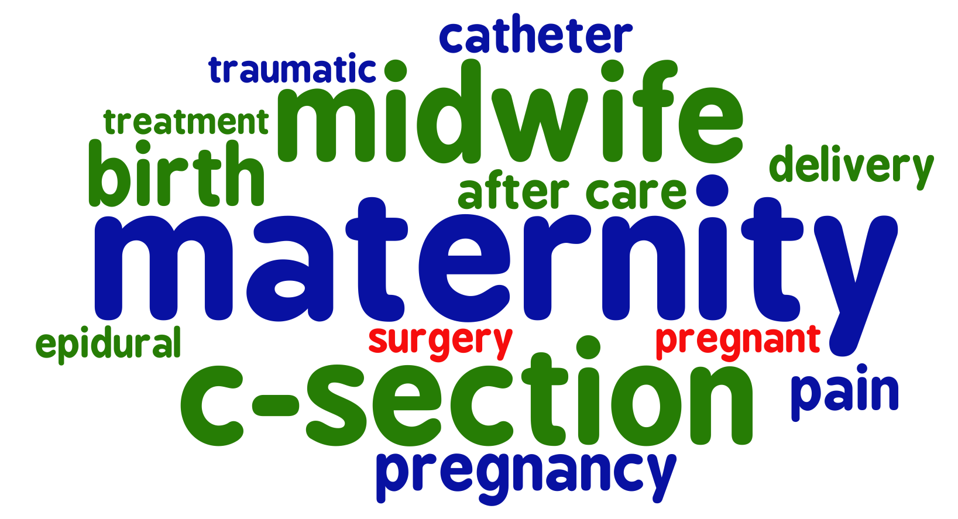
Mat. unit 2 : What could be improved?
Notes:
The improvement themes are also different. ‘Midwife’ is a prominent improvement theme for this unit along with ‘c-section’. Interestingly this unit does have a high c-section rate.
Starting to get a hunch from the g chart and the tags so far that this unit might not be as safe, effective, or person-centred as the first one.

Slide 16
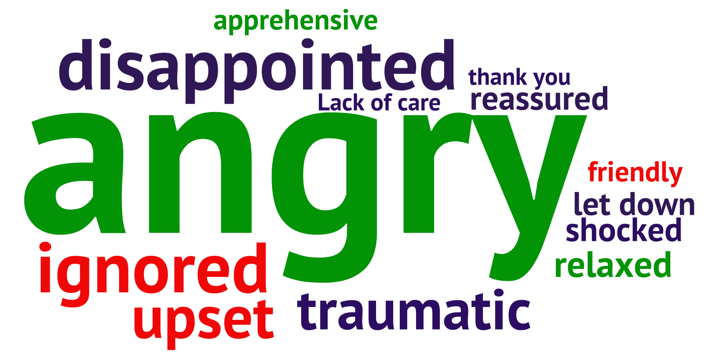
Mat unit 2: How are people feeling?
Notes:
The feelings confirm that this unit needs some support to improve….. Powerful negative emotions compared to the Wishaw example… This unit does not seem to be providing good realtional, person-centred care, but I also think its intuitive that the care being delivered here will not be as safe and effective as in the first unit, and indeed, some of their clinical outcome data seems to confirm this.
Listening deeply, making it safe for people to open up about there experience, and thoughtful use of qualitative and quantitative data together to give us a fuller picture.

