Slide 1



Stories meet QI

Slide 2
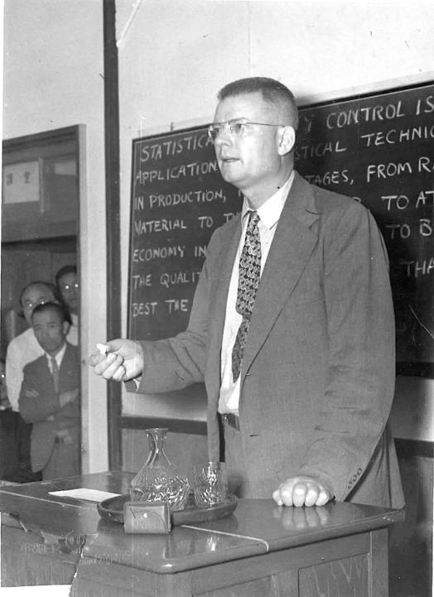
“The greatest waste… is failure to use the abilities of people… to learn about their frustrations and about the contributions they are eager to make.”
W. Edwards Deming
Out of the Crisis p53
Notes:
At the heart of the QI culture described by Deming is valuing people – especially the people who work in the system and carry out its core work., as well as those it serves. Listening to people is at the heart of QI.
According to Deming, a leaders job is to trust the integrity of the worker, listen to their suggestions for improvement and support the workers to develop and test those improvements. They are also to listen to their frustrations, the things that get in the way of them doing their job, and then work to remove those obstacles.
Deming saw two of the primary roles of a leader as being a listener and a facilitator.

Slide 3
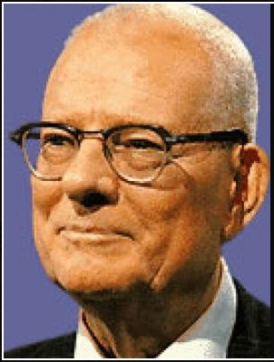
“the most important figures that one needs for management are unknown or unknowable… but successful management must nevertheless take account of them.”
Out of the Crisis p121
“It is wrong to suppose that if you can’t measure it you can’t manage it – a costly myth!”
The New Economics p35
Notes:
The most important figures are unknown and unknowable, and “the myth”. I think this was Deming’s way of saying “ignore qualitative data at your peril!”
page 35. For more information see: Myth - If You Can’t Measure It, You Can’t Manage It, How to Manage What You Can’t Measure and Unknown and Unknowable Data.

Slide 4

Listen. Really listen.
Coproduction, patient-centered care, what matters to you — they’re encoding a new balance of power: the authentic transfer of control over people’s lives to the people themselves. That includes, and I have to say this, above all, it has to include the voices of the poor, the disadvantaged, the excluded. They need our mission most
Dr D.M. Berwick
Era 3 medicine for healthcare
https://www.hhnmag.com/articles/6798-don-berwick-offers-health-care-9-steps-to-transform-health-care
Notes:
The message from today’s QI leaders is the same. Ref to Dr Berwick’s era 3 principles and specifically this one. He calls for a reduction in quant data and an increase in listening…

Slide 5
Different data sources
“The other thing I didn’t raise and I should have done because it does annoy me intensely, the time you have to wait for a bedpan [bed toilet]….Elderly people can't wait, if we want a bedpan it’s because we need it now. I just said to one of them, ‘I need a bedpan please.’ And it was so long bringing it out it was too late. It’s a very embarrassing subject, although they don't make anything of it, they just say, ‘Oh well, it can't be helped if you’re not well.’ And I thought, ‘Well, if only you’d brought the bedpan you wouldn't have to strip the bed and I wouldn't be so embarrassed.’ Betty
Patient questionnaire
Overall, did you feel you were treated with respect and dignity while you were in hospital?
Yes, always
Overall, how do you rate the care you received?
Excellent
Robert G. (2013) ‘Participatory action research: using Experience-based Co-design (EBCD) to improve health care services’. In: S Ziebland, J Calabrase, A Coulter and L Locock (eds). Understanding and using experiences of health and illness, Oxford; Oxford University Press

Slide 6
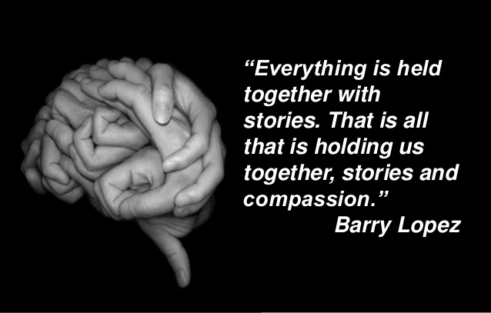

Slide 7
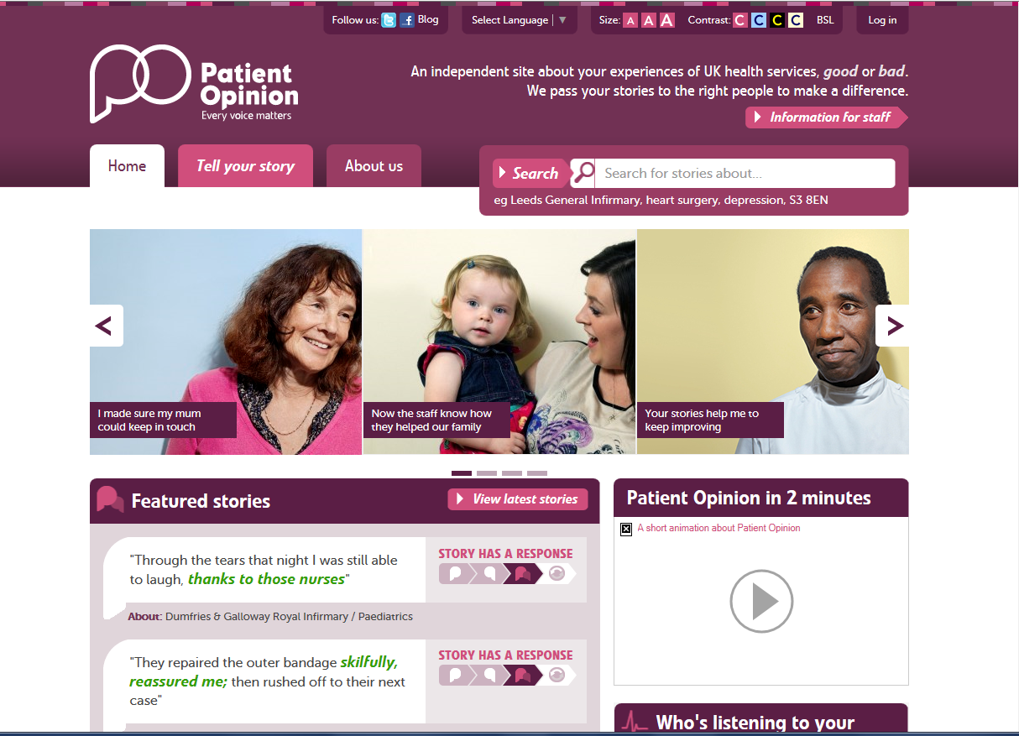
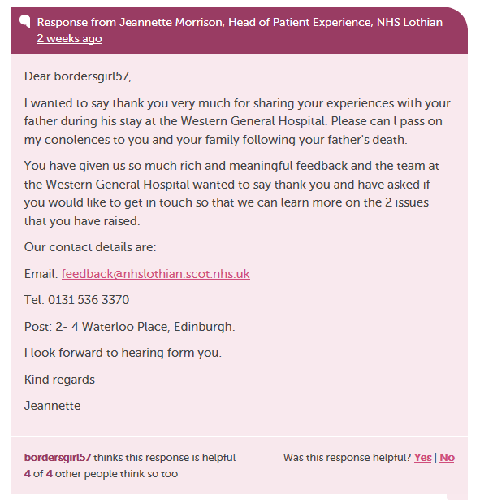
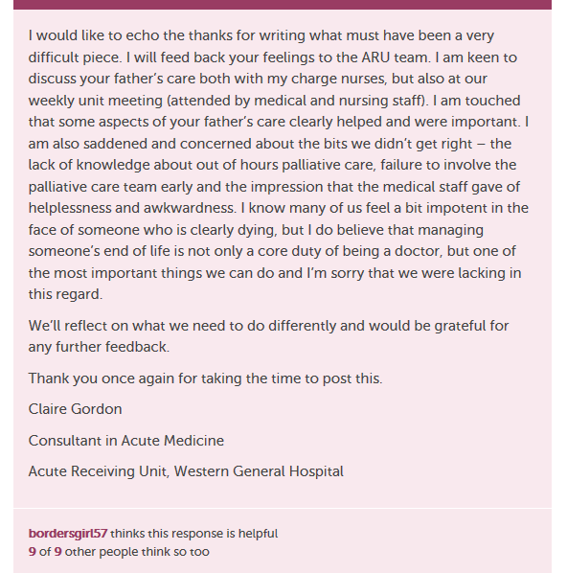
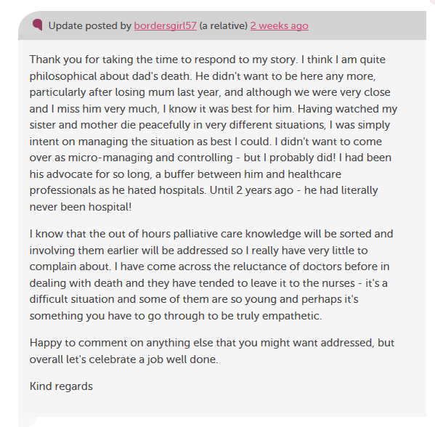
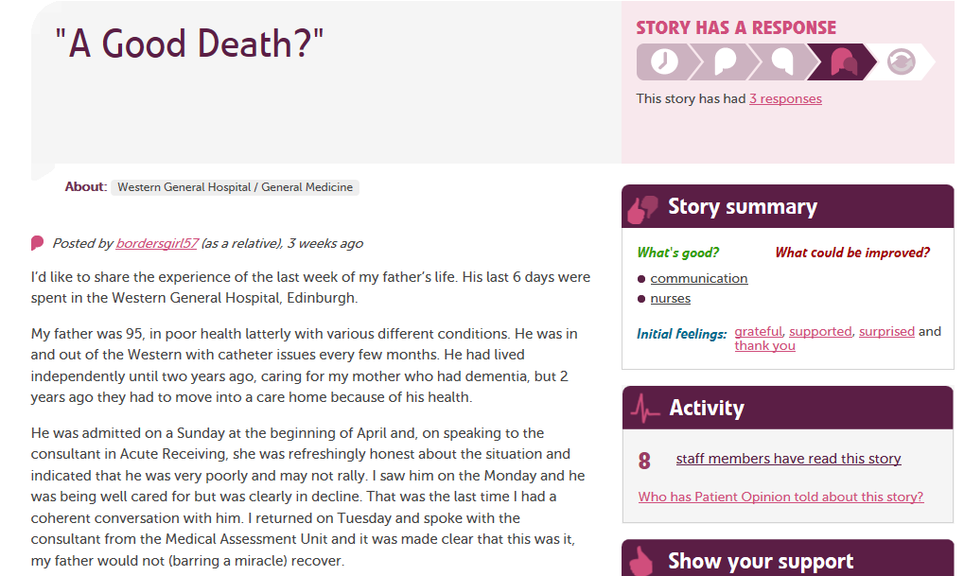

Slide 8
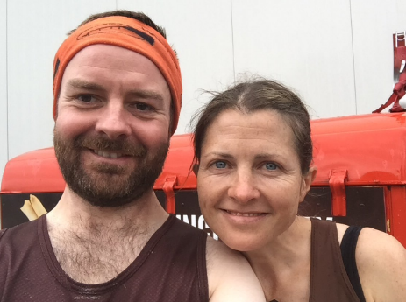
Joy in work?
“I felt exposed and vulnerable and it was difficult to respond – what would I say to her?”
“It made me think and we’ve done a lot – provoked more of a response and actions than if it had been a complaint.”
Claire Gordon
Acute Physician
Edinburgh
“It gave me a degree of freedom to respond in a different way – I was amazed at the response! Lots of support from peers & even the CEO of the NHS in Scotland retweeted!”

Slide 9
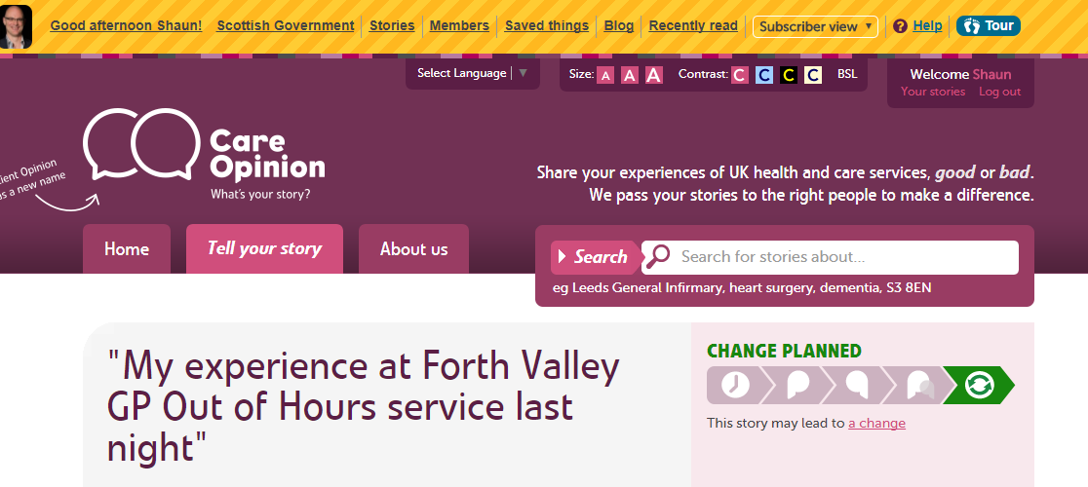
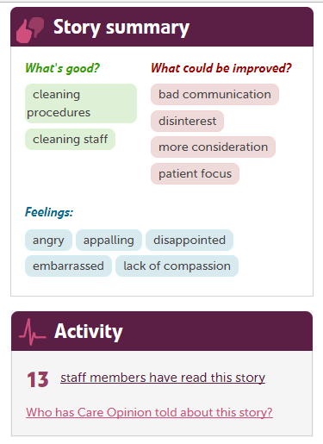
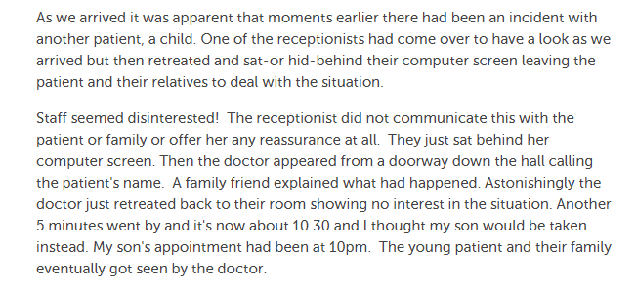
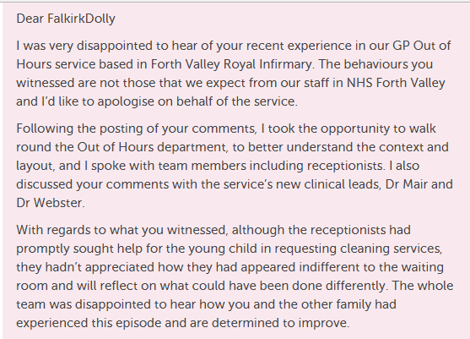
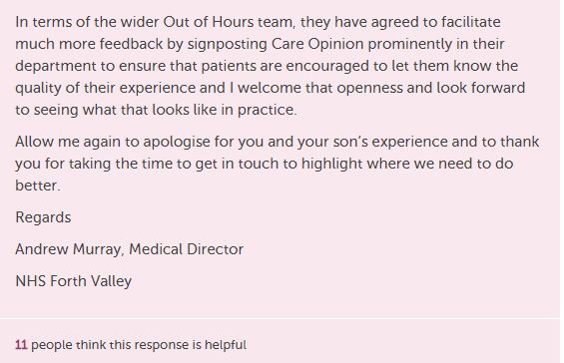

Slide 10
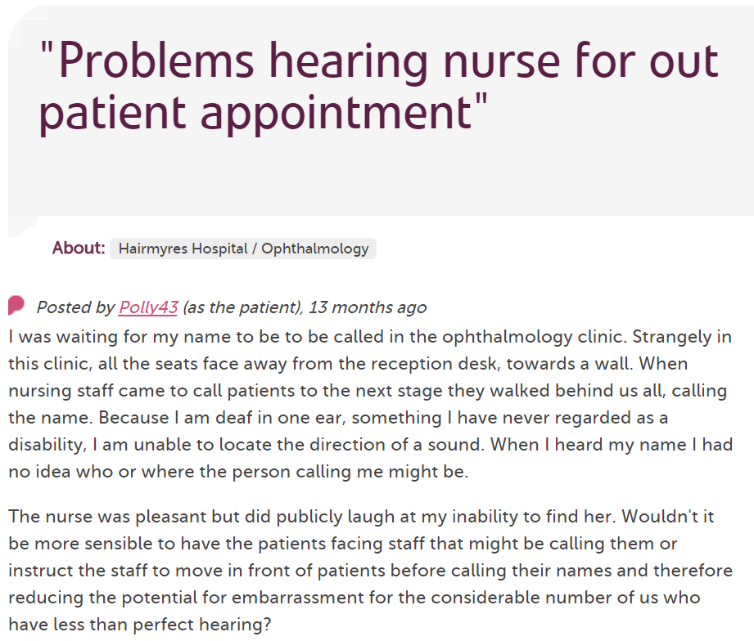
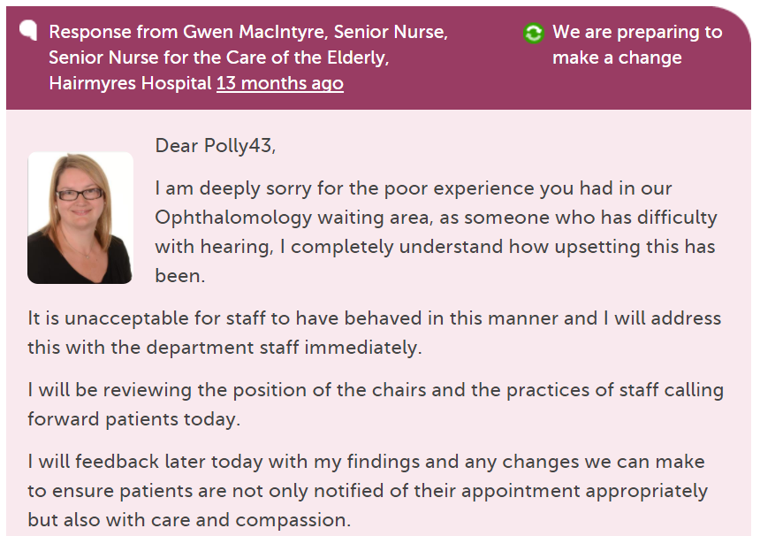
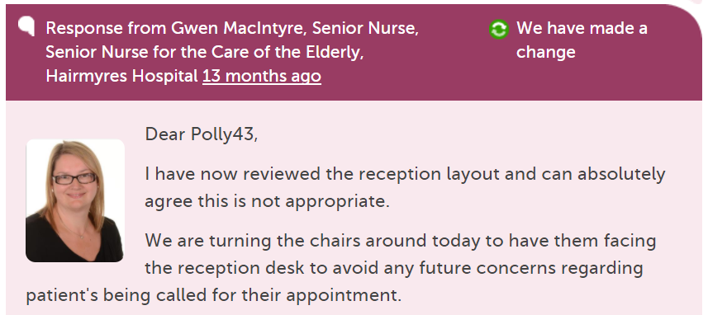

Notes:
Example of use, Rapid feedback and improvement cycles unencumbered by bureaucracy. Humane interactions. 1minute

Slide 11

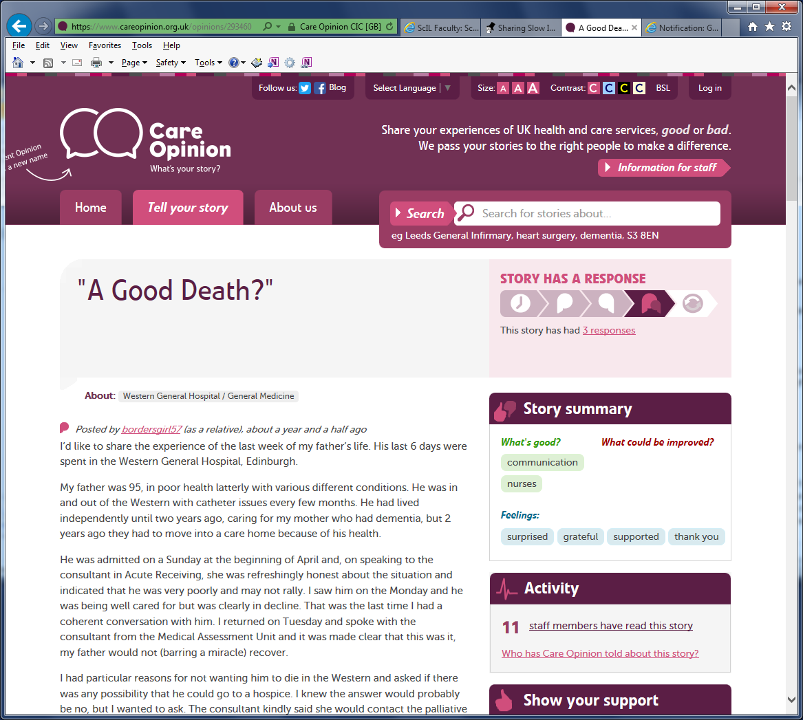
Timeline of a story
Story published………….Day 1 25/05/2016
Initial response…………..Day 2 @10.51 hours
Change made & further response……………………Day 2 @ 11.59 hours
Time from story told
to change made…………..Less than 24 hours
Notes:
Close to real-time. 30 Secs

Slide 12
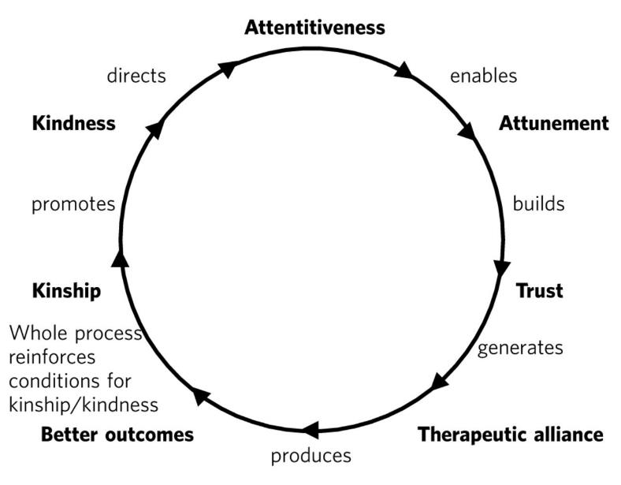
Attentiveness
Intelligent Kindness: reforming the culture of healthcare (Ballat and Campling 2011)
Notes:
An important element of creating the right conditions is to design systems and processes that reliably provide opportunities for healthcare staff to be attentive with one another and with the people they support and care for. When we stop and listen and understand, trust is generated which in turn leads to better outcomes (working and treatment!).

Slide 14
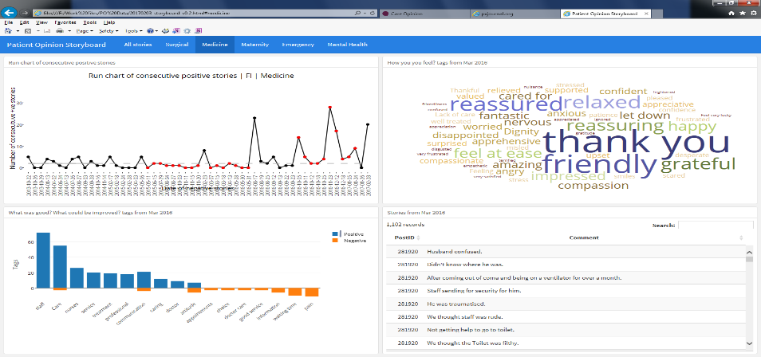
A Care Opinion QI dashboard?
Notes:
We’ve created a dashboard using R. Helps frontline teams, organisational leaders, commissioners and government to understand care experience more fully AND to improve. Qualitative and quantitative data. 30 secs.

Slide 15

…a new balance of power: the authentic transfer of control over people’s lives to the people themselves. That includes, and I have to say this, above all, it has to include the voices of the poor, the disadvantaged, the excluded. They need our mission most.
A vision of the future?
Notes:
What is our ultimate aim? Where do we think we are going with this? What would be different in the future? The words of Dr Berwick again perhaps describe this better than I can.

