Slide 1
USING ONLINE FEEDBACK FOR QUALITY IMPROVEMENT
IN MATERNITY CARE
SAM WHELAN PATIENT EXPERIENCE MIDWIFE: RM, PGCERT MID

Slide 2
WHO ARE WE?
NORTHERN CARE ALLIANCE
OLDHAM CARE ORGANISATION

Slide 3
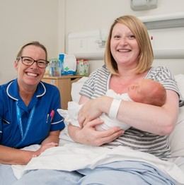
PATIENT EXPERIENCE MIDWIFE
DYNAMIC NEW ROLE
LEADERSHIP
SUPPORT

Slide 4
WHAT DID I DO?
Staff Engagement
Ward Visibility
Promotional Boards
Posters
Trust News Magazine

Slide 5
INITIAL CHALLENGES
WHAT IS IT?
NOT MORE FEEDBACK
IT’S ALL GOING TO BE NEGATIVE

Slide 6
THE POWER OF SOCIAL MEDIA
Staff Engagement
Easy
Increase Morale
Powerful
Far Reaching
@samanthawhelan7

Slide 7
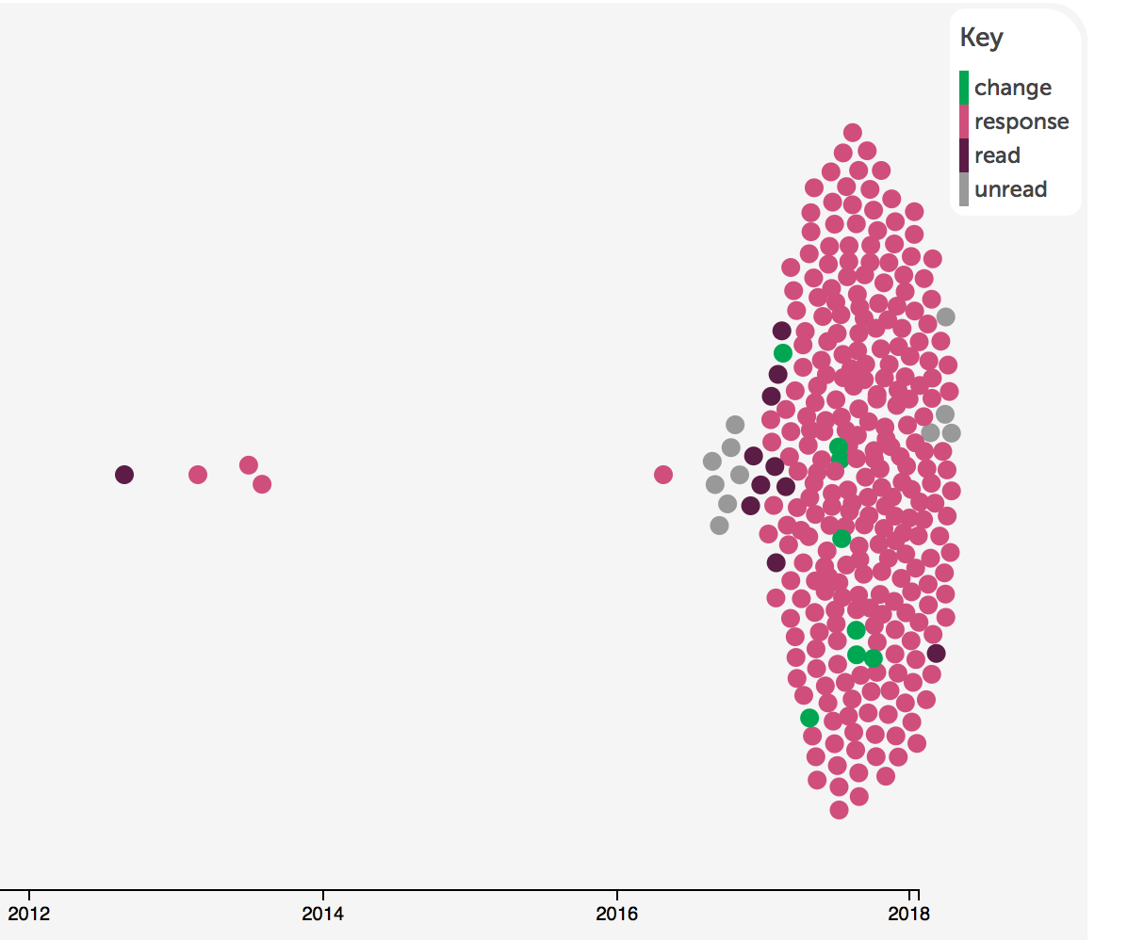
STORIES TOLD…..

Slide 8
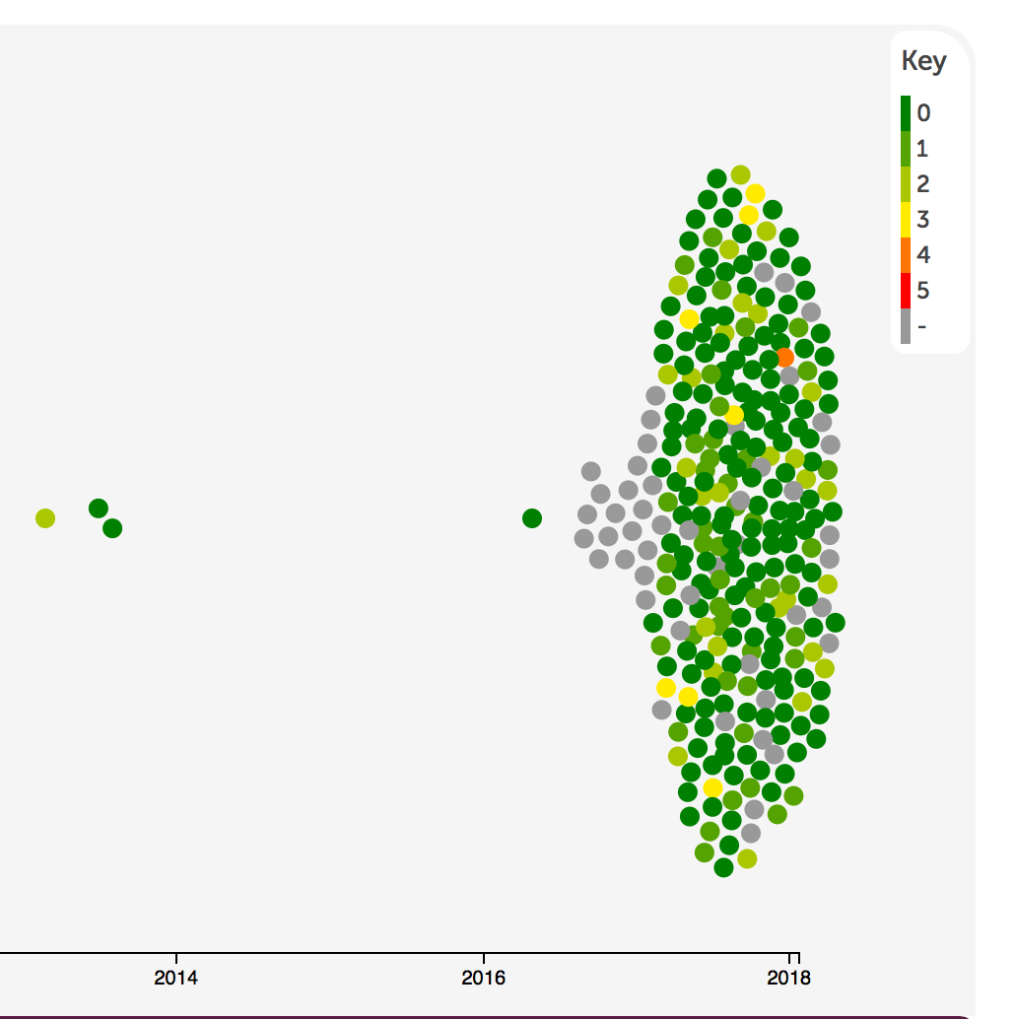
CRITICAL RATING……

Slide 9
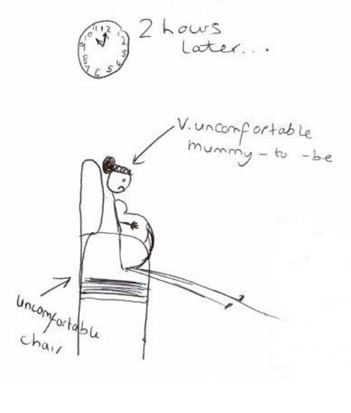
CHANGES MADE
Pelvic Girdle Pain
Room not cleaned?

Slide 10
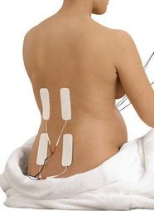
Continued……..
Ward Information
TENS Machine

Slide 11
MATERNITY QUALITY IMPROVEMENT FORUM
Birth Companions
Meet Monthly
Using QI Methodology

Slide 12
INFORMATION PACK
EDUCATE NEW STARTERS
UPDATE EXISTING STAFF
AMBASSADORS

Slide 13
ANY QUESTIONS?

