Slide 1
Care Opinion Spring Conference May 2025

Slide 2
Where we started and the challenges we had
‘Your Opinion Counts’
Paper based
Logistics
Managed by PALS
Manually inputted
Delays in receiving feedback from services

Slide 3
Our Journey
Steering group set up in May 2024
Officially became members in June 2024
Built the service tree – 179 services
381 members
Held a number of training sessions – Trust induction
Early Adopters set up in June 2024
Really got started in September 2024
Over 160 invitation links created
QR codes / leaflets / posters / business cards/ bookmarks
Officially removed YOC process in October 2024

Slide 4
1000 Stories!!!!

Slide 5
How Care Opinion has changed patient feedback for RDASH
Modernised
No longer open to interpretation
Timescales
Personalised responses
Response direct from the services
Anonymity
Availability of data and reporting – learning from feedback
A true feel of what our patients think of RDASH
Real time feedback

Slide 6
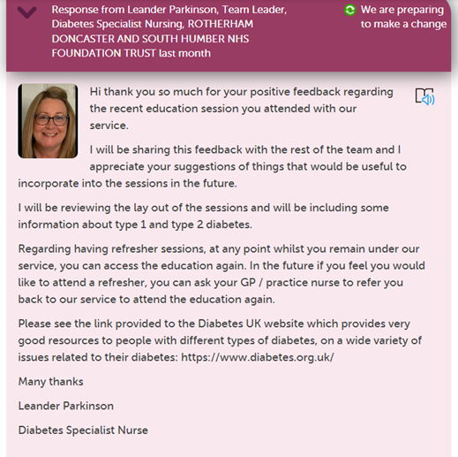
Examples of change from our stories

Slide 7
Using Care Opinion in the community

Slide 8
Background
Caroline Jefferies – Team Manager for Children's Neurodevelopmental pathway – Rotherham and North Lincolnshire.
I have been in my current role since January this year but have worked for RDASH since 2016, previously in more of a clinical capacity as a physiotherapist.
Our service offer childrens assessment for ADHD and Autism, with a post diagnosis ADHD service (within Rotherham) offering medication and emotional regulation support.
Work closely with local authority, ICB, schools and parent carer forums.
Large MDT of Nurses, AHPs, psychology assistants and social workers.
High volume of referrals and a waiting list we are trying very hard to reduce over the next year or so.

Slide 9
In the news!

Slide 10
How does this make people feel?
Young people and their families
Anxiety
Never going to get support
Without a diagnosis nothing will improve
Poor view of service before they get there
Staff
Anxiety
Not good enough
Not working hard enough
Failing children
Failing families
Reduced job satisfaction

Slide 11
Before Care Opinion
Positive feedback would come in informally i.e. verbally, thank you cards, chocolates and not always easily captured.
Our response would be a verbal thank you whilst saying goodbye.
Complaints however – tend to be more formal, written, requiring a formal response.

Slide 12
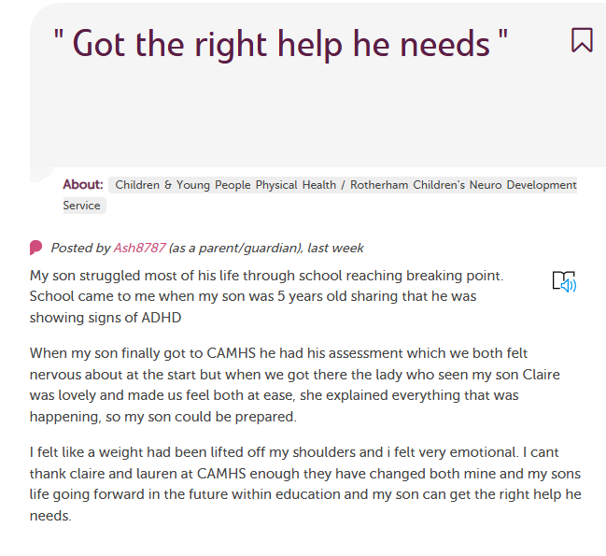
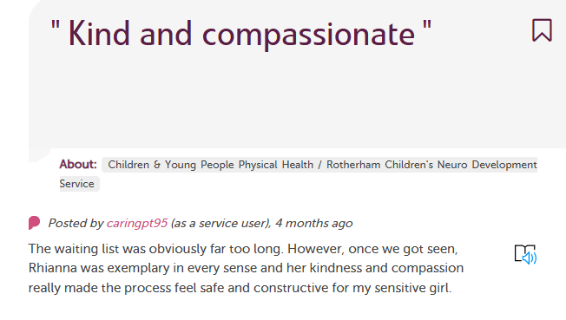
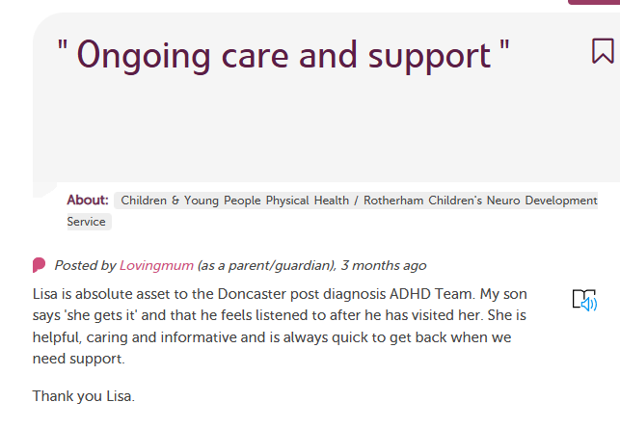
Introduction of Care Opinion
Prior
Nervousness about how accessible it would be as a digital platform
Would people take the time to complete responses?
Would responders feel confident to know what to say?
88% stories were positive

Slide 13
How does this make people feel?
Staff
Morale boost
Job satisfaction
Feel they are doing a good job
Incentive to carry on
Know they are making a difference to peoples lives
Healthy competition between teams
Young people and their families
Can see real time experiences
Know others are in the same situation
Know it is worth the wait
Support is available
Light at the end of the tunnel
Change the narrative – positivity against negativity
As a manager/ responder:
Not only replying to complaints, able to share the feedback with the team easily. Can engage and respond to patients and patients families directly, ease of response.
Support from care opinion with training of how to respond
Reports and visuals ie word clouds, bubble chart
Feedback visible to all and quickly – inclusive of senior managers, stakeholders, colleagues.

Slide 14
How do we obtain feedback?
Posters, business cards, bookmarks
Link and QR code on email communications
QR code on letters and discharge reports
Text messages
Verbal requests

Slide 15
What's next for RDASH?
Target areas where we get less responses
Older Peoples services
Learning Disabilities
Forensic services
People with no emails/internet access
Reach out to youth advisory group/ parents/ carer forums/ patient groups to encourage feedback
Sharing links text messages and letters

