Slide 1
How public, real-time patient feedback is helping the NHS get better
James Munro
Patient Opinion
james.munro@patientopinion.org.uk

Slide 2
Berwick Report, August 2013
Recommendation 8
“All organisations should seek out the patient and carer voice as an essential asset in monitoring the safety and quality of care.”

Slide 3
Keogh Report, July 2013
“Patients, carers and members of the public… should be confident that their feedback is being listened to and see how this is impacting on their own care and the care of others.”

Slide 4
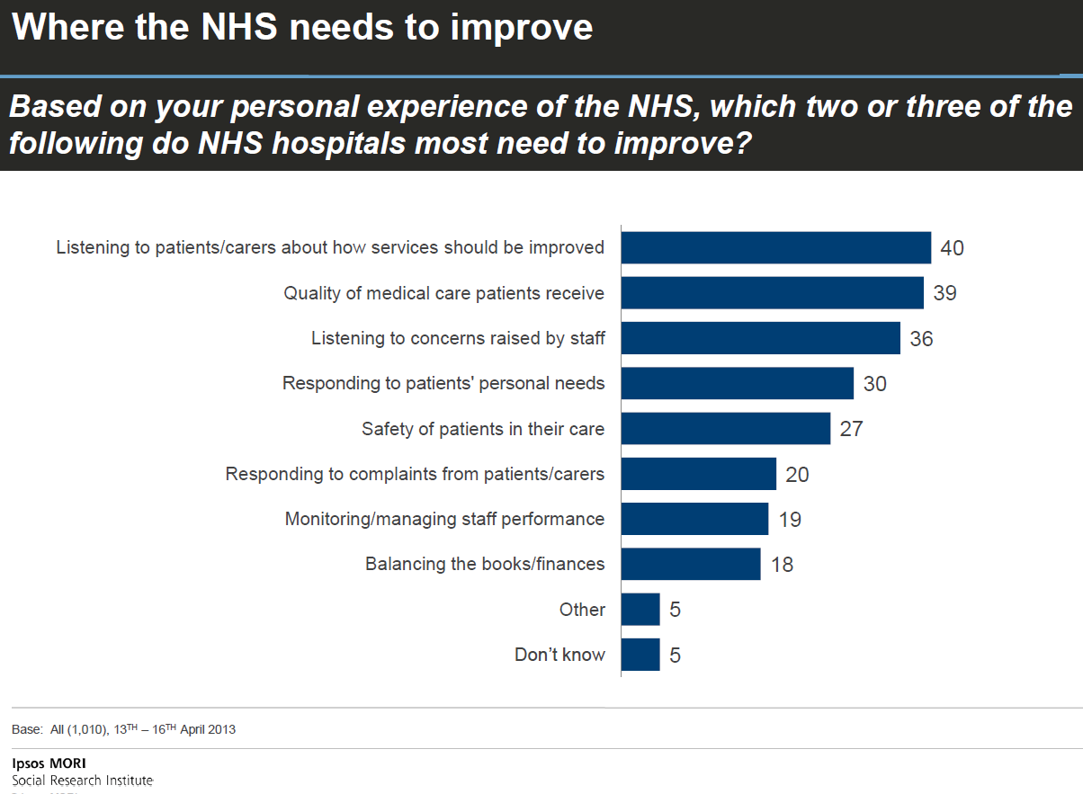

Slide 5
I will be seen as a troublemaker

Slide 6
“More than half of those who had voiced a concern about poor care felt that their feedback wasn’t welcomed”
CQC, 2013

Slide 7
Nothing will be done

Slide 8
“There is a lack of learning from complaints, and providers are not making clear to users that services are being improved as result.”
NAO, 2008

Slide 9
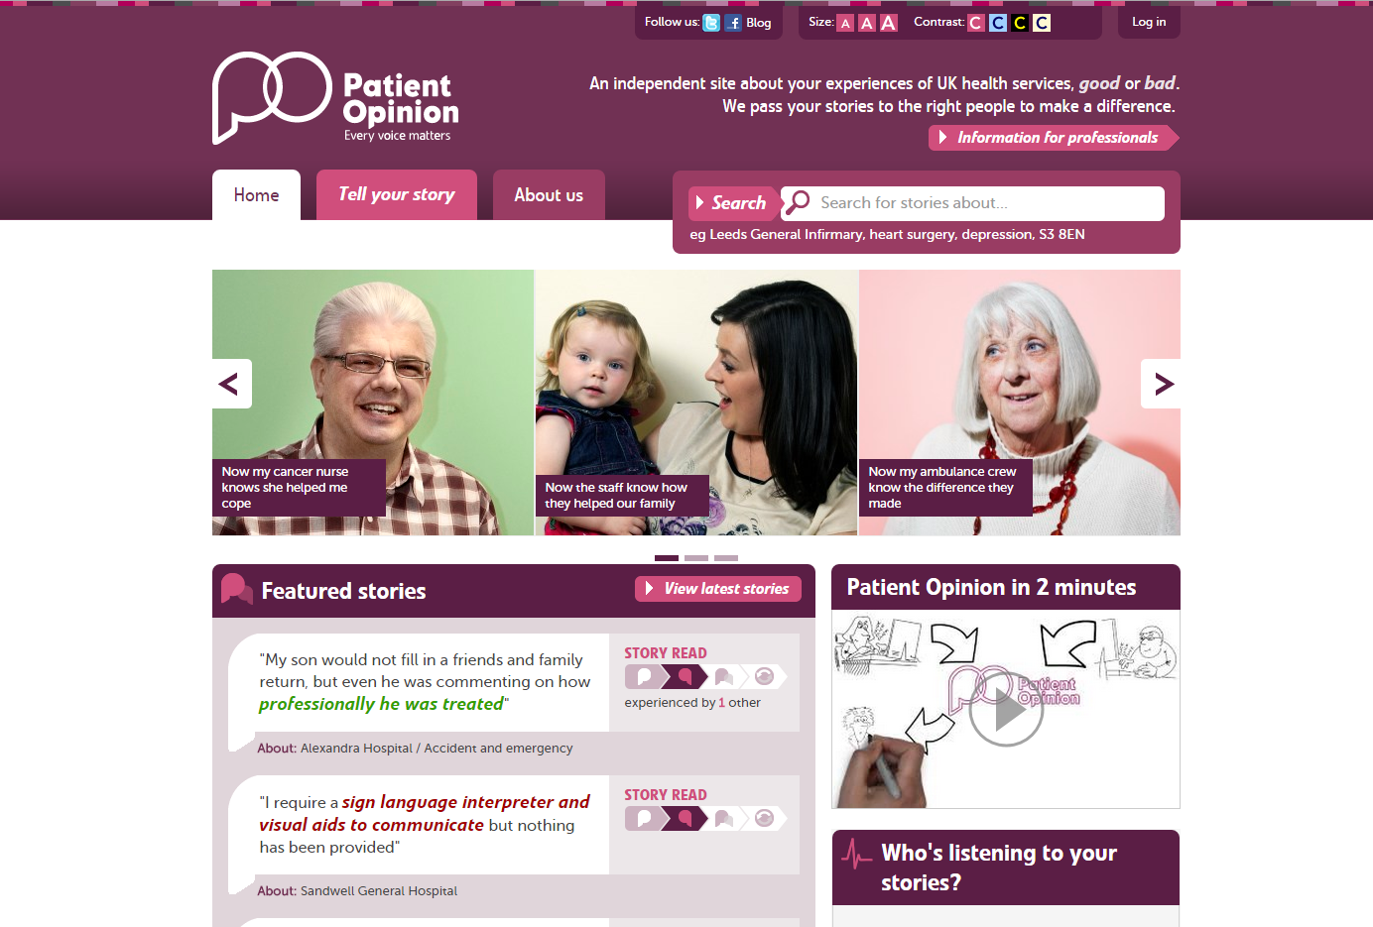

Slide 10
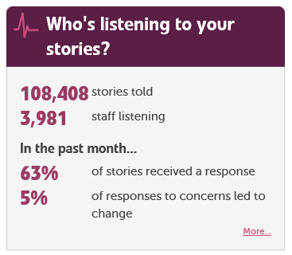

Slide 11
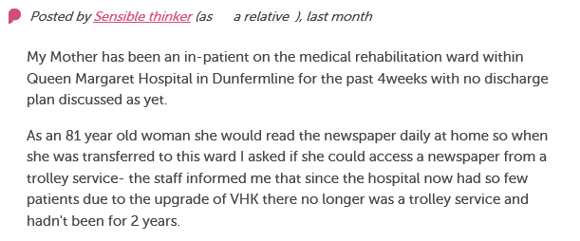
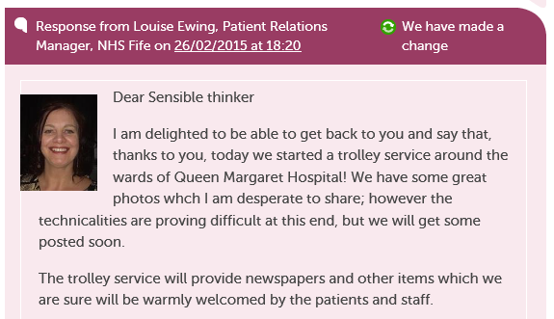
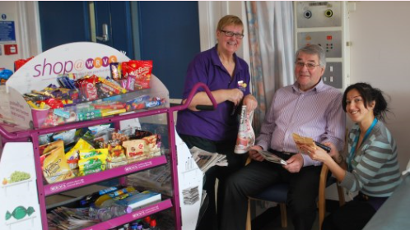

Slide 12
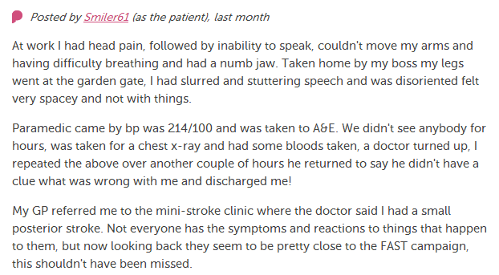
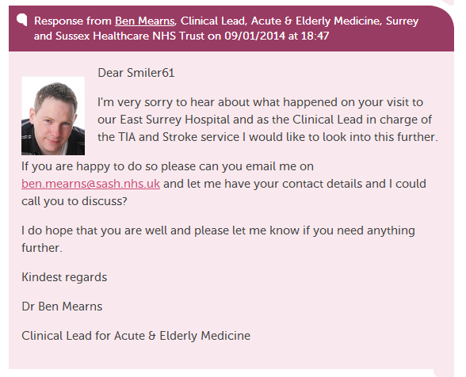
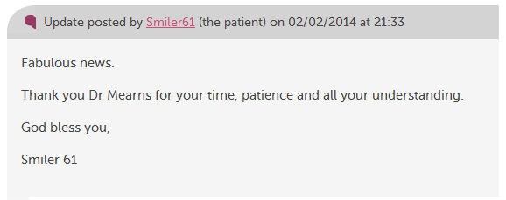

Slide 13
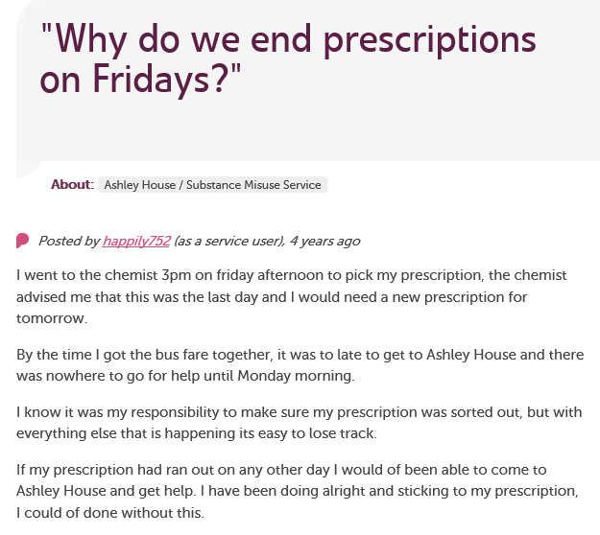
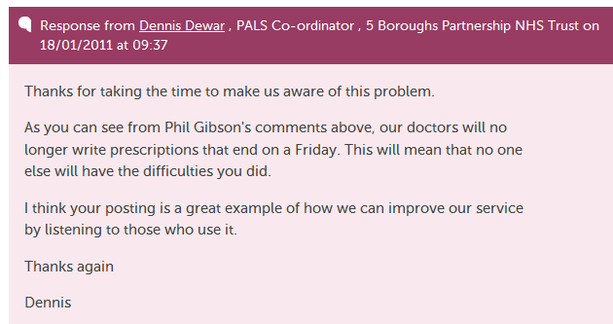

Slide 14
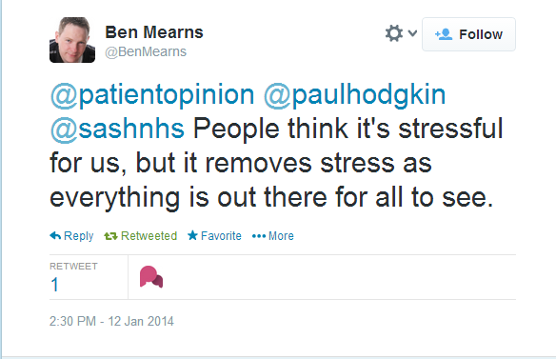

Slide 15
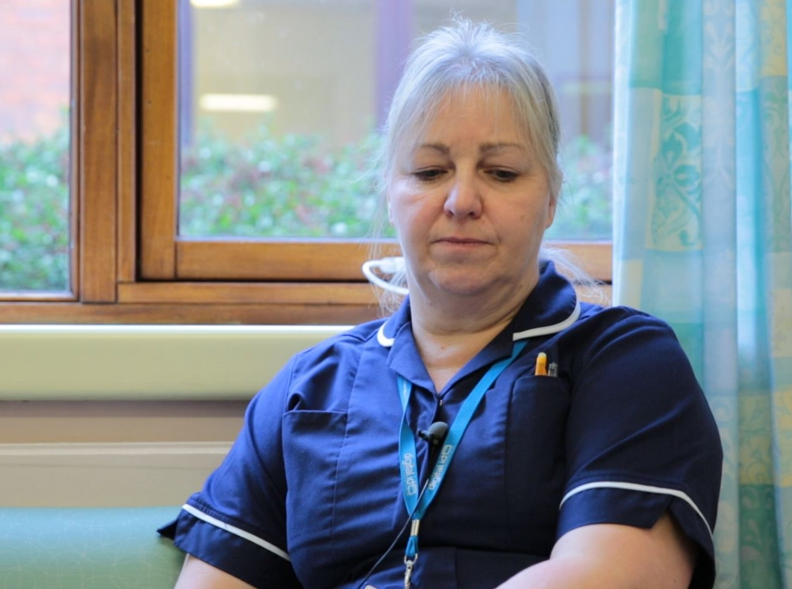
“I get an email to say we've had an opinion posted.
I can respond that day and it’s back on the website for the patient or relative to read.
I think that’s an excellent service for people.”
Karen Hansord A&E sister

Slide 16
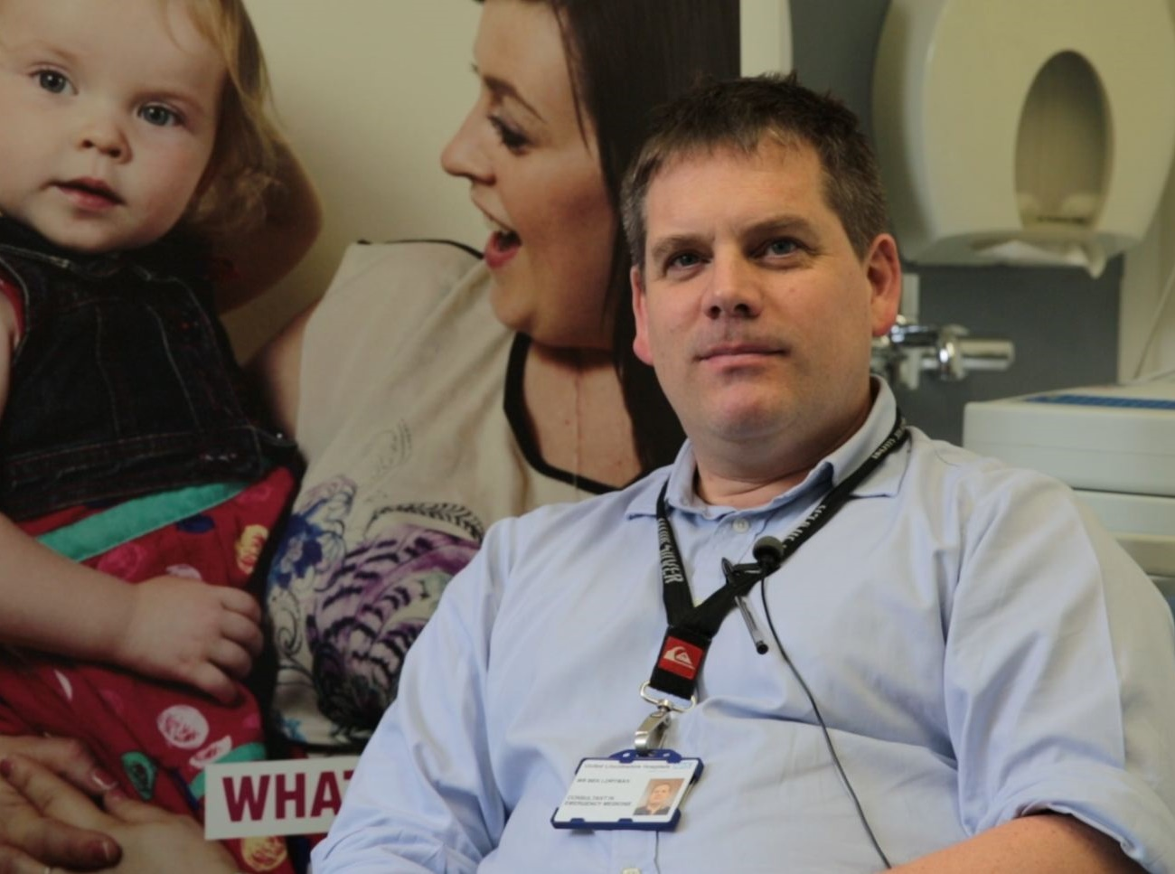
“I try and use Patient Opinion whenever I can because it makes trying to change people, and the way that the system works, much simpler.”
Ben Loryman, consultant in emergency medicine

Slide 17
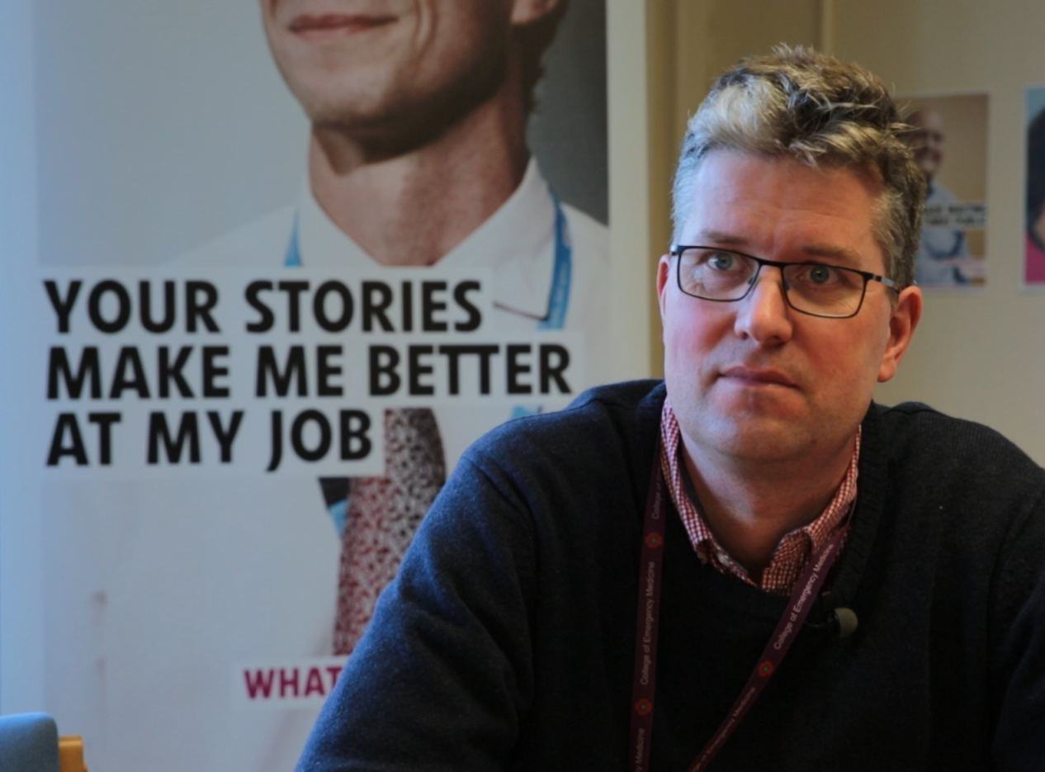
“At times it also helps to actually reduce complaints. We can get in touch with a user straight away and we can avoid a lengthy complaint response.”
Dr Arne Rose, associate medical director, HEFT

Slide 18
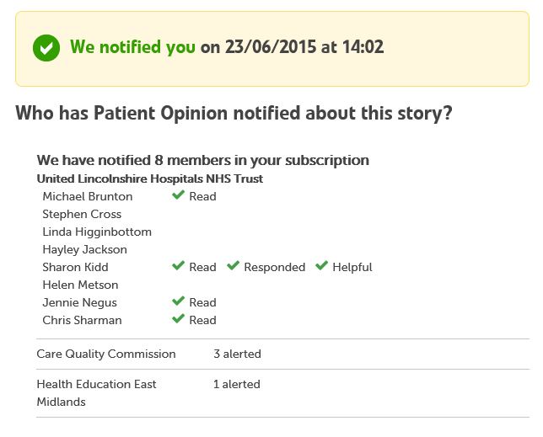

Slide 19
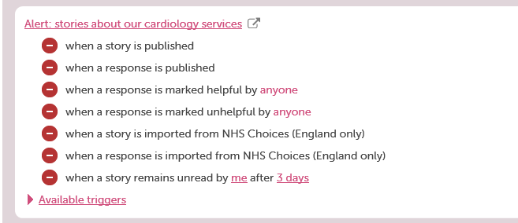
Smart alerting

Slide 20
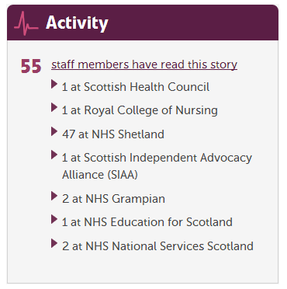

Slide 21
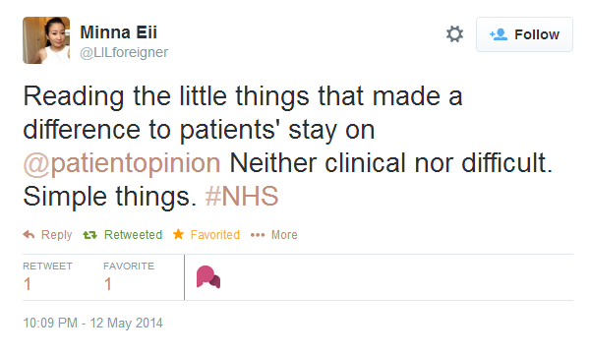

Slide 22
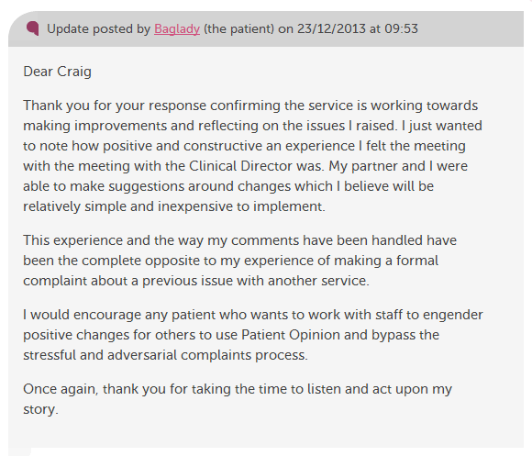

Slide 23
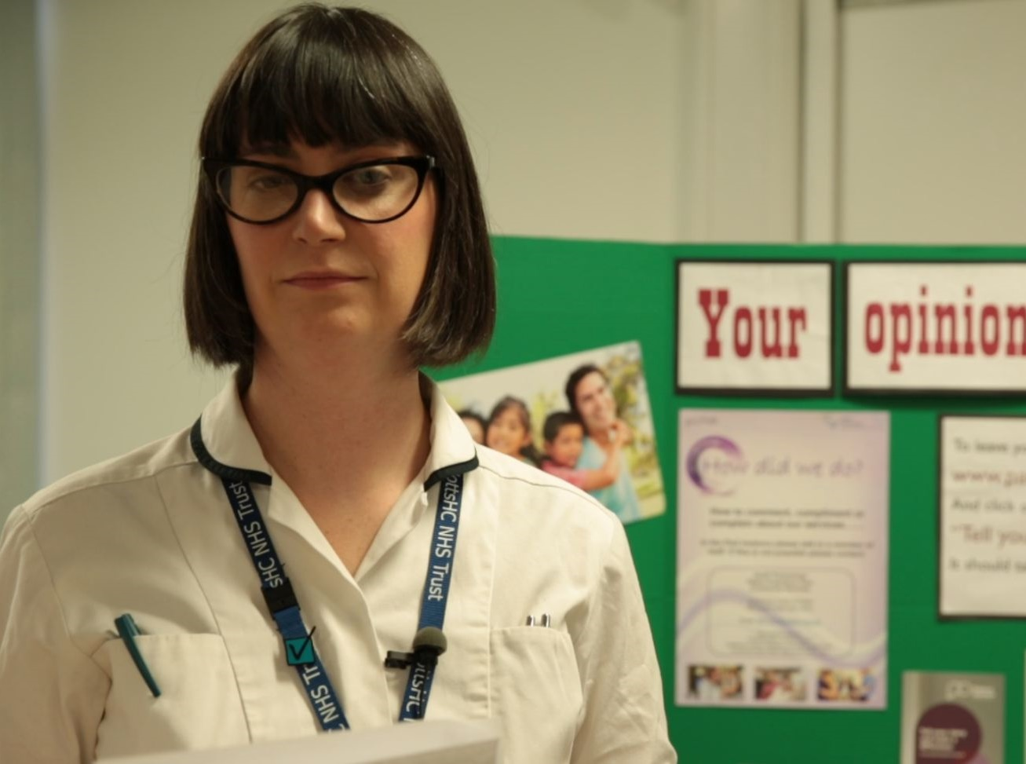
“More than just listening, it has helped us to focus on what we can change to improve our service.
We’ve learnt that Patient Opinion gives patients a powerful voice, which in turn has empowered us.”
Lisa Metcalf podiatrist

Slide 24
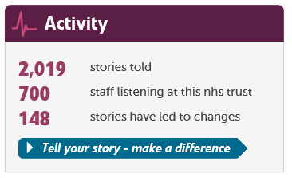

Slide 25
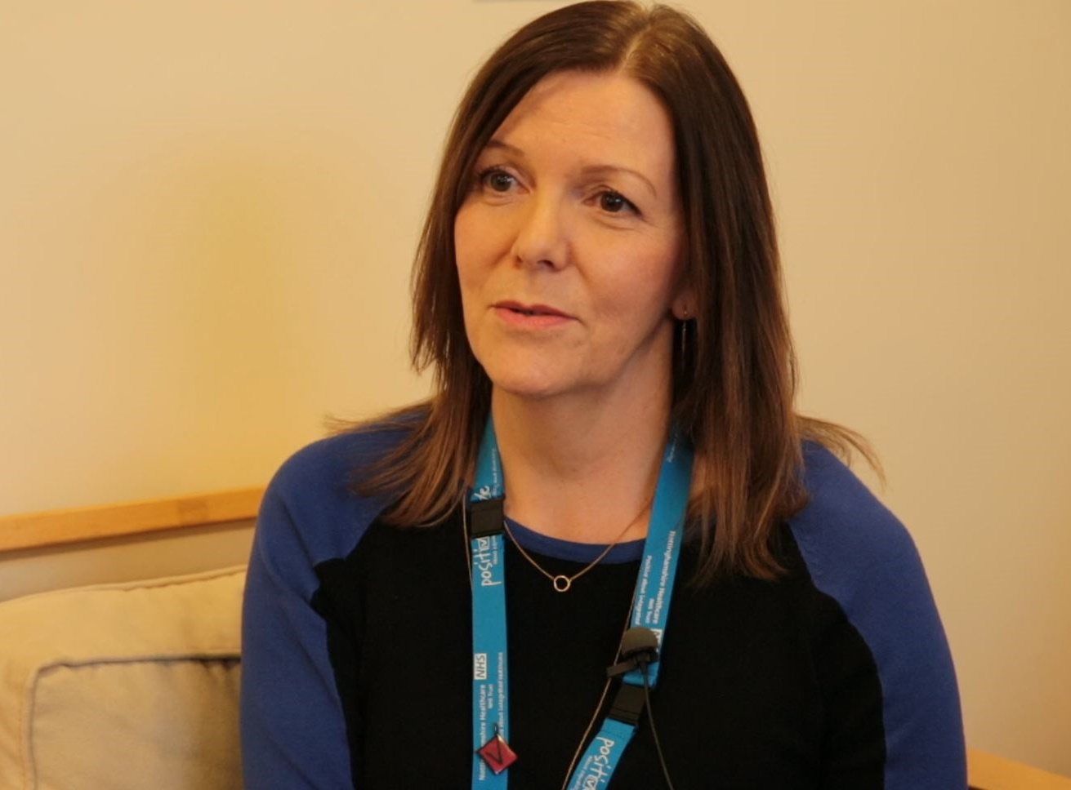
“I think Patient Opinion has given us much more of a connection with service users, carers and families and that’s because we can actually work directly with people.”
Jane Danforth involvement officer

