Slide 1
The “integration agenda” and public online feedback
Tim Hunt
Patient Opinion
Tim.hunt@patientopinion.org.uk

Slide 2
Integration Transformation Fund AKA Better Care Fund: is it just another brick in the wall?
'Share it fairly but don't take a slice of my pie', wrote Roger Waters about money, in the track of the same name from Pink Floyd’s classic album 'Dark Side of the Moon' in the 1970s
It's a sentiment that has echoed through various initiatives to bring NHS and local authority social care funding closer together over the past 30 years.
….to be spent locally on health and care to drive closer integration and improve outcomes for patients and people with care and support needs. As further details emerge, it's becoming clear that most of it will come from existing NHS budgets – it is not new money.
Kings Fund Richard Humphries

Slide 3
Care Act-Integration
The Act includes a statutory requirement for local authorities to collaborate, cooperate and integrate with other public authorities e.g. health and housing.
New services are likely to emerge from health and social care organisations working together to provide services and information that underpin wellbeing and provide more person centred services, tailored to people’s needs and preferences.

Slide 5
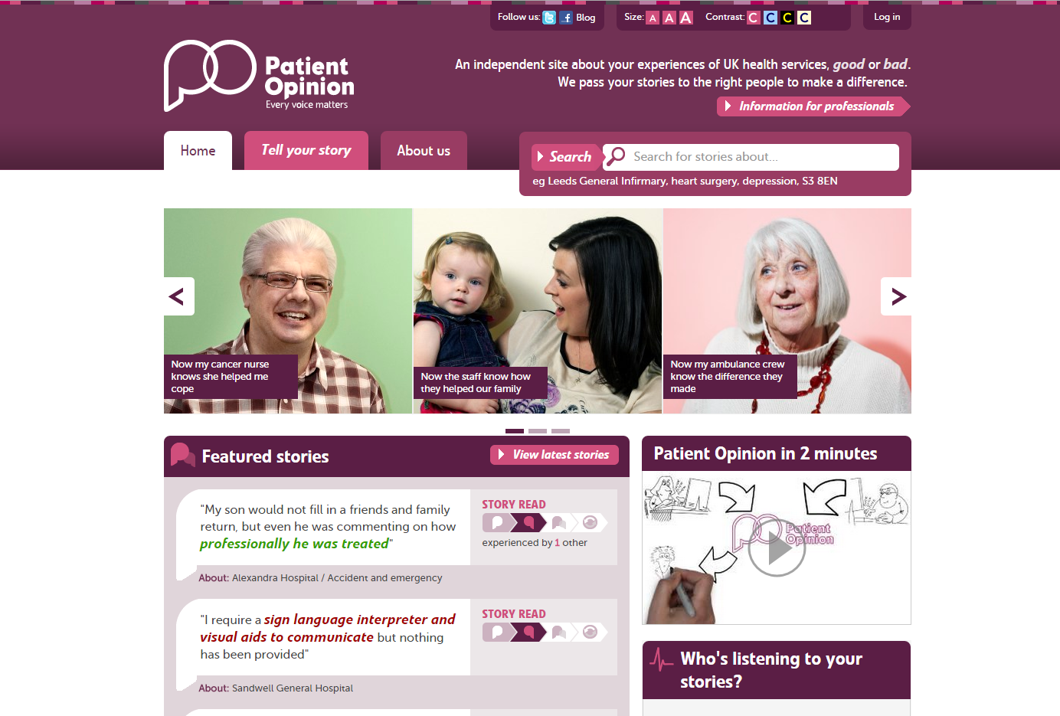

Slide 6
Health service stories
via Patient Opinion
CCGs
Patient Organisations
CQC
Automatic notification
FT staff
Response
Comment
covers both responses
Hospital improvement
Service
User
Story
Comment
Care home staff
Response
Care home improvement
Comment from patient
Local Authorities, HealthWatch
Social care stories
via Care Opinion
National government, and MPs
Patient Opinion/Care Opinion: fully integrated across health & social care

Slide 7
How stories improve integration across health and social care
Care Home
“The ambulance arrived quickly”
Daughter
Ambulance
Local NHS FT hospital
Ambulance
“We really liked the step down home
but it was awful arriving there at 22.00
after waiting all day for the hospital to
discharge her”
Daughter
Step down facility
Ambulance
Social care
Care Provider
Health services
“We used to find residents coming
back to us late at night so it was great to
see the new arrangements working”
Care home comment
Community physio

Slide 8
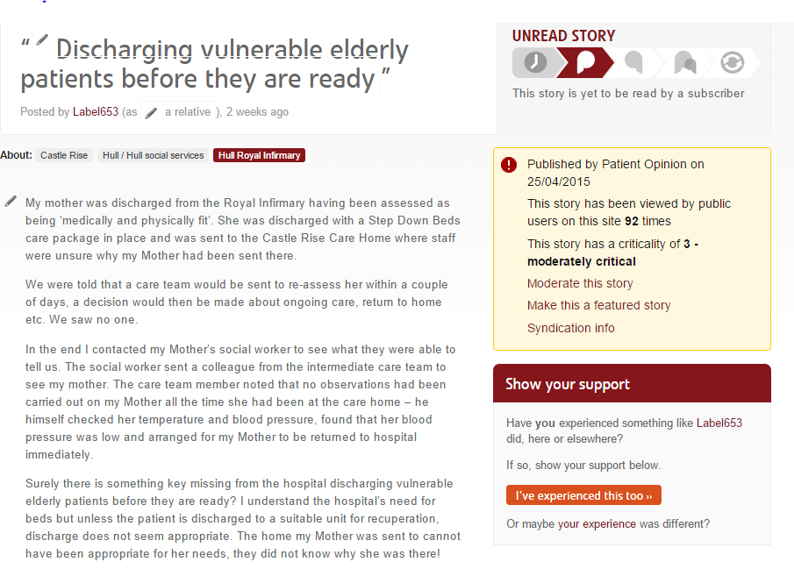

Slide 9
Keeping the user at the centre
User or carer
Health care provider
Social care provider
Local authority
CCG
CQC
Healthwatch

Slide 10
One journey: one story
Care home
Kindness
A&E
Waiting
Information
Recovery
OT
Physio
Care
Story
Response
Response
Response
Response

Slide 11
Achieving Integrated Care!
“The Patients perspective is at the heart of any discussion about integrated care. Achieving integrated care requires those involved with planning and providing services to impose the patients perspective as the organising principle of service delivery” Kings Fund

Slide 12
Key Challenges.
Listening to stories about a whole care pathway
Sharing across key stakeholders and providers
Learning collectively
Encouraging the public to tell their story.

