Slide 1
Online feedback and organisational culture
James Munro
Patient Opinion
james.munro@patientopinion.org.uk

Slide 2
Berwick on culture
“Achieving a vastly safer NHS will depend far more on major cultural change than on a new regulatory regime.”

Slide 3
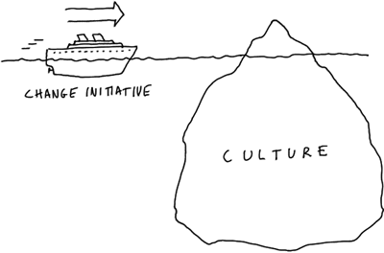

Slide 4
Which providers are using PO?
Almost 90% of NHS trusts in England & Wales
Acute
Mental health
Community
Ambulance
All Scottish health boards
42 independent sector providers

Slide 5
Who else?
59 CCGs
57 national patient organisations
53 healthwatches
45 Scottish MSPs
35 Westminster MPs
3 universities
NHS England, DH, CQC, TDA

Slide 6
9 levels of online engagement
9
The absence of fear
8
Everyday Patient Opinion
7
Widening staff involvement as active participants
6
Widening staff involvement as recipients
5
Initial commitment
4
Engagement
3
Acceptance
2
Controlling or organisation-centric
1
Resistance or defensiveness
1

Slide 7
Your culture
Where are you now?
How do you know?
Where would you like to be?
How will you get there?

Slide 8
Berwick Report, August 2013
“Hear the patient voice at every level – even when that voice is a whisper”

Slide 9
Guy Brookes
Associate medical director
Adult mental health services
Leeds & York Partnership Trust

Slide 10
1: Resistance or defensiveness
Organisational culture is resistant or defensive in response to online patient feedback
Fear or suspicion about online feedback
Feedback is seen as, at worst, harmful or, at best, an irrelevant nuisance

Slide 11
2: Controlling or organisation-centric
The organisation recognises value in feedback in general
It tolerates public feedback but strongly prefers feedback to be delivered privately
Public feedback is seen as threatening to reputation
Feedback is seen in an organisation-centric way, as helpful or unhelpful to the organisation

Slide 12
3: Acceptance
The organisation is accepting of public online feedback
It may see value in feedback, and in responding to it in public
Public feedback is seen as a threat to be managed by responses which deflect criticism

Slide 13
4: Engagement
The organisation goes beyond acceptance to a more active engagement with online feedback
Public online channels are encouraged
Typically seen as a undertaken by just a few people in the organisation

Slide 14
5: Initial commitment
A clear commitment to deeper engagement with online feedback
Online patient feedback seen as a positive force for quality improvement
Responses about a service are specific and constructive
But usually do not come directly from staff in that service

Slide 15
6: Widening staff involvement as recipients
Sharing online public feedback more widely in the organisation is valued
More staff become involved
Mainly as recipients of feedback
Not as active participants in an online exchange

Slide 16
7: Widening staff involvement as active participants
Widespread involvement of staff in using and responding to public online feedback is encouraged
Staff at many levels listen, improve services, and post responses
Strong support for online feedback by the organisation’s leaders

Slide 17
8: Everyday Patient Opinion
Use of and learning from public online feedback occurs at every level of the organisation
Staff and users are expected to provide, seek, use and respond to feedback
Training in the use of online feedback is a standard in staff development
Departments regularly review and audit their performance and learning using online feedback

Slide 18
9: Culture transformed
The culture of the organisation has been transformed by the prevalence of real-time user feedback
Learning from feedback has become core to professional practice.
Users have no fear of giving honest feedback, whether online or face-to-face
Online public feedback is seen as an effective way to access the huge resource of patient and carer insight

Slide 19
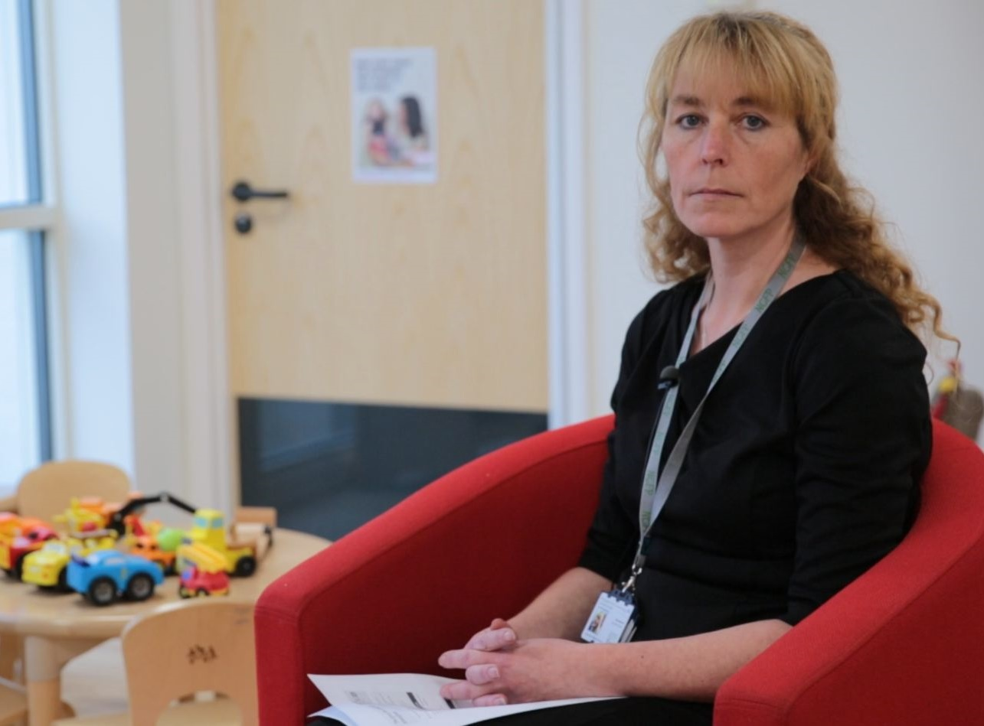
“That’s what it’s there for. It’s a way of sharing really good examples of how everybody works together to make things happen.”
Tina Hancock district manager Sure Start children’s centres

