Slide 1
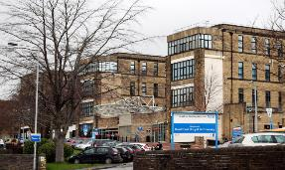
What are the opportunities and obstacles to using patient feedback in service improvement? Laura Sheard, PhD Bradford Teaching Hospitals 30th January 2018

Slide 2
Background to study - Aim: to understand and enhance how hospital staff learn from and act on patient experience data - 32 month study (Nov 2015 – Jun 2018) funded by NIHR - Qualitative exploratory study → co-design of toolkit with ward staff and patient reps → action research and improvement science cycles → mixed methods process evaluation

Slide 3
Focus for today - Findings of qualitative study conducted towards start of project (Feb to Aug 2016) - Based on interviews with 23 middle/ senior hospital management participants and 7 focus groups with ward staff at 3 NHS Trusts (50 participants in total) - A look at the macro and micro factors that inhibit effective use of patient feedback - And potential high level solutions to these problems

Slide 4
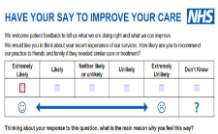
What are the main sources of patient feedback that participants talked about?

Slide 5
What’s the problem with patient experience feedback? Macro level → impeded by the system, organisation, structure or strategy, such as: hospital culture, how teams or processes are set up and NHS ways of working Micro level → issues with individual feedback sources, how people interact with and use them

Slide 6
Macro level Patient experience feedback has become its own self-perpetuating industry Significant resource, effort and time being expended but primary focus is on maintaining collection rates rather than interpretation or action Participants reported feeling overwhelmed and fatigued by the volume and variety of data

Slide 7
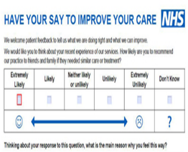
Two examples… Friends and Family Test: - focus on how many patients had filled in the form and how to increase the response rate rather than how feedback could be used Complaints: - overt focus on timeliness of response and trying to reduce volume rather than understanding what an effective response looks like

Slide 8
Fractured working Teams may work in separate offices and, in some cases, do not meet to discuss common issues. Little opportunity for shared learning or understanding Trust wide trends Divide felt to be confusing to patients/ public who sometimes struggle to understand difference between the two functions and do not know that teams rarely communicate
Complaints team
PALS team (focuses on resolving issues before they become complaints)

Slide 9
Micro level - Many wards are awash with large amounts of generic positive feedback (“the nurses are lovely”) which rarely guides improvement - Staff often struggle to interact with raw data and the volume and complexity is too much - Timeliness of feedback is important but it is sometimes received months later which dilutes impact

Slide 10
Perfect storm - Macro and micro factors come together in a perfect storm which provides a barrier to improvements being made - Already a recognition that too much feedback is being collected from patients in relation to the small amount of action taken as a result of it. But participants seemed powerless to prevent this - Well known that ward staff find interpreting and using feedback difficult but no strategy in place to try and address this - Culture/ structure surrounding patient feedback not responding as fast as people strive for it to change

Slide 11
High level solutions/ recommendations Organisational emphasis on notion that all feedback collected must have ability to be meaningfully utilised Immediate concentration on quality over quantity with strategic focus on use and action rather than collection rates Learning across the organisation from feedback rather than siloed teams on a constant treadmill of targets per source

Slide 12
Acknowledgements This research was funded by the NIHR Health Services and Delivery programme (Ref: 14/156/32). The research was supported by the NIHR CLAHRC Yorkshire and Humber (www.clahrc-yh.nihr.ac.uk).The views expressed are those of the authors and not necessarily those of the NHS, the NIHR or the Department of Health I gratefully acknowledge the contribution of: - Rosemary Peacock - Claire Marsh - Tom Mills - Rebecca Lawton (PI) - All research participants - Co-applicants and collaborators

Slide 13
