Slide 1
Listening to Patient’s Opinions at ULHT
Jennie Negus
Deputy Director of Patient Services

Slide 2
Had a few challenges recently………
Pilgrim Hospital CQC, NMC & Deanery.
Lincoln County Hospital CQC.
But, lots of work……e.g. at Pilgrim
February 2011 | Now
Warning notices – 2 Major concerns – 2 Moderate concerns – 7 Minor concerns - 3 | Warning notices – 0 Major concerns – 0 Moderate concerns – 0 Minor concerns - 2

Slide 3
How is that reflected day to day?
Complaints.
Survey results.
Letters to local papers.
Media………
Focus on the negative
Staff impact.

Slide 4
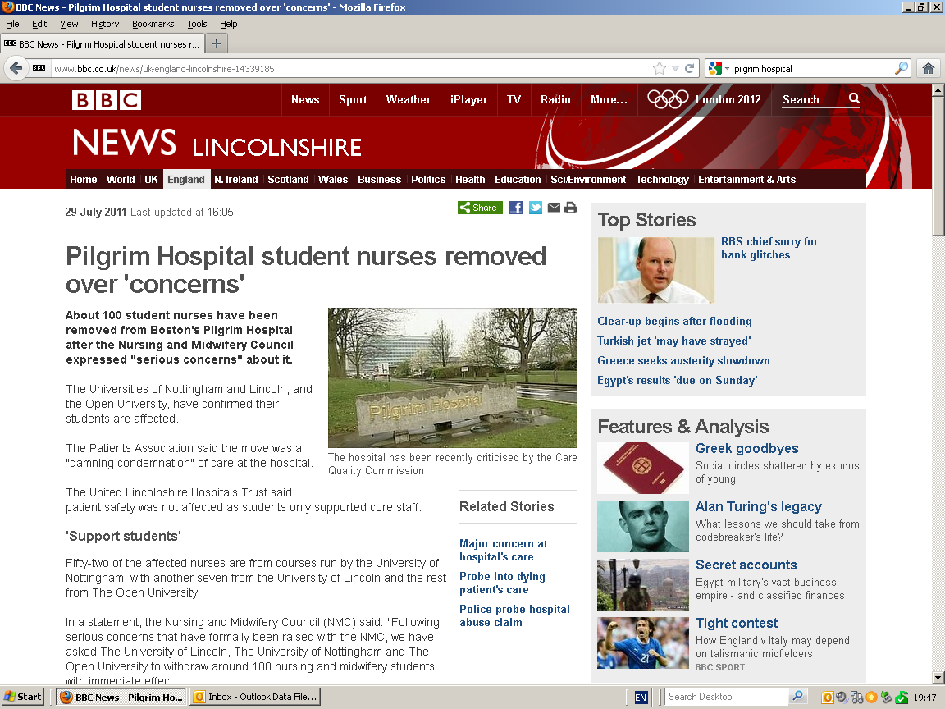
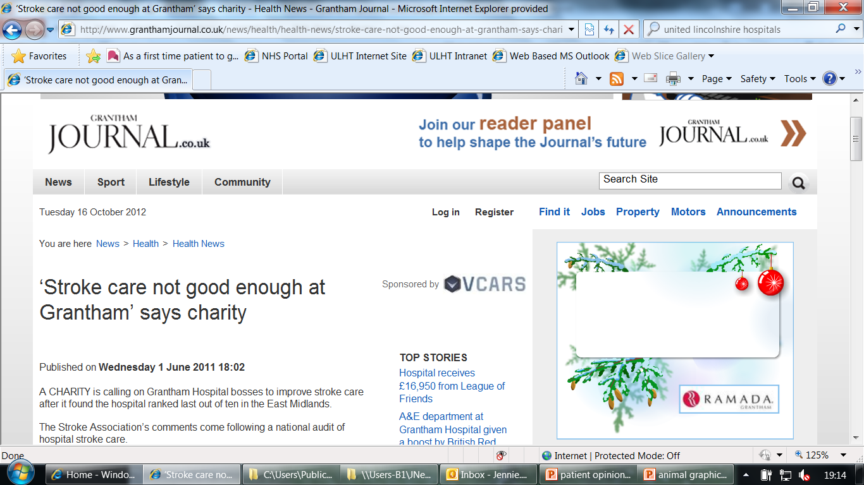
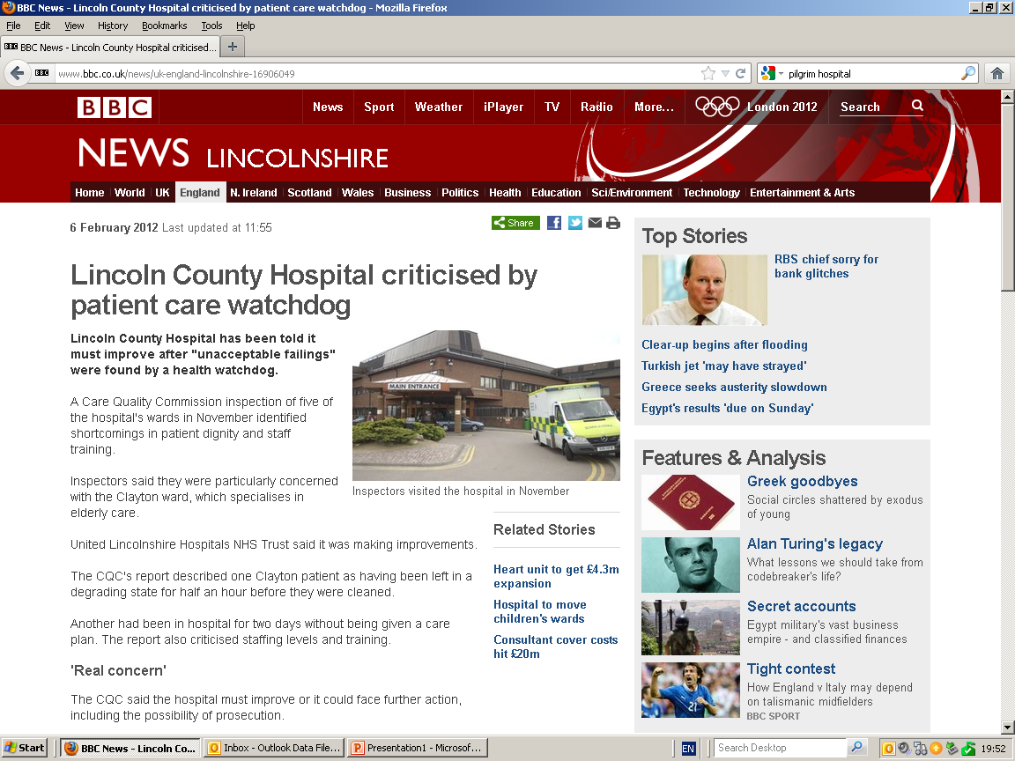

Slide 5
If patients and families read these how will they feel?
Lack of confidence…
Fear and anxiety…
Expecting poor care….
Staff impact

Slide 6
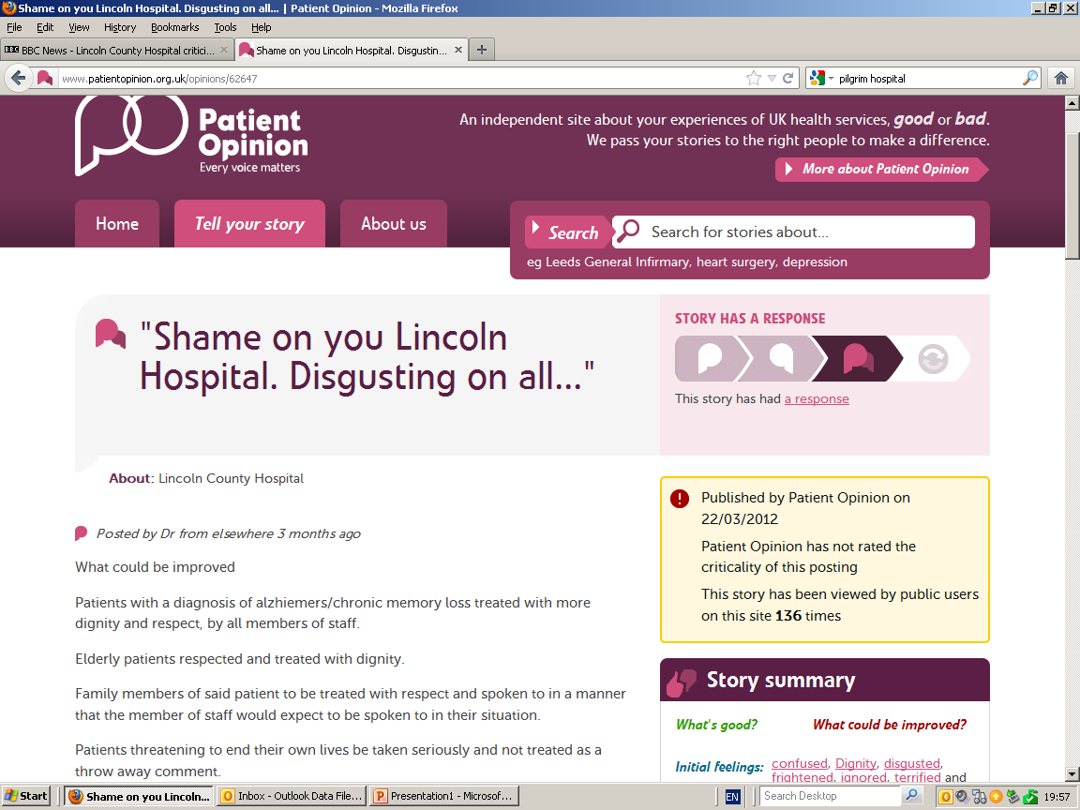
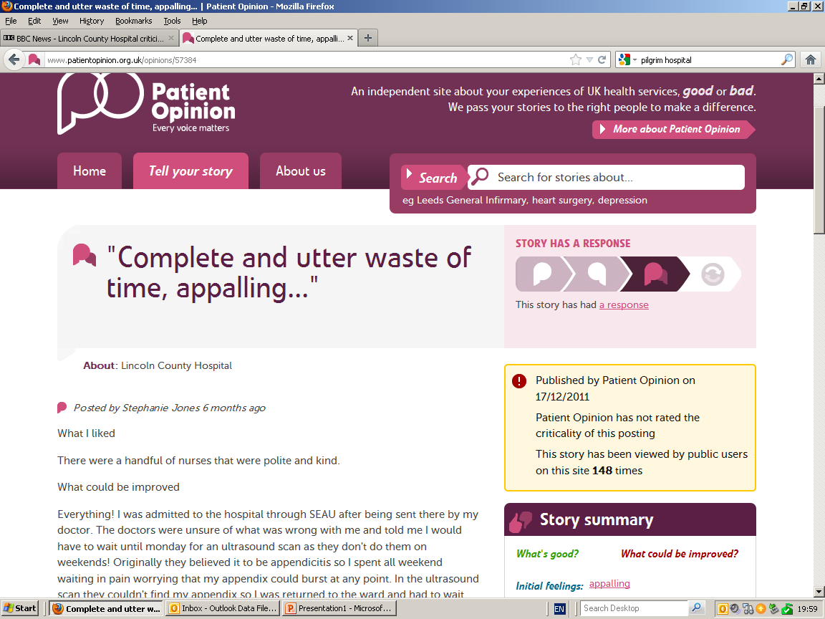
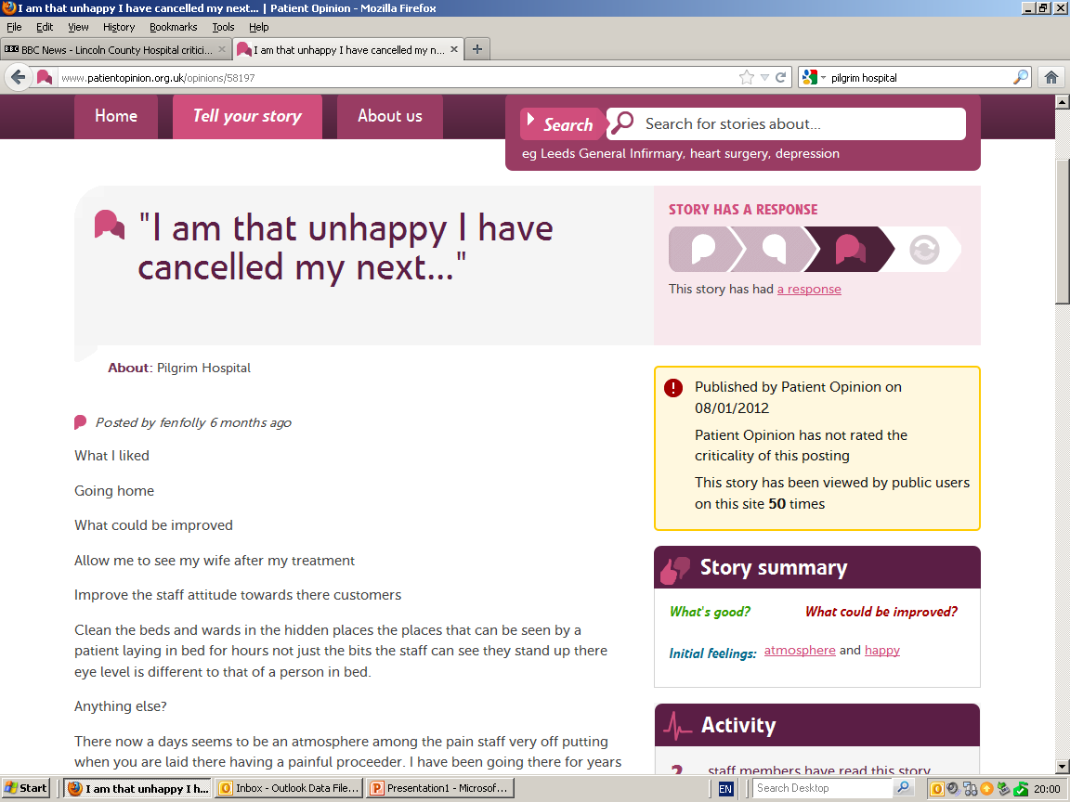

Slide 7
We weren't listening.................
Imagine how patients felt when they posted their stories and saw that no-one had responded to previous ones.
Poor reports about ULHT overshadow the good…….

Slide 8
Pockets of really good work around patient experience.
Real time surveys.
Local service studies and questionnaires.
Focus groups, matron listening clinics.
April 2012:
No overarching strategy.
Who was leading?
Time, capacity, priorities…..

Slide 9
Now:
Pan-Trust Lead.
Strategy.
Patient Experience Committee.
Action plan and workplan.
Patient Experience & Engagement Manager.
‘Patient Experience Toolbox & (almost a) Toolkit’
Patient Opinion is a key component.

Slide 10
Process for responding to Patient Opinion
Principles: who, why and how.
Lead responder receives alert.
Aim for response – or ‘holding response’ within 5 working days.
Reports & learning.
Address ‘backlog’ of stories….

Slide 11
Backlog…..136 stories 01.06.10 to 12.09.12

Slide 12
Criticality rating
 | Number of stories | Number of ‘views’
Pilgrim | 44 | 13,382
Lincoln | 69 | 20,250
Grantham | 16 | 3,891

Slide 13
Most read stories
Posted 5 months ago entitled: ‘no ECG machine at the doctors’ in Skegness but then went on to thank staff at Skegness A&E which at this time was part of ULHT.
Posted 7 months ago entitled: ‘my son’s bad hospital experience’ referred to a teenager taken to Lincoln A&E following an asthma attack and his care within A&E.
Posted 3 months ago entitled: ‘excellent and caring’ thanking staff on M2 at Pilgrim.

Slide 14
Its about empathy and compassion.
What if that was me or my family?
Its about being genuine, open and honest.
Being truthful, saying sorry with meaning.
Its about being better late than never.
A bit embarrassing to reply so late….but can still learn from the experience.
Its about language…what we say and how we say it.

Slide 15
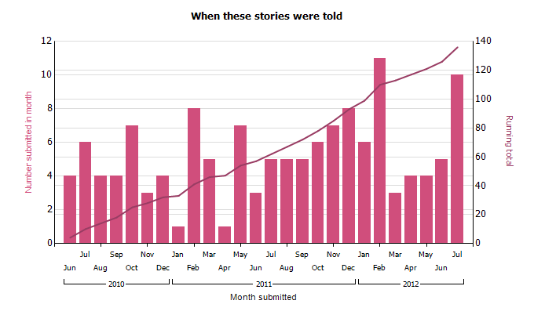
Increase in postings, but still low

Slide 16
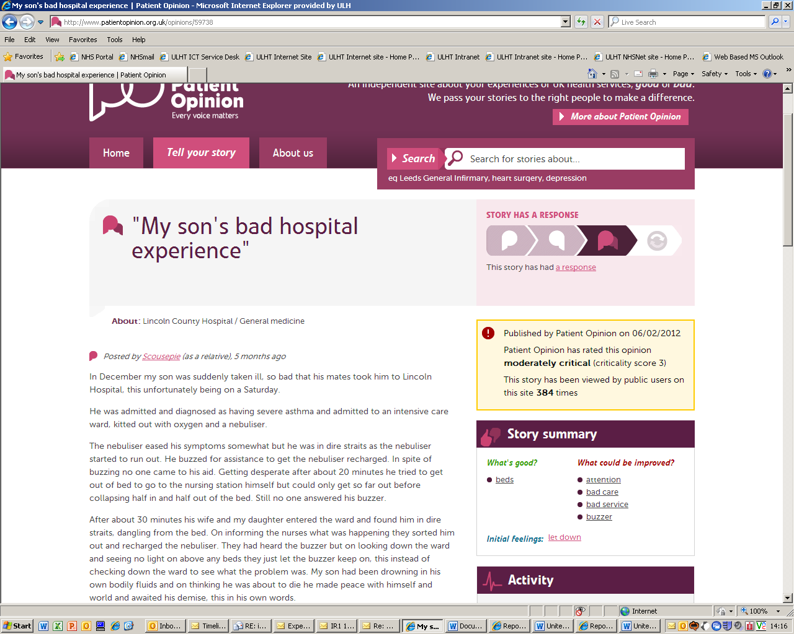

Slide 17
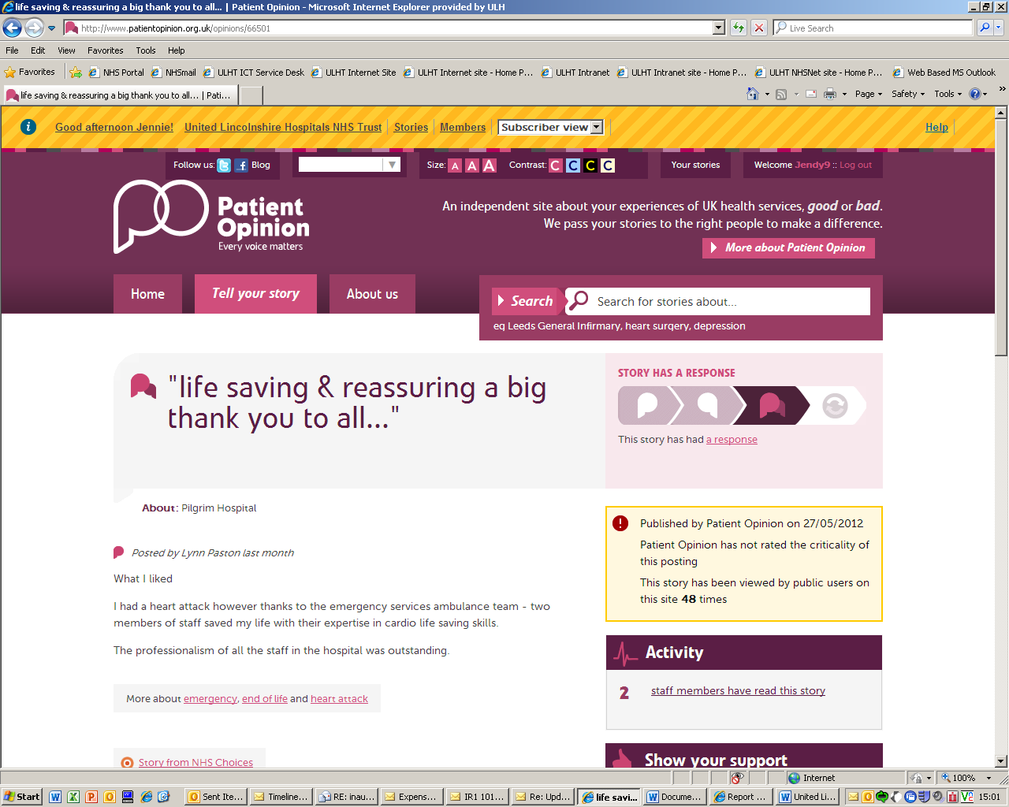

Slide 18
Services the stories are about | Number of stories | Latest story
United Lincolnshire Hospitals NHS Trust | 136 | 30/07/2012
Grantham and District Hospital | 16 | 19/07/2012
Trauma and orthopaedics | 1 | 23/02/2012
Lincoln County Hospital | 69 | 30/07/2012
Cardiology | 2 | 30/07/2012
Gastroenterology | 1 | 28/07/2010
General medicine | 1 | 06/02/2012
Gynaecology | 1 | 01/08/2011
Maternity | 1 | 20/07/2011
Pain Management | 1 | 15/05/2012
Trauma and orthopaedics | 1 | 09/02/2012
Pilgrim Hospital | 44 | 19/07/2012
General surgery | 1 | 07/09/2011
Gynaecological oncology | 1 | 21/12/2010
Gynaecology | 1 | 20/07/2011

Slide 19
Publicly viewable.
Valuable to the patient who told the story.
Valuable to others who may be reading.
Valuable to our commissioners and regulators in understanding how we listen to and respond to issues raised.
Reports sent to the 3 sites, Patient Experience Committee and to Board of Directors.

Slide 20
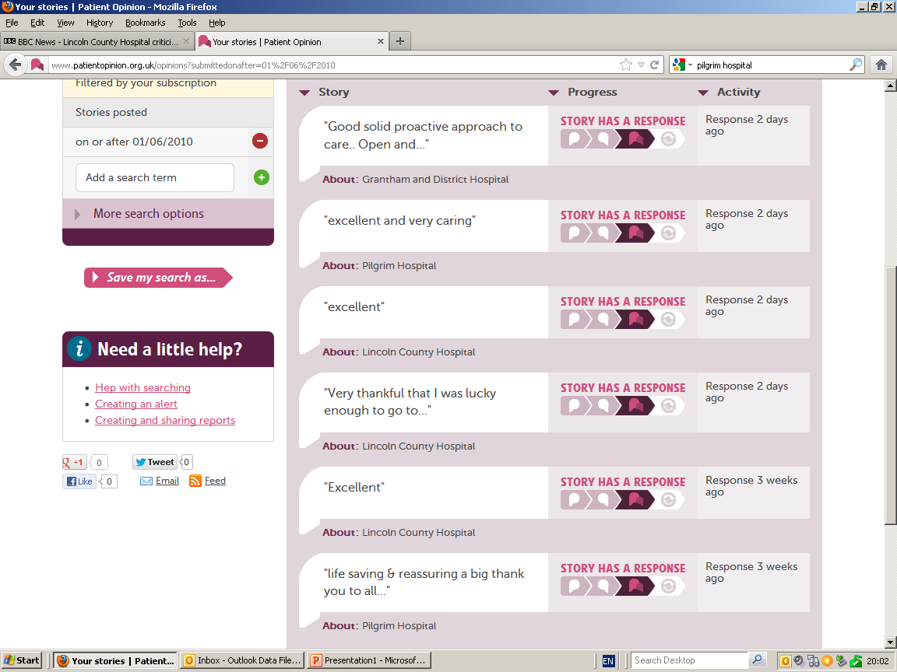

Slide 21
What's good?
hospital
A&E
appointment
assessment
attention
beds
brilliant
Cancer Services
cardiac ward
cleaners
doctors
great care
great service
in patient
nurses
referred
staff
ward
work
What could be improved?
communication
advice
ambulance service
attention
bad care
bad management
bad service
buzzer
compassion
diagnosis
doctor care
ECG
feeding
insensitive
nurse
staff
telephone answering
understanding
Initial feelings
thank you
friendly
happy
Lack of care
Dignity
fantastic
upset
appalling
frightened
impressed

Slide 22
Sept Board report conclusion
There is no doubt that patient stories via Patient Opinion are an incredibly powerful means to listen to and reply to patient’s voices, they provides us with a wealth of data and embedding a culture of accountability for that experience is critical for the Trust.
Cascading the responder role to the sites is an important next step and Patient Opinion is keen to work with us to train staff. It is proposed that the Deputy Directors and identified lead responders, by branch attend a workshop to begin this deployment process with a view to taking over the responder role in the new calendar year.

Slide 23
Next steps
Local responses:
Matron & ward sister at Lincoln this week
Training & admin rights
Medical engagement – meeting with MD
Changes:
Showing we have made changes
Increase responses

Slide 24
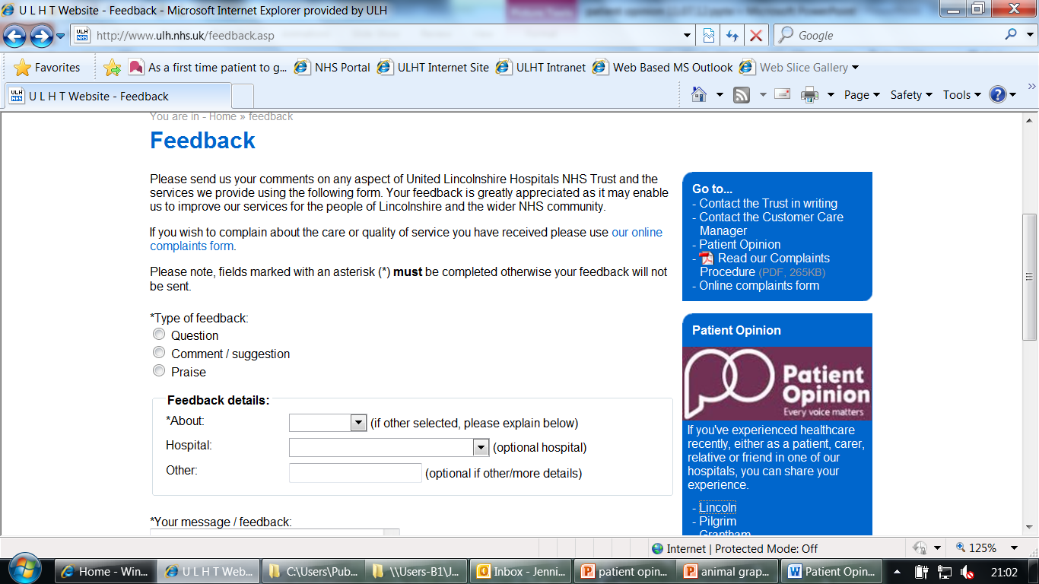
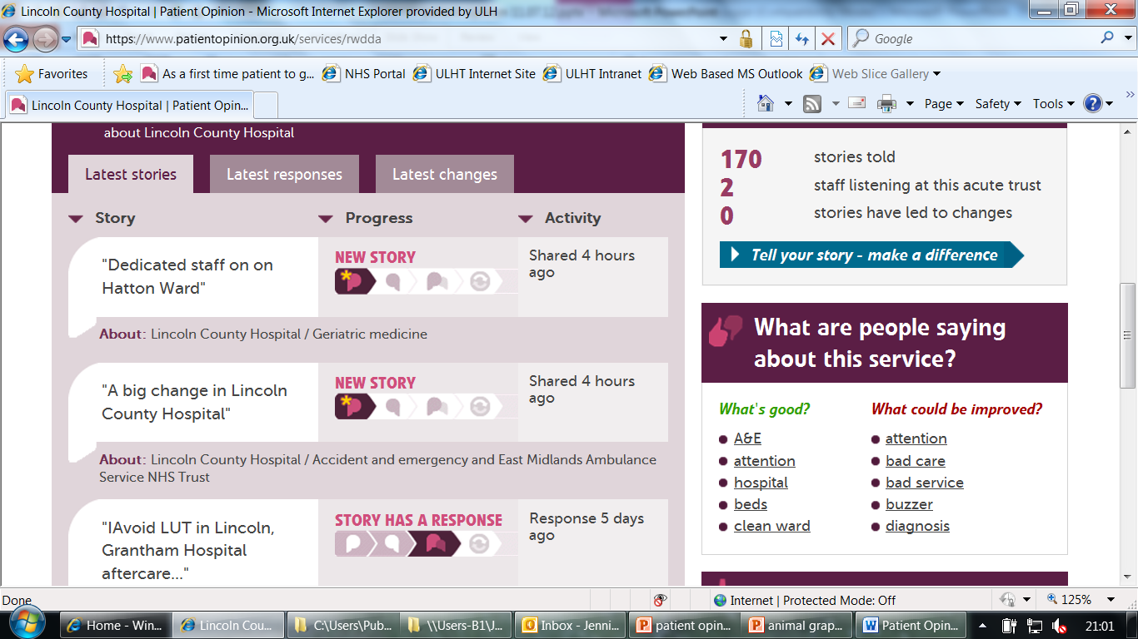

Slide 25
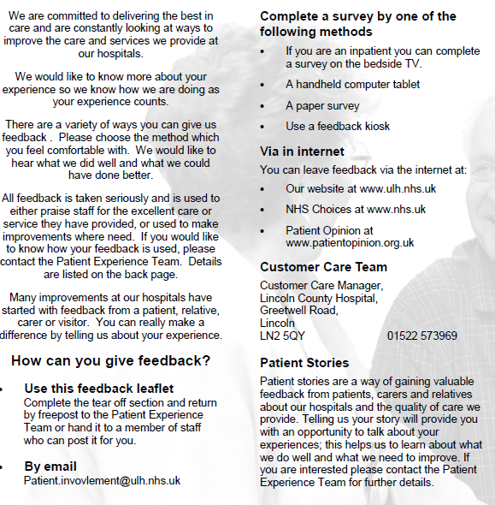

Slide 26
Thank you Any questions?

Slide 27
PS….anyone speak French?
‘Take the bull by the horns’

