Slide 1
A listening health service?
James Munro
Patient Opinion
james.munro@patientopinion.org.uk

Slide 2
Keogh Report, July 2013
“Patients, carers and members of the public… should be confident that their feedback is being listened to and see how this is impacting on their own care and the care of others.”

Slide 3

I will be seen as a troublemaker

Slide 4

Nothing will be done

Slide 5
“More than half of those who had voiced a concern about poor care felt that their feedback wasn’t welcomed”
CQC, 2013

Slide 6
“There is a lack of learning from complaints, and providers are not making clear to users that services are being improved as result.”
NAO, 2008

Slide 7
Berwick on Mid Staffs
“Warning signals abounded and were not heeded…
Especially costly was the muffling of the voices of patients and carers who took the trouble to complain but whose complaints were too often ignored.”

Slide 8
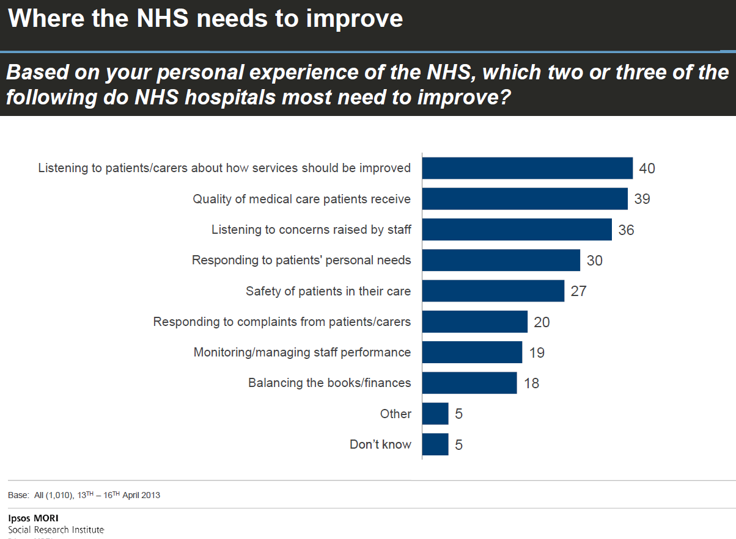

Slide 9
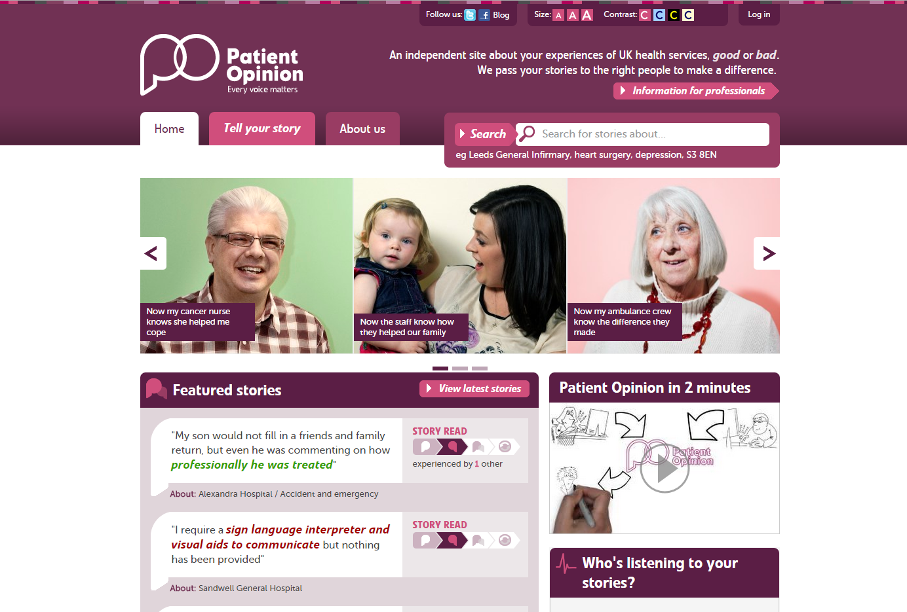

Slide 10
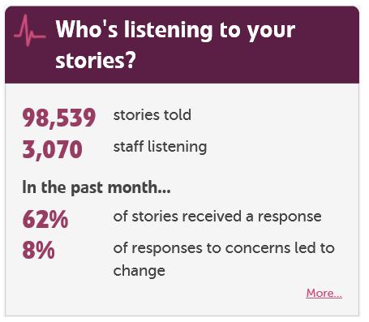

Slide 11
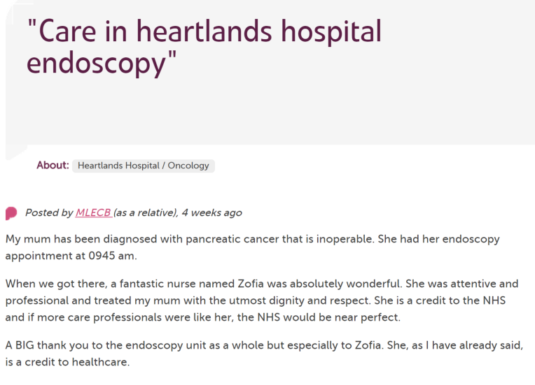

Slide 12
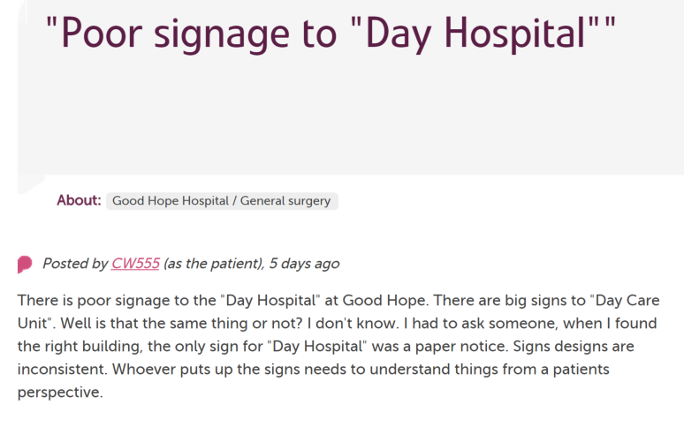
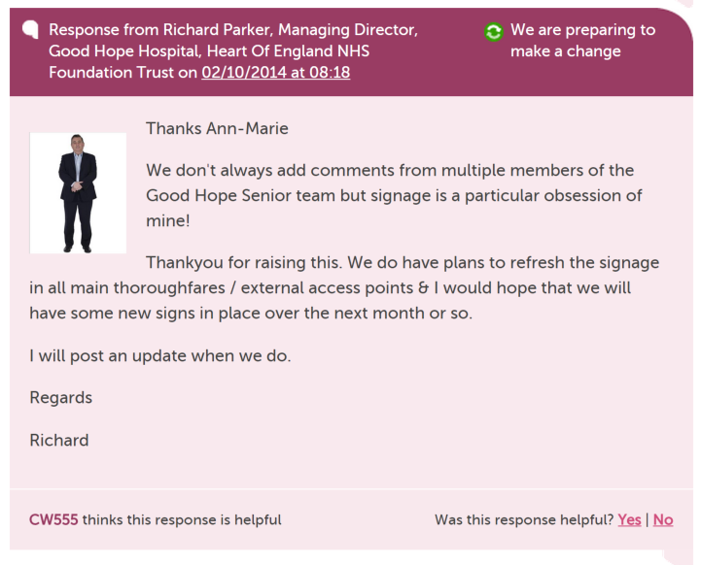
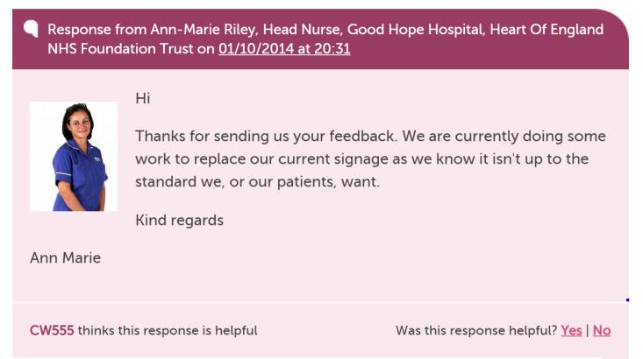

Slide 13
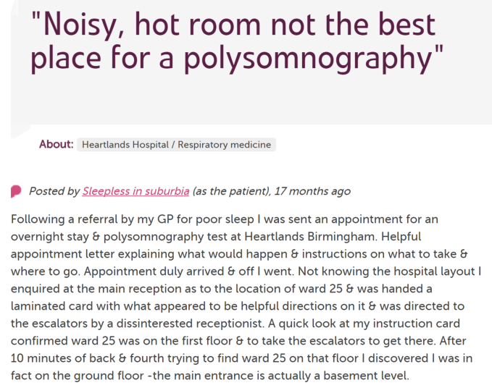
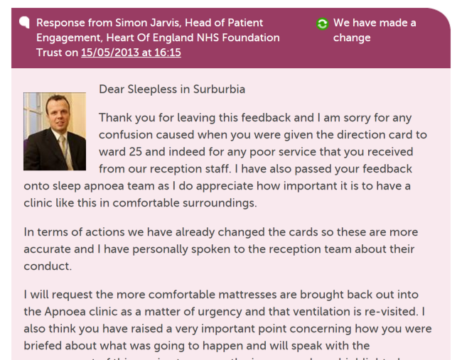
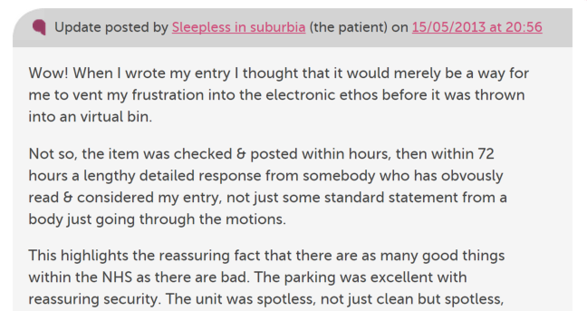

Slide 14
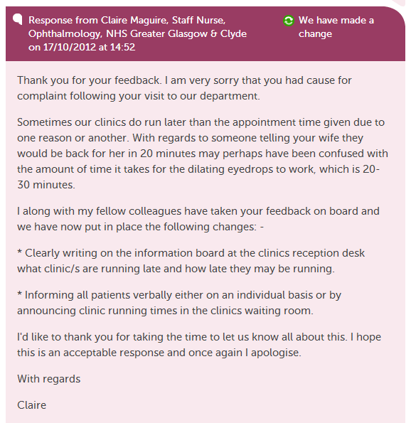

Slide 15
Story
Moderation
Alerts
Responses
Learning + change

Slide 16
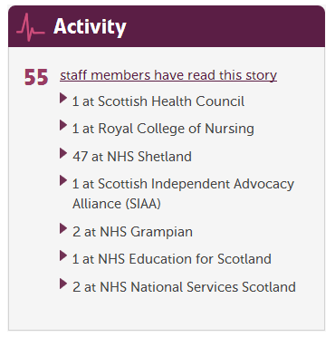

Slide 17
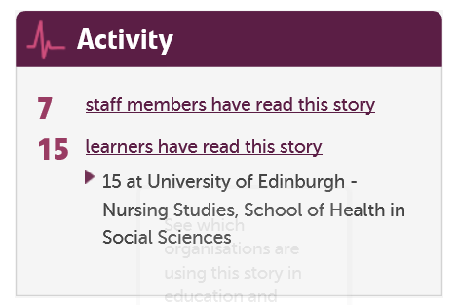

Slide 18
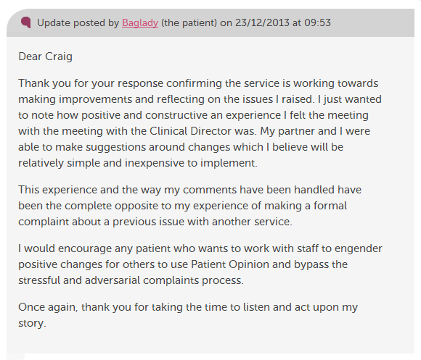

Slide 19
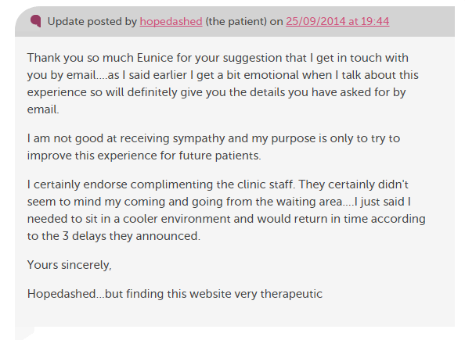

Slide 20
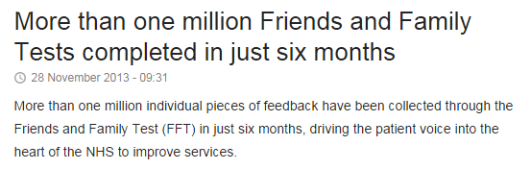

Slide 21
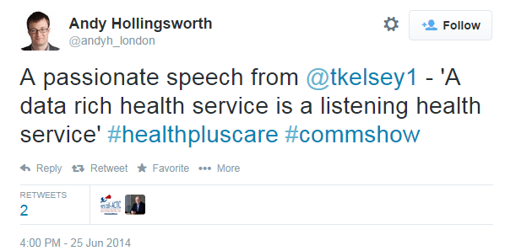

Slide 22
What is “listening”?
Organisational | Relational
One-way | Two-way
Process based | Empathy based
Unequal | Equal
Not empowering | Empowering
Informative | Transformative

Slide 23
The world is changing – fast
Old world | New world
Hierarchy | Network
Broadcast | Conversation
Hiding | Sharing
Few | Many
Closed | Open
Passive recipients | Active participants

Slide 24
Active citizens and the NHS
Not collecting data, but connecting people
Not making a comment, but making a difference
Not choosing, but changing

