Slide 1
Introduction to Care Opinion

Slide 3
Who are we?
Care Opinion is a non-profit social enterprise, based in Sheffield and Stirling.
We have been sharing people’s experiences of health and care services online since 2005, and we have built a national and international reputation for our innovative and value-led approach to online feedback.
At Care Opinion we make it safe and simple to share your story online and see other people's stories too. You can see how stories are leading to change.
How is Care Opinion funded? | Care Opinion
Meet the Care Opinion team | Care Opinion

Slide 4
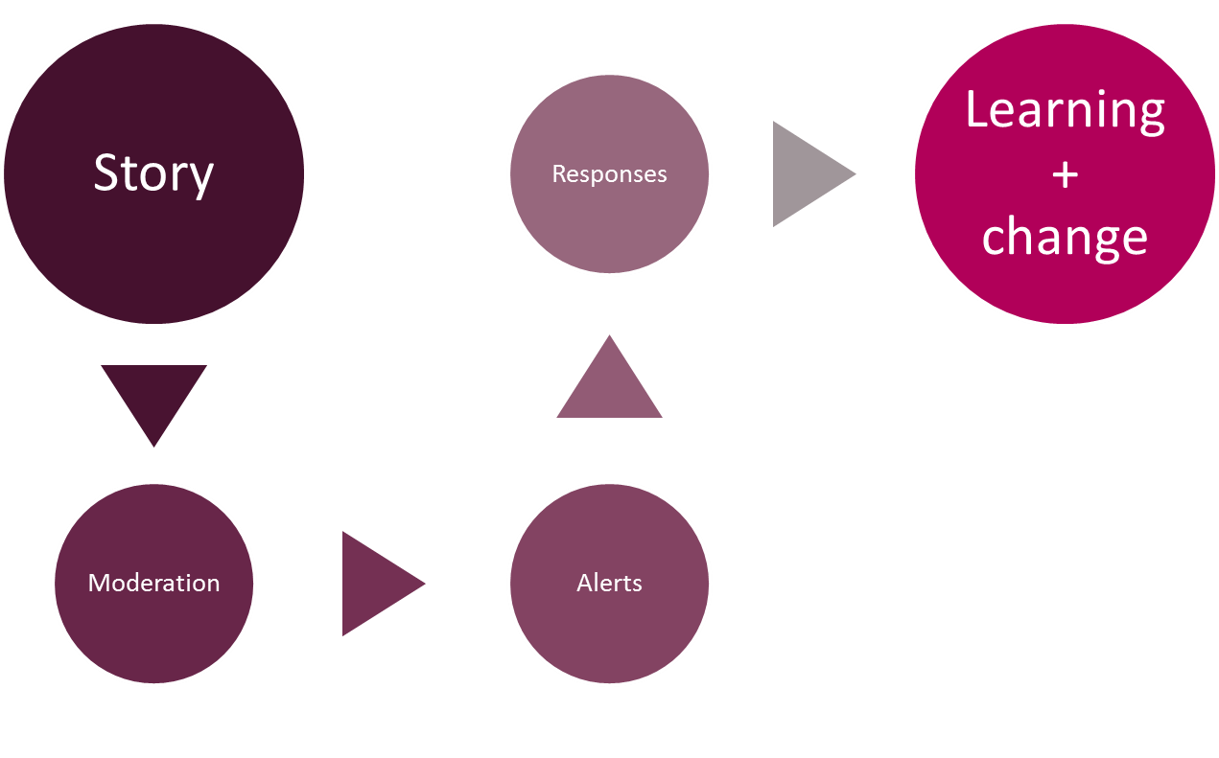
The story-telling flow – it’s about the conversation

Slide 5
Care Opinion in 2 minutes
Watch this short video to find out more about Care Opinion.
Notes:
Embed code is available for you to use this video on your site.

Slide 6
Mission, Vision & Values
Our vision
What do we want to see?
We want people to be able to share their experiences of health and care in ways which are safe, simple, and lead to learning and change.
Our mission
Our mission, in a nutshell, is to provide an online platform so that people can share honest feedback easily and without fear
Our values
How will we pursue our mission?
Innovation Transparency Inclusivity Positivity Humanity

Slide 7
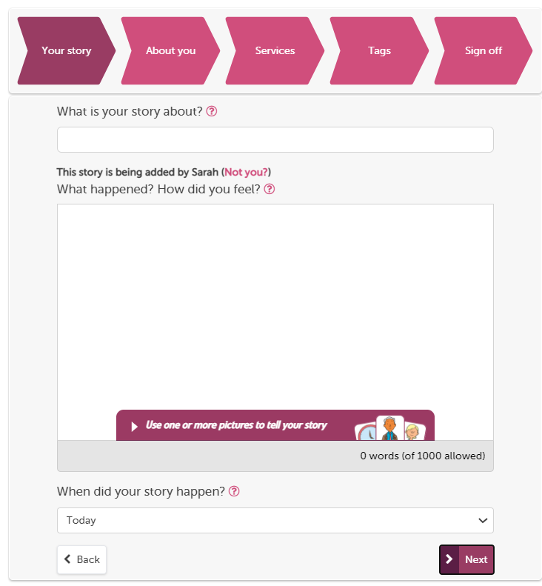
The “tell your story” workflow is our full process on the website
You can use pictures
Give what was good/could be improved tags
Provide optional demographic information, FFT and ratings.
Tag story to multiple providers
Formatted to work on mobile devices
Notes:
You can use pictures
Give what was good/could be improved tags
Provide optional demographic information, FFT and ratings.
Tag story to multiple providers
Formatted to work on mobile devices

Slide 8
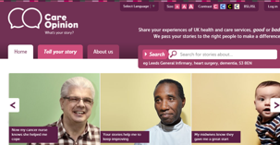
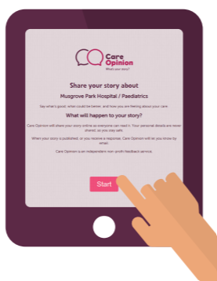
Ways to share a story with Care Opinion
Online careopinion.org.uk or careopinion.ie
Freephone 0800 122 3135 (UK only)
Freepost leaflets
From an invitation link
With support from Volunteers
Using picture tiles
All stories are subject to moderation and are uploaded to the website

Slide 10
Inviting online feedback with an invitation link
The simplest way to invite people to share their experiences on Care Opinion is just to provide a link to the site.
Another way is to make an "invitation link“ and provide that instead. They look like this https://www.careopinion.org.uk/49/aah-ed
What does an invitation link do?
An invitation link allows you to:
customise various aspects of our story-telling workflow
easily access widget codes, kiosk links or QR codes to share with people using services
keep track of which stories came via which invitation links, and run reports and visualisations easily
Notes:
The simplest way to invite people to share their experiences on Care Opinion is just to provide a link to the site.
Another way is to make an "invitation link“ and provide that instead. They look like this https://www.careopinion.org.uk/49/aah-ed
What does an invitation link do?
An invitation link allows you to:
customise various aspects of our story-telling workflow
easily access widget codes, kiosk links or QR codes to share with people using services
keep track of which stories came via which invitation links, and run reports and visualisations easily

Slide 11
What are the pros of using an invitation link ?
With an invitation link you can customise the “tell your story” workflow, or direct people to the "kiosk workflow".
Your invitation link can:
make sure a specific health/care service is pre-selected
add specific tags to new stories
after a story is told, invite the author to visit your own survey or consultation too
For English services you can add the FFT question to the kiosk work flow
Track stories relating to a specific topic by using subscriber tagging
Feedback focus
Notes:
With an invitation link you can customise the “tell your story” workflow, or direct people to the "kiosk workflow".
Your invitation link can:
make sure a specific health/care service is pre-selected
add specific tags to new stories
after a story is told, invite the author to visit your own survey or consultation too
For English services you can add the FFT question to the kiosk work flow
Track stories relating to a specific topic by using subscriber tagging
Feedback focus

Slide 12
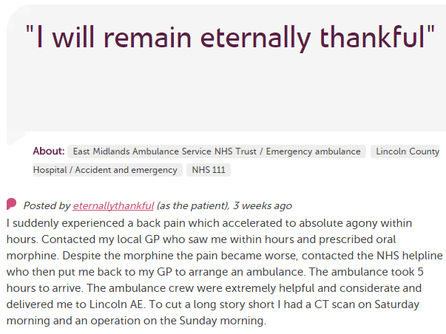
In each provider
Moderation
Service staff
Different Staff Teams
User exp, comms, complaints…
Alerting
CEO
Commissioners
Nursing, AHP students
Healthwatch
Researchers
Other Stakeholders
CQC

Slide 13
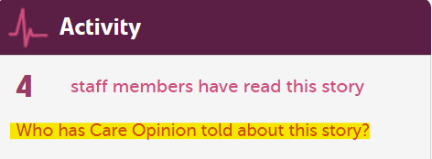
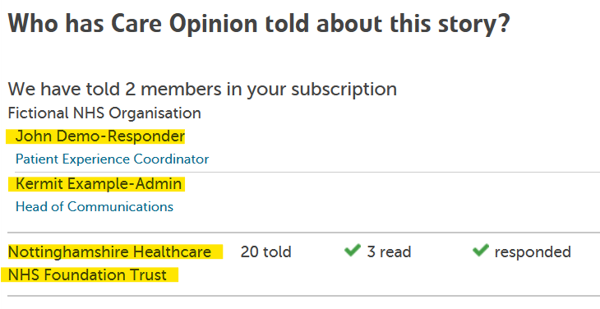
How do I hear about stories that are relevant to me?
You can also find out who else in your subscription has been sent an email alert
Not only can you see who's been notified, but if anyone has read or responded to the story too

Slide 14
Accessing the site

Slide 15
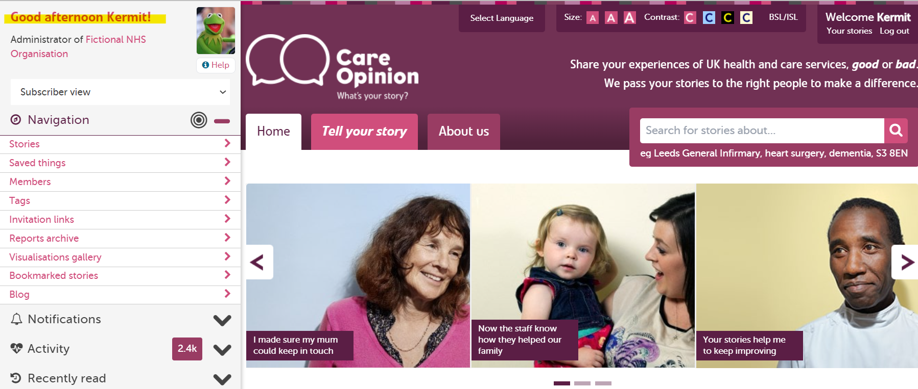
Notes:
Change this to sub admin

Slide 16
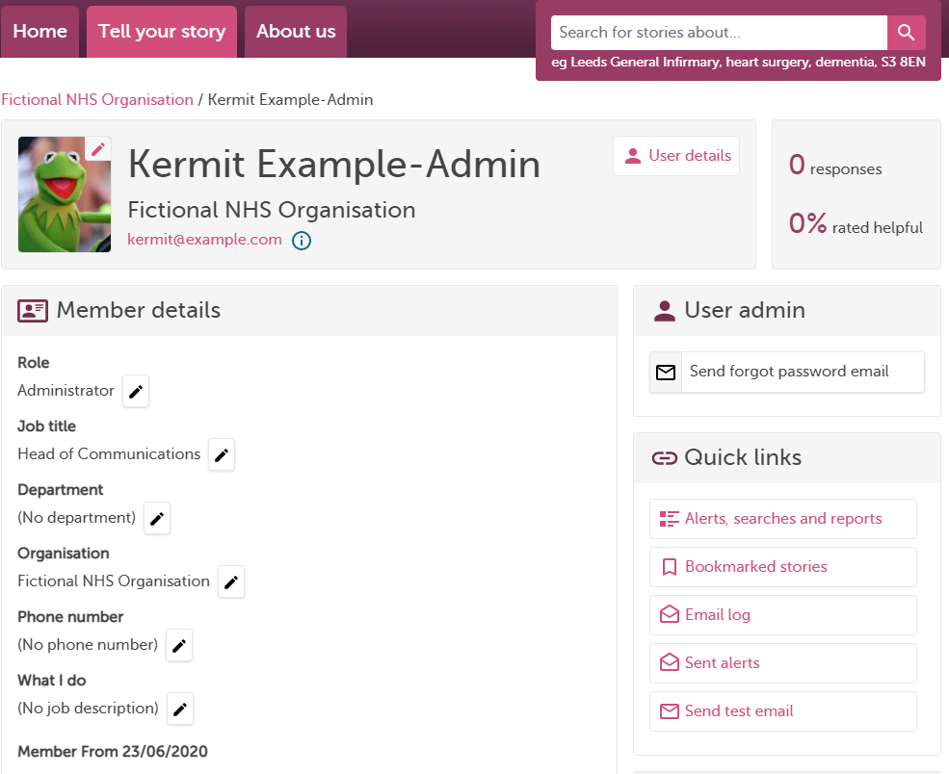

Slide 17
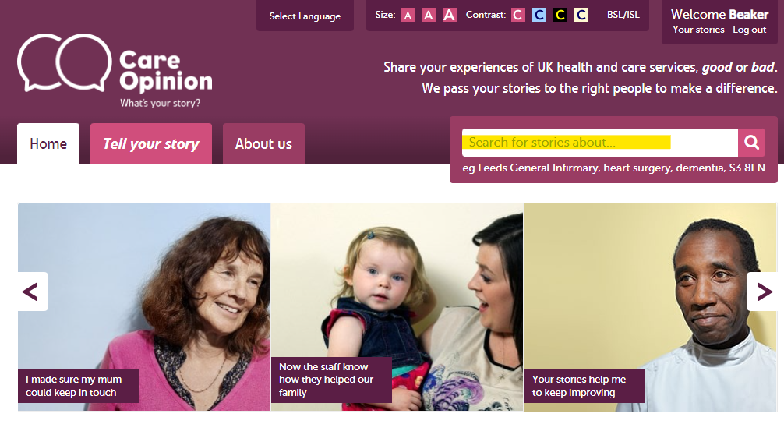

Slide 18
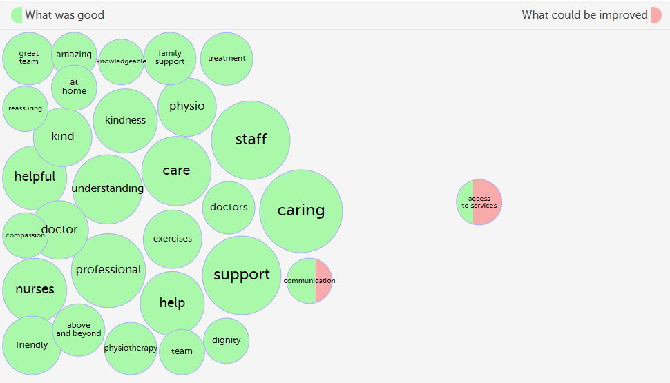

Slide 19
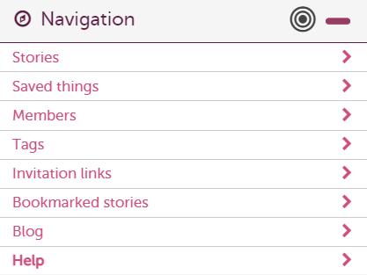
How to find help?
Help button
Support page
Contacting your support lead
Emailing info@careopinion.org.uk

Slide 20
Resources and Care Opinion training webinars/events
Invitation Links
You can watch a short 9 minute video on how to create Invitation Links here: https://vimeo.com/681943773
Other webinars
Sign up for and view webinar recordings on this page: Training and support webinars | Care Opinion
Know How Page For all your support needs, you can find lots of information at this page: Subscriber know-how | Care Opinion
Events
Find out about our upcoming Care Opinion events here: Care Opinion Events | Care Opinion
Contact us: info@careopinion.org.uk
Notes:
Cally: Upcoming How to training webinars: Invitation Links and subscriber tagging How to use reports and visualisations How to respond well and demonstrate impact And many more

Slide 21
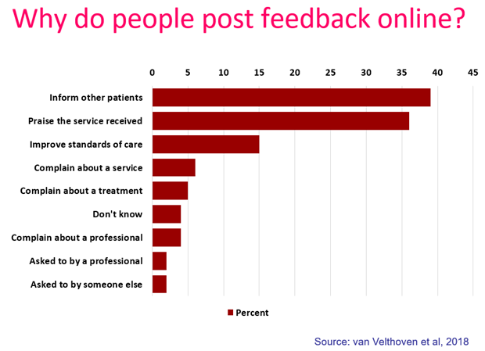
“To give people a chance to read what I went through and maybe give them some hope.”
“It was a difficult time for me to go through and Care Opinion allowed me to control the speed
and words rather than be rushed through Q&As or tick box scenario where things don't quite fit.”
“To highlight the problem without making a formal complaint and to thank the staff for excellent care”
“People need to know how valuable this care is”

Slide 22
Blogs
Royal Devon University Healthcare NHS Foundation Trust
Our journey from single service to trust-wide subscription
Inclusion – Sexual Health Services
Celebrating 1st year f online feedback
Nottinghamshire Healthcare
Blog by MH service user
GP in Hackney – The Lawson Practice
Care Opinion within a GP setting
City & Hackney GP Confederation
How City & Hackney are embracing online feedback

Slide 24
Thank
you

