Slide 1

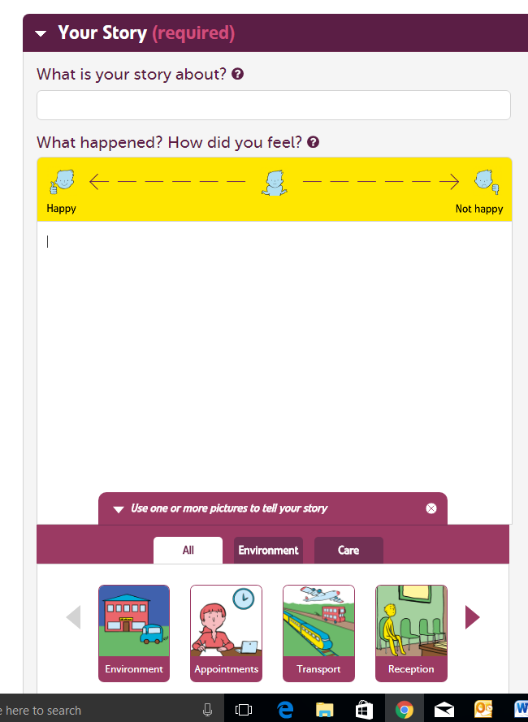
Notes for helpers
Supporting everyone to tell their story
These notes help you think how can you assist someone with dementia to give feedback using the picture story feature on care opinion

Slide 2

A little bit of background
At Care Opinion we believe it is important that everyone can tell the story of their experience of using health and care services.
This can be hard as there can be barriers to telling a first-hand account of an experience. These barriers can include
difficulties with expression and finding the correct words
difficulties with memory
difficulties with writing or typing on a computer
To enable a wider range of people to tell their story we have partnered with Talking Mats. Talking Mats is a social enterprise that works to improve the lives of people with communication difficulties.
This joint work was funded through Life Changes Trust and has been developed in partnership with people with dementia, their families and staff who work with them.

Slide 3

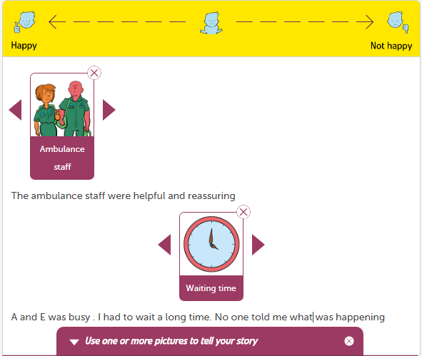
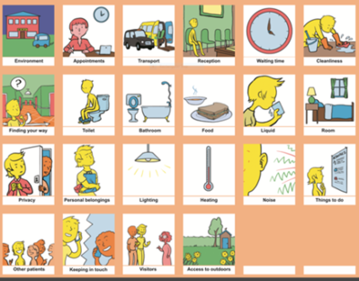
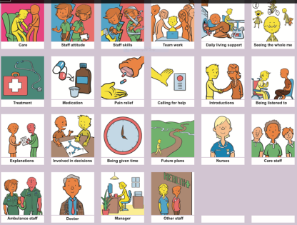
The Picture Story Space
Our aim was to create a way where people are enabled to tell their story by creating an alternative story space on the Care Opinion website that is adapted from the work of Talking Mats
To do this we developed
1. Picture sets with different options
2. A scale that enables you to reflect whether you were happy or unhappy with the a particular option
3. A way that you can add to your story using words

Slide 4
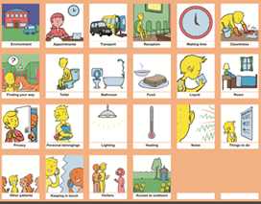

The picture story sets
The picture story sets were made up after thinking about the topics that arose on the care opinion website .Then we worked with our expert advisor groups which included
people with dementia,
their carers
staff
Our aim was to find a structure that would be comprehensive but keeping thing simple and not overwhelming .
There are two sets
1. Environment This set is focused on the physical aspects of health and care e.g. cleanliness , temperature, outside space ,privacy
2. Care This set is focused on the care aspects of health and care e.g. staff skills, team work ,pain relief , being involved in decisions
An example of keeping things simple is we have not included a different picture for all the possible health and care staff. We have a picture for most used roles and an ‘other staff’ picture that can be used with words to describe the wide range of roles that exist

Slide 5
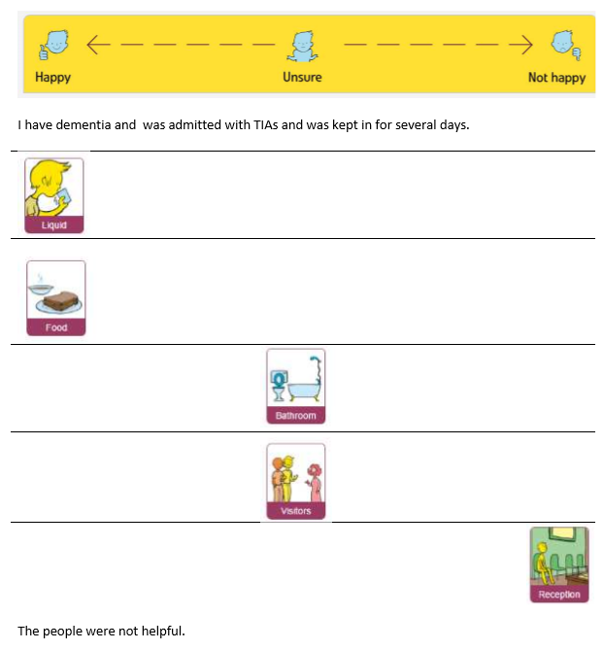
Why will picture help people tell their stories
Why will pictures help ?
The pictures in the sets are the common issues that occur in feedback to health and care. This structure will provide a scaffold to thinking
The pictures can help work out what are the important things about the story and support sequencing of ideas
The pictures can support story telling and enable memories to be triggered
An example Story from the Pilot project

Slide 6
Levels of support required to use the Picture Stories on care Opinion
Ask someone what support they would like
Some will need
• No additional support
Some support on the more technical aspects of finding the website , coordinating the mouse and picture etc
Some will need a scribe to add the additional spoken information
The number of symbols available can be changed from 1 at a time to 4 at a time depending on what is most help.
You can tell a story using as few or as many pictures as you want
Some may find it helpful to do some pre preparation of their story using a paper version
Click here to access and print pictures to help with pre preparation
Some will not be able to use it even with support
Additional guidelines about how to support people with dementia to have a conversation
  https://www.scie.org.uk/dementia/after-diagnosis/communication/conversation.asp
  https://www.alzheimers.org.uk/info/20064/symptoms/90/communicating_and_language/3

Slide 7
Top tips When you use the paper pictures
Above all think about the way you communicate .
You can change the way you interact and that can support the other person to communicate more
Give Time – let the conversation go at the other persons pace and take care with the amount and type of language you use
Remember making comments is usually more helpful than asking lots of questions
Communication is often easier for people with communication difficulties when there is a shared focus of attention and the pictures can provide that focus
Less is sometimes more .Getting the flavour of the story is more important than every detail
Sometimes an old memory will trigger and may get mixed up in the new story if that happens try to go with the flow and don’t contradict The pictures can be a non confrontational and helpful way of keeping the conversation on track
Practice with the scale get people to place the pictures on whether they were happy or not happy as you do this keep your questions open
  e.g What did you feel about the nurses
  Not closed Did you like the nurses ?

Slide 8
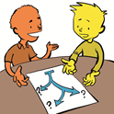
Some of the options are easier for some people to understand than others
This relates to the cognitive demand of the options so for example options such as food , ambulance staff , medication are easy to visualise
Some people will only be able to give feedback on these more ‘concrete’ ideas
Options such as ‘seeing the whole me’, ‘involved in decisions’, privacy are more abstract and may not be accessible to everyone even with explanations
Although always be prepared to be surprised. When we were testing out the resource one lady with late stage dementia who did not appear to be engaging in conversation said about 5 minutes after we had talked about privacy – ‘they barged in you know they did not knock on my door’

Slide 9
Developing further
This work is based on research by Talking Mats but it is adapted and if you want to use the paper sets according to the Talking Mats principles then we recommend attending a Talking Mats foundation course see www.talkingmats.com
Research references are
file:///Z:/Attachments/publications/reports/Dementia/Dementia%20and%20Effectiveness%20of%20Talking%20Mats%20short%20Findings%20(1).pdf
Although this was developed with and for people with dementia .
It is designed to support communication difficulties and therefore we think it will have a much wider application .
We also think it important that we all become familiar with visual communication supports to help us move towards a more inclusive society

