Slide 1
Healthwatch Subscription with Care Opinion
Tim Hunt and Tracy Molloy

Slide 2
Agenda
Intro and Update on Care Opinion
Value and Aims of the Subscription
Overview of Care Opinion Functionality
Questions and Discussion

Slide 3
Vision
We want people to be able to share their experiences of health and care in ways which are safe, simple, and lead to learning and change.

Slide 4
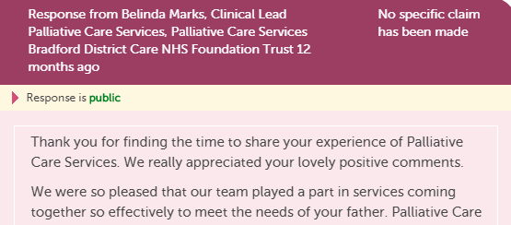
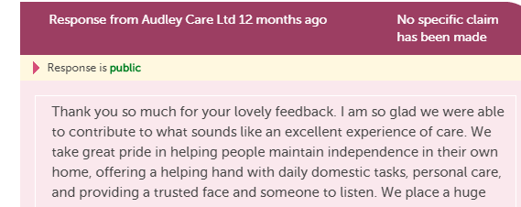
Integrated Feedback with Responses

Slide 5
Value of Care Opinion
All Postings are independently moderated includes Safeguarding etc
Includes all NHS.uk Postings
Care Opinion covers all Health and Social Care Providers including Care Homes, domiciliary care etc
Data filtered by provider, geographical area, themes, treatment functions etc
Public able to post about multiple providers in one posting
Public, transparent, encourages learning and improvements
Social Media Friendly

Slide 6
How is the Subscription structured?
Each HW has access to all Care Opinion and NHS.uk postings, scoped to their own areas
2 standard reports set up for subscription members
Training to generate reports, visualisations, digests, alerts
Training to help Staff/Volunteers to generate postings
Access to Widgets

Slide 7
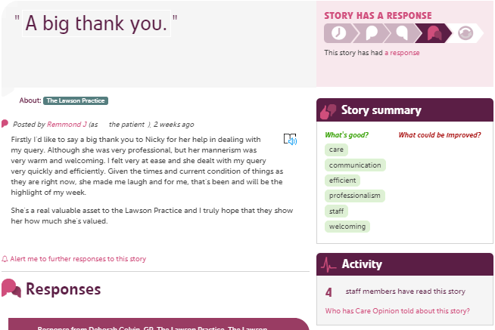

Slide 8
Stories and responses
Use Care Opinion search options to…
Find stories about your service
Save searches
Create alerts/weekly digests
Create and schedule reports
Run visualisations
Searching on Care Opinion - the start of everything
Smart
Alerting
Searching
Subscriber tagging
Reporting
Visualisations

Slide 9
Available reports

Slide 10
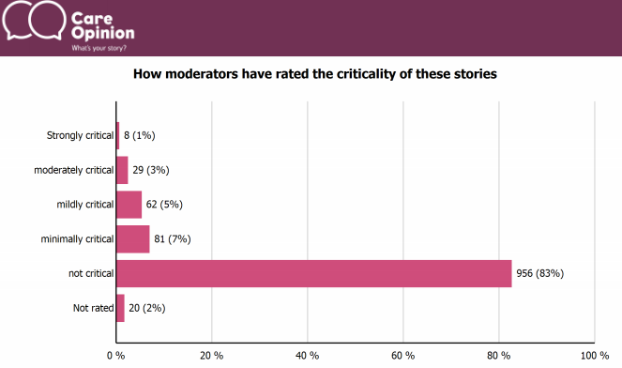
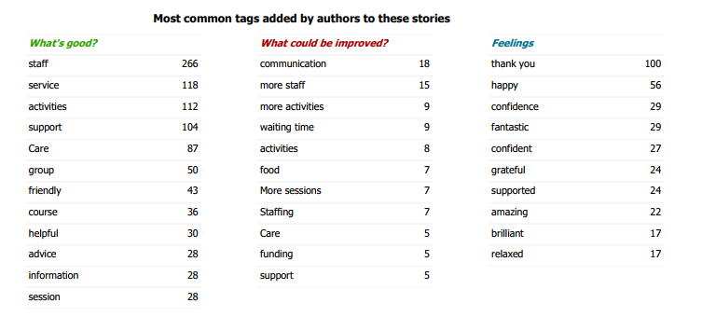
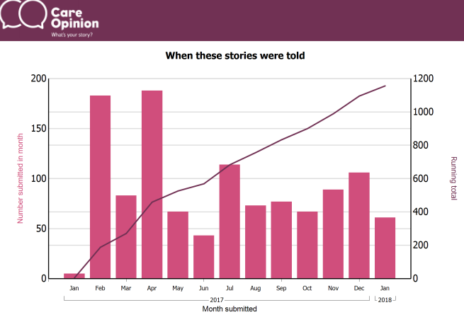
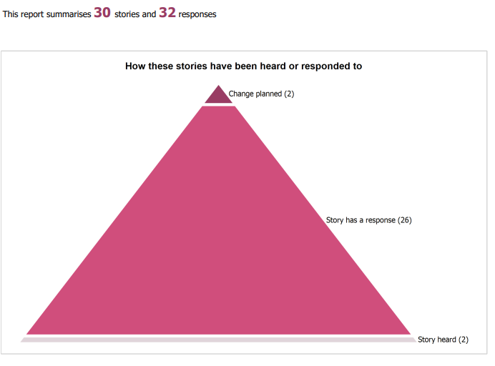
Notes:
Screenshot from stories in summary report

Slide 11
Story listing in a table report

Slide 12
All reports:
Can be saved for later
Downloaded in different formats
Be tailored to specific services
Be set on a schedule (weekly, monthly etc)

Slide 13
All stories from SHSC – Tag bubbles
Your visualisation is now available here: https://www.careopinion.org.uk/vis/bnvaw

Slide 14
Tag word cloud
Your visualisation is now available here: https://www.careopinion.org.uk/vis/nedrv

Slide 15
Weekly Digest

Slide 16
Widgets

Slide 17
On-line promotion
Latest stories Widget on front page - Stays up to date with most recent stories
Story telling widget – people can share feedback with Care Opinion about your service without leaving your site
Embed the Care Opinion video so people can watch how Care Opinion works

Slide 18
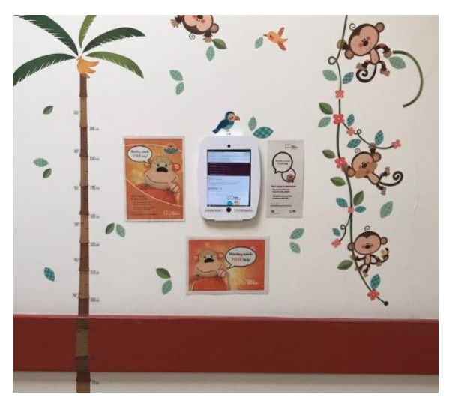
Kiosk Mode
Blog: How to collect stories via kiosk mode How to locate Kiosk mode on a service page

Slide 19
Other use for Kiosk Mode
“We’d love to hear your story of using our service,
Tell us what was good or what could be improved at Care Opinion using the link below”:
https://www.careopinion.org.uk/kiosk/f84096
https://www.careopinion.org.uk/blogposts/831/how-can-i-invite-rapid-online-feedback-about

Slide 20
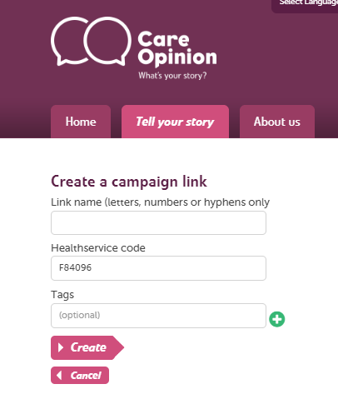
Campaign Link

Slide 21
Support from Care Opinion
https://www.careopinion.org.uk/info/how-to-sessions
Info@careopinion.org.uk
0114 281 6256

Slide 22
HW Generating Postings
Different Ways for Staff/Volunteers to generate postings
With a subscription you will see all feedback
Ways to track postings that you help to generate
You can focus on a service area or theme
Fits integrated care agenda

Slide 23
Getting Started
Make sure all the team including volunteers are on the Subscription
Discuss appropriate access to postings for each team member
Align access and posting generation to strategic objectives
Ensure staff sign up to Webinars, access support pages etc

Slide 24
Discussion
How might you use this Subscription to increase partnership working with local providers/commissioners?
How does the feedback coming in sit alongside other data/feedback you collect?
Tim Hunt, Integration Manager, tim.hunt@careopinion.org.uk
Tracy Molloy, Engagement & Support Officer, tracy.molloy@careopinion.org.uk

