Slide 1



OUR JOURNEY
IN ENDOSCOPY
Gill Ogden, Clinical Nurse Manager
Neil Cruickshank, Clinical Lead, Endoscopy

Slide 2
WHY?
Want to make a difference – We’ve got the power!
Need to really understand the culture
Sensitive specialty – intimate procedures
What do our patients really, really think?
Reassurance to future patients - we are listening

Slide 3
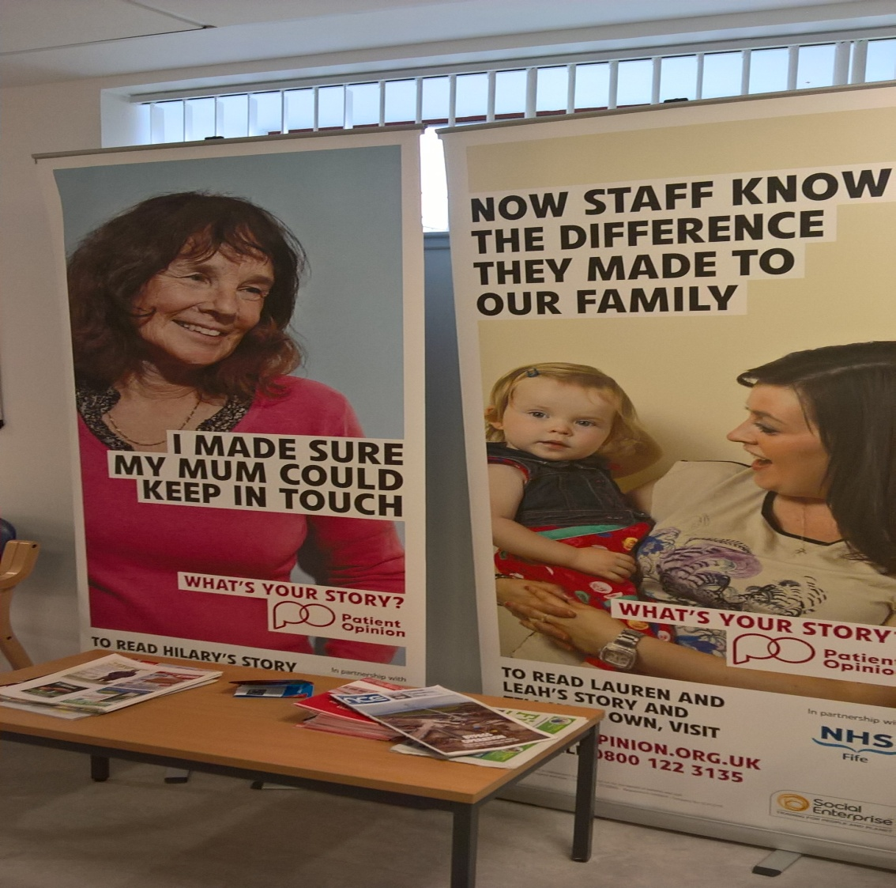

It can’t be that hard, can it?

Slide 4
Engaging the Staff....
“...........Your observations led to much discussion between our staff and they all agreed that music could be really beneficial in helping our patients to relax during their procedures. So, I am pleased to say that thanks to you, we are now in the process of purchasing CD players and CD’s for the Manometry and Endoscopy procedure rooms across the Victoria, Queen Margaret and St Andrew’s hospital sites...............”
“....I would also like to suggest that if there was the opportunity for patients to listen to music during this procedure then it may help them to relax easier and for the procedure to go more smoothly and quicker...”

Slide 5
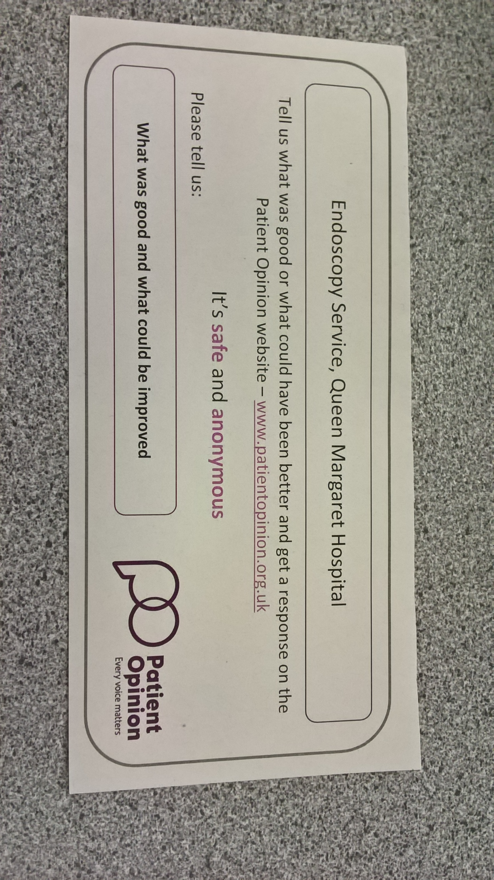

Slide 6
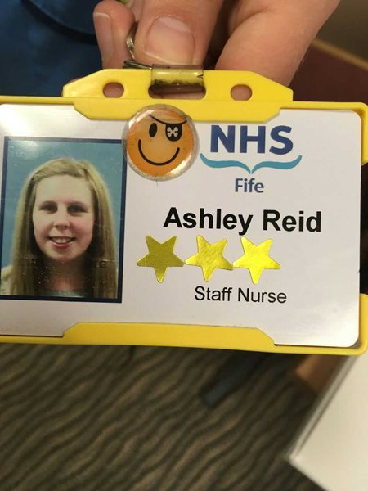
3 gold stars for Ashley
“I came into the unit for a colonoscopy and although I have been many times before this time I was more apprehensive but I need not have worried all the staff in this unit are kind and caring to everyone but my three gold stars go to Callum , S/N Ashley and S/N Natalie for making me feel so much better, there is so much negativity about make a positive remark, so thanks for making this wee old wreck walk out feeling 10ft tall.”

Slide 7
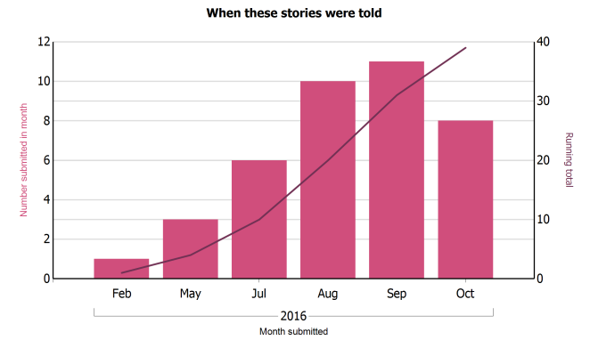

Slide 8
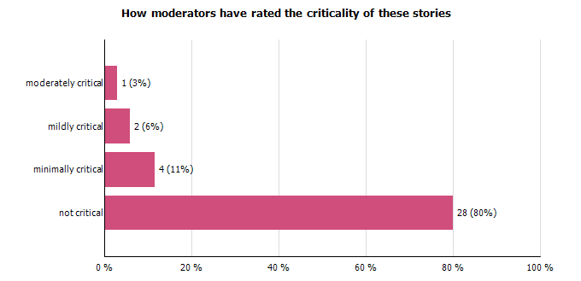

Slide 9
16.32 hours
16.42 hours
"I am disappointed that I was assured id be sedated then wasn't."
Email from the Chief Executive to the Medical Director, the Nurse Director and COO
“I am worried about this can we investigate could you both support Scott . I would be interested in the consent process . Please feed back to me Scott.”

Slide 10
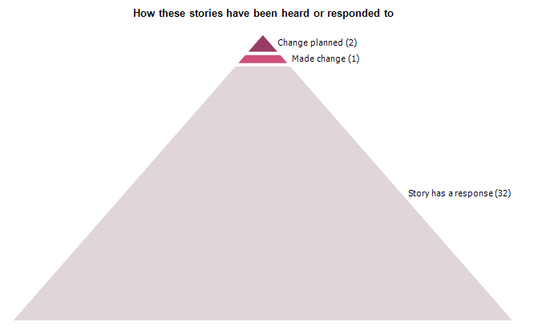
Next Steps....
Get better at closing the loop
Specific feedback?
Patient Opinion action plan?
Devolve responding responsibility to SCN’s
Support to other NHS Fife colleagues
Spread the word

Slide 11


"7 star review"

Slide 12
Clinical Lead Perspective
JAG accreditation
Clinical changes – require staff involvement and moral
Patient feedback allows us to make relevant changes
Need to be proactive in asking for feedback
Need to analyse our feedback better and focus on themes
  Endoscopy
    Timeliness and scheduling
    Patient information
    Patient comfort – person centred care/approach (needle phobia etc)
    Explanation of procedure, findings and next steps

