Slide 1
About Care Opinion

Slide 2
Careopinion.org.uk
Care Opinion is a place where people can share their experiences of health or care services
At Care Opinion we make it safe and simple to share stories of care online and for people to see other stories too. The public, services and regulators can see how stories are leading to change.
We think that by sharing honest experiences of care, we learn to see the world differently. Working together, we can all help make care better. As a social enterprise, this is very important to us.
https://vimeo.com/215724873

Slide 3
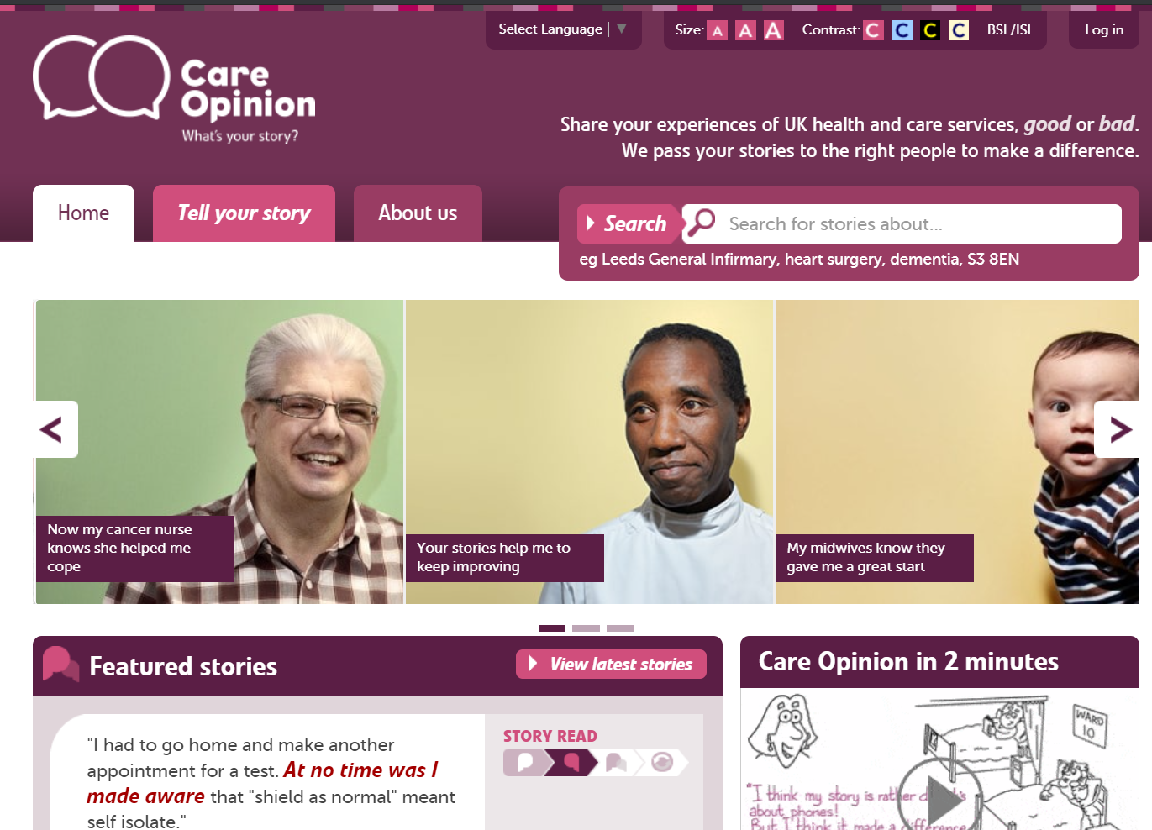

Slide 4
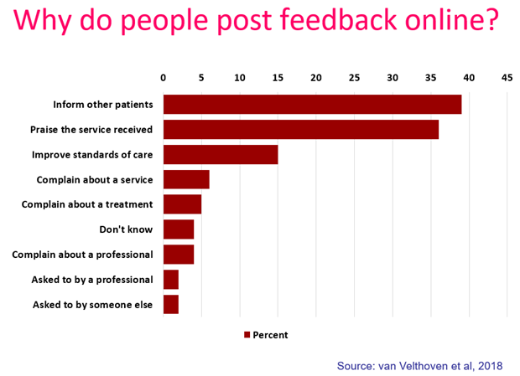
“It was therapeutic in healing my soul.”
“It was a difficult time for me to go through and Care Opinion allowed me to control the speed
and words rather than be rushed through Q&As or tick box scenario where things don't quite fit.”
“The fact I did not have to give my name made it a lot easier to provide feedback. I find it hard to do it in person.
I would like it to make changes.”

Slide 5
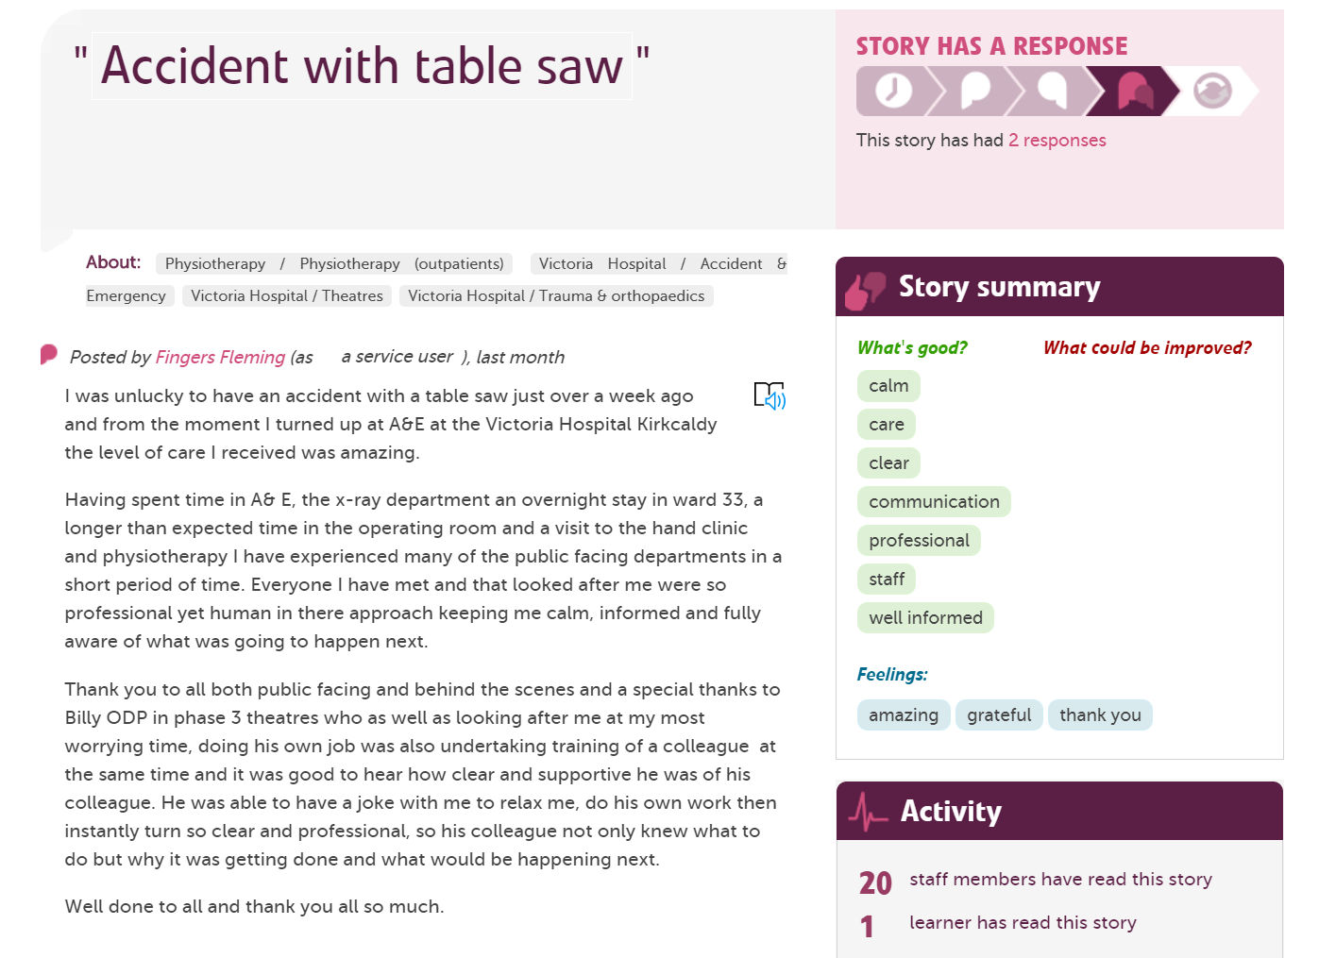

Slide 6
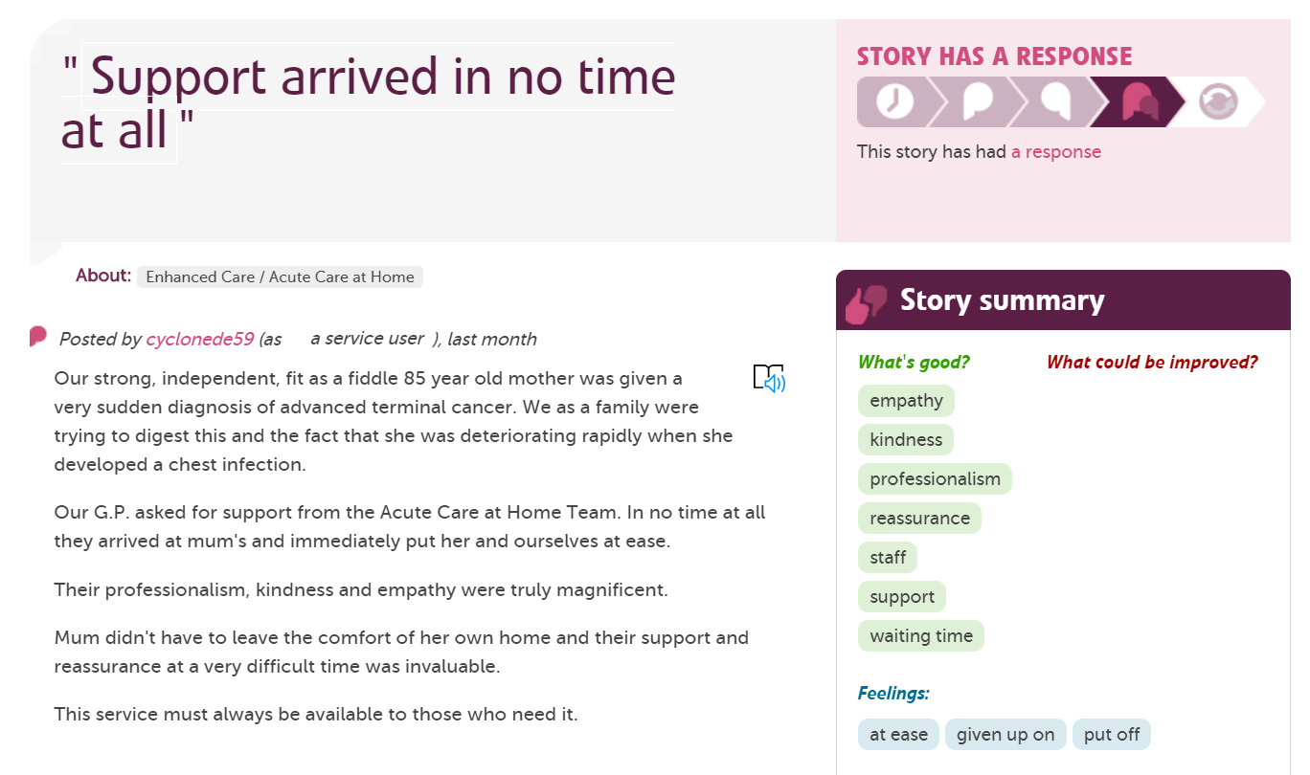
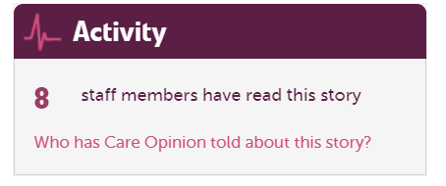
Tags are added by the author to show key themes
Stories by the same person are linked by a username
See which organisations are reading feedback

Slide 7
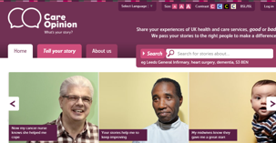
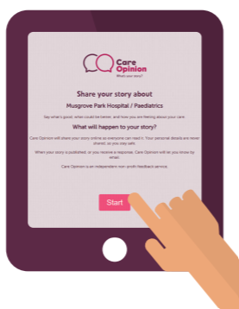
Ways to share a story with Care Opinion
Online careopinion.org.uk or careopinion.ie
Freephone 0800 122 3135 (UK only)
Freepost leaflets
Via a Kiosk link
From a campaign code
With support from Volunteers
All stories are subject to moderation and are uploaded to the website

Slide 8
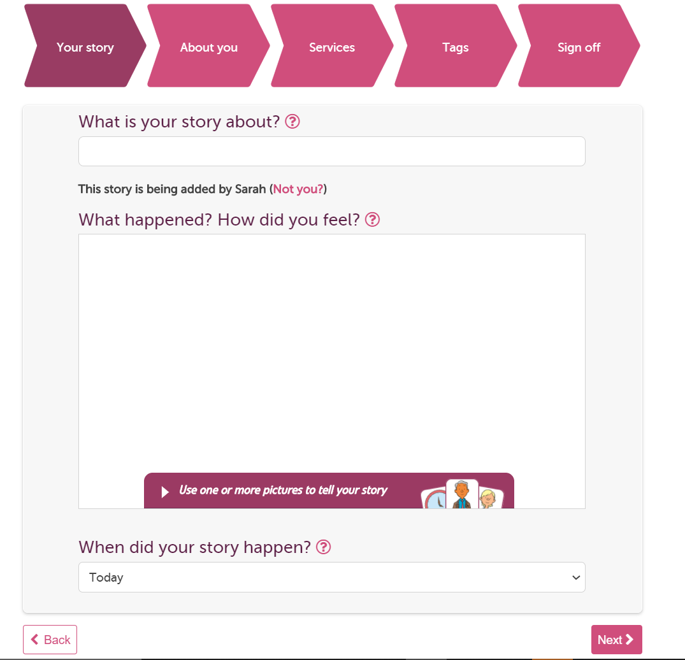

Slide 9
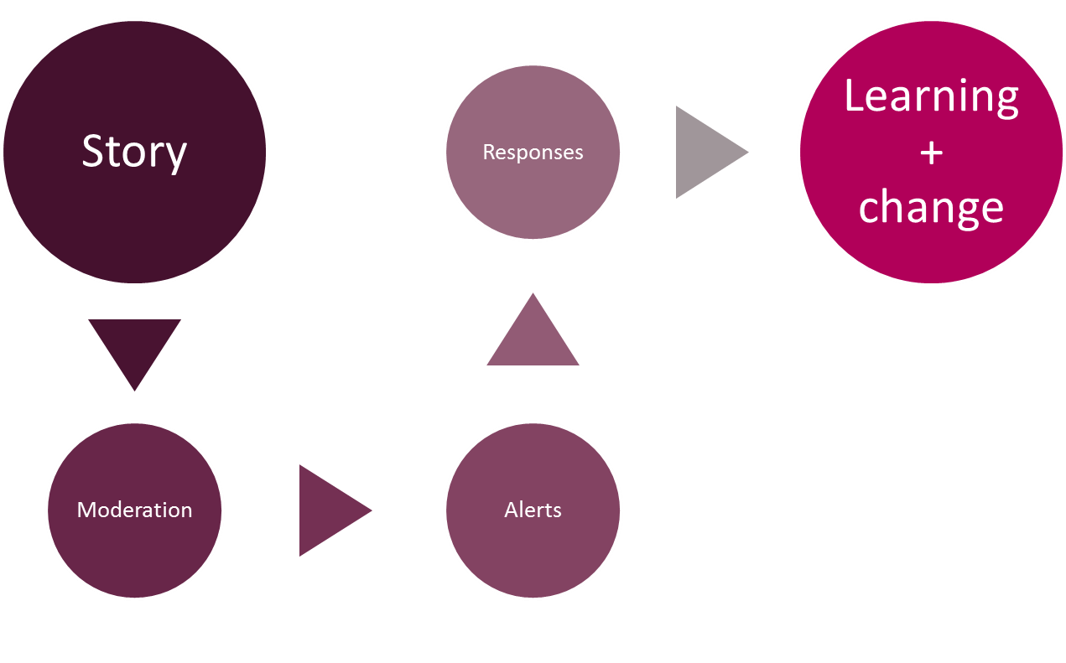
Stories – it’s about the conversation

Slide 10
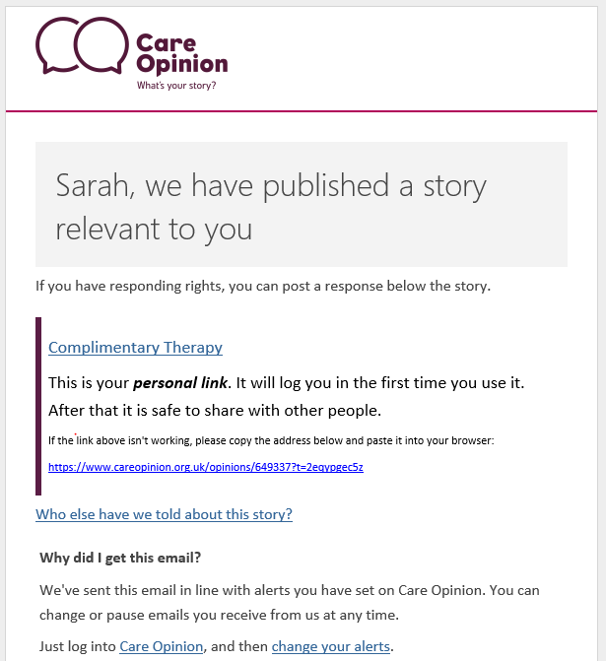
When a story that is relevant to you is published, Care Opinion sends you an email alert

Slide 11
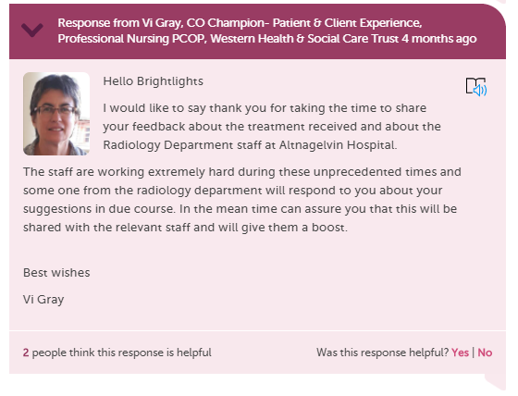
When responding as a member of staff to a story you can…
Respond more than once
Have multiple people respond
Show you are making a change
Include a profile picture
Add links and images
Invite the author to reply to you

Slide 12
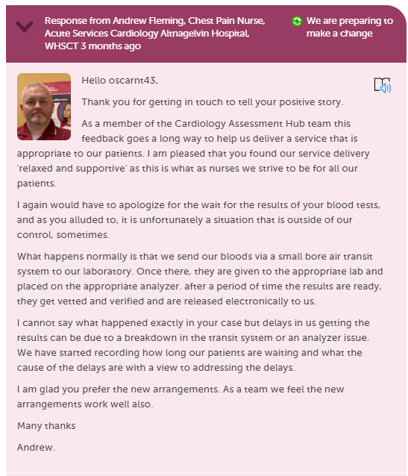
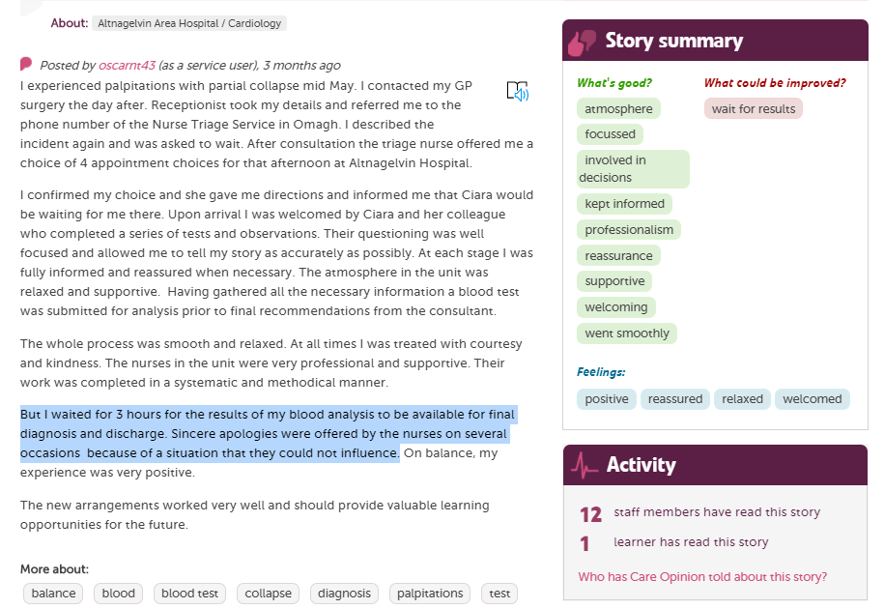
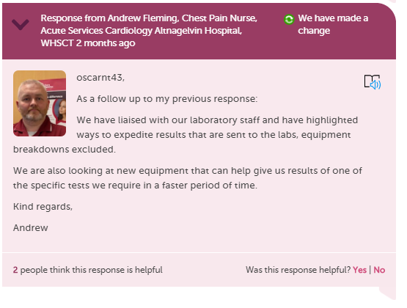

Slide 13
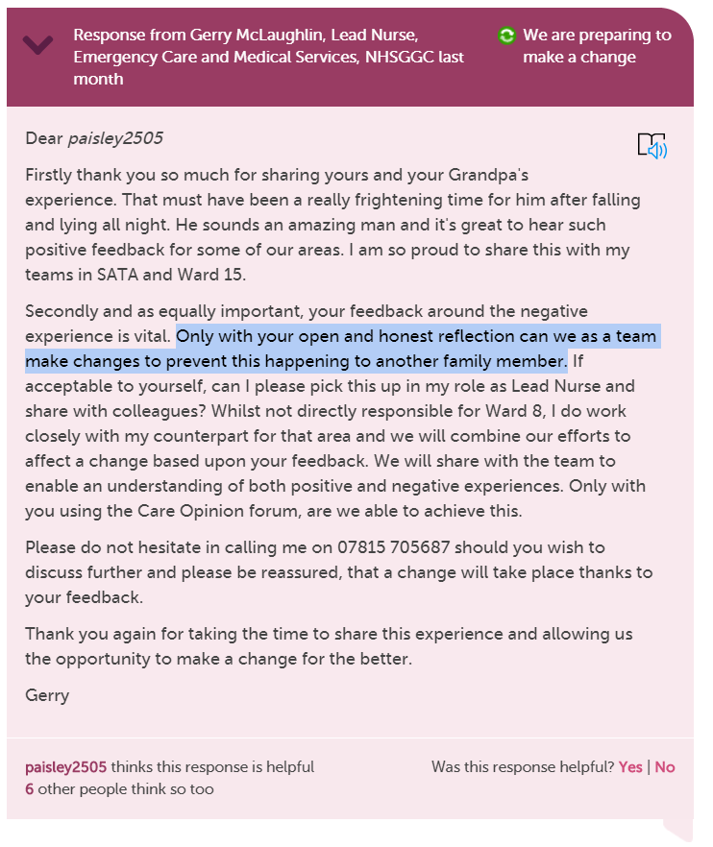
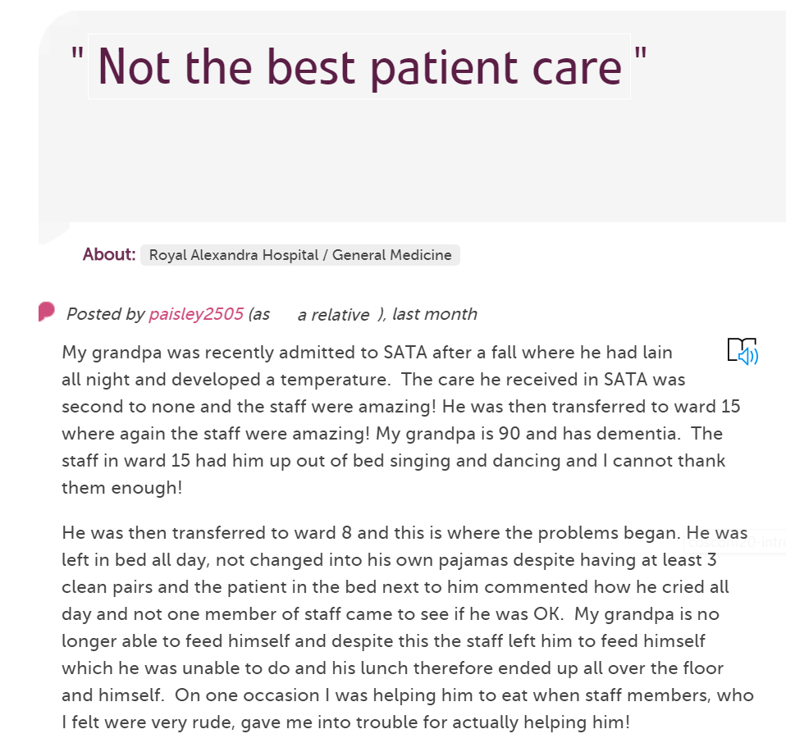

Slide 14
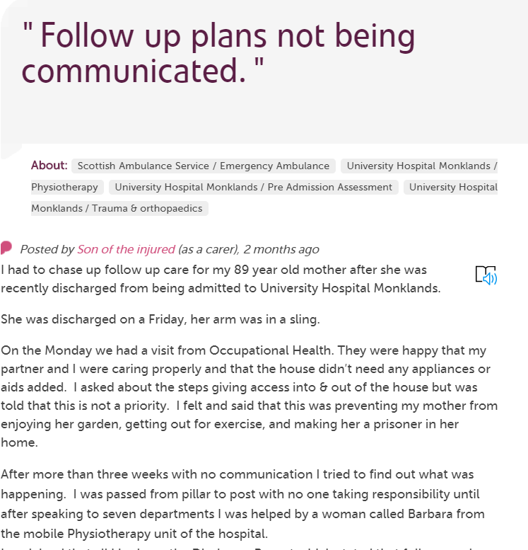
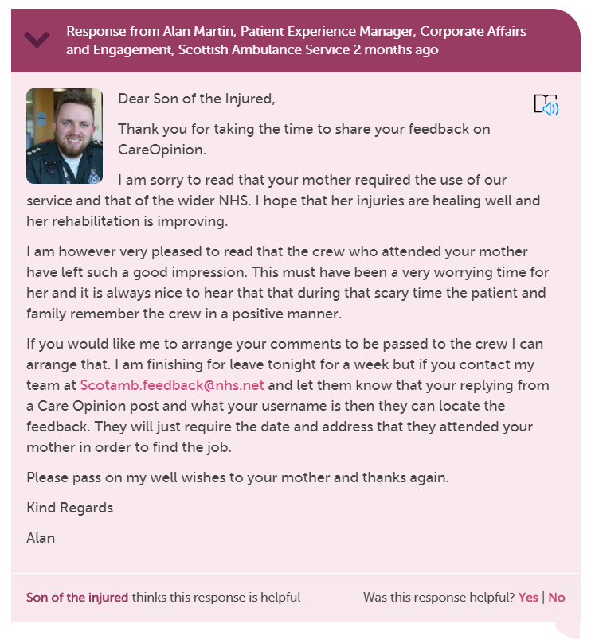
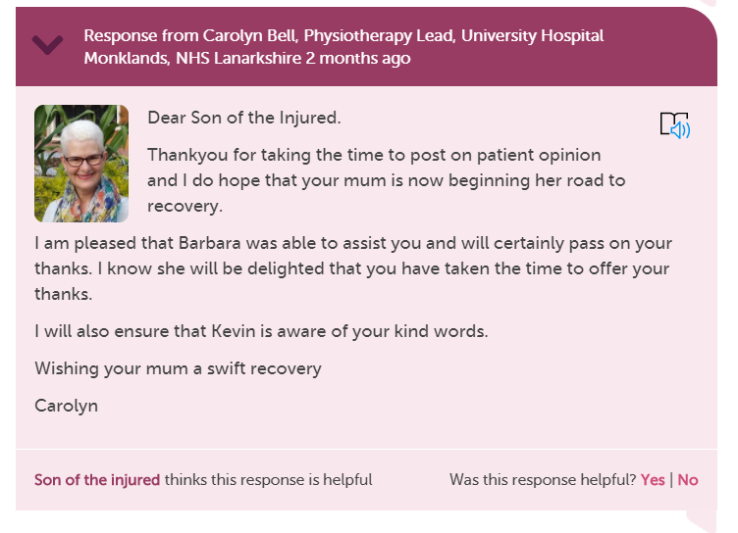
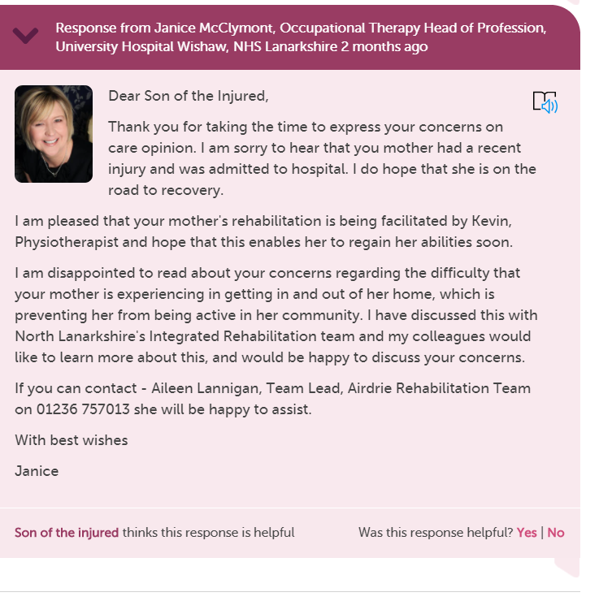

Slide 15
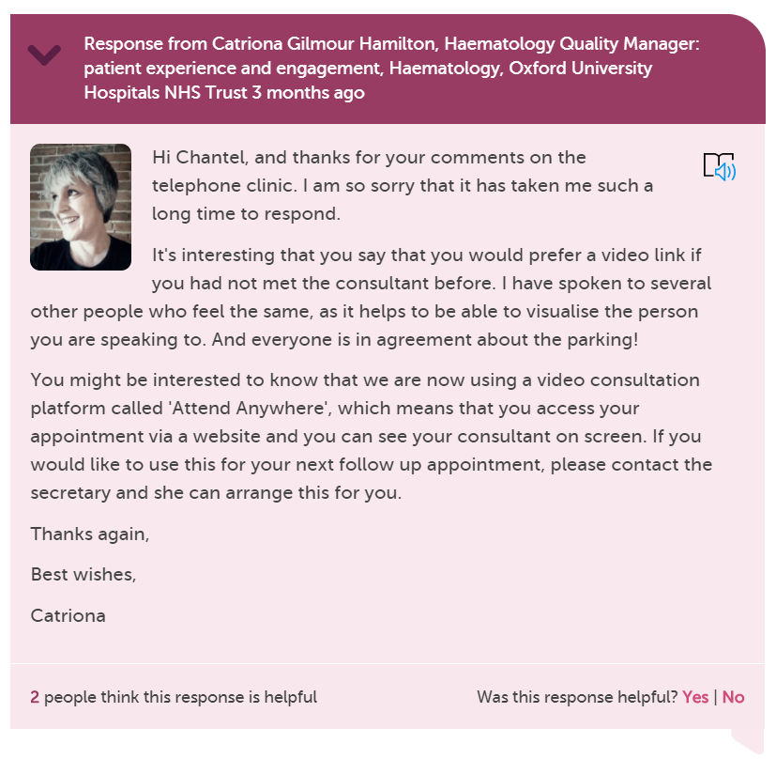

Slide 16
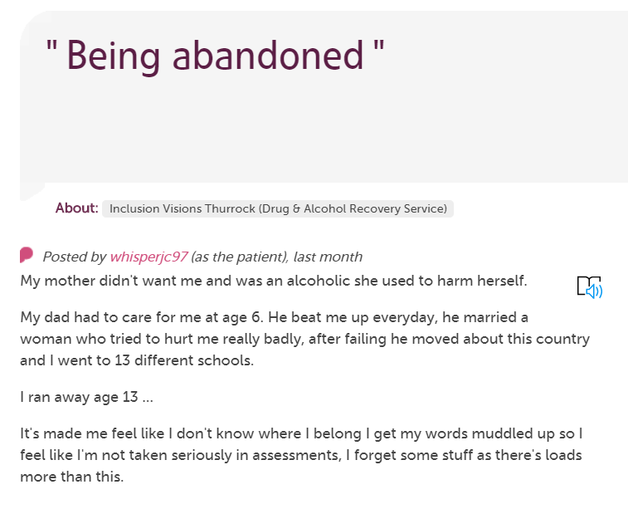
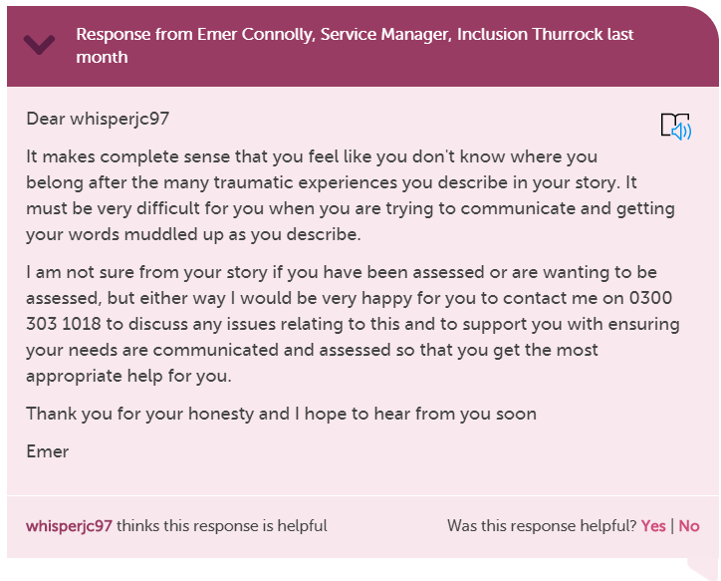
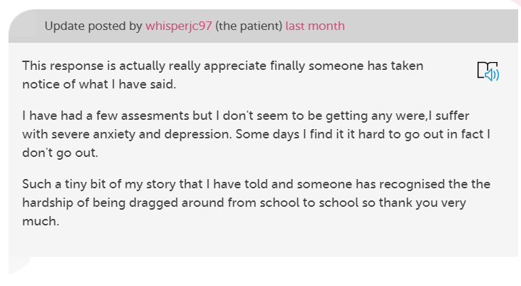

Slide 17
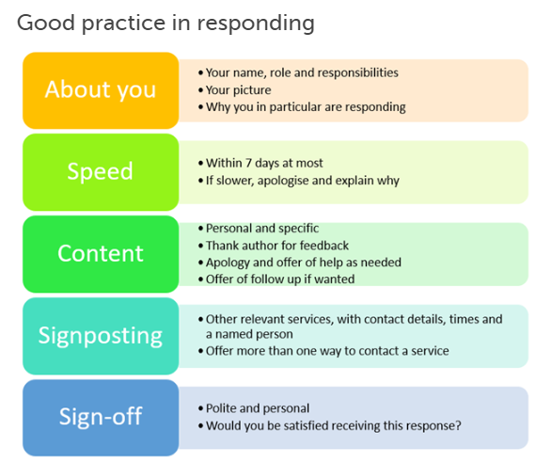
https://www.careopinion.org.uk/blogposts/813/how-do-i-respond-well-to-stories

Slide 18
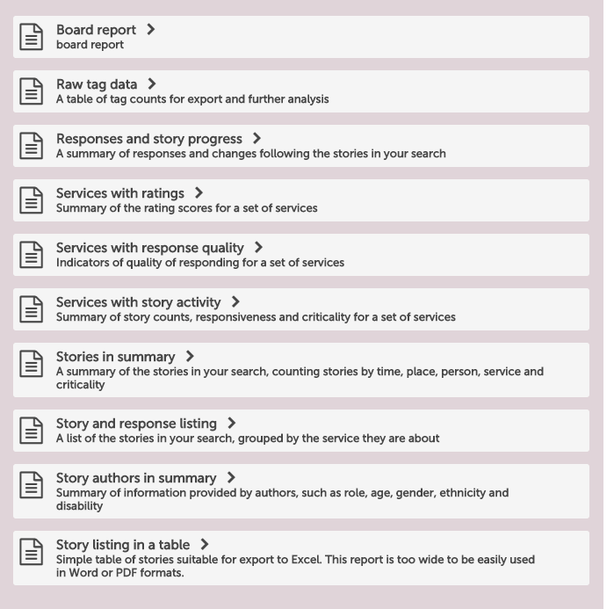
Care Opinion reports

Slide 19
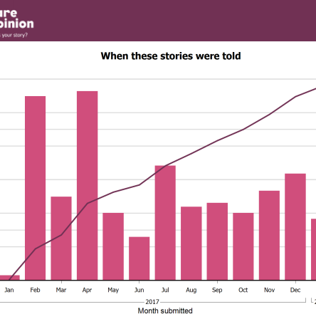
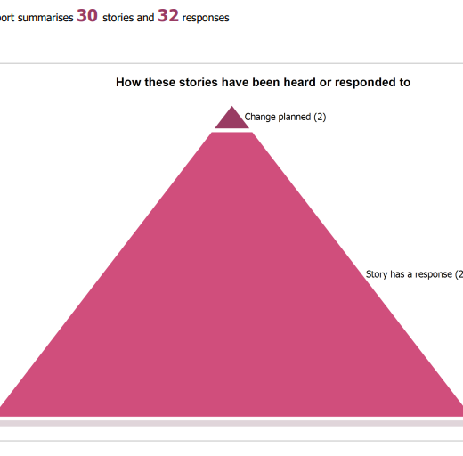
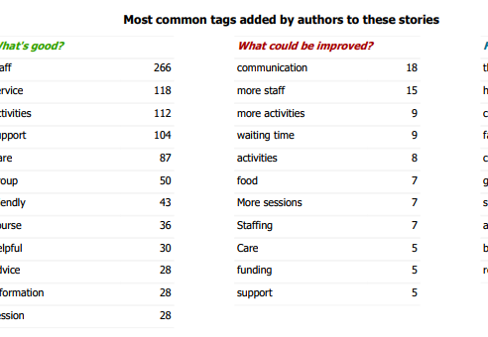
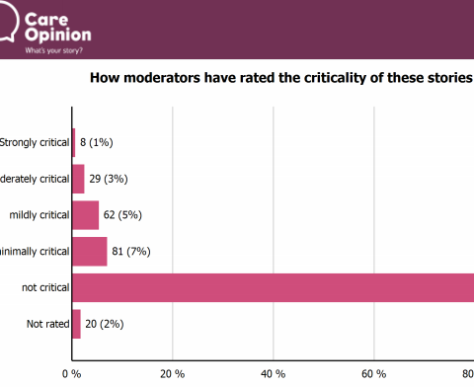
Beyond responding, to individual stories, you can create reports on stories and replies.
Using online feedback in QI projects, workshops and staff training means authors only share their story once but it can have a huge reach and impact.
Don’t forget to tell them.
Notes:
Screenshot from stories in summary report

Slide 20
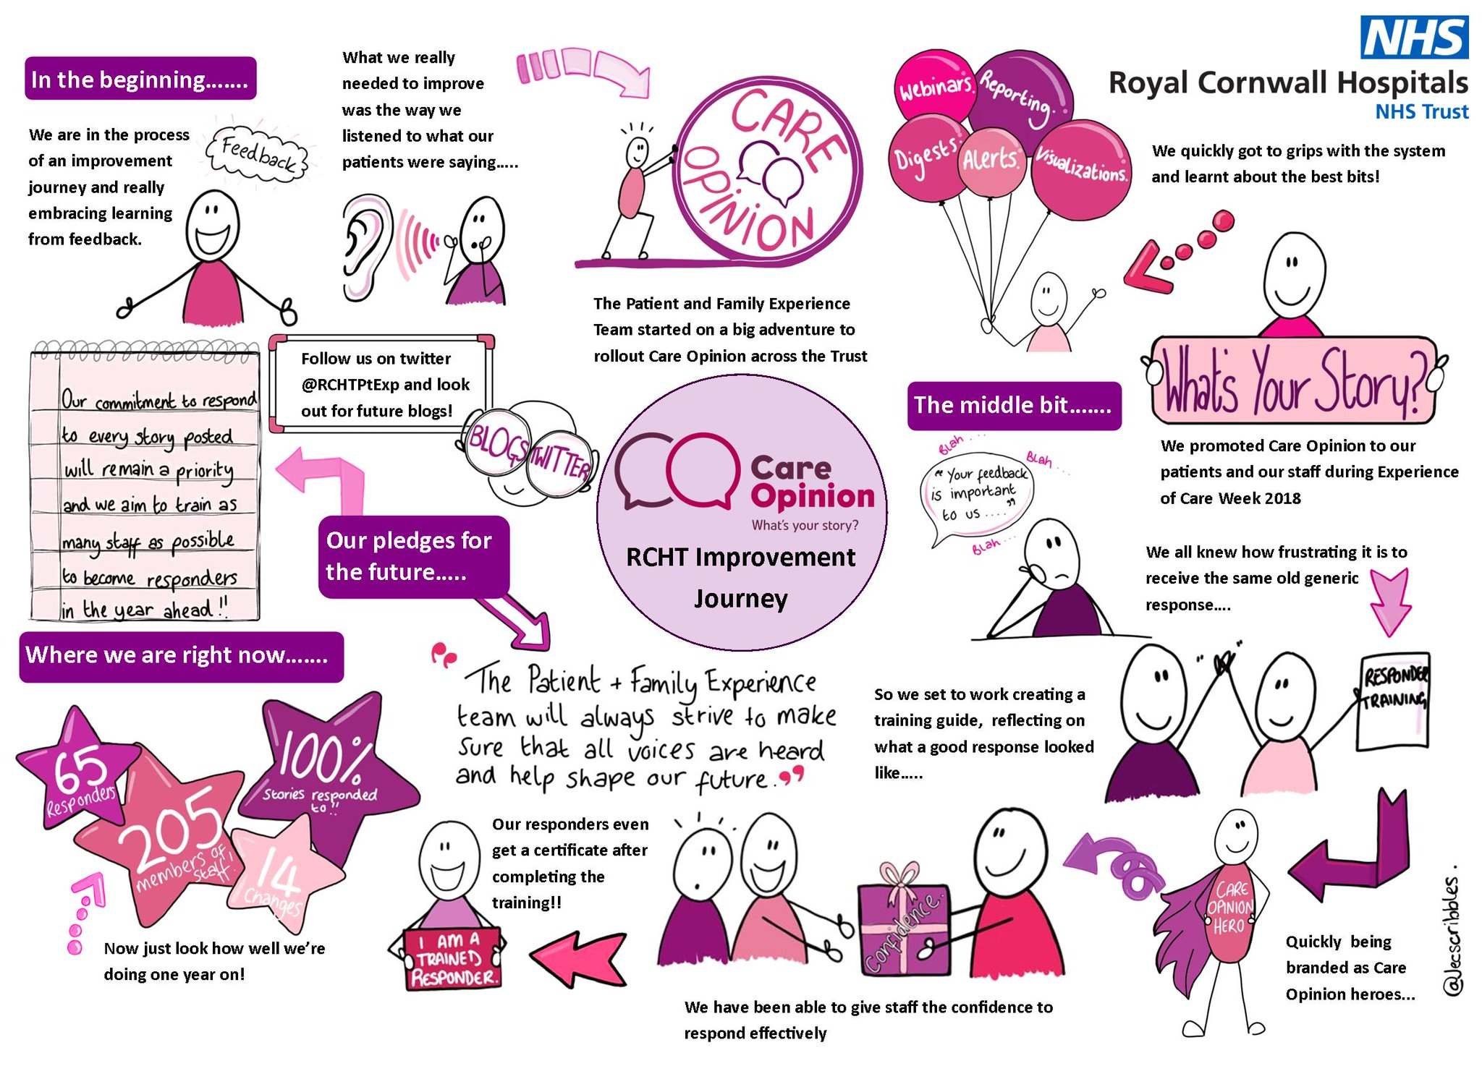

Slide 21
Anonymity makes feedback a less scary and risky thing to do. I can’t help worrying about life’s what ifs… what if they take my services away if I speak out? If they’re horrible to me afterwards? If they see my anger as poor mental health, rather than being quite frankly fed up with your service?
Posting here takes feedback out of the helping relationship and stops it from being seen as biting the hand reaching out to us. Care Opinion is a step removed. We share with you, the providers, instead. No one takes it personally or feels misunderstood.
-A Catherine Wheel
https://www.careopinion.org.uk/blogposts/794/feedback-via-care-opinion-a-dainty-dish-to-se

Slide 22
Thank
you

