Slide 1
Using Care Opinion within the School of Health Sciences
Dr Leslie Robinson (EdD): University of Salford
PI WoMMeN project (Social Media for Breast Screening)

Slide 2
School of Health Sciences
Diagnostic Radiography
Physiotherapy
Occupational Therapy
Podiatry
Prosthetics and Orthotics
Psychology
  Psychology and Counselling
  Psychology and Criminology
  Psychology and Criminology
  Psychology of Sport
Public Health
Public Health with Placement
Sport Rehabilitation
Sports Coaching
Exercise, Nutrition and Health
Sports Science
Wide range of post-graduate taught and research programmes
e.g. Media Psychology

Slide 3

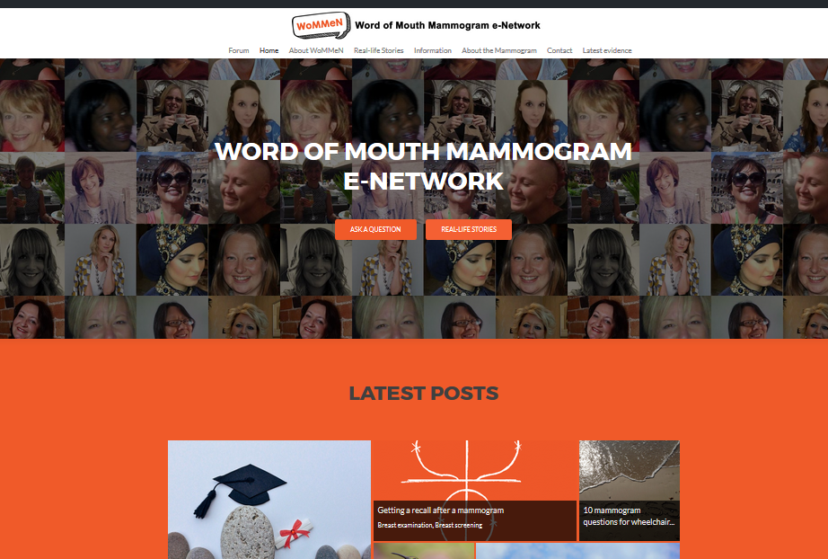
Why Care Opinion?
Jan 2017-Jul 2017
HEIF funding to embed lessons from WoMMeN project within learning activities
  Using social media to communicate with patients/clients online
    Professional/Medico-legal issues
    Employer social media communication strategies
    Technical issues: how/where
Care Opinion seemed ideal vehicle

Slide 4
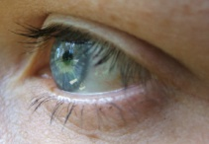
Ways of using Care Opinion
1. Social media as illustrative content: story scenarios
  Learning
  Assessment
2. Social Media as concept
  Value of patient feedback
  Communication skills in an on-line space
Exploring the ‘case’
Exploring the ‘space’

Slide 5
Plan for using Care Opinion in 2017/18
Module/learner/Profession | Level | Activities
“Introduction to Collaborative Professional Practice” Radiography; physiotherapy; OT; podiatry; P&O | 4 | Scenarios for learning Summative assessment
“Fundamentals of Patient Centred Care” Radiography | 4 | Scenarios as PBL triggers Source material for summative assignment
Into Employment Radiography; physiotherapy; OT; podiatry; P&O | 6 | Classroom Discussions Summative assessment – service re-design?
“Psychology and Health” Psychology, Psychology and Counselling and Psychology and Criminology | 6 | Classroom discussions: this group do not have access to real clinical cases (already used this)
“Fundamentals of Mammography Practice” Mammographers | 7 | Scenarios for learning
Occupational Therapy Development of communication and empathy | 7 | Scenarios for learning Application of these skills to online interaction linked to HCPC focus on mediation and truth telling skills (to be evaluated as part of a VC award project)
MSc Research Methods OT Advanced Practice, distance learners | 7 | Qualitative data analysis exercise
Nuclear Medicine | 7 | Scenarios for learning Summative reflective assessment
National project on values-based practice in Radiography | Post qual | Leslie Robinson to deliver session on Care Opinion at study day October

Slide 6
Plan for using Care Opinion in 2017/18
Module/learner/Profession | Level | Activities
“Introduction to Collaborative Professional Practice” Radiography; physiotherapy; OT; podiatry; P&O | 4 | Scenarios for learning Summative assessment
“Fundamentals of Patient Centred Care” Radiography | 4 | Scenarios as PBL triggers Source material for summative assignment
Into Employment Radiography; physiotherapy; OT; podiatry; P&O | 6 | Classroom Discussions Summative assessment – service re-design?
“Psychology and Health” Psychology, Psychology and Counselling and Psychology and Criminology | 6 | Classroom discussions: this group do not have access to real clinical cases (already used this)
“Fundamentals of Mammography Practice” Mammographers | 7 | Scenarios for learning
Occupational Therapy Development of communication and empathy | 7 | Scenarios for learning Application of these skills to online interaction linked to HCPC focus on mediation and truth telling skills (to be evaluated as part of a VC award project)
MSc Research Methods OT Advanced Practice, distance learners | 7 | Qualitative data analysis exercise
Nuclear Medicine | 7 | Scenarios for learning Summative reflective assessment
National project on values based practice in Radiography | Post qual | Leslie Robinson to deliver session on Care Opinion at study day October

Slide 7
Example level 4:
Introduction to Collaborative Professional Practice
Knowledge and Understanding
Explain how Professional Body/HCPC Standards and Codes of Conduct, influence professional practice in the Health and Social Care context.
Identify how communication, ethics, beliefs and health psychology impact on professional practice.
Describe the factors which contribute to inequalities in Health Care
Transferable/Key Skills and other Attributes
Communication - written communication
Information technology - use of databases and web based material to research topic area of interest for assignment and referencing in assignment
Managing own learning - self management in the planning and completion of the assignment

Slide 8
Example level 4:
Introduction to Collaborative Professional Practice
Classroom discussion
Exploring the ‘case’
Divide into 5 groups
Take one story for each group
  “unprofessional"
  https://www.careopinion.org.uk/opinions/314838
  "I am still in pain“
  https://www.careopinion.org.uk/opinions/248130
  …and 3 more
What are your thoughts?
How does the patient feel and why?
Was there a response?
Was it helpful?
Was change made?
Would you have done something different ?

Slide 9
Example level 4:
Introduction to Collaborative Professional Practice
Summative Assessment
Exploring the ‘case’
Using CO identify story of good quality healthcare provision
  ‘Communication’ or ‘Team working’.
  Download a copy of story as appendix
Introduction (approximately 200 words)
  Overview of your chosen story, summarise the story, including responses if these have been posted.
  You should then identify two key points that are raised in the ‘story’.
Main body (approximately 1100 words)
  Discuss the two points raised using academic evidence
Conclusion (approximately 200 words)
  Summarise discussion/themes together in a conclusion by drawing together all the main points raised. Do not introduce new ideas or themes in your conclusion
Reference list
For this 1500 word assignment it is recommended you read, and reference, a minimum 10 sources

Slide 10
Example level 7:
Fundamentals of Mammography Practice (relevant LOs)
Knowledge and Understanding
Critically analyse and evaluate professional issues through reflection on own practice
Critically review practice within the breast service using evidence based research, demonstrating a contribution to the enhancement of service delivery
Transferable Skills
Application of inter-personal skills to enhance communication skills with patients, carers and other agencies
Develop team working and leadership skills, and improve patient/health care

Slide 11
Example Discussion Session Level 7: Fundamentals of Mammography Practice
Week 1 (mid Sept): Introduction of Care Opinion and concepts
Independent study: students find one positive and one negative story associated with either communication, team working or compassionate care within a mammography department/breast screening service
Week 2 (beginning Oct): Feedback to the student cohort in week two session as a delivered 5 minute presentation.
Exploring the ‘case’
Exploring the ‘space’

Slide 12

Evaluation of CO activities
Questions as part of Module Evaluation
Focus groups
Semi-structured
  Outcomes
    Related to claims made by CO for learning
    Module learning outcomes
  Process
    Impact on learning experience
Any others CO would like to add?
Would CO other HEIs like to be involved in interviews and/or analysis
Ethics approval for publication

Slide 13



Issues
Staff reluctance
  change at a difficult/busy time
  concern regarding Social Media
  anxiety regarding IT in classroom
Cost of evaluation
  incentives for participants
  transcriptions
What happens next year?

