Slide 1
Updating your service tree

Slide 2
Welcome!
We will be recording the session. It’s ok to turn your video off
Please mute yourself. Background noise make the session hard to follow
Microsoft has accessibility features you can use, so we will be mostly presenting in Teams. But we may demo the website, send us a private message if that is a problem
We will share all slides, links and recordings after the session
Ask us questions! Pop them in the chat or speak to us at the end. We love hearing from you

Slide 3
Before we start…
Welcome!
Recording
Camera & Mic
Live Captions
PowerPoint Live
Questions
Post session email
Notes:
cally

Slide 4
What are we going to cover?
What is a service tree
Navigating your service tree
Where to find the spreadsheet to request changes
How to fill this in
Treatment functions
What happens next

Slide 5
Service Trees
A service tree is a group of services you provide
The relationship is linear, and one service can only be in one place - like a family tree (hence the name)
Service trees are public, and it helps site users “hang” their story on the right part of the health service
Organisation
Location/area
Ideally, most stories should be linked to service level
Services

Slide 7
Navigating up and down the tree,
Finding the service link and NACS code
Live Site…​

Slide 8
Creating a service tree (rare)
service should only be included if it is something accessed by the public.
A service should only be included if it is the point of care
Any service must have one single parent (no more and no less).
It is easy to create a service tree which is so complex that nobody (you, us and patients) can understand it. A good service tree finds a balance between being too simple and too complex
Likewise, a service name should make sense to both patients and staff, avoiding unfamiliar acronyms.
If you are a new organisation working with us and you have not been on the Care Opinion service tree before, we will work with you direct on your service tree. This might mean breaking things down into multiple uploads to priorities top level services/locations or early adopters
Don’t let reporting needs dictate the service tree

Slide 9
Changing a service tree
There may be mistakes to be corrected
New services may open
Old services may close
A service may change its name or location
A service may move from one location or grouping to another
A service may not have been added to you service tree yet but is ready to collect feedback

Slide 10
Requesting changes to your service tree
Help pages found in
Use the spreadsheet service-tree-change-request-template-apr24.xlsx
Send through monthly if possible
We will action and send the spreadsheet back with confirmation (green), questions (yellow) errors/not added (red)
We try and do all requests in two weeks from the date sent and work in date order

Slide 11
Adding a new service
Service name | Link of parent | Street/locality | Town/city | Postcode | Treatment functions | Comments
 |  |  |  |  | Add Treatment fuction code here. Eg put "180" for emergency medicine
To ask yourself:
Is it already on the tree somewhere else?
What is the name patients know it as?
What group/service location provides that service
What type of care does it provide?
Use the “add” sheet on the spreadsheet. You will need to know:
The nacs code of the parent/link to the parent
The Treatment fuction(s) of the service

Slide 12
Treatment function?
We have a help page about this - And the full list online and on the spreadsheet.
Treatment functions help to describe what services provide – some services have names which do not make it immediately obvious what the service provides. Services can have more than one treatment function or none at all.
Treatment functions help the site suggest services to authors and moderators, they help with reporting and alerts.

Slide 13
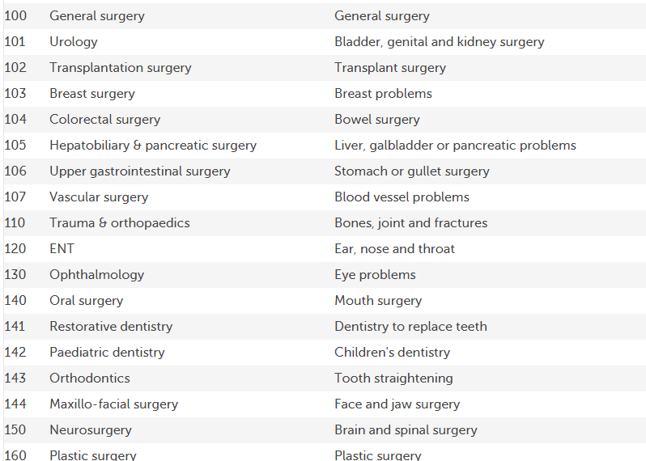
Treatment function cont.
Each Treatment function has a code, clinical name and common name.
You need the code to add to the spreadsheet for creating new services or updating services that provide care
Treatment functions should be at service level, not location or group. Eg The treatment function Emergency Medicine should be given to the Emergency department, not the hospital.

Slide 14
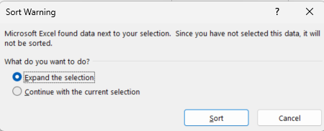
Treatment function cont.
Tip for searching the online list; use ctrl + F to search the whole page
Tip for searching the spreadsheet list; highlight the “name” column and use ctrl + F or find to search the whole list
Or highlight the name column, go to , sort A – Z, and remember to expand the selection to keep the right numbers next to the right names

Slide 15
Moving a service
To ask yourself:
HOW is the service moving
Location – Is it physically moving or just changing places on Care Opinion? If physically, see “update” tab.
Does the existing service have stories attached to it?
Is it ok that they move too? If not, you may want to close the service and open a new one. E.g the urgent care Centre is ran out of hospital A then changed to Hospital B
Do you need to update staff alerts and reports?

Slide 16
Moving a service cont.
Use the “move” tab on the spread sheet. You will need:
The link/nacs to the service you need to move
The link/nacs for the new parent
Link to service to move | Link to new parent on CO | Comments

Slide 17
Updating a service
A service may change its physical location, name, or the care it provides. You need:
The link or nacs code to the service you want updating
The updated information
Link to service to be updated | Updated name | Updated location | Updated treatment functions | Comments
 |  |  | Add Treatment fuction code here Eg put "180" for emergency medicine

Slide 18
Delete/expire tabs
Delete a service only if:
There are no stories linked to it
The service has closed
The service was added incorrectly
Expire (Close) a service if
There are stories linked to this service correctly
The service has closed
You no longer run this service
You have an end date
Optional: you have a subsequent service we can point people to

Slide 19
Then email to your support lead

Slide 20
When the spreadsheet is returned
Check any questions or warnings added by CO staff – there may be follow up actions needed
Consider if you need to edit staff alerts and reports and update
Pat yourself on the back 😎

Slide 21
Resources to Help you...
The service tree | Care Opinion​
Setting up or making changes to your service tree | Care Opinion​
Request changes to a service tree | Care Opinion​
Understanding treatment functions | Care Opinion​

Slide 22
Questions?

