Slide 1


Mental Health Inclusion
Making use of online feedback to reduce stigma and discrimination in health and social care
Tom Scott, See Me

Slide 2



Slide 3

Stories of change
Lived and professional experience
Education, improvement, and stories
Complexity of people and system
3 minutes, 30 minutes, 3 hours
Adaptable, flexible, and modular

Slide 4



Slide 5

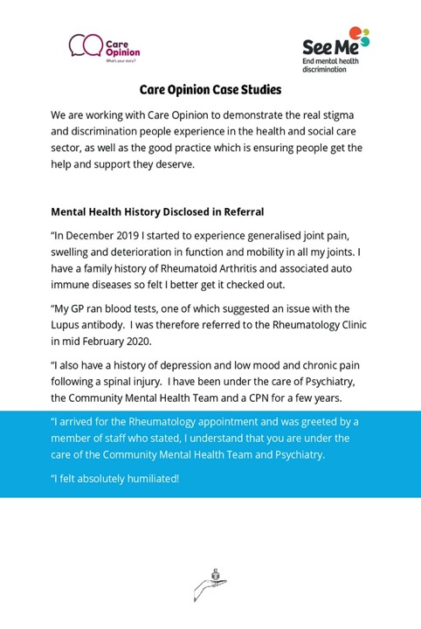
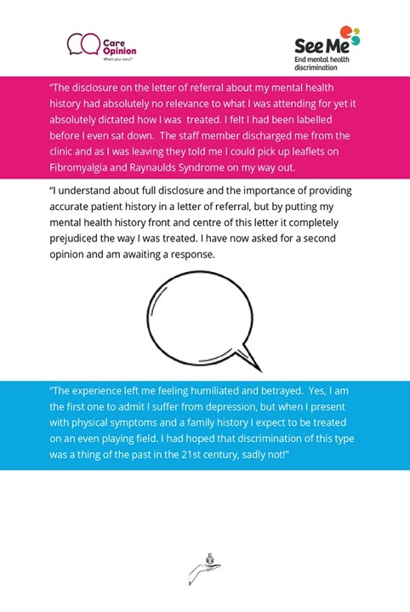

Slide 6
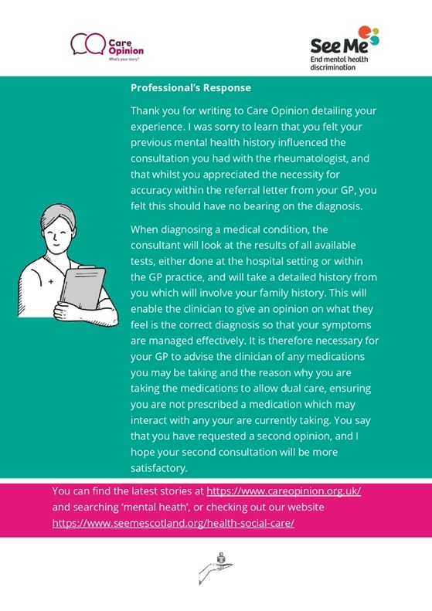

Slide 7

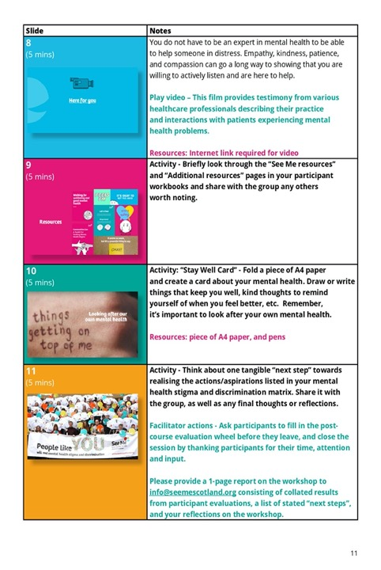

Slide 8

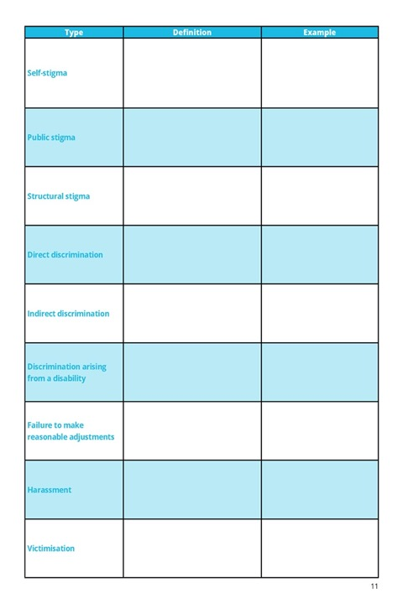
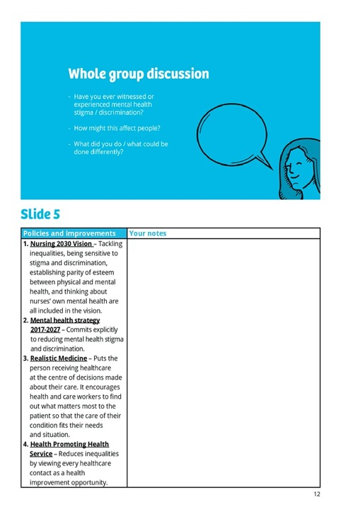
Toolman Tom

Slide 9

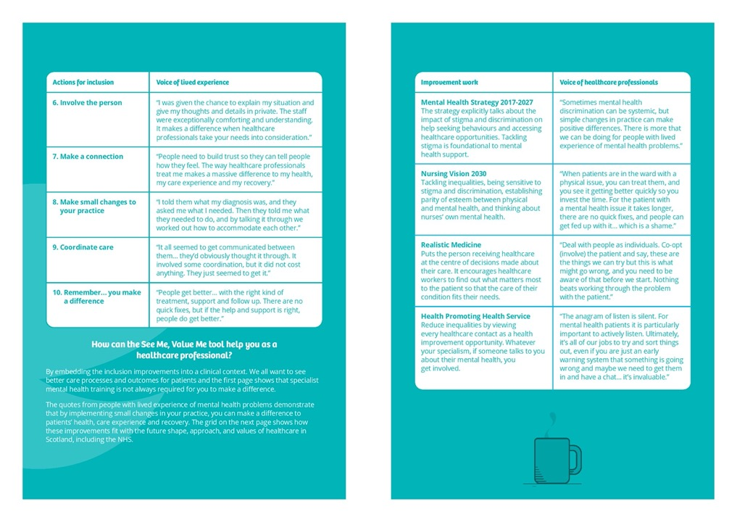

Slide 10
Help us promote mental health inclusion in the health and social care system in Scotland
Looking to get in touch?
tom.scott@seemescotland.org

