Slide 1

Notes:
We were founded in 1911 by Douglas Macmillan. We have over 100 years of experience of helping people living with and beyond cancer.
In 1911 Douglas Macmillan started the Society for the Prevention and Relief of Cancer after the death of his father from oesophageal cancer. Cancer at the time was something people never talked about, and to have cancer was seen as something shameful. Douglas wanted advice and information for all people with cancer, to provide support and compassion, and to overcome the many taboos around cancer.
Times and attitudes have changed, as has the understanding and experience of cancer. But we’ve continually adapted the support we offer to ensure it’s right for people today, and will be right in the future too. And our determination to continually improve the experience of cancer is something that will never waver.
Video on our heritage can be found on The Library, Resource ID: 30213

Slide 2
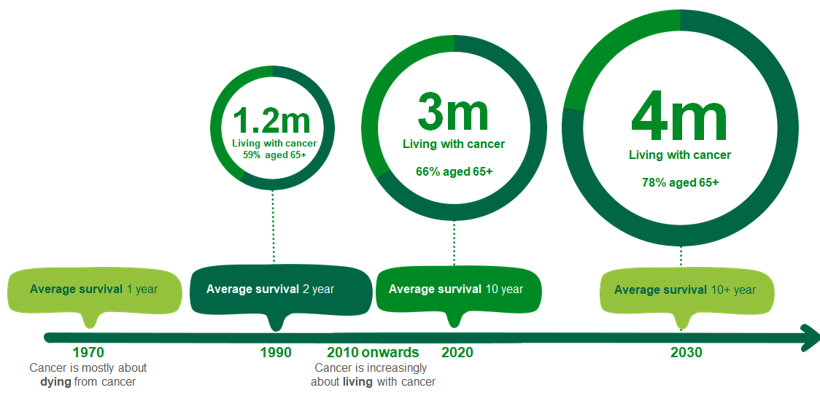
The changing story of cancer
Notes:
The number of people being diagnosed with cancer is rising and more people are surviving cancer than ever before. This means the nature of cancer care itself needs to adapt and evolve to meet the rapidly changing needs of people living with cancer. But current cancer care provision is approaching a crisis point. Existing support services are struggling to cope, yet the number of people living with cancer continues to grow.
•Today, around 3m people are living with cancer in the UK, and by 2030 this figure will rise to 4m. (Source: Macmillan Annual Report and Accounts 2019)
•Half of us will get cancer at some point in our lives.
•What we do has never been more important or urgent.
Cancer can affect anyone. Receiving a cancer diagnosis can turn life upside down in a single moment. We’re here to help everyone with cancer live life as fully as they can, providing physical, financial and emotional support. So whatever cancer throws their way, we’re right there with them.
People are now living longer with a cancer diagnosis. Through better treatment we have added years to life but now we need to add life to years.

Slide 3
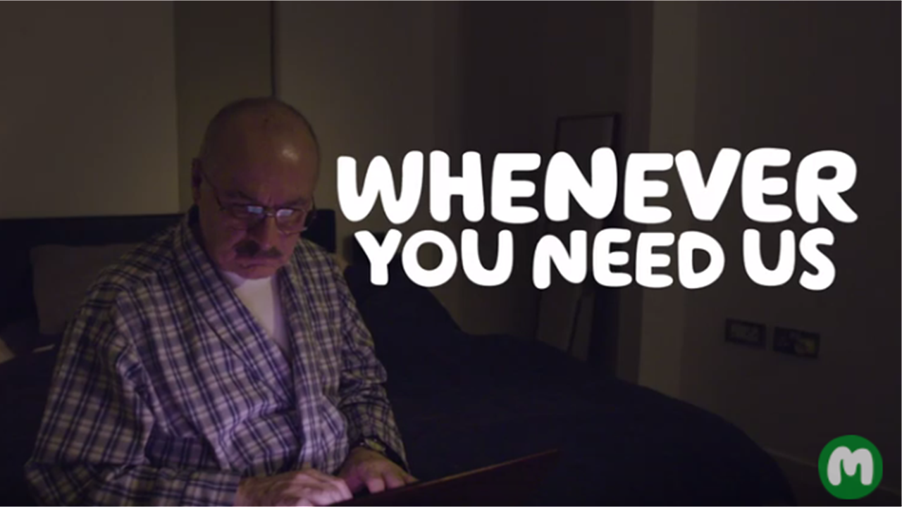
Notes:
Description of services and support from Macmillan:
Macmillan Professionals – Nurses, Welfare Rights, Cancer Information & Support
Support Line
Online Community
Macmillan Telephone Buddies
Practical & Emotional Support (pre-covid)
Website and information

Slide 4

Gathering, listening to and amplifying voice
Notes:
My role in Scotland is to ensure that the voices of people affected by cancer are at the heart of everything that we do.
We gather, listen to and amplify the voices of people affected by cancer. Our entire engagement and involvement strategy in Macmillan in Scotland is based around ‘what matters to you?’. By finding out, listening and acting on what is the most important to the people we care for is the only way we can provide truly person-centred care.
This is why our partnership work with care opinion is so important to us.

Slide 5





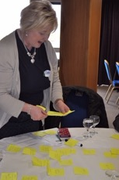


Gathering the voice
Notes:
Pre-covid – conversation cafes, face to face events, training, 1-1 interviews, cancer voices annual conference. Focussed around building relationships with people by being in the room with them.
When it became clear that covid was going to be with us for the longer term, we reviewed our approach, to ensure that we could continue with our work in the digital space.
Digital storytelling – moved to a virtual delivery model as a result of Covid-19
Surveys
Cancer Voices Networks – webinars and virtual discussion groups and semi structured interviews
Community Organisations Men’s Sheds Association of Scotland
Disability Equality Scotland
The Alliance
Care Opinion – I’ll go into more detail about this later

Slide 6

Putting people at the heart
Notes:
So what? What do we do with what we hear?
We listen and try to understand, and think about how what we hear can be used to influence services and policy.
Involvement in service development
Example of ICJ and the role of user involvement groups
Transforming Cancer Care – Macmillan’s £9m partnership with the Scottish Government to provide a holistic needs assessment or ‘what matters to you conversation’ and named link worker to everyone diagnosed with cancer in Scotland by 2022.
We have built an infrastructure to support meaningful engagement at all levels which feeds into the TCC programme

Slide 7


Amplifying voice
Notes:
We gather, listen to and amplify the voices of people affected by cancer. Our entire engagement and involvement strategy in Macmillan in Scotland is based around ‘what matters to you?’. By finding out, listening and acting on what is the most important to the people we care for is the only way we can provide truly person-centred care.
Cancer Conversations with Jason Leitch – we were able to facilitate a conversation with members of our cancer voices networks, e-campaigners and volunteers who deliver our telephone buddies service and Jason Leitch, there were 35 participants all of whom are affected by cancer in some way. They were able to put their questions directly to Jason and engage with a senior civil servant on the issues that are important to them
Internally within Macmillan – recognising that we needed to reconnect with our cancer voices we hosted a webinar which saw over 150 people affected by cancer join us to restart our conversations. Following on from this we are in the process of setting up cancer conversations with senior leaders across the organisation such as our CEO and Chief Medical Officer
Scottish Government through working with our public affairs and policy colleagues
TCC & ICJ – as I’ve already described

Slide 8


A very special partnership
Notes:
A very special partnership
We have been registered with Care Opinion since October 2017. Some SLT members are set up to receive notifications of new feedback which mentions ‘cancer’ or ‘Macmillan’. We do not take any action at present on any feedback posted.
Proposed next steps
Identify an NHS Board who might be receptive to working with us in Macmillan to provide signposting responses to feedback stories, where appropriate.
This would need to be very carefully managed to ensure that relationships with our partners is not put at risk. I would envisage testing this approach by responding to positive feedback stories.
Level 2 activity - Raising awareness of Care Opinion
We are in the process of developing a postcard which explains why Macmillan supports Care Opinion. We plan to use this to raise awareness of Care Opinion amongst our Macmillan Professional community across Scotland. Activity around this will include:
Potential future activity
Some information about care opinion Macmillan’s website
Mention of Care Opinion in Macmillan’s complaint processes

Slide 9

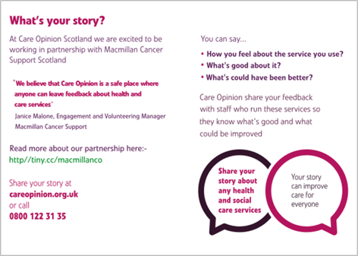
The story so far…
Notes:
We identified our first step as being a postcard that we would send to our 600+ Macmillan Professionals in Scotland, along with a joint letter from Macmillan & Care Opinion encouraging them to tell their patients about care opinion.
E-version of postcard to be posted to all Macmillan Professionals in Scotland.
Followed up by mailing copies of the postcard to all clinical professionals, asking them to encourage their patients to provide feedback via care opinion.
Plan a ‘go-live’ date to begin to talk about our partnership publicly, with associated social media activity. Publish a blog written by Janice Malone.
Promote Care Opinion at Volunteering Celebration Events.
Article about Care Opinion in our Engagement Newsletter.
Arrange a training session / webinar on Care Opinion for the Scottish Team to develop wider knowledge of Care Opinion and to support staff to encourage staff, volunteers and PLWC to utilise care opinion to provide feedback.
Our plan was to follow this up with delivering talk and presentations to groups of professionals – wherever they came together, be it at peer group meetings, conferences, visiting cancer centres.
Then…..

Slide 10

Notes:
Just as we were moving forward with our plans - Covid hit.
We gave some consideration to how we might be able to carry on our partnership with Care Opinion in the new world that we found ourselves in.

Slide 11
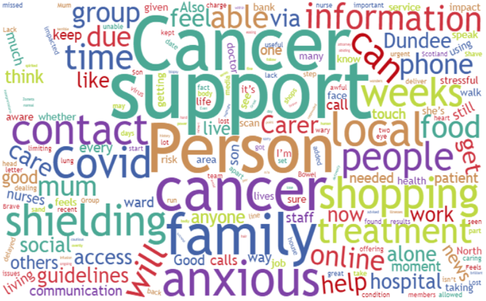
Covid-19 insight reports
Notes:
Conversations with our networks – semi structured interviews to gather experiences of people with cancer during covid
Survey
Stories from Care Opinion
Gathered, analysed and themed into reports which detail the things that matter to people with cancer

Slide 12
What we heard…
“Your team has responded superbly to all the challenges, logistical and human with such spirited determination. What a brilliant team. I do appreciate all that has been undertaken for me”.
“To have a palliative/hospice nurse have a 45min conversation over the phone with my mum discussing dying etc I think is utterly disgusting. Show her some respect, put on PPE and sit with her when these things are being discussed. During this conversation 3 members of staff entered the room so I’m sure the hospice nurse could’ve done so too.”
“As a family we are desperate to see our mum and are heartbroken that since she’s had that news, she’s had no support from her family. To listen to your mother breaking her heart over the phone to you when you’re not allowed to be there for her is something that will haunt me.”
“At this point I was really angry and upset but nothing I could do. Another week went by and nothing until today when I have received an appointment for the end of July!! I am sorry this is completely unacceptable for an urgent referral when the possibility of having cancer is suspected?!! Is that right??”

Slide 13
The difference…
People with Cancer
Transforming Cancer Care
Macmillan internal stakeholders
Insight
INSIGHT
Health & Social Care Alliance
Scottish
Government
NHS
Notes:
Sharing of reports internally shone a light on the impact of our engagement work with the most senior leaders in the organisation.
Dovetailed our real life experiences and stories with the hard data of our evidence and impact teams providing a rounded picture of the impact of covid-19 on cancer patients
In Scotland, we used the report to inform the Transforming Cancer Care Executive Group, senior civil servants and policy makers on the impact
Used the reports to hep shape our campaigning and policy calls around the restart of cancer services
Connected with more people with cancer through blogs and social media

Slide 14

The future…
Notes:
Discussions within Macmillan to embed the stories from Care Opinion into our practice – right across the UK. Plan to be able to begin this work in January 2021.
When restrictions lift, open up conversations with Macmillan Professionals to carry on encouraging them to tell their patients about Care Opinion.
Consider if we might be able to have feedback directly from people about Macmillan’s directly delivered services (support line, financial support etc).

