Slide 1
People helping health/care get better #coEducate
James Munro, CEO
@jamesfm55

Slide 2
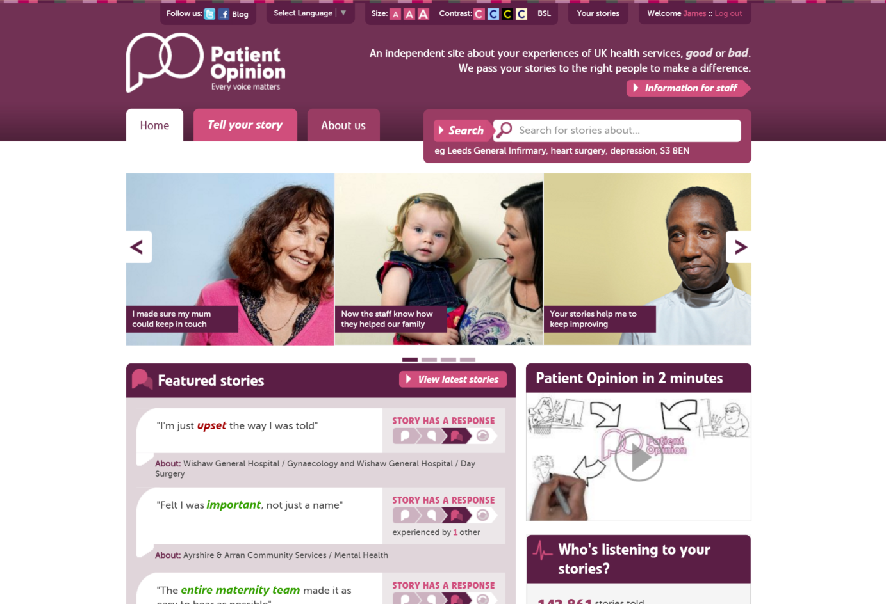

Slide 3
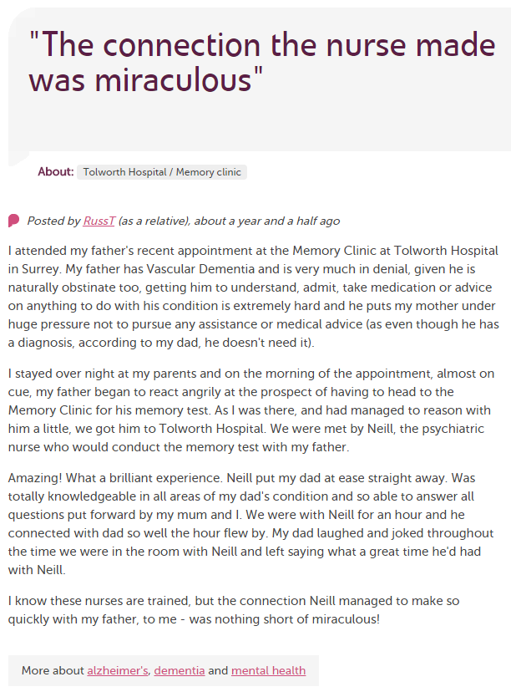
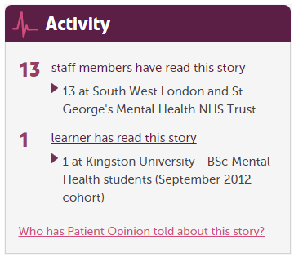
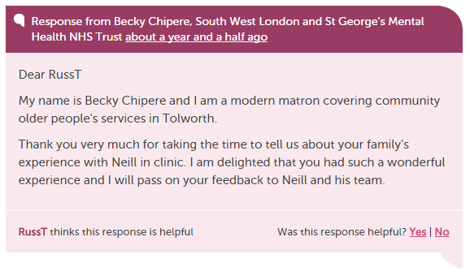

Slide 4
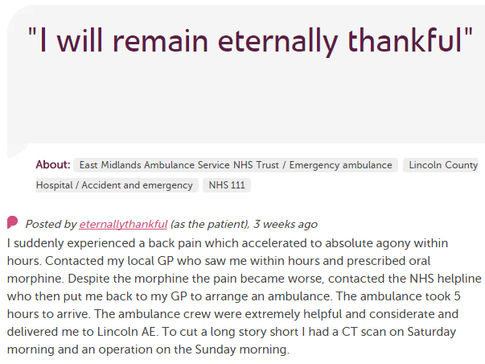
In each provider
Moderation
Clinical staff
Porters, reception, catering…
Pt exp, comms, complaints…
Alerting
CEO
Commissioners
Nursing, AHP students
Healthwatch
Researchers
Patient groups
CQC
Local authority

Slide 5
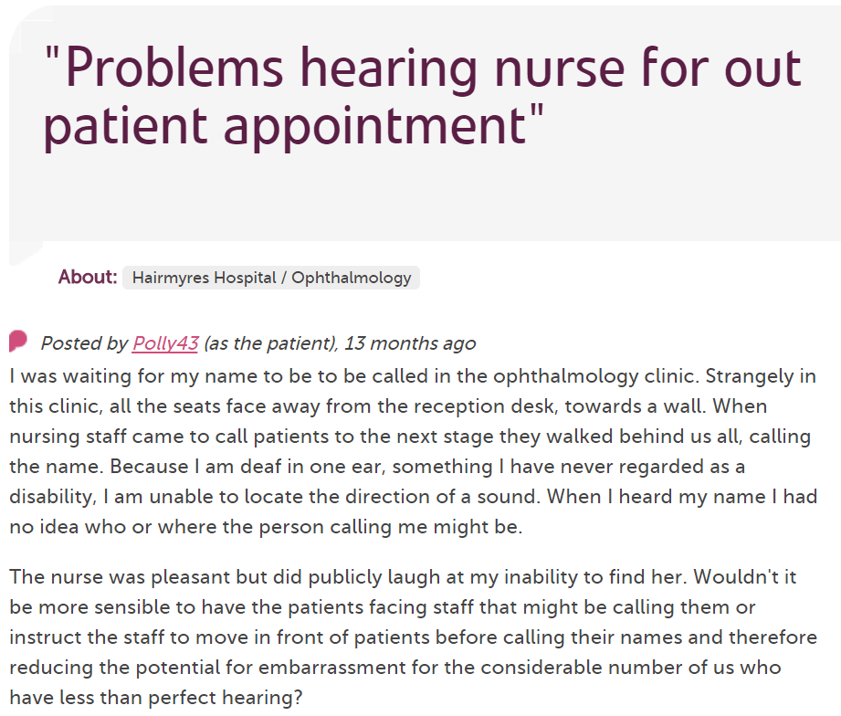
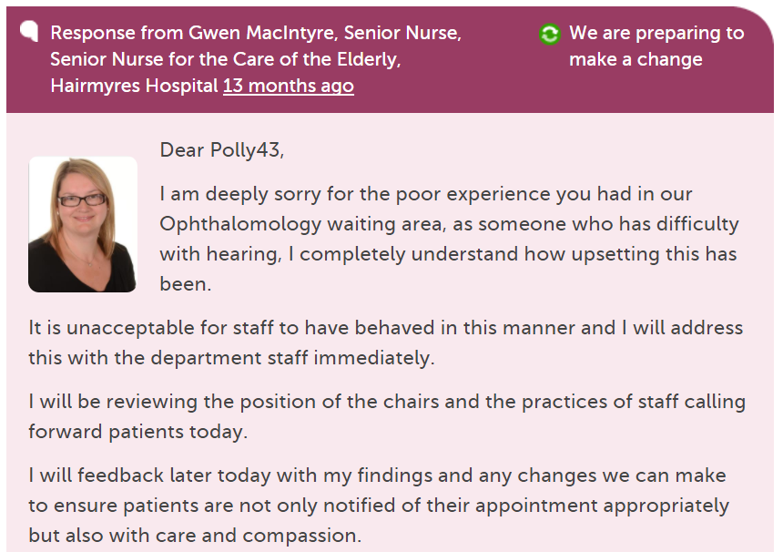
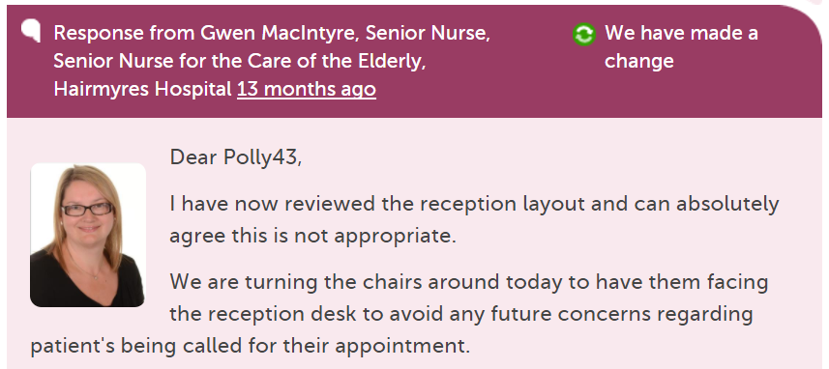

Slide 6
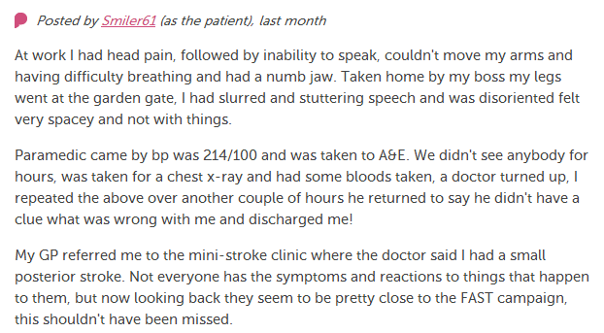
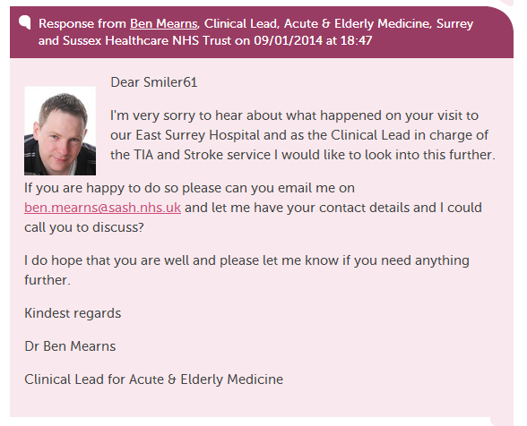
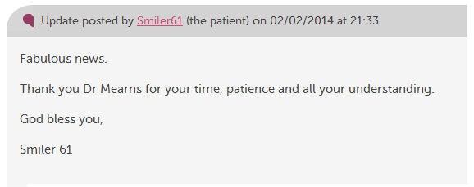

Slide 7
190,000
stories
7,000
staff + students listening
stories read
89 million
times
100,000
visitors per week

Slide 8
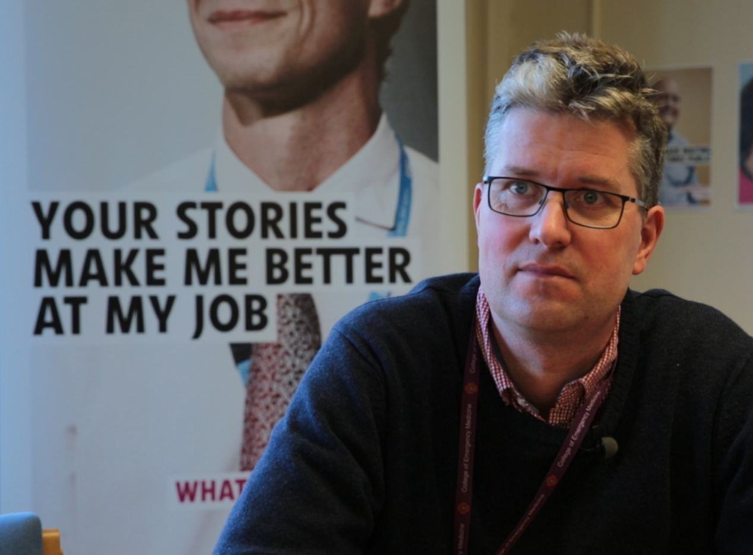
“At times it also helps to actually reduce complaints. We can get in touch with a user straight away and we can avoid a lengthy complaint response.”
Dr Arne Rose, consultant in emergency medicine

Slide 9
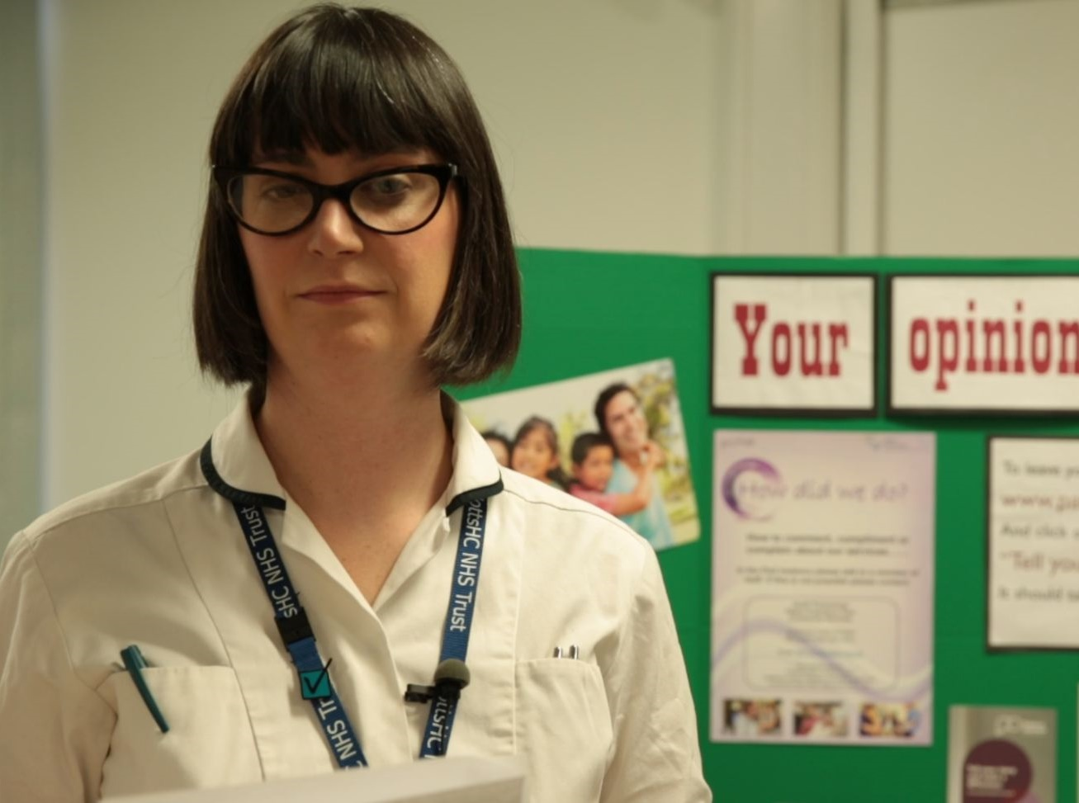
“More than just listening, it has helped us to focus on what we can change to improve our service.
We’ve learnt that Patient Opinion gives patients a powerful voice, which in turn has empowered us.”
Lisa Metcalf podiatrist

Slide 11
Why does this matter to professional education?
Healthcare is changing
Professionals are changing
Patients are changing

Slide 12
The world is changing – fast
Old world | New world
Hierarchy | Network
Broadcast | Conversation
Hiding | Sharing
Few | Many
Closed | Open
Passive recipients | Active participants

Slide 13
Vision
We want people to be able to share their experiences of health and care in ways which are safe, simple, and lead to learning and change.

Slide 14
Michelle Cullen, Salford Uni
I have always avoided social media. I don't use Facebook, I don't tweet. I could only see the trouble social media caused...
Until Leslie introduced me to the Care Opinion website. I think it is brilliant. By using this site in our teaching, we can show students how to use social media in a positive, proactive way, to engage with our patients.
I can honestly say that your website has helped us breathe new life into our teaching.

Slide 15
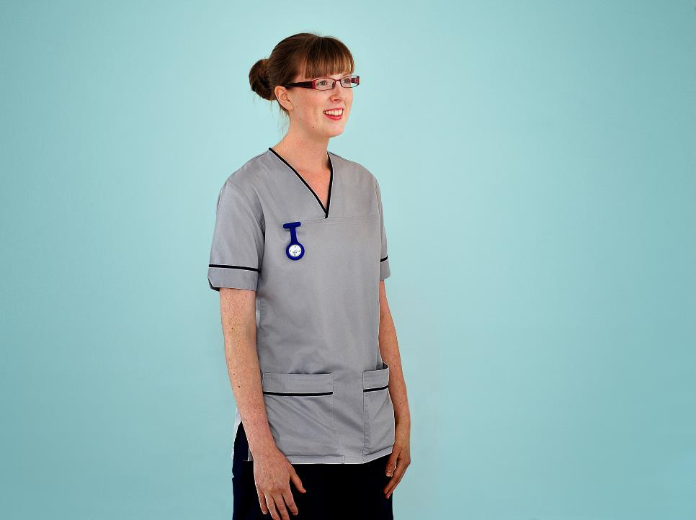
“We’re often told the NHS must be patient-centred.
Care Opinion helps us understand what that means in practice.”
Fiona Tevendale
Student nurse
Edinburgh

Slide 16
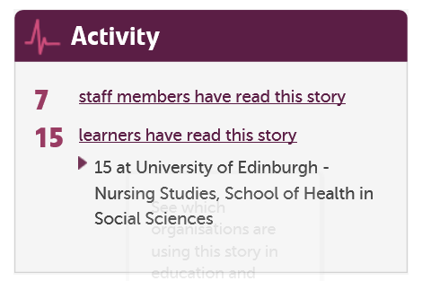

Slide 17
New for learners
Visualisations
Tag bubbles, story swarms, word clouds…
Weekly digests
New search options
Talking Mats integration
Member tagging
Stories I’ve read

Slide 18
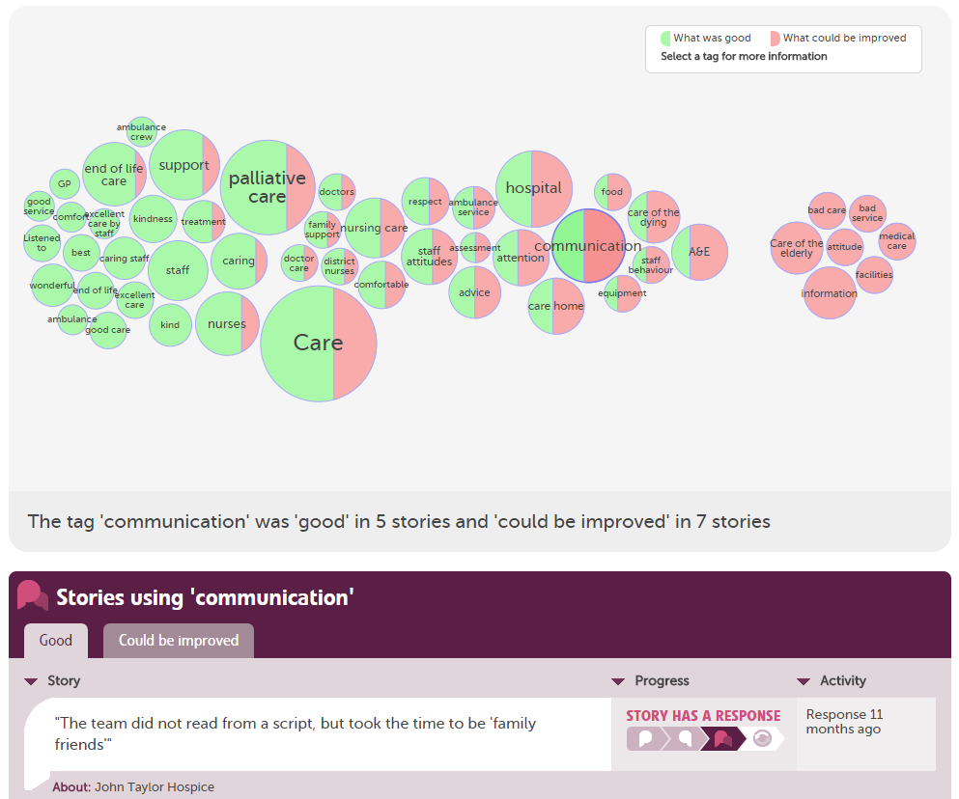

Slide 19
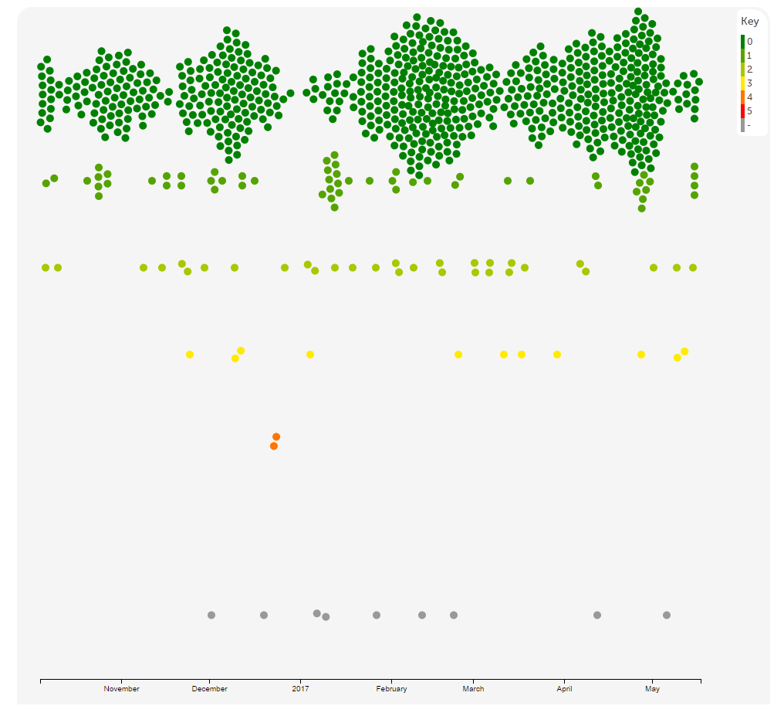

Slide 21
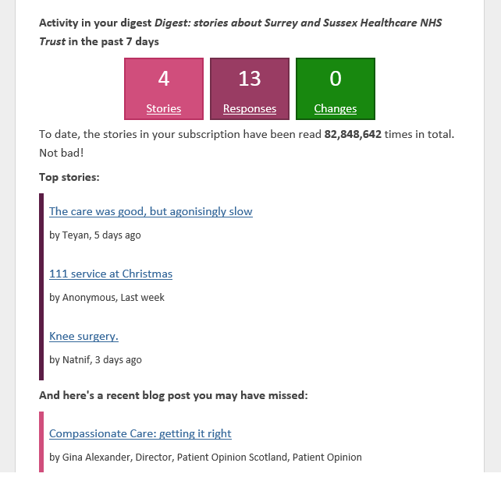

Slide 22
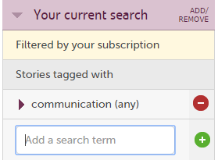
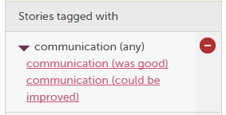
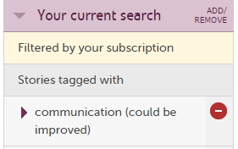

Slide 23
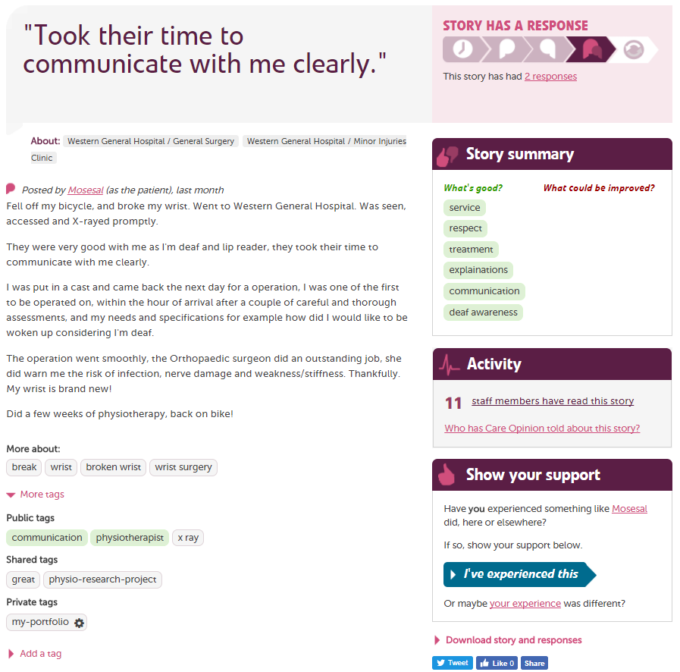

Slide 24
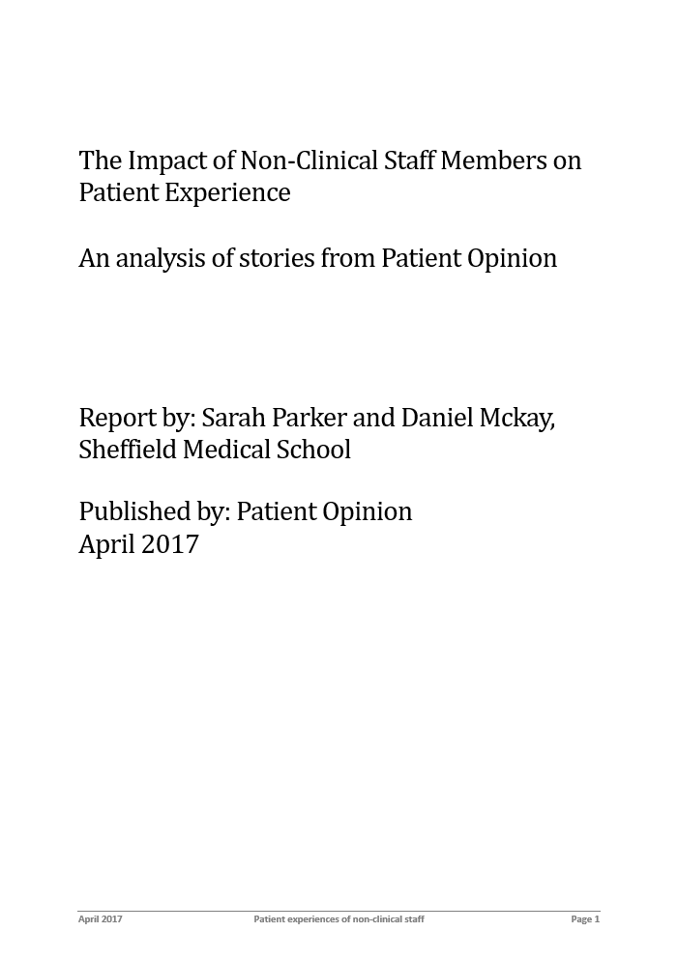

Slide 25
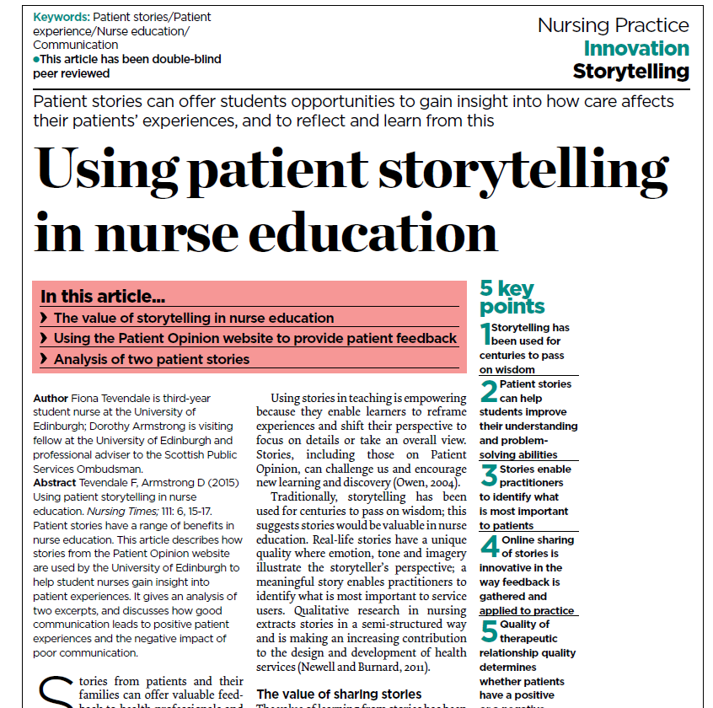

Slide 26
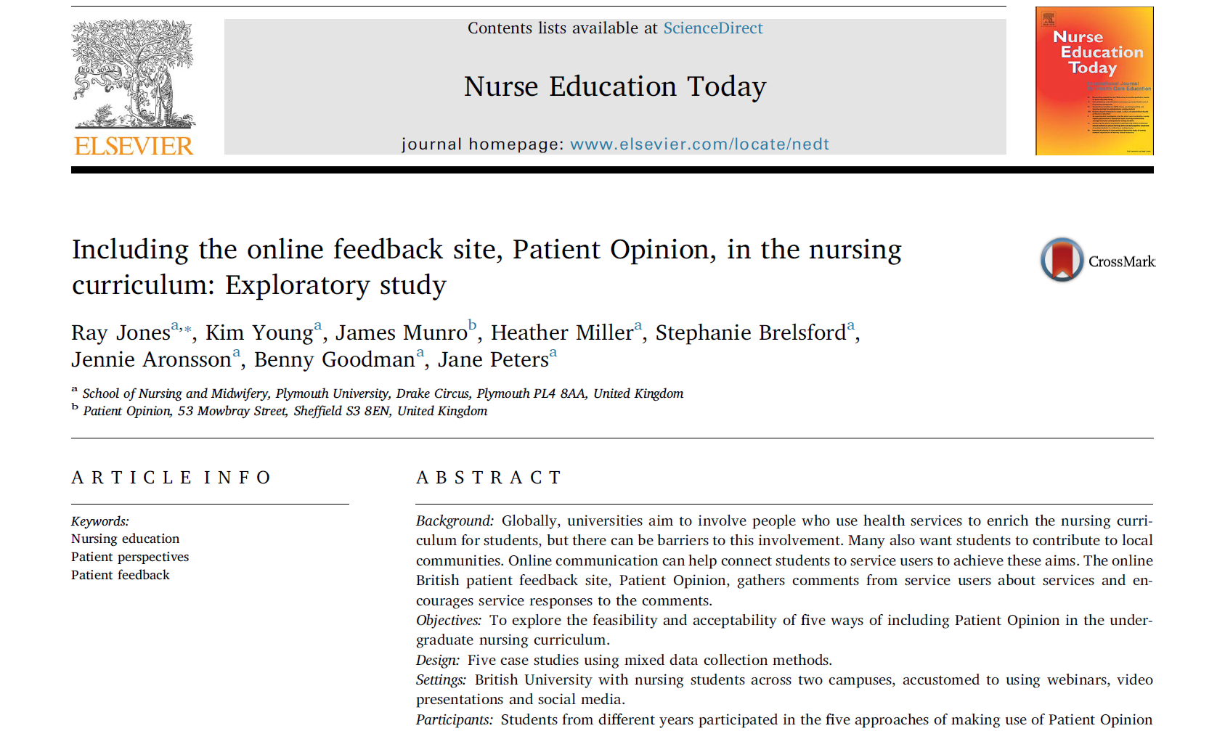

Slide 27
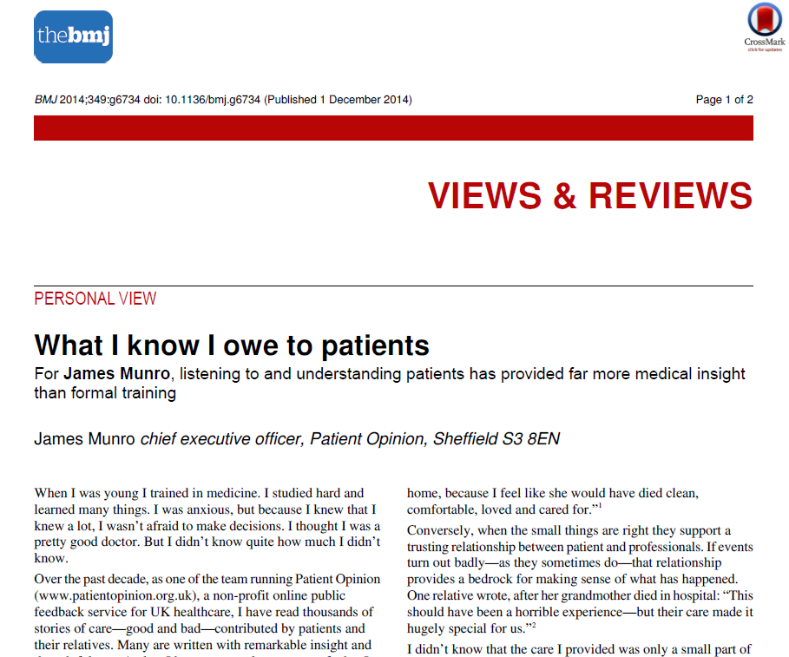

Slide 28
Hear the patient voice at every level – even when that voice is a whisper.
Don Berwick
August 2013

