Slide 1








‘I CAN’T TALK TO MR NHS BECAUSE HE DOESN’T EXIST’
service users’ perspectives on providing online healthcare-related feedback in the UK
FADHILA MAZANDERANI
University of Edinburgh
f.mazanderani@ed.ac.uk
IMPROVING NHS QUALITY USING INTERNET RATINGS AND EXPERIENCE (project info)
John Powell
University of Oxford
Susan Kirkpatrick
University of Oxford
Louise Locock
University of Aberdeen
Sue Ziebland
University of Oxford

Slide 2
Project 1: Literature review and stakeholder consultation
Project 2: Survey of the general public
Project 3: Qualitative interviews with patients and carers
Project 4: Survey of health professionals
Project 5: Organisational case studies in 4 NHS Trusts
IMPROVING NHS QUALITY USING INTERNET RATINGS AND EXPERIENCE
[FULL REPORT @ NIHR JOURNALS LIBRARY] [TOOLKIT @ THE POINT OF CARE FOUNDATION]

Slide 3
WHO PROVIDES FEEDBACK ONLINE?
42% of general public had read online feedback in the last year
  Younger; female; higher income bracket; health condition; urban area; frequent internet user
8% had provided the feedback in the same period
  Frequent internet user
  van Velthoven, Atherton, Powell, 2018, ‘A cross sectional survey of the UK public to understand use of online ratings and reviews of health services’ Patient Education & Counseling.

Slide 4
INTERVIEWEES
AGE | MALE | FEMALE | ETHNICITY: WHITE BRITISH | ETHNICITY: OTHER
20-35 | 0 | 7 | 7 | 0
36-50 | 2 | 9 | 9 | 2
51-65 | 4 | 8 | 10 | 2
66+ | 6 | 1 | 4 | 3
 | 12 | 25 | 30 | 7
Total |  |  |  | 37
Multiple complex conditions | 10
Mental health | 6
Cancer | 4
No specific condition identified | 3
Diabetes | 3
Care of a family member (parent or spouse, not children) | 3
Childbirth (no specific condition) | 2
Chronic pain | 1
Early onset dementia | 1
Heart condition | 1
Multiple Sclerosis | 1
Osteoarthritis and hip replacement | 1
Spinal problems | 1
Total | 37
3 interviewees from Scotland

Slide 5
SOME PARTICIPANT CHARACTERISTICS
Regular internet users (including social media)
Long term investment in the NHS (chronic, complex conditions)
Intense and emotive experience (positive and negative)
Desire to improve services, help patients and staff
Other forms of communication had failed to achieve a response
Rarely prompted by NHS staff

Slide 6
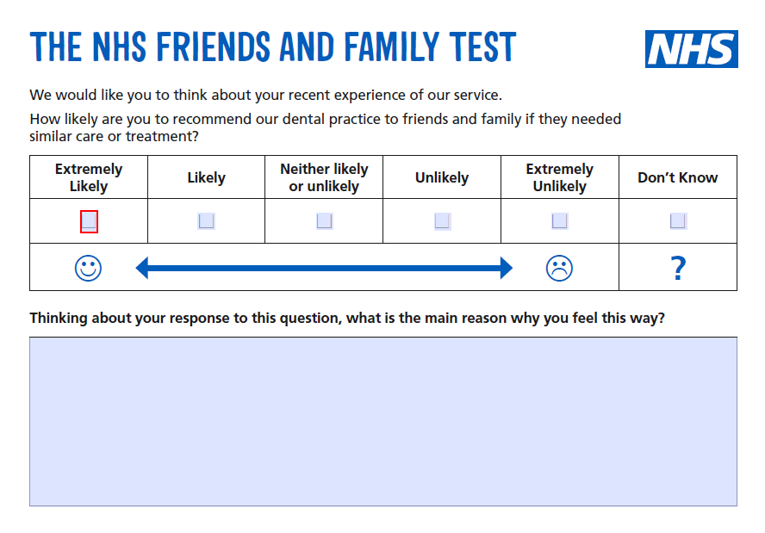




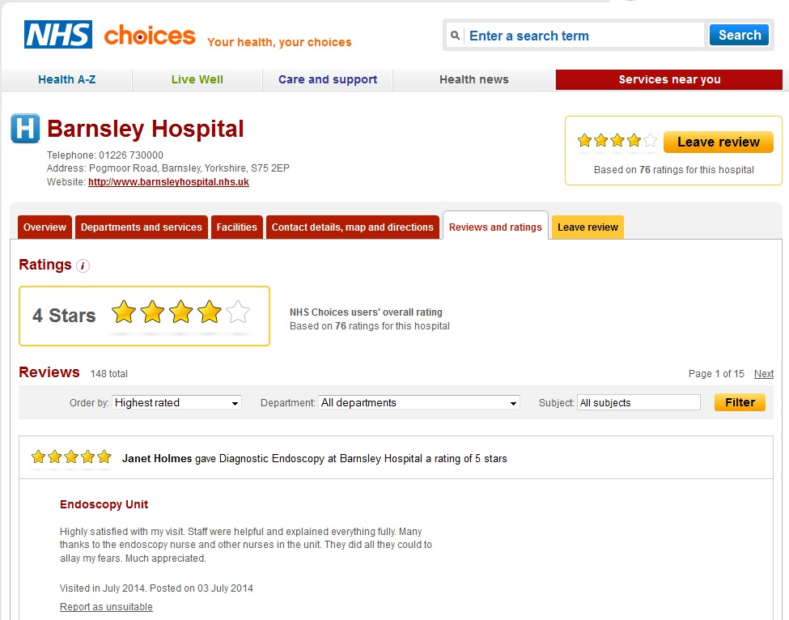




Dudhawala et a;. 2017, ‘What counts as online patient feedback, and for whom?’ Digital Health.

Slide 7
INTERVIEWS
What are people’s experiences of reading and writing online healthcare-related feedback, ratings and reviews in the UK?
Why do people read others’ healthcare experiences and share their own online?
Recommendations for how the NHS should deal with online patient reviews, ratings and feedback

Slide 8
FOCUS ON…
Feedback to improve care (how and for whom)
  a way patients and family members perform care for healthcare services (‘caring for care’)
Relationship(s) with the NHS (actual and symbolic)
Feedback as ‘conversation’ (dialogic metaphors)

Slide 9
[..] there’s lots of reasons why I do it [provide online feedback]. It’s not just one. There have, in the situation that I described at the start, that was first and foremost to try and get a bloody answer out of them as about what was going to happen here next but, underlying all of this, was the sharing it with other people, letting other people know that they’re not alone and, hopefully, leading to change. But there’s been other times where my post has been purely to highlight good practice or to instigate change in some way.
INQ36: female, thirties, mental health

Slide 10
ONLINE FEEDBACK TO IMPROVE CARE
The NHS fails, we fail, like we need the NHS to not only survive but to thrive and keep going and any feedback, certainly I’m giving and I know a lot of people in my position are, it’s constructive, not because we’re being critical but because we need this to work.
INQ16: female, mid-thirties, multiple long term conditions
Munro, 2017, ‘Online opinions changing care’ British Journal of Nursing

Slide 11
ONLINE FEEDBACK AS CARE FOR OTHER PATIENTS AND THEIR FAMILIES
[…] I wanted to give other patients, who might be feeling equally vulnerable and uncomfortable asserting themselves, some confidence. To be able to say, ‘It’s okay, you know, if you’re not sure, its okay to ask questions and to request another point of view and, eventually, you know, you would hope that you would find somebody and feel comfortable, comfortable and confident in.’
INQ08: female, early fifties, osteoarthritis and hip replacement

Slide 12
ONLINE FEEDBACK AS CARE FOR HEALTHCARE SERVICES AND STAFF
I wanted to say thank you to the GP that, who’d been really, really good with me. And the way I did that was by emailing the practice manager and just saying I’ve had this good experience, thank you. Because I was hoping, I guess, that they could use that somehow with the CQC or something.
INQ22: female, mid-thirties, mental health and eating disorders

Slide 13
COMPLEX RELATIONSHIP WITH HEALTHCARE SERVICES
I think doctors and nurses need to hear that we’re grateful and not just turn on the TV and see the NHS is crumbling around our knees.[…] I don’t like, I can’t think of a better term, NHS bashing. I don’t like kicking a system when it’s down. It’s not the fault of the system. Well, it’s not the fault of the staffing in the system that the system is crumbling around people’s knees. But, actually, patients have some responsibility as well.
INQ 16, female, mid-thirties, multiple health conditions
And so there’s this two headed thinking I think, where we are incredibly pleased and love the NHS and want to keep and will defend it at all costs but there’s another part side of us that very much tolerates what is an absolutely open secret which is that it’s very defensive and that some parts of the NHS offer poor care and some parts of the NHS offer absolutely world-class, you couldn’t possibly fault it care.
INQ 15, male, late-thirties, mental health condition

Slide 14
FEEDBACK AS ‘CONVERSATION’
[…] the reason that you’re putting it out there, the reason that you’re saying it is because you don’t feel heard… And so the reason that I blogged about the NHS, is because I felt that the NHS was not listening, that there was no way for me to talk to the NHS. I can’t get the NHS in for a cup of coffee and say, “Now look here NHS.”
INQ02: female, mid-forties, chronic pain

Slide 15
THE IMPORTANCE OF A RESPONSE
I happened upon it [Care Opinion] by accident… I was just looking for [hospital location] or somebody had linked something on Facebook and I went looking. And I just thought, I wonder whether anybody else has complained about the wards and, so yeah somebody else had.
And there was another lady that had and she got a response on there from the NHS and I thought, well, I want a response, nobody had actually ever responded to me. So I thought it would be a good idea to have a go
And what were you hoping? What were you thinking you might get from that?
Well, given that somebody else had a response on there, I hoped I would get a response as well.
I was disappointed that I didn’t get any response.
INQ10: female, mid-thirties, maternity services
Baines et al. 2018. ‘Responding effectively to adult mental health patient feedback in an online environment: A coproduced framework’. Health Expectations
Ramsey et al. 2019. ‘How do healthcare staff respond to patient experience feedback online? A typology of responses published on Care Opinion’. Patient Experience Journal

Slide 16
TAKING STOCK…
Feedback for care improvement
Feedback as care improvement
Care enacted through ‘conversation’
  (Partial and selective) anonymity [Locock et al. 2020, ‘Anonymity, veracity and power in online patient feedback: A quantitative and qualitative analysis of staff responses to patient comments on the ‘Care Opinion’ platform in Scotland’ Digital Health]
  Public facing with multiple (potential) audiences
Premised on particular relationship(s) with NHS

Slide 17
‘CARING FOR CARE’
Feedback as a way patients and publics ‘care for care’
Empirically grounded alternative framing (e.g. consumerist ‘choice’; technocractic ‘quality control’)
Thinking of feedback as ‘care’ brings particular sensibilities and approaches to the fore (drawing on work on the ethics of care)
  Values emotions, particular relationships, moral commitments
  Blurs private and public
  Bring invisible labour of feedback to the fore
  Foregrounds digital technologies as part of care
  Highlights the mutuality of care (patients and publics caring for…)

Slide 18
QUESTIONS AND NEXT STEPS
Is ‘caring for care’ a useful way of thinking about online feedback?
What is the significance of foregrounding conversational and dialogic metaphors when thinking and working with online feedback?

Slide 19
ACKNOWLEDGEMENTS
Research participants
Care Opinion
INQUIRE project team
The NIHR
This presentation summarises independent research funded by the National Institute for Health Research (NIHR) under its Health Services and Delivery Research Programme (Grant Reference Number 14/04/48). The views expressed are those of the authors, and not necessarily those of the NHS, the NIHR or the Department of Health.

