Slide 1



Care Opinion Webinar
Welcome!

Slide 2
Our plan for today
Overview of Care Opinion - James Munro, CEO of Care Opinion
Strategic Commitment to Listening - Jane Thomas, Head of Patient and Public Engagement, Experience and Participation
Implementation of Care Opinion – Kate Wood, Community Engagement Manager
Operational Experience of Care Opinion – Debra Abbots, Operational Lead Malvern Neighbourhood Team
Q&A

Slide 3

Your patients want to help you get better!
James Munro, CEO @jamesfm55
Care Opinion CIC @careopinion

Slide 4
Vision
We want people to be able to share their experiences of health and care in ways which are safe, simple, and lead to learning and change.

Slide 5
Who are we?
Non-profit community interest company
Almost 20 years' experience
UK, Ireland, Canada and Australia
The system-wide platform for:
  Northern Ireland
  Scotland
  Western Australia

Slide 6
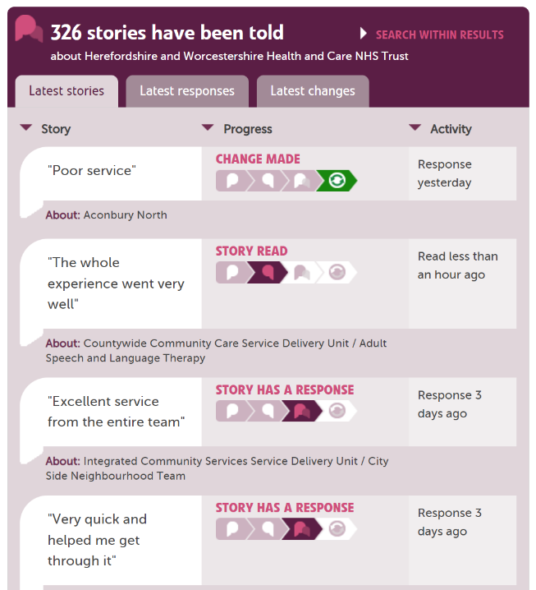

Slide 7
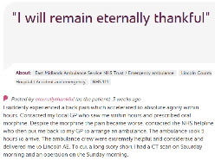











In each provider
Moderation
Clinical staff
Porters, reception, catering…
Pt exp, comms, complaints…
Alerting
CEO
Commissioners
Nursing, AHP students
Healthwatch
Researchers
Patient groups
CQC
Local authority

Slide 8
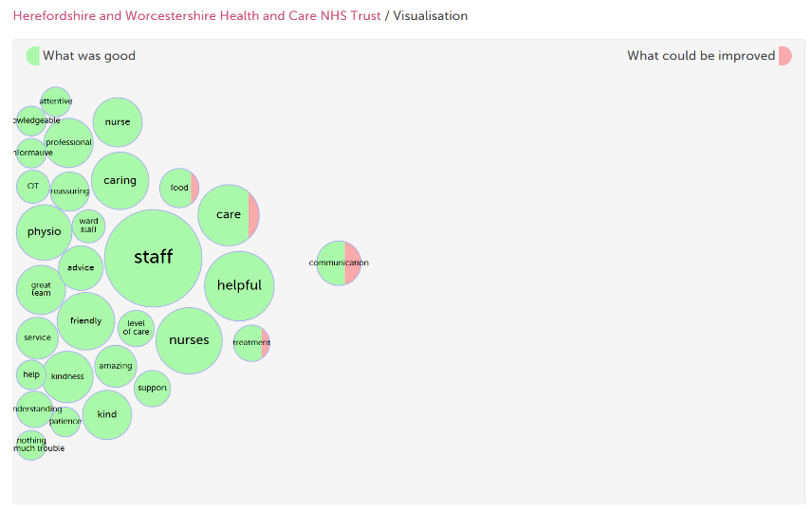
Tag bubbles

Slide 9
Staff morale
“I really love it… working in the emergency department, you see a lot of terrible things happen, you see a lot of sick patients…
So for me, it’s such a refreshing change because we predominantly get positive feedback.
It's just so nice to be able to cling on to that… I think it helps improve morale.”
Clinical manager, Royal Cornwall Hospitals
Source: Baines R. Care Opinion at RCHT: one year on. Plymouth University, November 2019

Slide 10
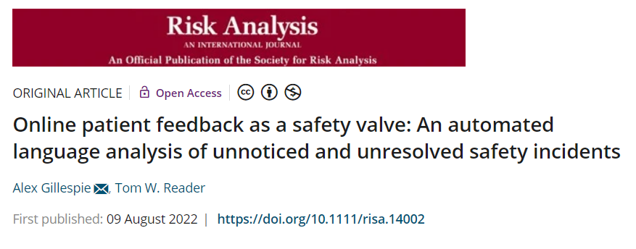
“First, online patient feedback may reliably track the number of safety incidents within a hospital by providing accurate information on adverse events.
Second, online patient feedback may reveal hospitals that are poor at detecting and responding to safety incidents.”

Slide 11
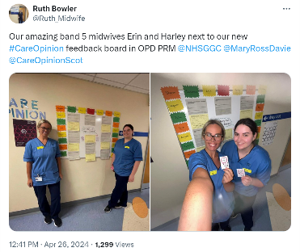
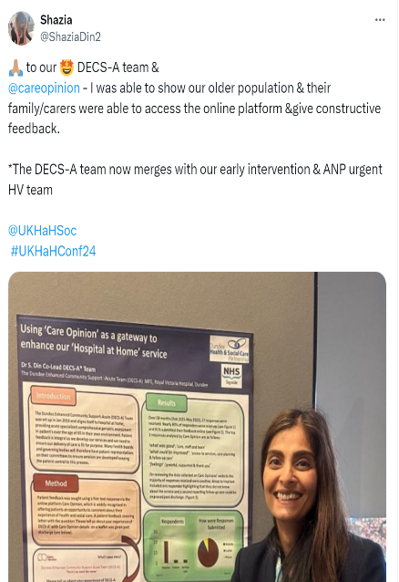
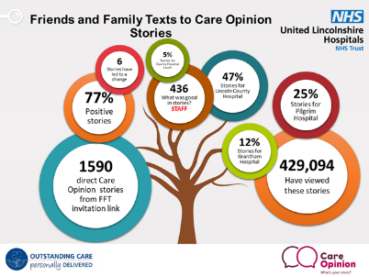

Slide 12
Berwick Report, August 2013
Recommendation 8
“All organisations should seek out the patient and carer voice as an essential asset in monitoring the safety and quality of care.”
See also: Francis, Keogh, Kirkup, Ockenden, Cumberlege…

Slide 13
Slowly, culture changes
“Care Opinion has changed culture in way which is soft, organic and relaxed, not corporate.”
Alex Clements, Southern NHS FT

Slide 14
A strategic commitment to listening
Patient and carer voice a top priority for the Trust
When we listen, we understand better what is working well, and what needs to improve
Listening can highlight safety issues
Impact on staff morale
Health Inequalities – listening can tell us when we need to do things differently
Its everyone’s business

Slide 15
When and how do we listen?
Proactively - as part of developing our strategies, and when planning and making decisions – forums and groups
Reactively – to encourage feedback following contact with our services in real time, and then we respond
The value of offering a menu of feedback options – one size does not fit all.

Slide 16
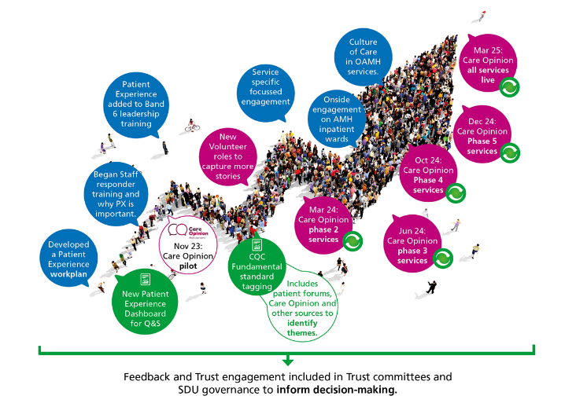
Our journey

Slide 17
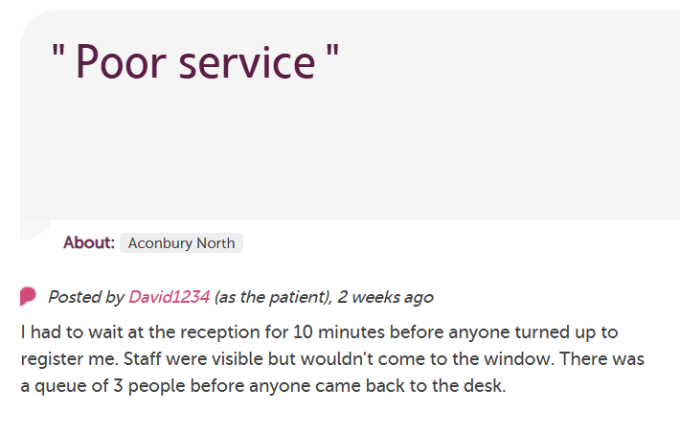
An example of learning and change…

Slide 18
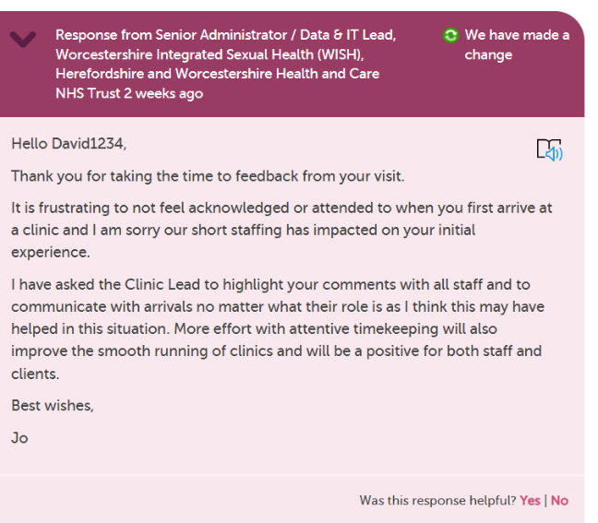
An example of learning and change…

Slide 19



Challenges
Diversity of services/barriers
New way of working for staff
Reluctance of staff to ask for something
Momentum
Triangulation
Capacity

Slide 20


Successes
Services getting feedback – who did not get feedback before
Staff morale
Whole service training –
how to ask for feedback
Star Responders
Patient and Carer
voice a top priority

Slide 21
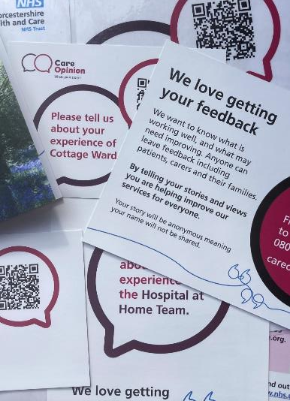
Learning Points
Let service guide on materials, think outside the box!
Easy Read and other languages
Importance of process

Slide 22
Care Opinion Journey of
Malvern Neighbourhood Team
Debbie Abbots
Operational Lead

Slide 23
Timeline to date
Late August 2023 – I became aware of Care Opinion and was keen to be involved.
05.09.23 - I put my team forward to participate in the pilot.
18.09.23 – I attended a demo of Care Opinion.
27.11.23 – I put name forward for an additional responder for the team.
09.01.24 – 1000 cards were requested and we then ‘went live’.
Regular catch ups.

Slide 24
My rationale for participation in the pilot
Desire to learn from our patient’s experiences with the team.
Desire to learn from the carer’s experiences with the team.
A need to know what is working well, and what needs improving.
Other platforms currently used were not working.
It is often difficult to ask patients and their carers for feedback and this method may be easier for the frontline staff.
Notes:
I know that we are doing a good job and the current F&F test is not effective within our team.

Slide 25
Initial thoughts
The website was fairly easy to navigate. However, I was unsure if our patients [within NTs], the majority of whom are elderly, would be able to use it.
I was concerned that the story’s that would be added would be ‘rants’ rather than positive, as most people/relatives appear to be stingy with compliments but happy to complain.
There were a lot of lengthy complaints available to read on the site.
The story would be moderated before we were alerted to the story and I would have 7 days to respond, allowing me time to gather the information [if any] that was needed.

Slide 26
Introduction to the team
Initially via team meeting
Jane’s team came to discuss with us
Started with A5 cards
Hand to patients at the beginning of their care
Insert into the ONPOS bags

Slide 27
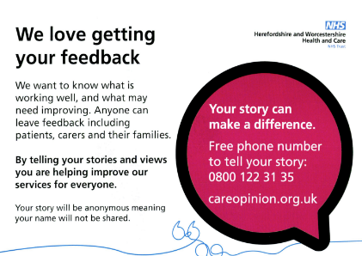
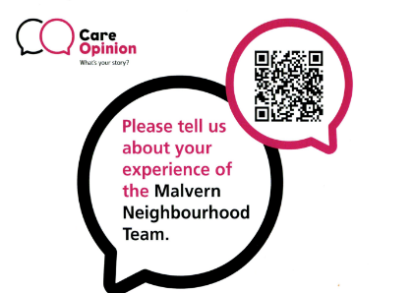
Care Opinion Card

Slide 28

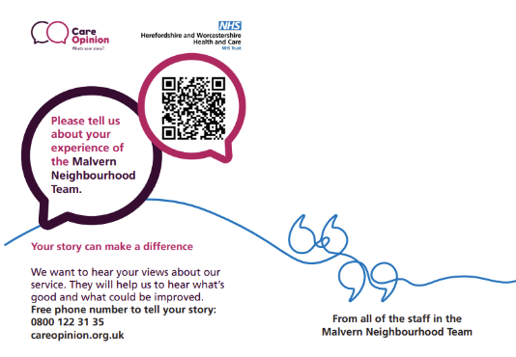
Where we are now!

Slide 29
Examples of stories
Posted by Chrissie41ca (as a service user), 7 months ago
I was quite desperate for help with 2 suspected skin cancer lesions on my leg, one of which had a biopsy done. No help forthcoming from my GP surgery. District Nurse called and was so helpful and comforting with dressings etc. Following a further biopsy, another DN called to change dressing and check wound. She also offered to refer me re circulation problems in the same leg - something which had been getting worse and making walking difficult for some time. Again, sadly a phone call with someone at my GP surgery had not been helpful. I am in my 80s with various health problems which cause me anxiety from time to time. I feel so relieved to have the Malvern Neighbourhood Team available to care as I live alone with family far away. I'm so grateful for all they do to help in time of need. They are like angels sent from God!
Response from Debbie Abbots, Operational Lead Malvern Neighbourhood Team. Herefordshire and Worcestershire Health and Care NHST Trust. 7 months ago.
Hi Chrissie,
Many thanks for your comments.
It is a pleasure to support you. Retaining your independence within your own home is important and you know that you can always contact us if needed.
Again, many thanks for your kind words.

Slide 30
Examples of stories
Posted by caelumrf95 (as a service user), 6 months ago
I wanted to give some feedback about the Malvern neighborhood team. The district nurses visited me from February 2023 to August 2023 during my first round of chemotherapy.
Now I am having chemotherapy again, I am able to book and appointment to see the nurses at Rowan House. This time, this is better for me as I don’t need to wait in for them
The nurses have always been pleasant, efficient and caring. They are lovely
Response from Jenni Rastall, Operational Lead Malvern Neighbourhood Team. Herefordshire and Worcestershire Health and Care NHST Trust. 6 months ago.
Thank you for your comments.
I am glad to hear that by being able to come to Rowan House has improved your experience.
It is nice to hear such wonderful comments about the staff too,

Slide 31
Examples of stories
Posted by Louise1980 (as a relative), 7 months ago
The Malvern community team visit my father monthly for catheter changes and occasionally for other things. They appreciate with long term chronic illness that sometimes my parents need advice on other symptoms. They always assess and refer on to others where necessary but never dismiss. Access to healthcare in the digital world is scary for my parents and they know they can rely on asking the nurses when they come and respect their opinion. Professional and friendly always.
Many thanks for this great feedback.
We will continue to support your parents as needed and they know that we are only a phone call away if they need us outside of the planned visits.
Thank You!

Slide 32
Challenges
Staff do not like asking for feedback.
Patients did not look in the ONPOS bags – they belonged to us.
Patients do not post stories
Unable to use the QR code
Forgot to ring the tel number
Family/carers do not see the initial cards we used.

Slide 33
Successes
Staff like giving the cards
at the end of treatment.
Increase in story numbers.
Positive feedback raises team morale, which increases productivity.

Slide 34

Thank you for listening

Slide 35
Any Questions?

