Slide 1
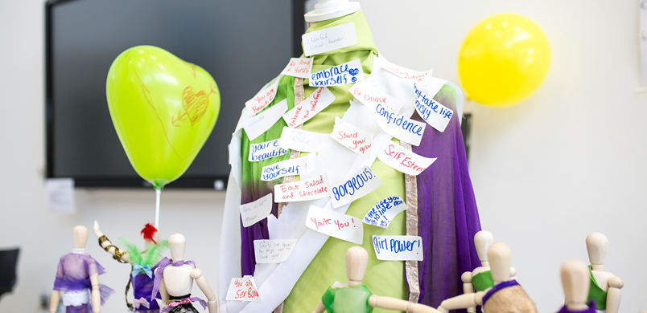
How can online feedback make a difference in commissioning?

Slide 2
Bradford District and Craven CCGs bring together feedback from a variety of sources in order to gain an understanding of what local patients, carers and stakeholders are saying about their experiences of local NHS Services. We pull all the insight into a database which enables us to analyse themes and trends in people’s experiences and generate reports. We call this system ‘Grassroots’

Slide 3
Notes:
Pulling it all together to see patterns and trends
Human eyes on every piece of feedback – serious/urgent flagged with providers if needed, Care Opinion allows us to see if they’ve already responded.
Patient experience built into our processes around Quality – JQC, seat at the table
The MES Experience system with Pansensic analysis let us look at emotions and sentiment analysis,

Slide 4
Sources of feedback
Notes:
Range of sources really important to us – not just the extremes of complaints & compliments, includes the ordinary everyday, the ‘nurses were lovely BUT…’
Care opinion is a small proportion of the data, but provides rich insight & different perspectives – feedback generated from our Patient Support & Complaints team the most commonly identified emotion is fear, in Healthwatch data it’s frustration and in NHS Choices & Care Opinion it’s delight.
Bringing these different data sources together gives a more rounded picture.

Slide 5
Example feedback: GP appointments
“You have to tell the receptionist your medical issues to have any chance of getting an appointment.”
“You have to explain your issues to the reception staff, who will do anything to avoid giving you an appointment and are pretty rude. I really don't think its appropriate being asked your symptoms by unqualified reception staff.”
Feedback shared via Care Opinion
Notes:
Feedback from Care Opinion prior to rollout

Slide 6
Acting on feedback: Care Navigation
People’s feedback was our starting point in developing our Care Navigation approach.
We provided training for all frontline admin staff in practices.
We developed a communications toolkit for practices to help make sure that ALL patients across Bradford district and Craven were getting good information.
We explained why people were being asked questions and emphasised patient confidentiality and choice.
Grassroots help us monitor the impact & check for changes in people’s experience.
Notes:
Having the ‘evidence’ of patient experience in our Grassroots system, along with insight from our patient network meetings and the views from practices, meant that we understood the challenges of introducing care navigation, and could use this as the starting point hwen we developed our approach.
The communications campaign included press releases, radio advertising, pop-up banners and posters for every GP practice, information leaflets including an Easy Read version and British Sign Language explanation, and videos. We also encouraged practices to work with their Patient Participation Groups and practice volunteers.
Voluntary sector partners took information about Care Navigation out to the community on our behalf, to make sure that people from different backgrounds understood what was happening and how it would help them. They’ve taken information leaflets and talked to people at lots of different locations, such as mosques and other places of worship, community centres, knit and natter groups and schools.
The feedback that people have given through Engaging People is being presented to practice staff in workshops set up to continually improve the way Care Navigation works for patients and carers.
Grassroots is being used to keep monitoring patient experience.
Other tangible examples of impact from Grassroots feedback: Deaf patients in GP practices, Mental health first response service, hospice discharge equipment ordering.

Slide 7
Sharing stories
Notes:
Increasing feedback Working with VCS partners and our staff to encourage them to share what they know & sharing what we pull together back to them – Maternity Voices Partnership
Encouraging providers to promote a range of feedback routes including Care Opinion
Proactively seeking out feedback from under represented groups
Development of system approach to Quality – system quality committee
Exciting opportunity for patient feedback to be addressed collectively
Haven’t been good at this in the past – patient exp. reports have sometimes felt like a stick used in a commissioner vs provider conversation – ‘What are you (Trust) going to do about this?’
BD&C is committed to a different way of working – commissioning is about the conversations not the contracts.
When we bring people’s experiences together through Grassroots, it tells a story of the challenges and opportunities we share as a system and the question becomes ‘how can we make this better for people, together?’
Working with Chief Nurse at BTHFT to develop a system approach to patient experience – first step is that leads have agreed to sharing the data they collect, so that we can build an even better picture. Want to identify some common questions and metrics, so that we can better measure our joined-up-ness as a system.

Slide 8
Any questions?
@simmons_vic
victoria.simmons@bradford.nhs.uk
Notes:
Increasing feedback Working with VCS partners and our staff to encourage them to share what they know & sharing what we pull together back to them – Maternity Voices Partnership
Encouraging providers to promote a range of feedback routes including Care Opinion
Proactively seeking out feedback from under represented groups
Development of system approach to Quality – system quality committee
Exciting opportunity for patient feedback to be addressed collectively
Haven’t been good at this in the past – patient exp. reports have sometimes felt like a stick used in a commissioner vs provider conversation – ‘What are you (Trust) going to do about this?’
BD&C is committed to a different way of working – commissioning is about the conversations not the contracts.
When we bring people’s experiences together through Grassroots, it tells a story of the challenges and opportunities we share as a system and the question becomes ‘how can we make this better for people, together?’
Working with Chief Nurse at BTHFT to develop a system approach to patient experience – first step is that leads of our three big providers have agreed to sharing the qualitative data they collect, so that we can build an even better picture. Want to identify some common questions and metrics, so that we can better measure our joined-up-ness as a system.

