Slide 1

New Care Opinion features for accessibility, learning, QI and mobile working

Slide 2

Keep it Simple!
Vision & Mission
We want people to be able to share their experiences
of health and care in ways which are
safe, simple,
and lead to learning and change

Slide 3
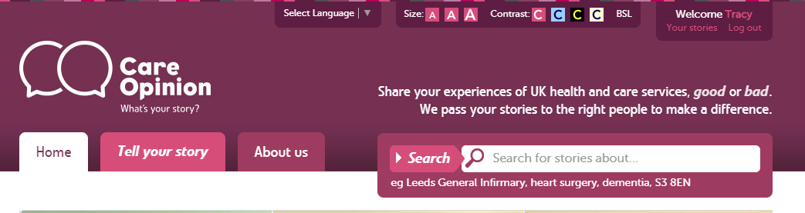



Accessibility

Slide 4

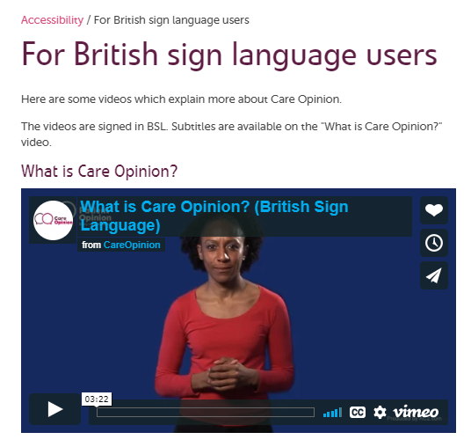
British Sign Language

Slide 5

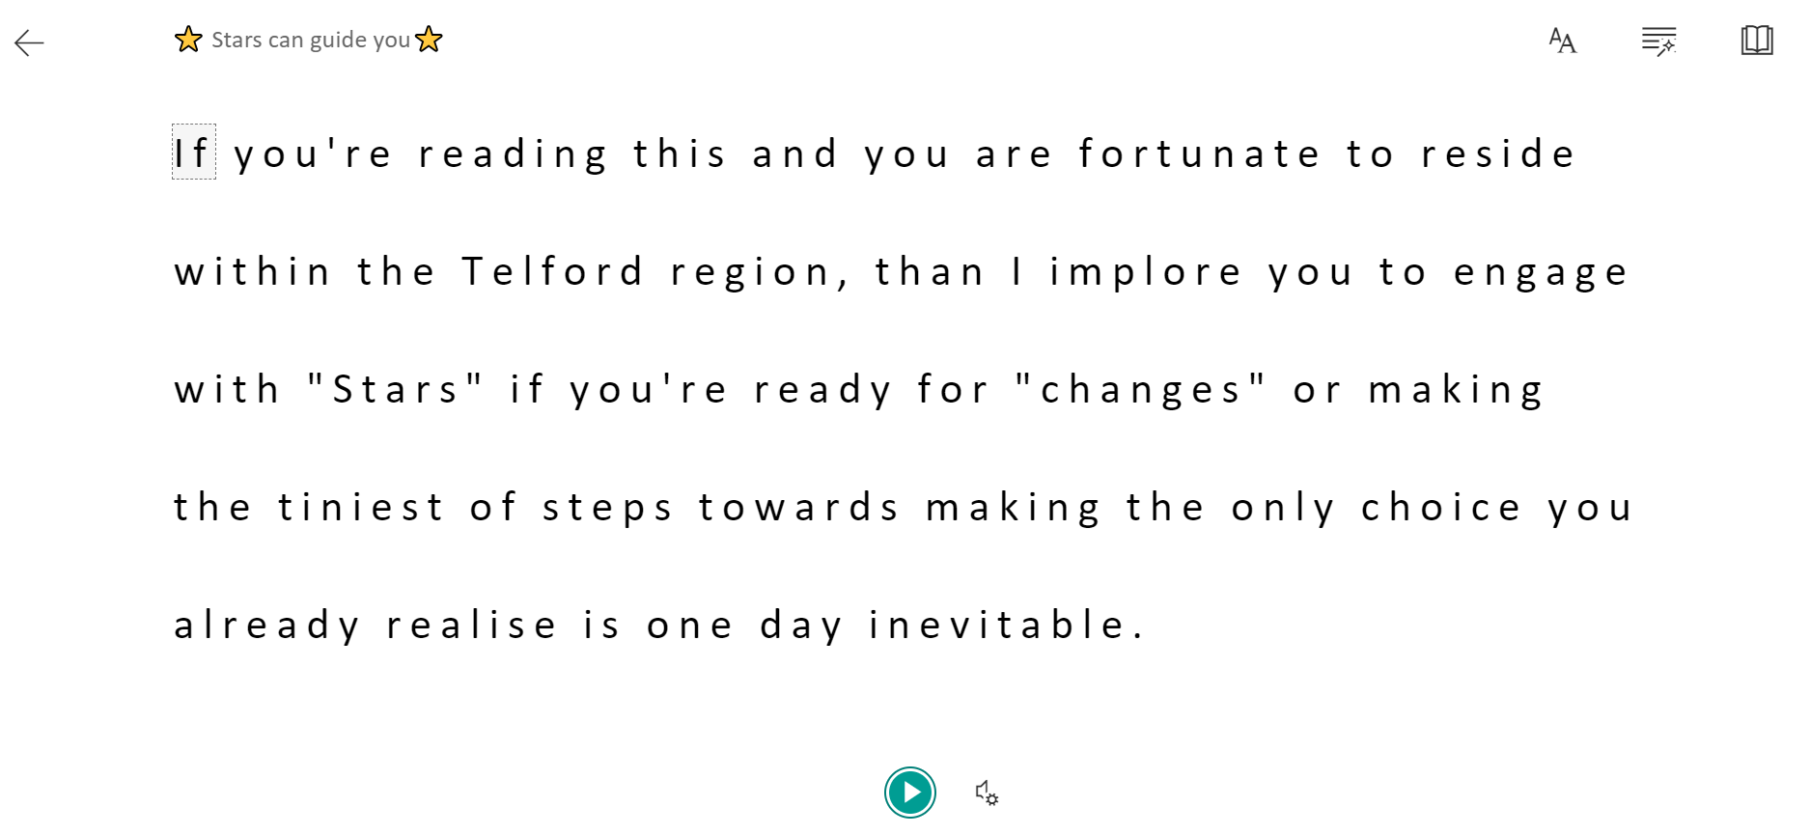
Immersive Reader
Make the story easier to read or hear it spoken

Slide 6
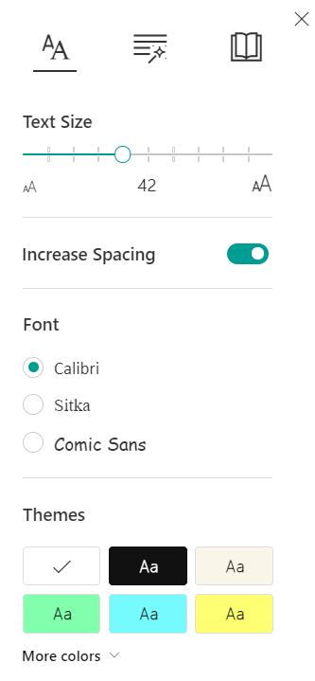
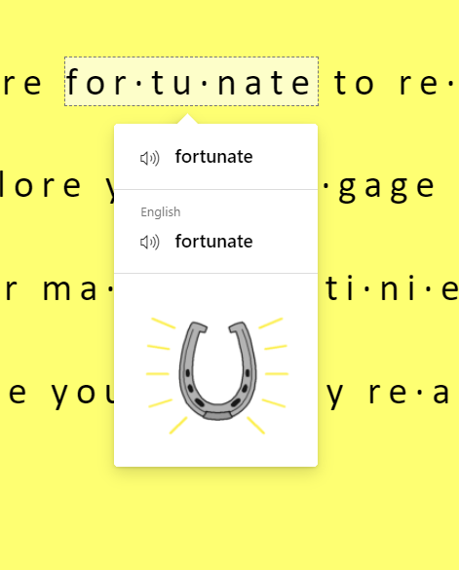
Options within Immersive reader
Break words down by syllables
Emphasize certain parts of the speech
Text Size
Spacing
Font
Theme

Slide 7
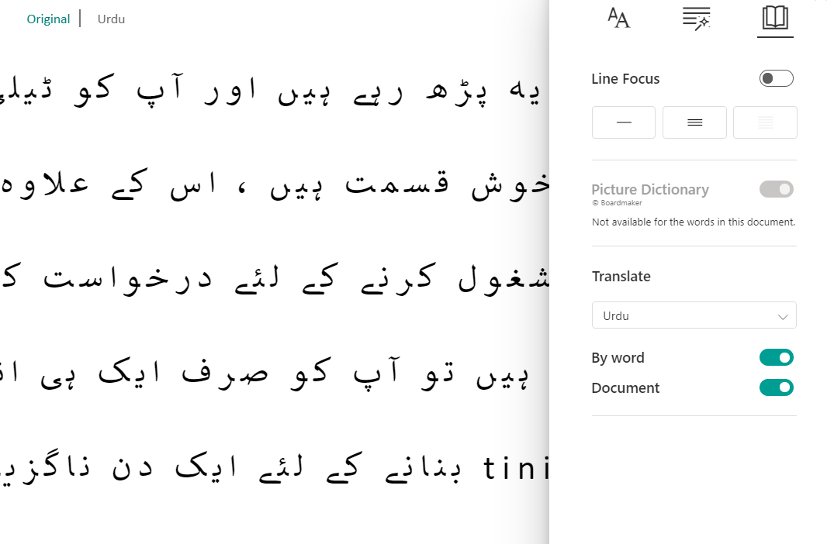
Translation

Slide 8
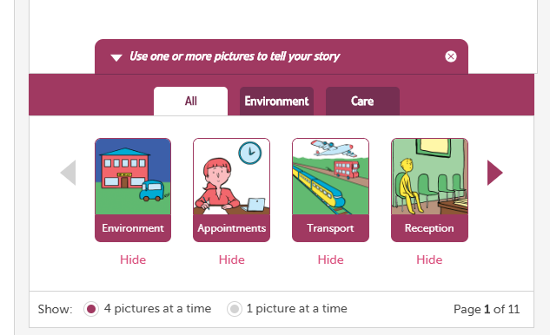
Picture Tiles

Slide 9
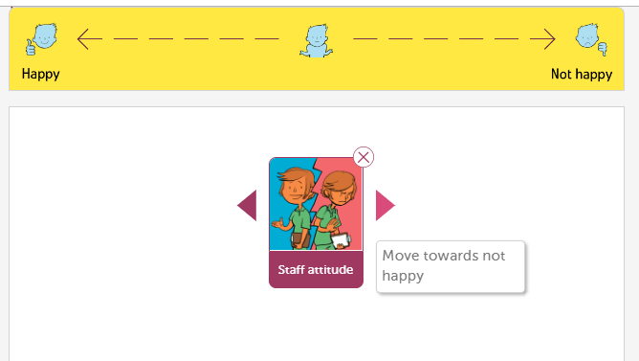

Slide 10
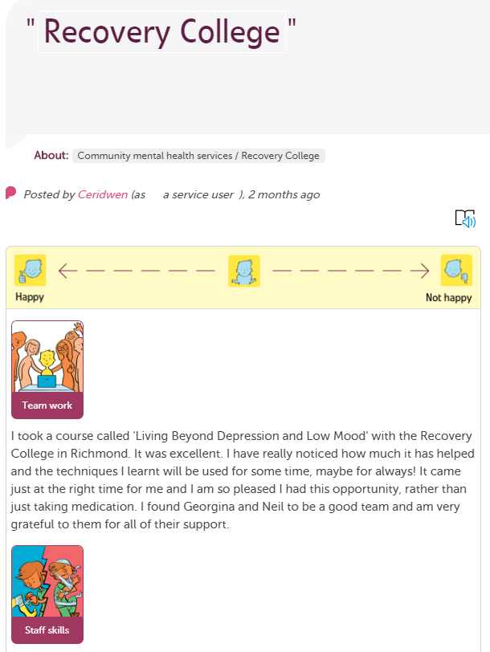
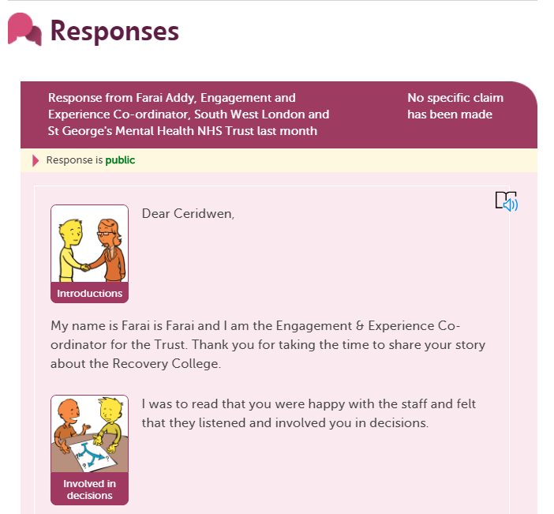

Slide 11
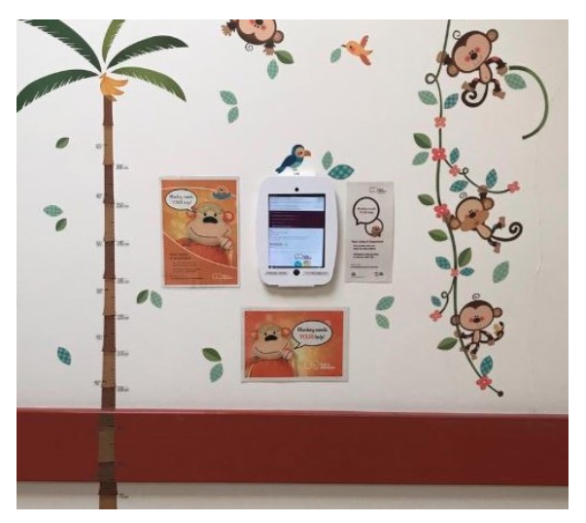
Kiosk Mode

Slide 12
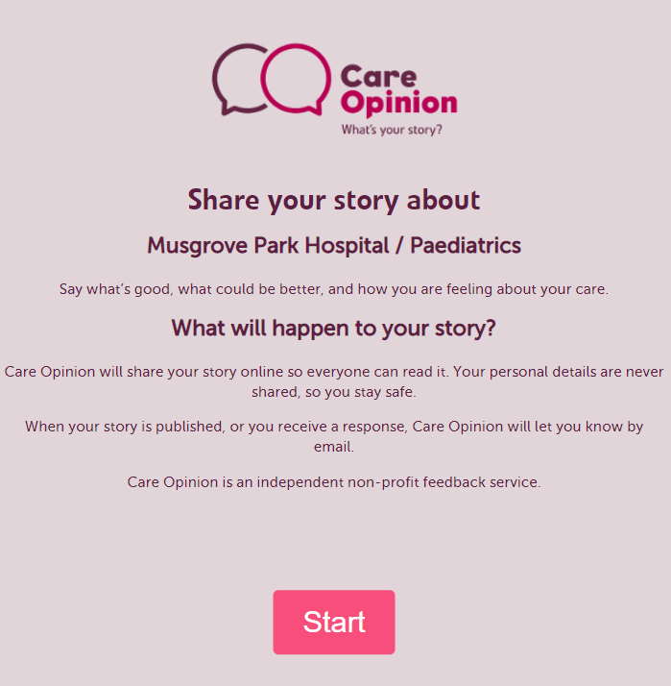
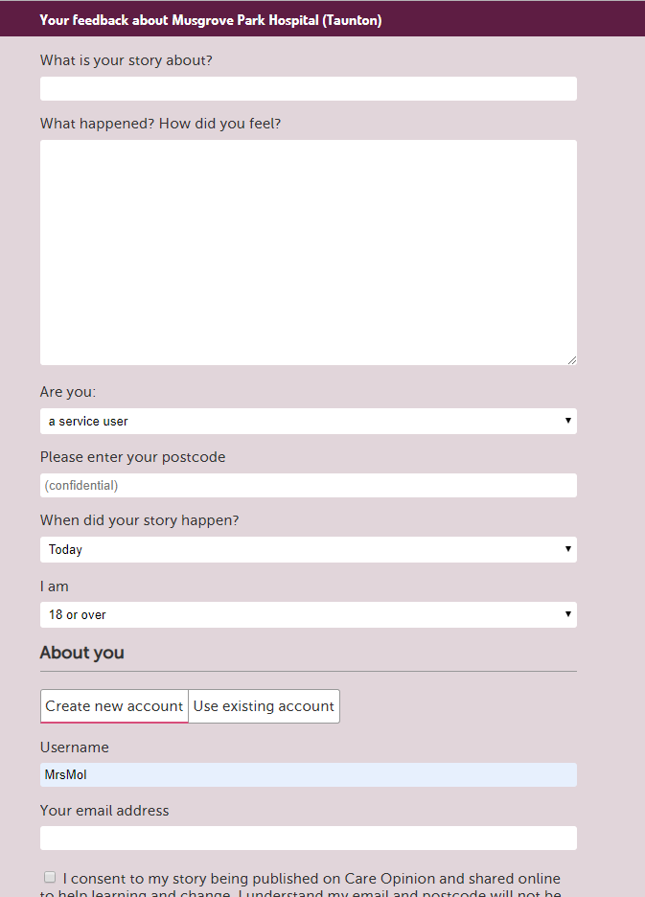

Slide 13

Other uses for Kiosk Mode
Text or email the kiosk mode link out to ask for feedback:
“Thank you for attending your appointment today at XXXX, We’d love to hear how we are doing, click the Care Opinion link below to tell us what was good or what could be improved careopinion.org.uk/kiosk/rba11”

Slide 14
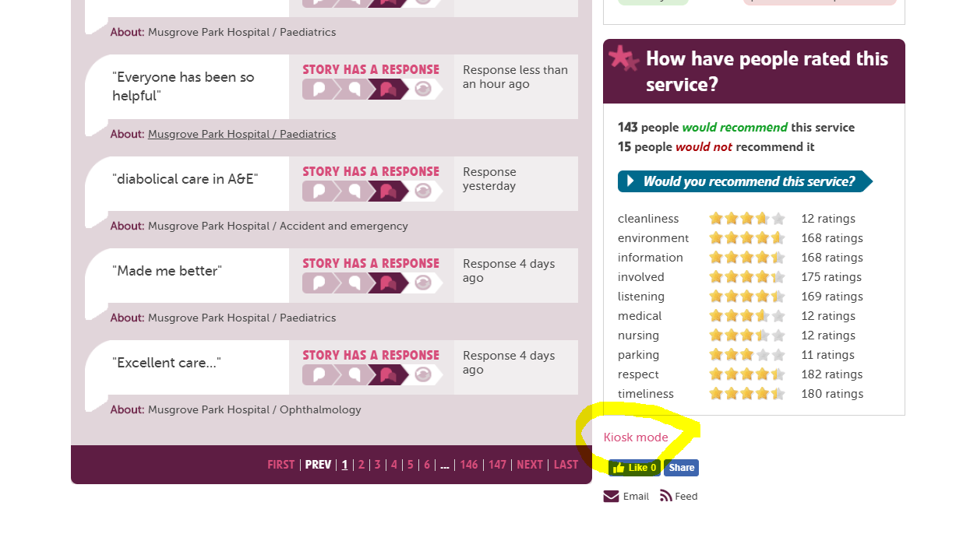
Do I have to request Kiosk Mode from Care Opinion?

Slide 15
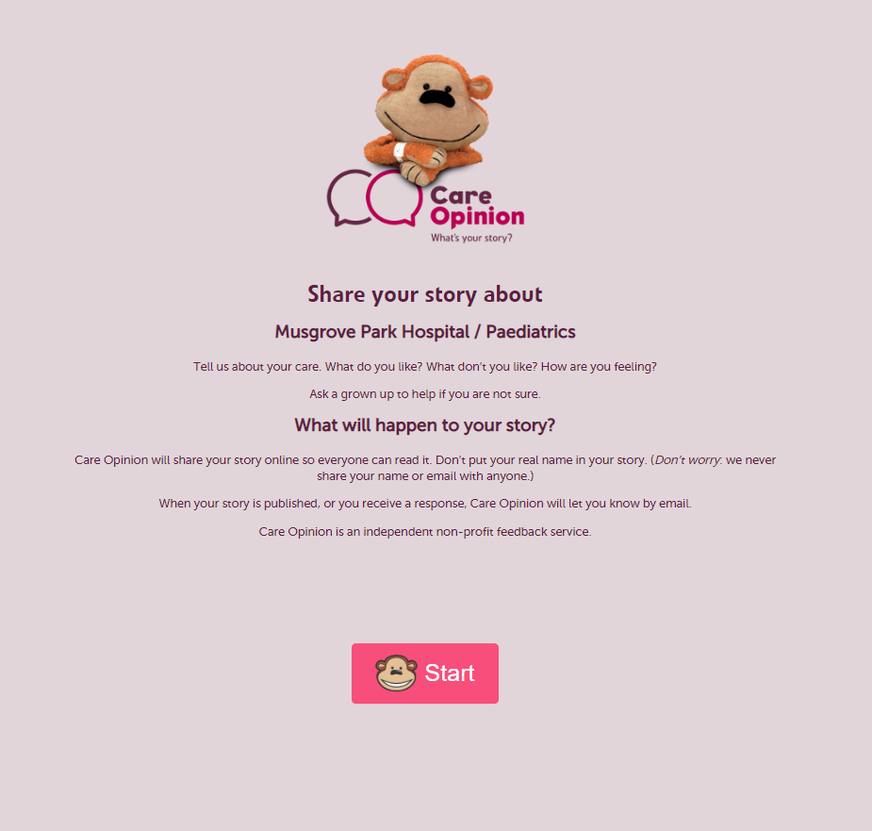


Slide 16
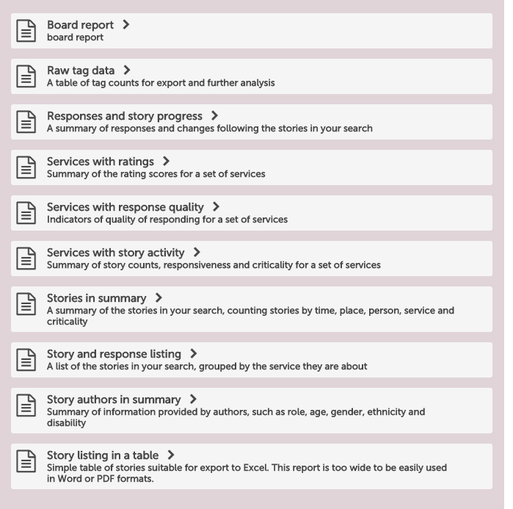
Care Opinion reports

Slide 17
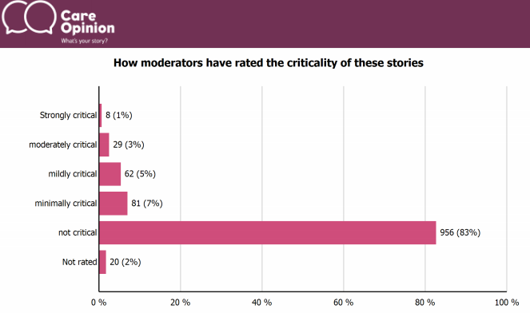
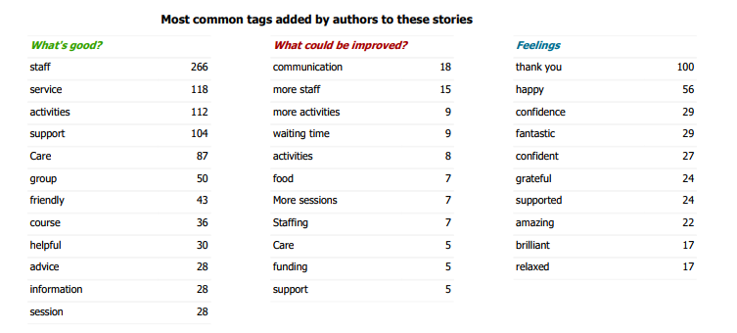
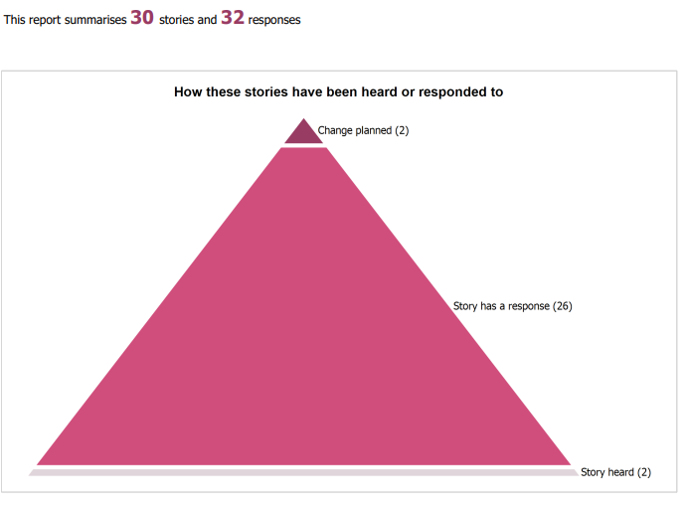
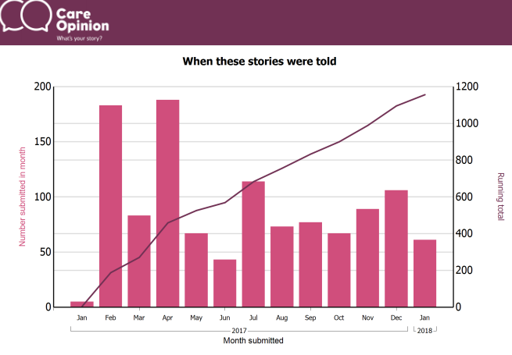

Slide 18
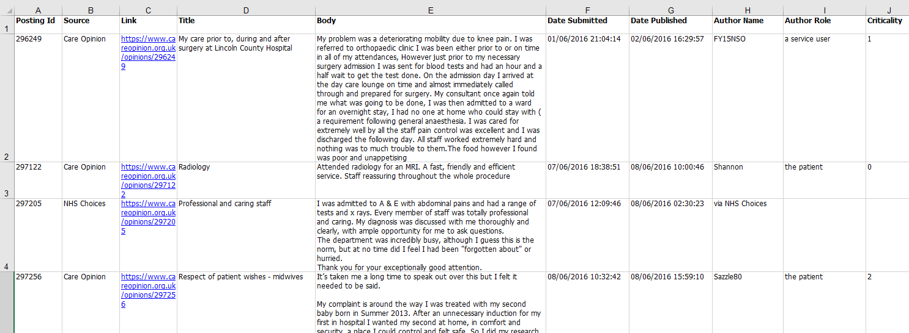

Slide 19

All reports…
Can be saved for later
Downloaded in different formats
Be tailored to specific services
Be set on a schedule (weekly, monthly etc)

Slide 20

Visualisations
Tag bubbles
Story swarms – criticality and progress
Lilly pad
Tag word clouds
Story word clouds
Sunburst

Slide 21
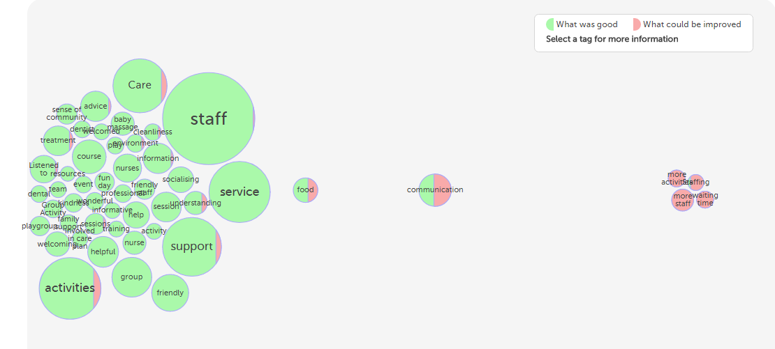
Interactive tag bubbles about All stories about Nottinghamshire Healthcare NHS Foundation Trust 2017-2018

Slide 22
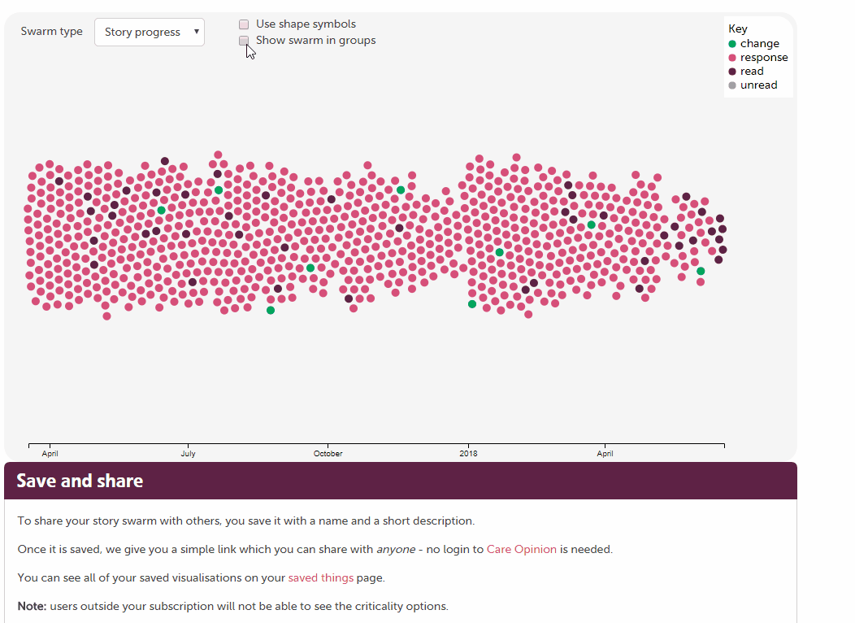

Slide 23
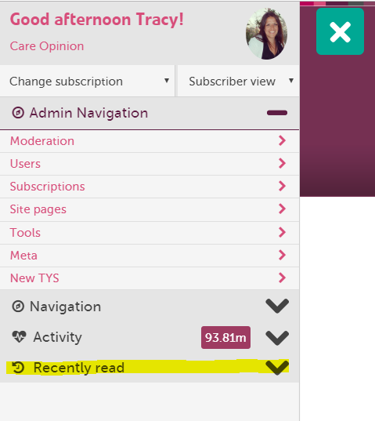
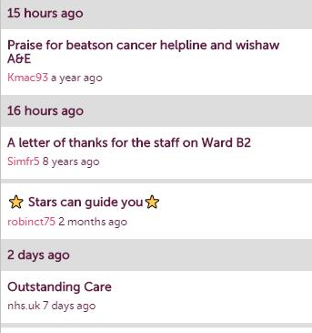
Recently Read

Slide 24
https://www.careopinion.org.uk/info/how-to-sessions
How to sessions….
How to generate stories
How to respond and demonstrate impact
How to generate reports and visualisations
How to make the most of subscriber tagging
Involving Volunteers

Slide 25


