Slide 1

Integration-some thoughts and some questions.
Tim Hunt, Integration Development Manager, Care Opinion CIC
@careopinion
tim.hunt@careopinion.org.uk

Slide 2
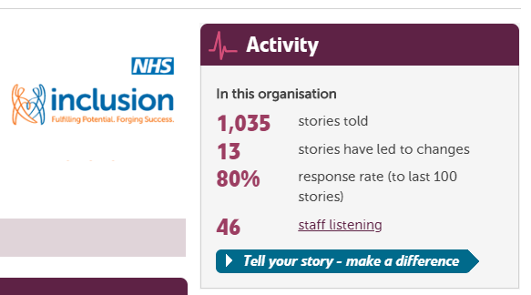
Care Opinion and MH Providers

Slide 3
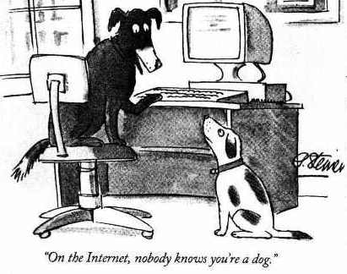

Slide 4
Mental Health
Subscribers across the UK and Ireland
Moderate feedback across all providers
Robust Signposting and Safeguarding procedures in place
Postings from Broadmoor, Rampton and other secure settings
Feedback and Validation from authors about value

Slide 5
Challenges to come
Rather, the NHS needs to work differently by providing more care in people’s homes and the community and breaking down barriers between services.
Breaking down barriers means co-ordinating the work of general practices, community services and hospitals to meet the needs of people requiring care.” Kings Fund 2018

Slide 6

Working in Silos

Slide 7
NHS England
Advanced local partnerships taking shared responsibility to improve the health and care system for their local population.
Breaking down barriers to better health and care. Local partnerships in every part of England to improve health and care in practical ways.

Slide 8
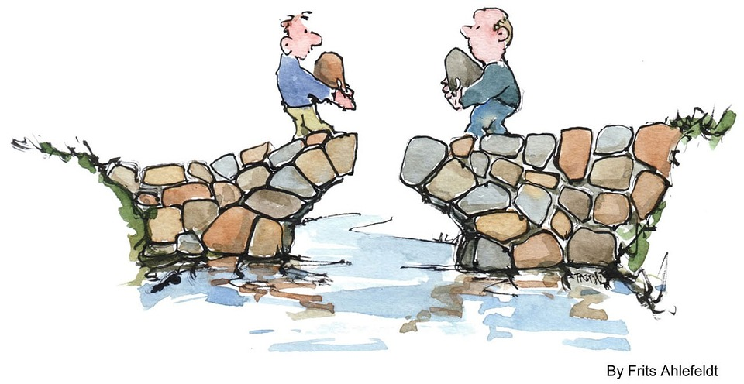

Slide 9
Putting the Patient at the Centre
Patient, User or carer
Health care provider
Social care provider
Care Home
GP
Community Health Provider
Domiciliary care

Slide 10
One journey: one story
Care home
Kindness
A&E
Waiting
Information
Recovery
OT
Physio
Care
Story
Response
Response
Response
Response

Slide 11
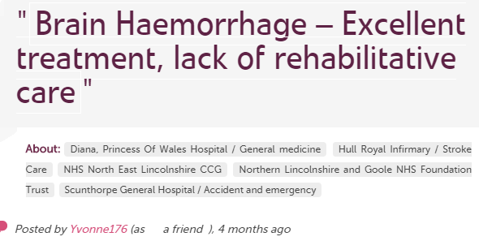

Providers and Commissioning

Slide 12
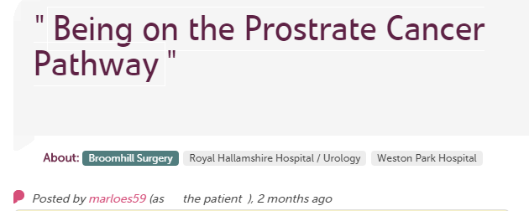
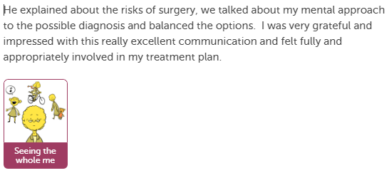
GPs and Hospitals.

Slide 13
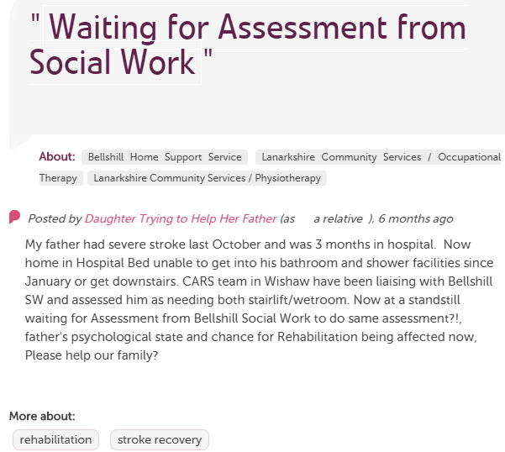
Community Support

Slide 14
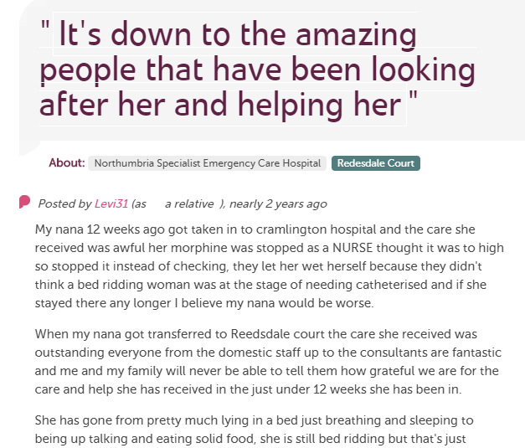
Care Homes

Slide 15
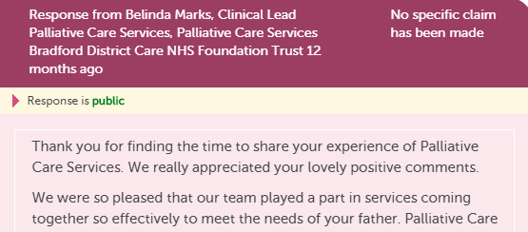
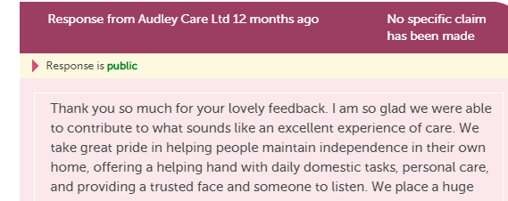
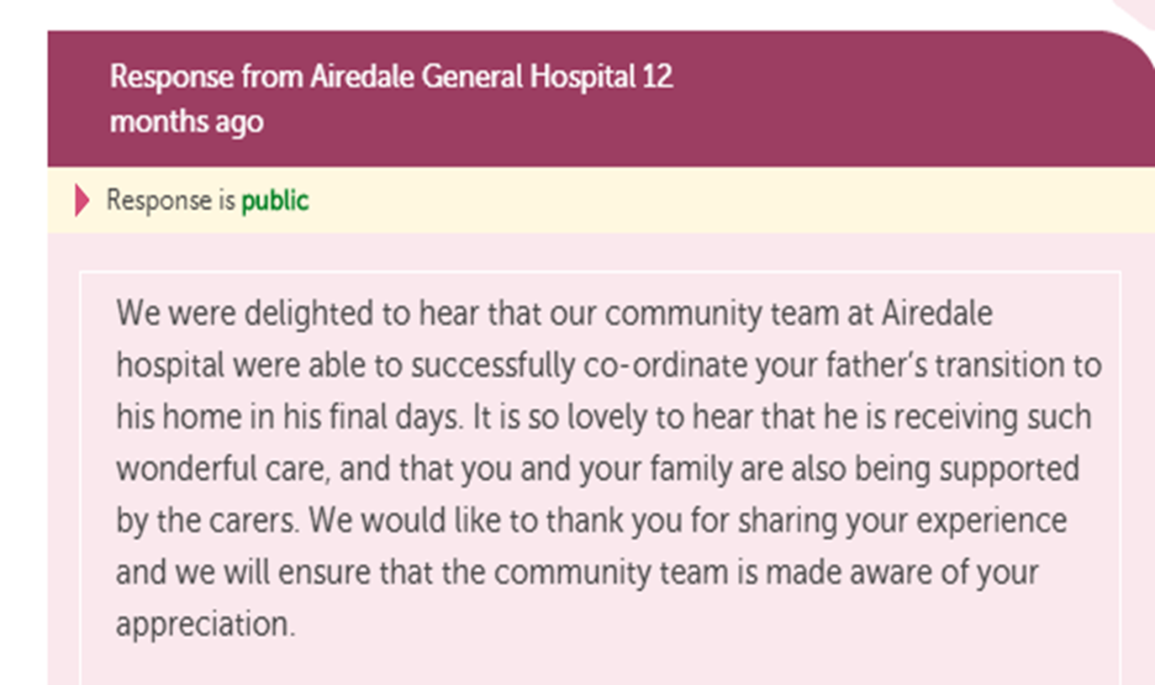
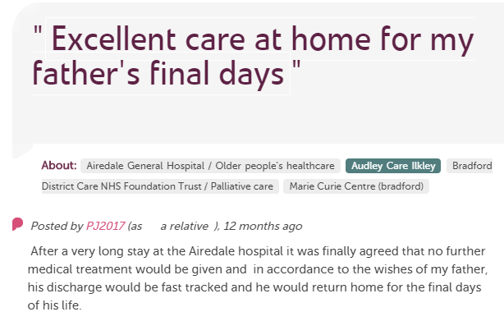
Integrated Feedback with Responses

Slide 16

Getting Onboard

Slide 17
Challenges and Opportunities
GPs-Individual Practices and Confederations
Care Homes
Domiciliary Care Providers
Local Authorities-Adult Social Care
CCGs-Continuing Health care

Slide 18
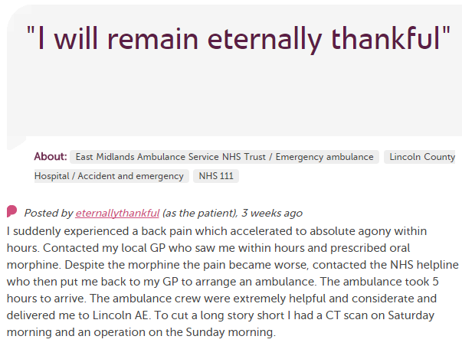











In each provider
Moderation
Clinical staff
Porters, reception, catering…
Pt exp, comms, complaints…
Alerting
CEO
Commissioners
Nursing, AHP students
Healthwatch
Researchers
Patient groups
Regulatory bodies
Local authority

Slide 19
Build your own subscription
Monitoring-Whatever your focus, Care Opinion can help you learn from and monitor public feedback. You can search all CCG areas, for activity across each patch including all primary care feedback. (inc NHS Choices)
Engagement-Care Opinion works right across the health economy in a flexible way to suit local circumstances. Many years of experience engaging with whole range of providers. Flexible moderation to suit each group.

Slide 20
Questions for you
How important is integrated feedback to you now and in the future?
How easy is it going to be to make joint arrangements for the right feedback to plan and monitor quality?

