Slide 1

Online Feedback in the context of changing landscape of care.
Tim Hunt, Integration Development Manager
tim.hunt@careopinion.org.uk

Slide 2

Getting Ready for:

Slide 3
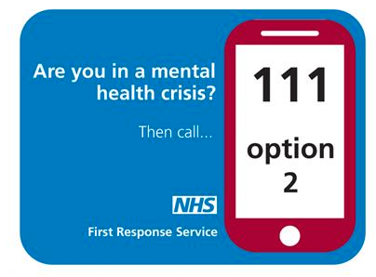
Integrated Care Systems-Making a difference
NHS organisations – including Cambridgeshire and Peterborough Clinical Commissioning Group – together with local authorities, Cambridgeshire Police and representatives from the third sector have also been involved in setting up the pilot projects, which aim to improve the way urgent mental health care is delivered and reduce the pressure on acute hospitals.

Slide 4
NHS England
Advanced local partnerships taking shared responsibility to improve the health and care system for their local population.
Breaking down barriers to better health and care. Local partnerships in every part of England to improve health and care in practical ways.

Slide 5
Challenges to come Local Authorities
Rather, the NHS needs to work differently by providing more care in people’s homes and the community and breaking down barriers between services.
Breaking down barriers means co-ordinating the work of general practices, community services and hospitals to meet the needs of people requiring care.” Kings Fund 2018

Slide 6
Local Authorities
Strong History of User Involvement
Not as far along with online feedback
Listed on Care Opinion
Can respond to feedback on services on registration subscription
Can be set up to monitor stakeholder services eg care homes and care providers
Can be set up as part of health economy

Slide 7

Working in Silos

Slide 8
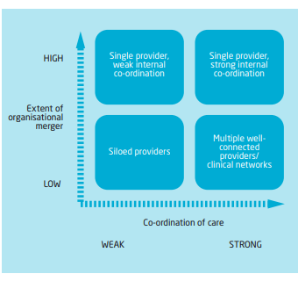
Kings Fund

Slide 9


Integrating Feedback-Moderation
This Photo by Unknown Author is licensed under CC BY-NC
This Photo by Unknown Author is licensed under CC BY-SA-NC

Slide 10

Meeting the Moderation Hotspots
Any Small Service
Primary Care
Residential and Nursing Homes
Mental Health Inpatients
Community Services
Multiple Providers
This Photo by Unknown Author is licensed under CC BY

Slide 11
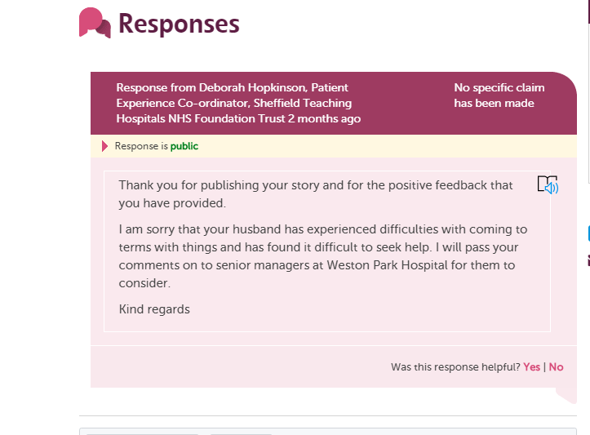
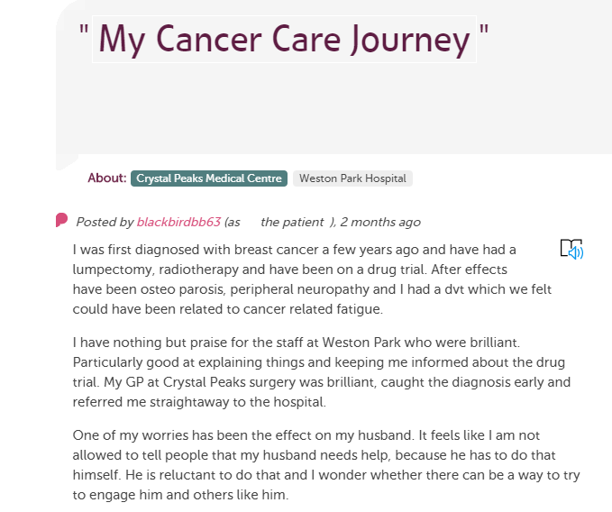
Cancer Care Pathway

Slide 12
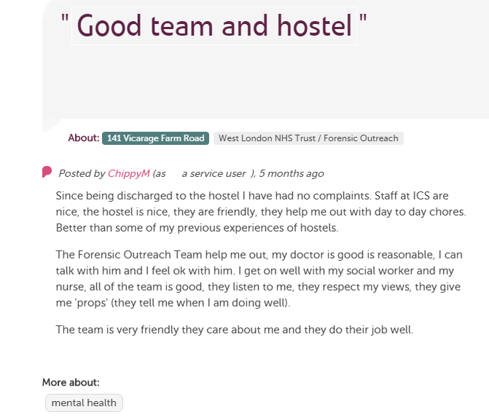

Slide 13
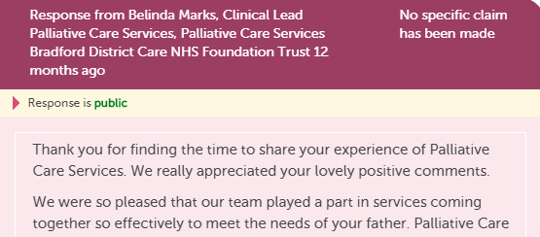
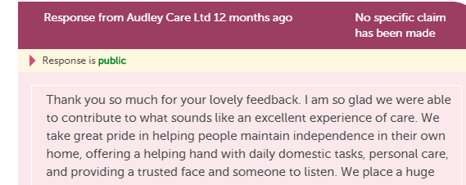
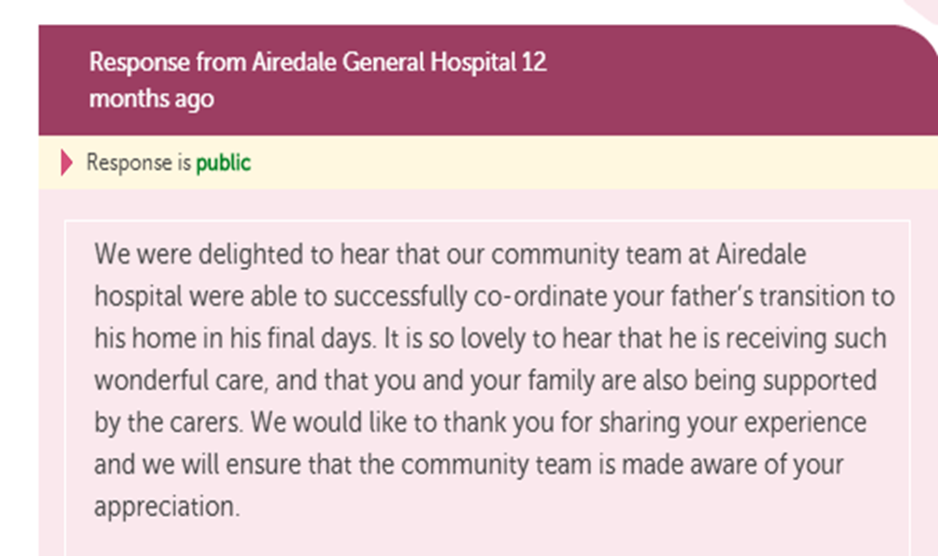
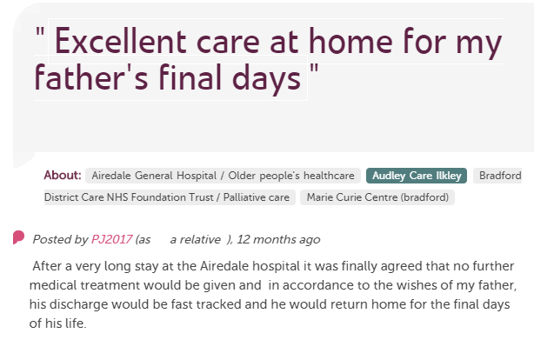
Integrated Feedback with Responses

Slide 14
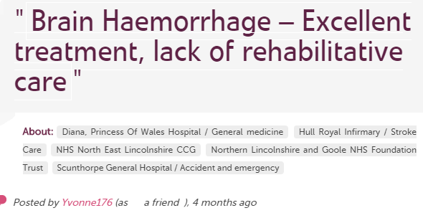

Providers and Commissioning

Slide 15
One journey: one story
Care home
Kindness
A&E
Waiting
Information
Recovery
OT
Physio
Care
Story
Response
Response
Response
Response

Slide 16
Changes are afoot
One of the consequences of these developments is that the commissioner/provider split that has underpinned health policy since the early 1990s is unravelling. Providers and commissioners are working together to establish ICPs and ICSs and some of the alliances of providers that make up ICPs are carrying out commissioning functions as subcontracting arrangements are put in place between lead providers and their partners. Clinical commissioning groups (CCGs) are either merging or agreeing to collaborate and are working closely with local authorities in many areas to develop joint or integrated commissioning.

Slide 17
Integrated Feedback
Changing the way we ask for feedback
Co-ordinating feedback across ICS/ Health Economy
Using Tags to collect themes
Projects looking at different care pathways-hospital discharge, substance misuse, mh
Working with vol sector, healthwatch etc.

Slide 18
Integrating Feedback-Key Components
Joined up feedback
Providers welcoming feedback about their service and others
Commissioners and other stakeholders listening and learning
Grassroots engagement-public aware of opportunity to feedback about ALL their story
Top down-engagement at senior level
Feedback reaches into and matches the emerging systems.

Slide 19

Structures and People

Slide 20
Getting Ready for Integration
How will the new commissioning/provider arrangements affect you?
What are the challenges and opportunities for your organisation?
How will you know whats working-feedback arrangements?

Slide 21
Thanks for listening
tim.hunt@careopinion.org.uk

