Slide 1
The Impact of Listening

Slide 2
Session Aims
In this session we will hear from 3 speakers, from 3 different services across the UK:
April Brooks, Sexual Health Service
Maria Garvey, Maternity Service
Gail Patel, Long Covid Support

Slide 3
Session Themes
We will share and discuss the impact of listening to stories.
Speakers will share their experiences of listening to authors and how this has impacted their team and/or service
We will cover themes:
The benefits for staff of engaging with feedback
Patients and the impact of knowing they are being listened to
Impact on service improvement

Slide 4
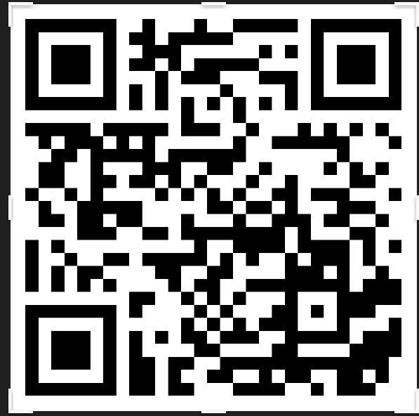
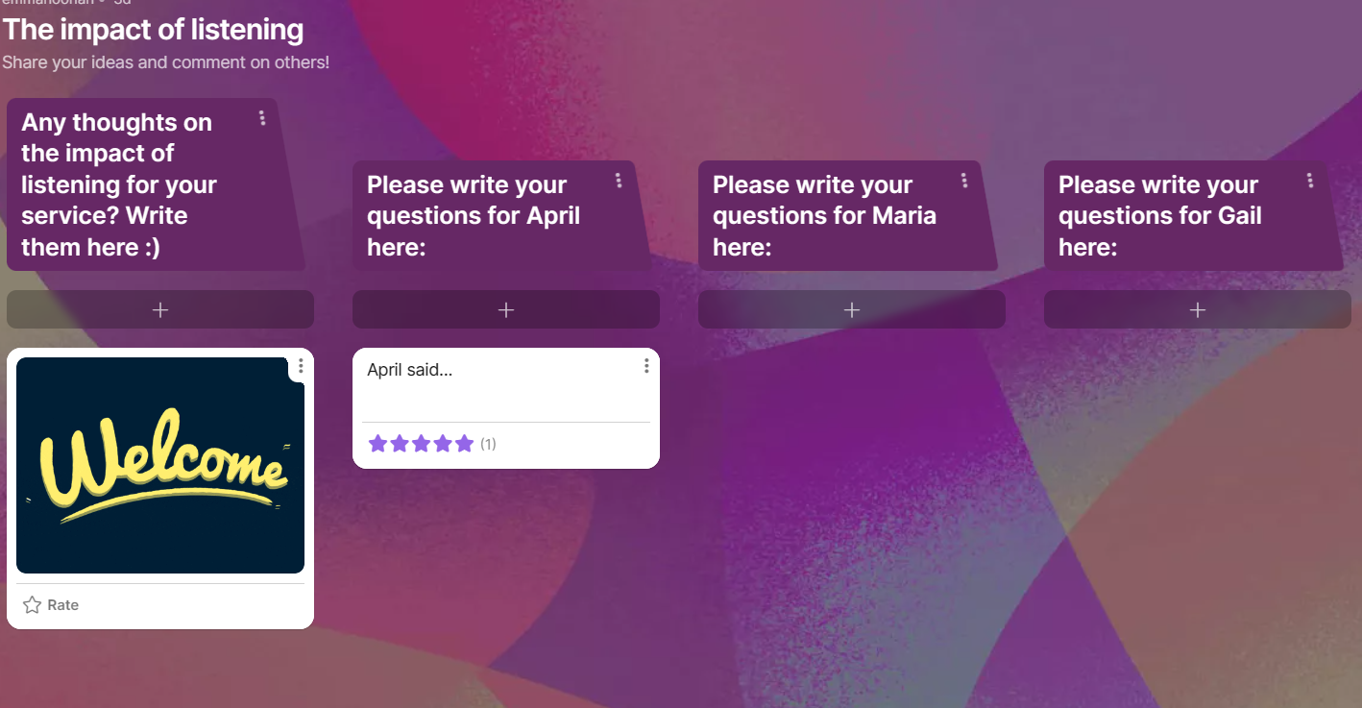
Any questions or thoughts? The impact of listening (padlet.com)
Are you willing to try Padlet to help contribute to the CO resource bank?
No obligation at all-the chat is a super alternative function
Questions will be selected after the all 3 presenters have spoken
A summary of the answers will be included on the Padlet
Notes:
Emma to tidy the slide
Explain how it works
Jot down questions on Padlet as we go
Use the chat if Padlet aint your thing
Remember to include the name of speaker

Slide 5
April Brooks
Lead nurse-Devon Sexual Health
Using Care Opinion for the past 6 months and received more than 400 stories between the Exeter and Barnstaple clinics.
Notes:
Liz to introduce the speakers. Emma to add trust log etc… few details. Name, job title, where from.

Slide 6
Maria Garvey
Lead Midwife, Continuity of Midwifery Carer (CoMC) Team Emerald
Southern Health and Social Care Trust, Northern Ireland
156 births where 72 patients have shared their stories…Amazing response rate of 46%.

Slide 7
Gail Patel
Specialist Physiotherapist
Perth & Kinross Long COVID Support
Offering a physiotherapist-led service to adults with long COVID.

Slide 8
Any questions or comments ?
Notes:
Emma and Lisa-Emma to select two questions from the Padlet and Lisa to select from chat. Any final comments from the audience! Lisa first, Emma second.

Slide 9
Finally…
Notes:
LIZ! Thank you, it was an interesting session….. Enjoy a little break now and at 11.30 please do join the ‘so you respond, what next? Session, Hosted by our Fraser Gilmore

