Slide 1


The Golden Thread
- Engaging and Championing the Public
-Listening to Sign Language Users to improve access to sharing experience

Slide 2

“… Lucie weaves her golden thread through people’s lives, she binds them into a better destiny, a tight;y knit community of family and close friends…”
-Charles Dickens ‘A Tale of Two Cities”

Slide 3
Our Project:
“Listening to Sign Language Users to improve access to sharing experience”

Slide 4

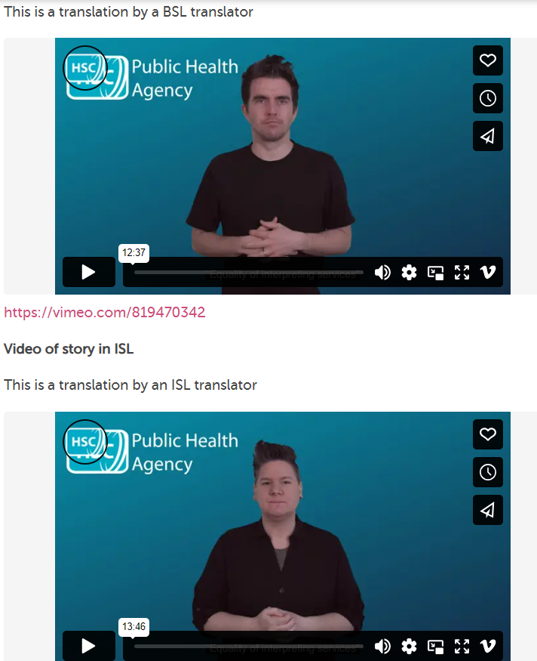

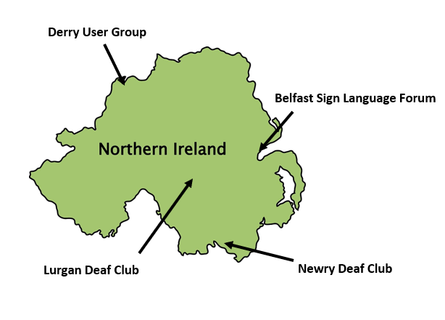





Slide 5
AIM
To develop a mechanism for people to share their experience of HSCNI in Sign Language and receive a response in sign language
DESIGN
TEST
Pilot the process, value the feedback,
REDESIGN
Identify what matter most to a sign language use
Explore the functionality available, opportunities, gaps in the resourcing
reconsider the process
Return to the process, explore the learning and redesign

Slide 6
Underpinning approach at every stage
Building Trust/Relationships
Agreed Purpose
Open Communication
Challenging Assumptions

Slide 7
REVIEW
Review any final changes with key stakeholders – this includes testing
PROMOTION
SHARE
Look for every opportunity across all the stakeholders to share the new process. Show case the process as best practice
STAY CONNECTED
Co Design the promotion material to ensure effectiveness of the messaging
Keep everyone engaged in the cycle of learning

Slide 8



Slide 9
Invite you to connect with us:-
Linda Craig:
Regional Lead for Regional PCE: Linda.craig3@hscni.net
Dalrene Masson:
Project Lead for PCE: Dalrene.masson2@hscni.net

