Slide 1
“Defining both the problems and the solutions in healthcare has to be a partnership between professionals and the communities they serve. “
Jeremy Taylor. National Voices UK

Slide 3
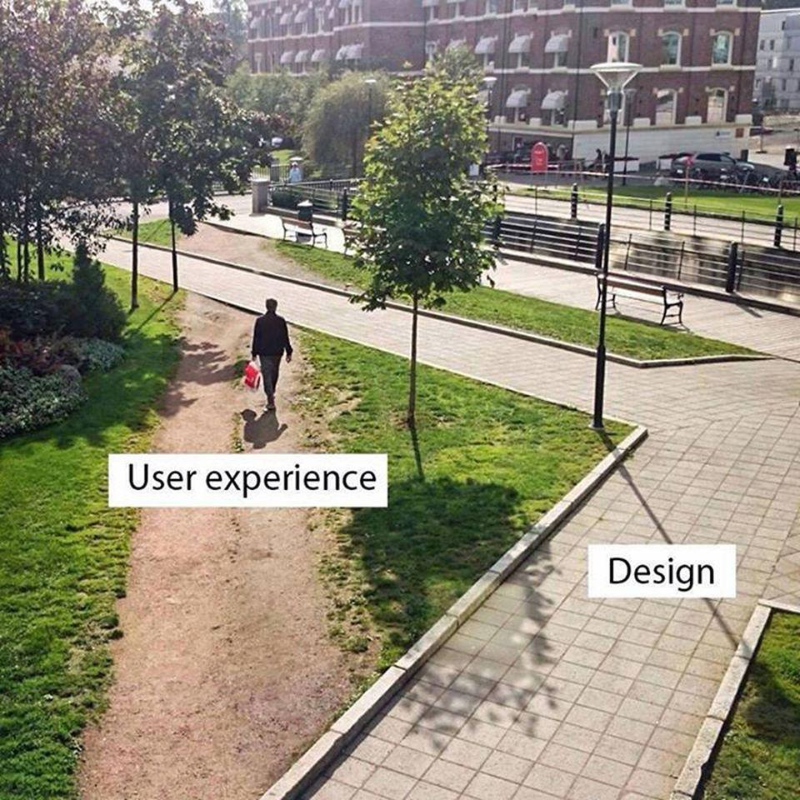
Disease and doctor centric
Care -and research -fragmented
wasteful
and inefficient
Poor understanding of patients experience, priorities. preferences and resources
What outcomes and services they value

Slide 4
Co producing research with patients +public
NIHR (UK)
PCORI (US)
SPOR (Canada)

Slide 5
Service co -design and delivery
ParkinsonNet
User-driven HIV Clinic

Slide 6
#PI in medical education
Patient generated CME : BMJ "WYPIT" series
Patients teaching and assessing student competencies
Peer2peer eg RA Warrior, Empowered#patientchat

Slide 7
Co creating the curriculum with patients Radboud UMC
BMJ Opinion Sept 6 2018 Thomas Vijn
.

Slide 8
Unlocking the potential of complaints to improve health care
Millbank Quarterly 2018 Vol 96 No 3 (pp 530-67)
Patient-Centred Insights: Using Health Care Complains to Reveal Hot Spots and Blind Spots in Quality and Safety
Alex Gillespie + Tom Reader

Slide 9
