Slide 1



Spring Online Conference 2024
Star Responder Awards!

Slide 2

Responding to Stories on Care Opinion – Not just a simple reply
Being human
A chance to explain how/why a service works a certain way
A chance to problem solve/say thank you/apologise
An opportunity to make or plan a change
Advice and updates can be offered
Read by the public
Notes:
A Star Response goes above and beyond a good response. So firstly, what makes a good response?
A good response to a story can make the world of difference. It lets the author know they’ve been listened to and valued. And it can help your organisation show how you’re making important changes.
Here are some of the things we look out for at Care Opinion and use in our training. In a good response the responder:
Is polite and personal
Says who they are, and why it is them who is responding
Includes a photo on their profile (this helps people relate to them as a person)
Responds in a timely way (2 or 3 days is ideal, and up to a week is acceptable by authors)
Thanks the author for taking the time to write their story Accepts the author’s version of events
Responds to the author’s personal experience
Explains what normally happens, or why the author’s experience may have happened
Apologises sincerely if an apology is called for. (And isn't tempted to say “I’m sorry you felt that…” )
Gives their contact details and offers a follow-up if needed

Slide 3


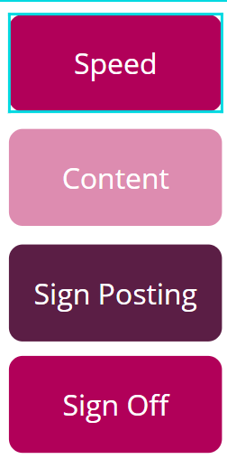
Good practice in responding
Your name, role & responsibilities
Your picture
Why you in particular are responding
Within 7 days at the most
If slower, apologise and explain why
Personal and specific
Thank author for feedback
Apologise and offer help as needed
Offer follow up if wanted
Other relevant services, with contact details and a named person if possible
Offer multiple ways of contacting if possible
Blog post : Link to
‘What makes a good response
Polite and personal
Would you be satisfied receiving this response?

Slide 4
So, what makes a Star response?
A Star Responder does all the things listed previously
Address each point one at a time
Showing real empathy towards the author’s situation/experience
Think of their response as an open and honest conversation rather than a task to be completed
Include images and links to show people what they’re talking about. Eg we’ve improved the signage – here's a picture
Follow-up their response, updating the author on actions now taken
Comment on how the person’s feedback may help other patients/service-users
Being creative in your responses
Want to nominate a star responder in your organisation?
Find out more here:
Star Responder
Notes:
Address each point one at a time, taking the time to work out what is really important to the author
Show empathy towards the author’s situation/experience
Are clear about what they’re going to do with the feedback in the story, eg “I’ll take it to the staff meeting next week”
Explain why there’s been a delay if there has been (people usually understand if you’ve been on holiday or were unwell)
Think of their response as an open and honest conversation rather than a task to be completed
Include images and links to show people what they’re talking about. Eg we’ve improved the signage – here's a picture
Follow-up their response, updating the author on actions now taken
Comment on how the person’s feedback may help other patients/service-users
Signpost to websites, organisations or charities relevant to person but not part of their service
In positive feedback, ask the author to mention anything they felt could be improved as part of their experience
Make a change planned into a change made

Slide 5

And the Winners are…

Slide 6

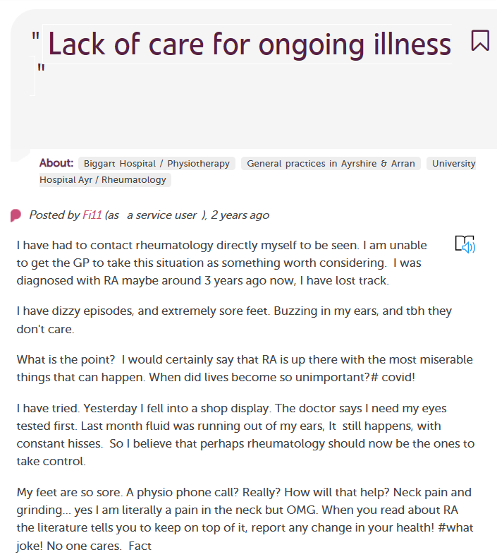
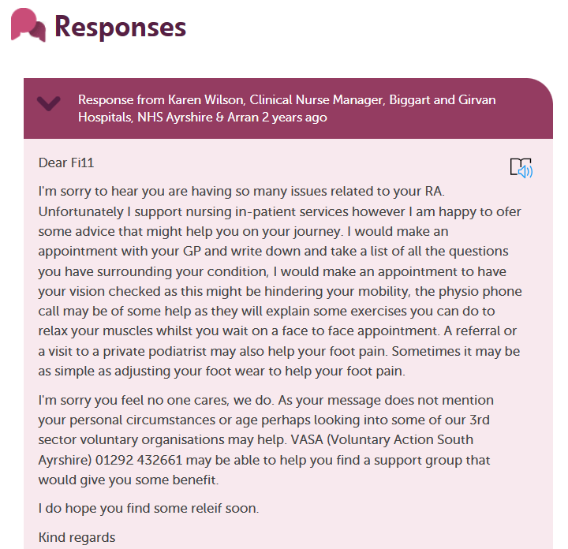
Karen Wilson, Clinical Nurse Manager
NHS Ayrshire & Arran
Lack of care for ongoing illness | Care Opinion
Notes:
Karen Wilson, Clinical Nurse Manager, NHS Ayrshire & Arran
Nominated by Pamela Gibson
“Although the example I have provided is from some time ago, it embodies the caring nature that Karen so clearly demonstrates in her responses. She was 'tagged' into a story that was not within her remit, however she showed genuine empathy for the story author and provided thoughtful and caring advice.
This continued with further online support for this author when they responded to her initial response.
Karen always responds in this same person centred way to all stories told about her remit”.

Slide 7
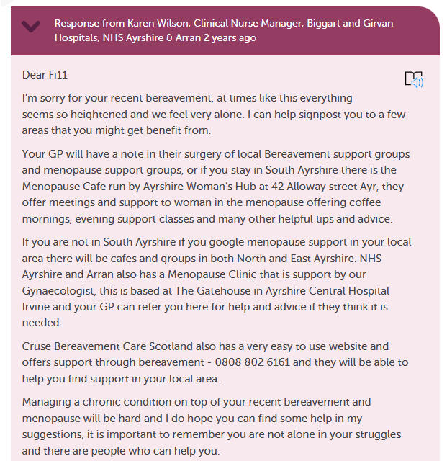
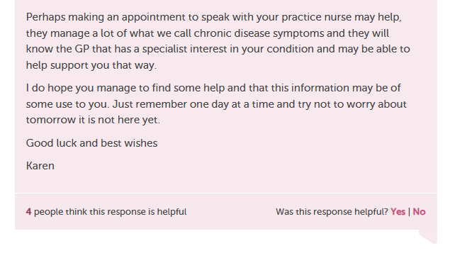
Karen Wilson, Clinical Nurse Manager
NHS Ayrshire & Arran
Lack of care for ongoing illness | Care Opinion
Notes:
Karen Wilson, Clinical Nurse Manager, NHS Ayrshire & Arran
Nominated by Pamela Gibson
“Although the example I have provided is from some time ago, it embodies the caring nature that Karen so clearly demonstrates in her responses. She was 'tagged' into a story that was not within her remit, however she showed genuine empathy for the story author and provided thoughtful and caring advice.
This continued with further online support for this author when they responded to her initial response.
Karen always responds in this same person centred way to all stories told about her remit”.

Slide 8
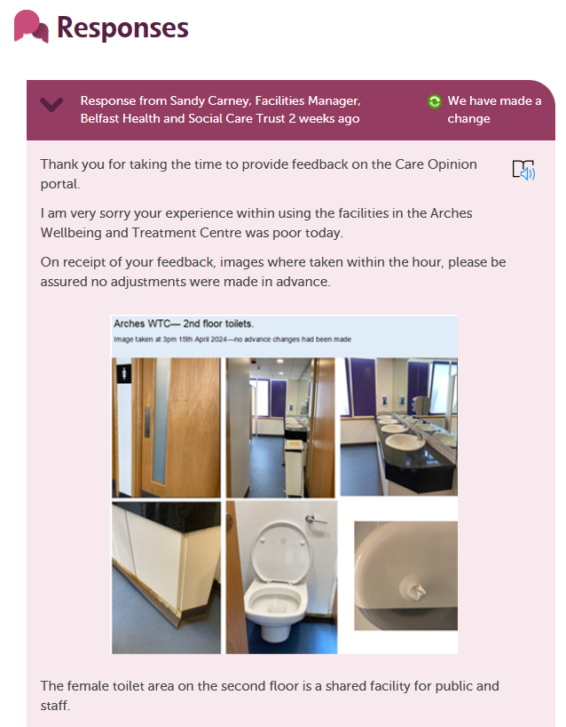
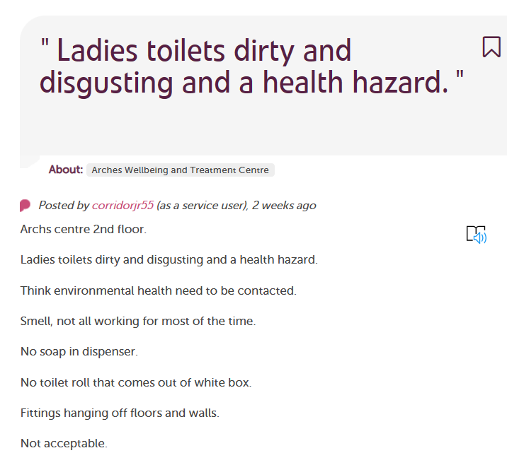

Sandy Carney, Facilities Manager,
Belfast Health & Social Care
Trust
Dirty toilets | Care Opinion
Notes:
Sandy carney, Facilities Manager at BHSCT
Nominated by Maire Alexander
“Sandy not only apologised for the issues that were raised but gave a really detailed explanation of what the process normally is and made changes to ensure that issues wouldn't be raised again.
It felt that she not only engaged with the feedback, but really embraced it. She included photos of the area as well as explaining what she would change as a result. It felt like there was care and intent behind her response and that hopefully others would benefit from the impact of the feedback”.

Slide 9
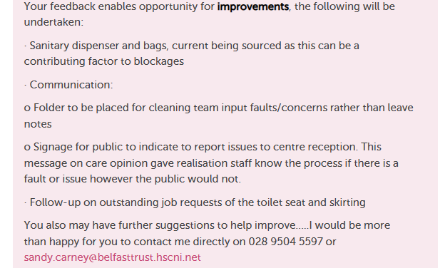
Sandy Carney, Facilities Manager,
Belfast Health & Social Care
Trust
Dirty toilets | Care Opinion
Notes:
Sandy carney, Facilities Manager at BHSCT
Nominated by Maire Alexander
“Sandy not only apologised for the issues that were raised but gave a really detailed explanation of what the process normally is and made changes to ensure that issues wouldn't be raised again.
It felt that she not only engaged with the feedback, but really embraced it. She included photos of the area as well as explaining what she would change as a result. It felt like there was care and intent behind her response and that hopefully others would benefit from the impact of the feedback”.

Slide 10
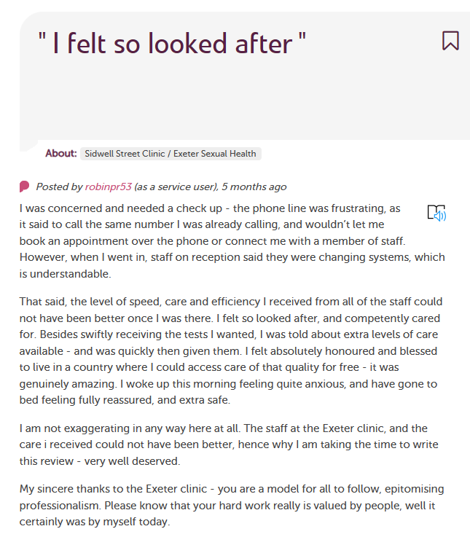
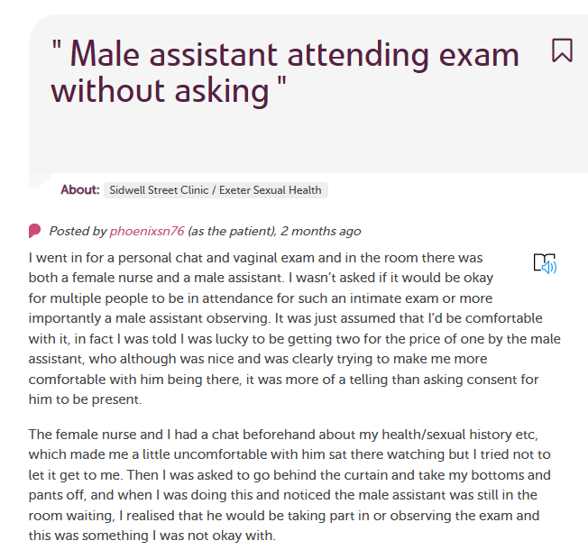
April Brooks, Devon Sexual Health, Royal Devon Uni Healthcare NHS Trust
I felt so looked after | Care Opinion
Male assistant attending exam | Care Opinion
Notes:
April Brookes, Devon Sexual Health, Royal Devon University Healthcare NHS Foundation Trust
Nominated by Lisa Townsend
“I am not sure where to start but April's responses are the very best example of "what good looks like" and if I could bottle her enthusiasm and professionalism in how she responds to feedback for the Sexual Health service, I would. April not only responds, but also leads her team by example, she encourages her team to listen, understand and act upon feedback in the same manner that she does, this really is a service that demonstrates a commitment to continuous improvement and patient centred care”.
One example wasn't enough, here is another example of how she responds to a critical story when the user had left the most honest and emotive feedback. She has a special caring manner and I am proud to work alongside her.

Slide 11
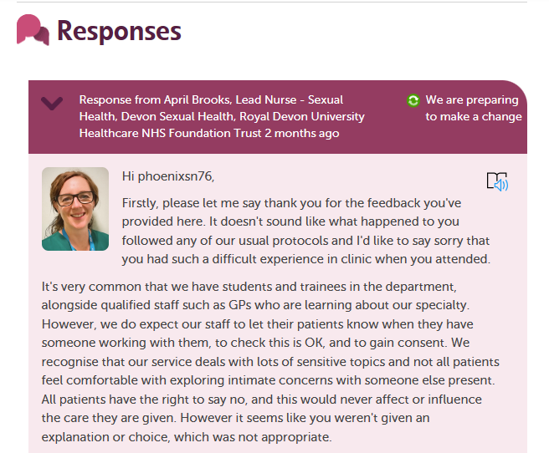
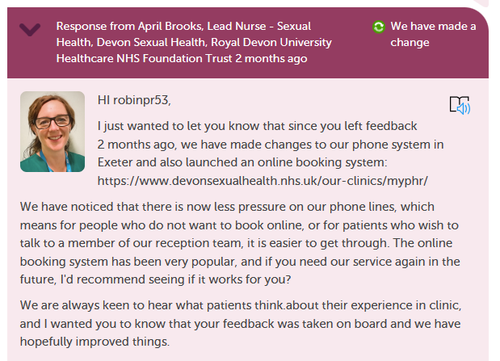
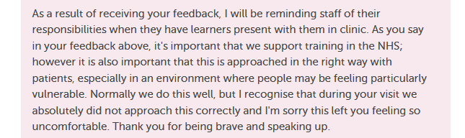
April Brooks, Devon Sexual Health, Royal Devon Uni Healthcare NHS Trust
I felt so looked after | Care Opinion
Male assistant attending exam | Care Opinion
Notes:
April Brookes, Devon Sexual Health, Royal Devon University Healthcare NHS Foundation Trust
Nominated by Lisa Townsend
“I am not sure where to start but April's responses are the very best example of "what good looks like" and if I could bottle her enthusiasm and professionalism in how she responds to feedback for the Sexual Health service, I would. April not only responds, but also leads her team by example, she encourages her team to listen, understand and act upon feedback in the same manner that she does, this really is a service that demonstrates a commitment to continuous improvement and patient centred care”.
One example wasn't enough, here is another example of how she responds to a critical story when the user had left the most honest and emotive feedback. She has a special caring manner and I am proud to work alongside her.

