Slide 1
So what have we learned?
Sharon Kidd
Patient Experience Manager

Slide 2
Human experience matters most “You can argue with figures and statistics, but you can’t argue with personal experience”.
Stephen Elsmere
Patient, Carer & Experience of Care Partner with the NHS Leadership Academy

Slide 3
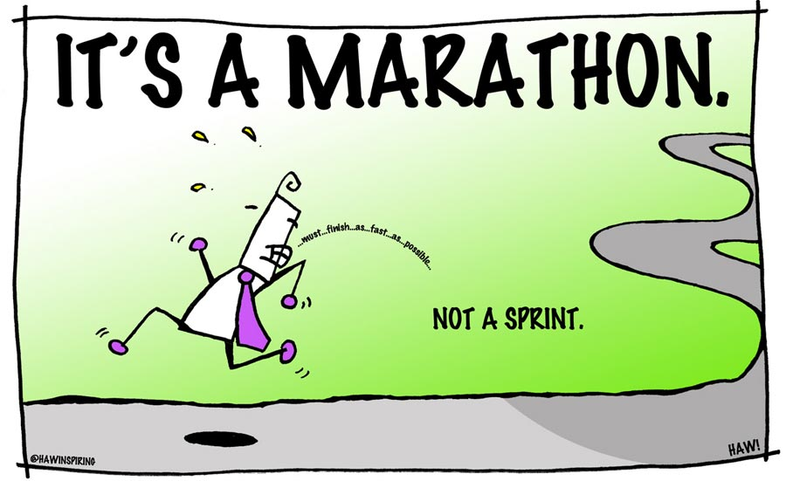

Slide 4
So what have we learned so far….
Process
Responding
Sharing
Champion areas
Learning

Slide 5
Process
Robust Care Opinion process for responding
Patient Experience Team are gatekeepers
CEO and Chief Nurse receive all story notifications
Care Opinion intranet pages
Care Opinion stories are recorded in Datix

Slide 6
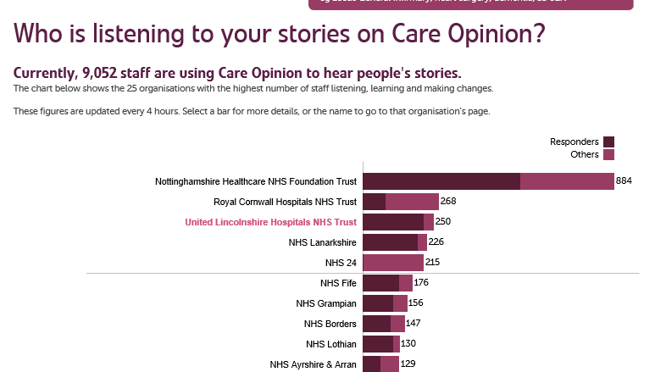
Responding
Who is best to respond?

Slide 7
https://www.careopinion.org.uk/695997
I read so many horror stories about this particular procedure when moderating stories on Care Opinion and it was such a refreshing change to hear how staff can make such an unpleasant procedure better and make the patient feel so reassured.
Well done to you and your team 😊 I will use your response as an example of best practice.
With best wishes
Tracy

Slide 8
Sharing
Positive patient stories have a great impact on staff morale, especially when we read/hear negative things. It’s the only place we can escape from it
ULHT Together Facebook
Launched December 2015
Currently 5,500 members of staff from 8,500
Post positive stories only
Staff morale
Summary reports
Widgits – intranet and internet pages
I thinks it’s a great way to share positive feedback, a real morale boost. We can all check the Care Opinion site – patients included and negative feedback should be communicated through ward meetings
I like to see the positive stories. However I don’t feel this is the right forum for negative feedback
Notes:
Site launched to welcome international nurses to offer them supoprt. Idea has grown and not just nurses. Allows staff to share ideas, ask questions provide help

Slide 9
Championing areas
FAB Experience Champions role
Engagement
Gynae services
Paediatric blood clinic

Slide 10
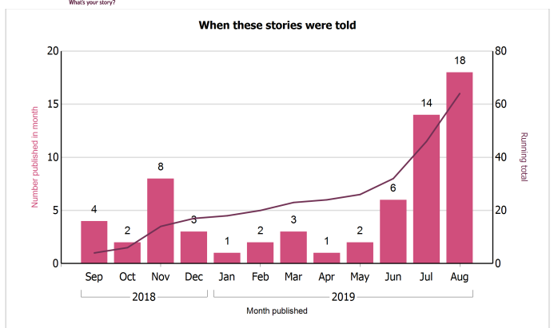
Gynae…the inside story ☺
Can you spot when the Champions started handing out awareness cards?

Slide 11
How did people feel about their experience of Gynae services?

Slide 12
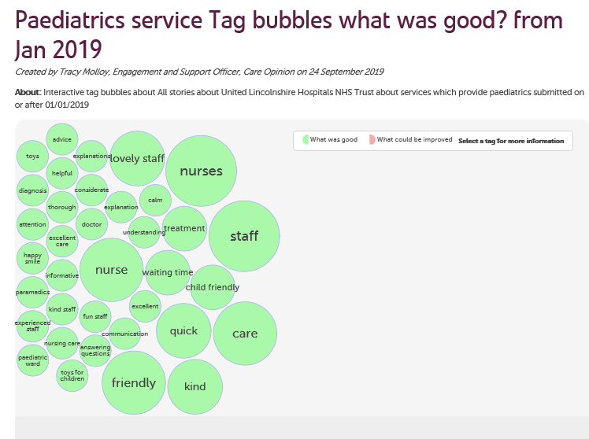
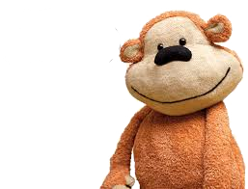
Monkey Care Opinion
Clinic 5 – dedicated paediatric clinic at Lincoln County Hospital
Clinic decorated
Feedback box
Monkey feedback cards
Monkey feedback wall
20 stories so far

Slide 13
My son's first visit to hospital
https://www.careopinion.org.uk/698868

Slide 14
‘Bed Crisis’
Themes:
Admitted for signs of stroke
Acute physician wanted to rule out seizure
MRI requested for this reason
MRI screening form could have been done sooner
Poor communication
Culture of keeping patients in hospital just for tests
Notes:
AP to go through.

Slide 15
Planned Actions
Culture Change – Doctors
Communication to wards re completion of MRI Screening Form
Valuing patients time
Ongoing capacity and demand modelling to look at MRI capacity requirements
Ambulatory MRI Pathway - for Urgent next days scans for patients who might be able to go home and come back in
New comfortable chairs in the ‘fit to sit’ area!
Notes:
AP will go through this, but with Michael’s help.

Slide 16
