Slide 1

Leigh Morgan
PCE Facilitator for Online User Feedback

Slide 2
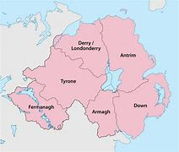

Care Opinion Northern Ireland

Slide 3

It’s a Journey

Slide 4
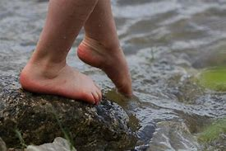

Slide 5


Slide 6
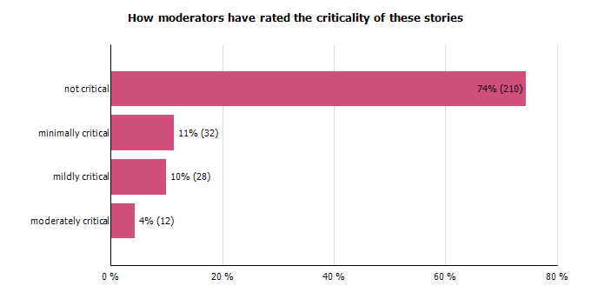

Slide 7


Slide 8
Thank You

