Slide 1
We care
We respect
We listen

Slide 2
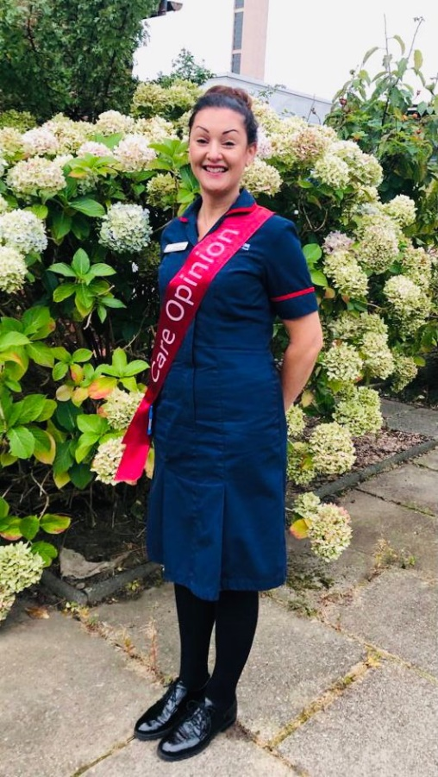
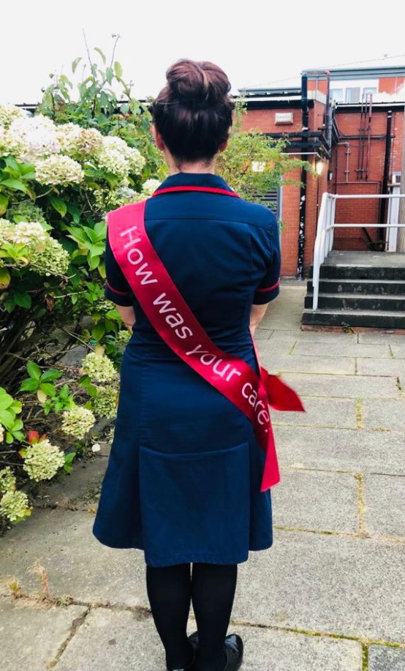
Emma Rogers
Matron for Patient Experience

Slide 3
#hellomynameis…
Introduction
My name is Emma Rogers and I am the Matron for Patient Experience at Stockport NHS Foundation Trust and is a role I have been doing for the past 4 years. My role is to lead the patient experience agenda ensuring that patients, their families and carers receive an experience that not only meets but exceeds their expectations of services at the Trust.
On the 2nd July 2018 Care Opinion was successfully launched at Stockport NHS Foundation Trust within Stepping Hill hospital. Care Opinion provides patients, carers, family and friends with a system to share their experiences of health and care and allows us to provide real time feedback
The feedback we receive from Care Opinion has enabled us to invite patients and their families into the organisation to discuss the care they received. The patient and families are also invited to partake in the filming of patient stories which enable the trust to share good practice, implement change and allow for lessons to be learned.

Slide 4
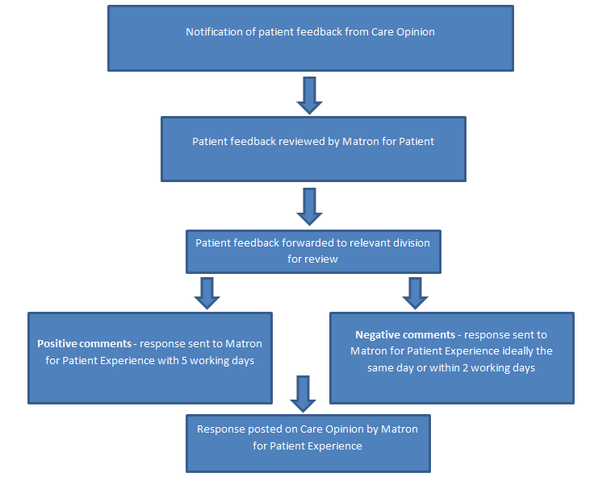
Our Care Opinion process
We have implemented a process to ensure all posts on Care Opinion are responded to quickly and by the relevant teams.
The Feedback Process

Slide 5
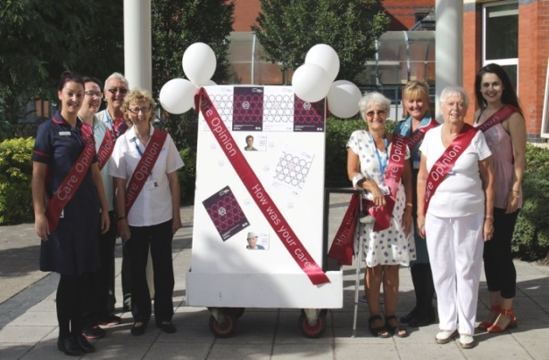
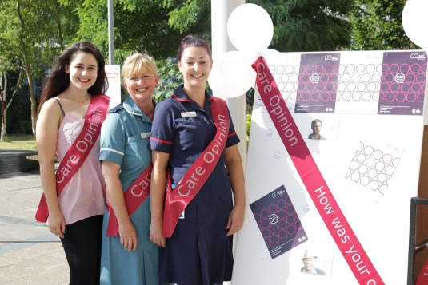
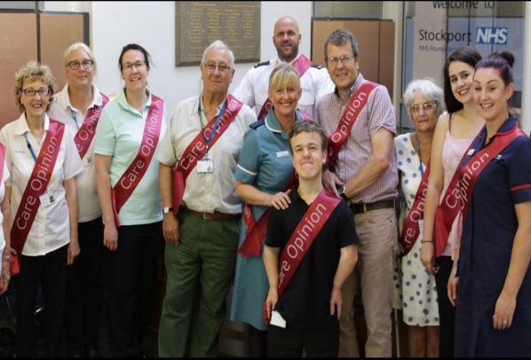

Slide 6
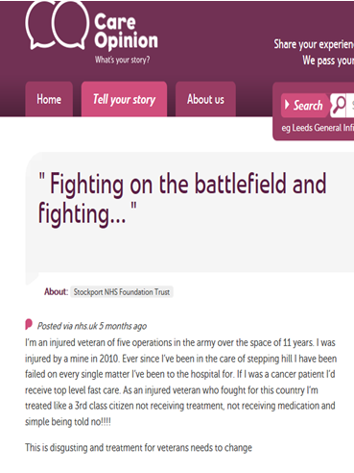

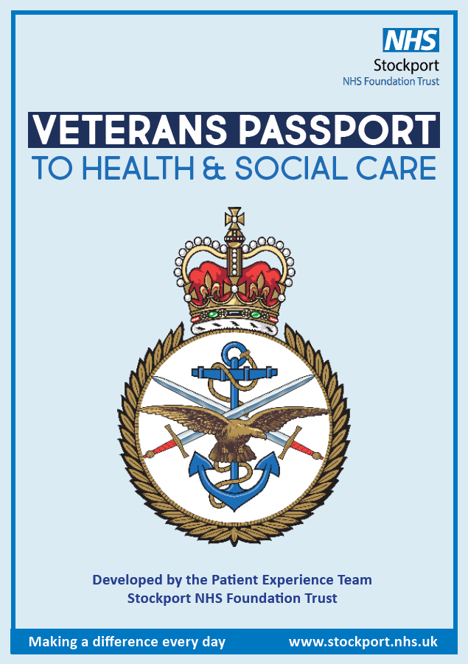
Impact of Care Opinion
Veteran Project
The Veterans project commenced in July 2018 following a comment posted on the ‘Care Opinion’ feedback portal by a patient and armed forces veteran. The comment raised the issue that the support for armed forces community was not adequate.
We invited the patient in to discuss the issues in more detail and the idea for a Veteran’s Passport was raised by the patient. It was highlighted that in any hospital or GP visit, a number of questions, (often the same question from different people), about patients’ history are asked. This information can sometimes be difficult and / or distressing to recall. The purpose of a passport would be to provide this history information in written format in a small handbook; thereby reducing the need to healthcare professionals to ask this verbally.

Slide 7
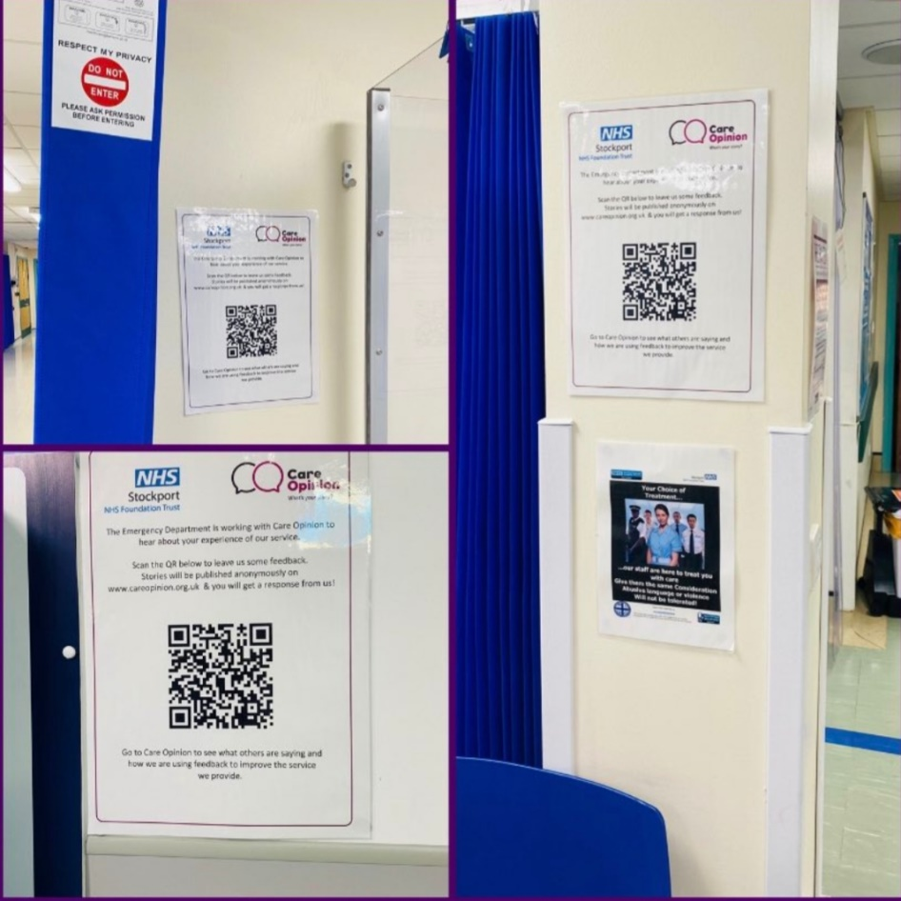
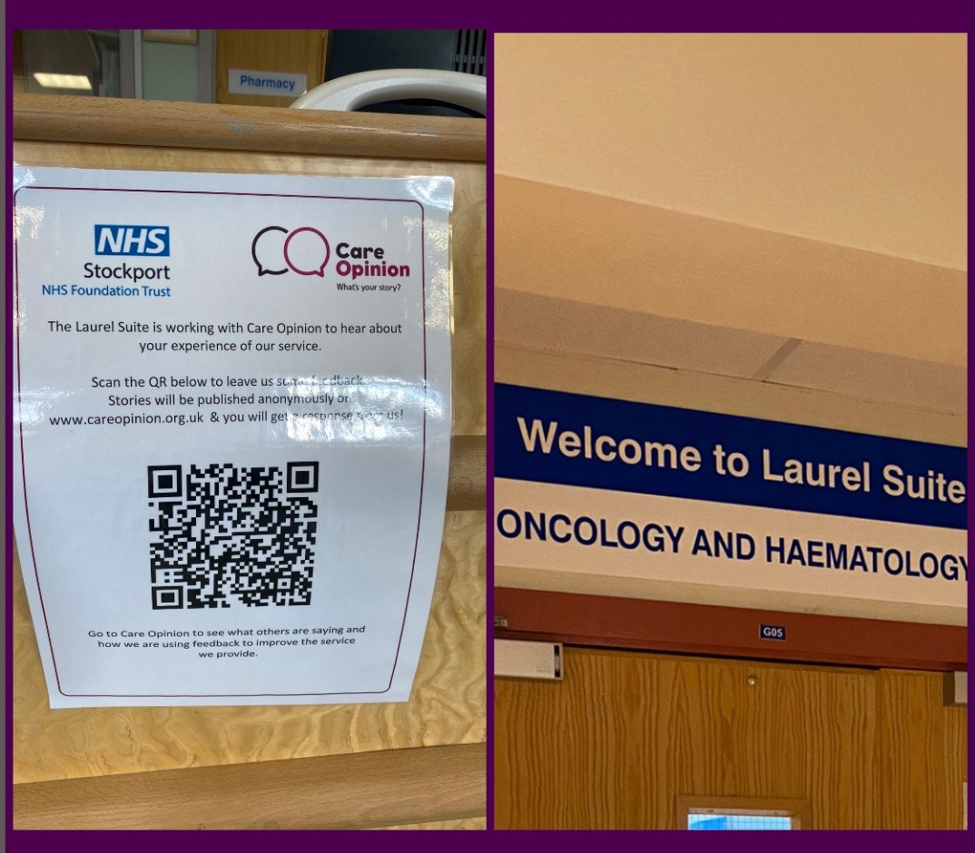
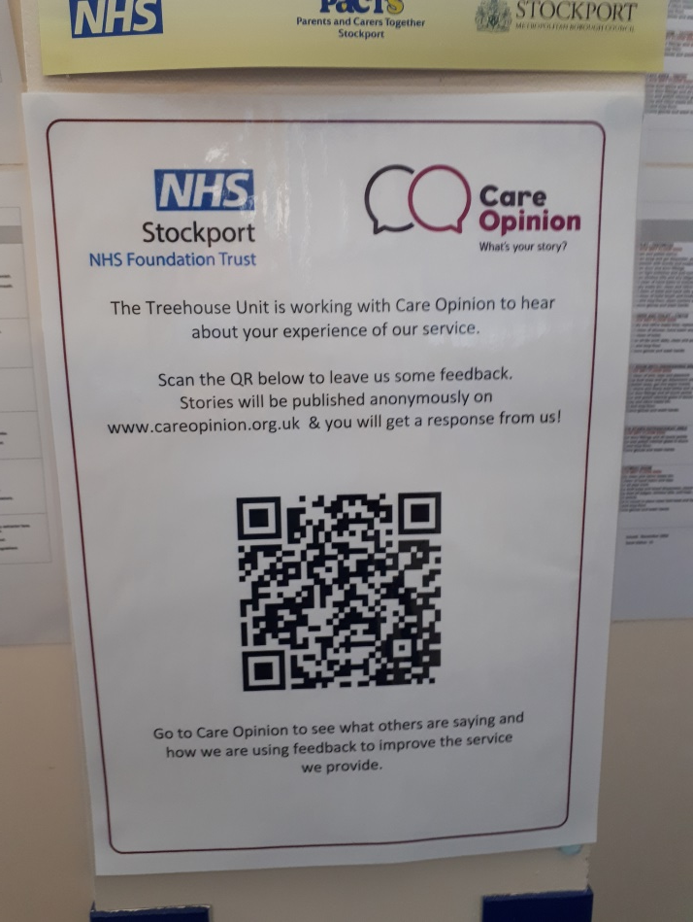
QR Code Posters
Bespoke feedback
The introduction of the new QR posters has meant that we can support departments to receive feedback about their service directly.
The posters are up in all of our Outpatient departments, Emergency Department and some other specialist areas and will provide patients, carers, families and visitors another way to tell us about their experiences.
We have also use the QR codes to develop smaller handouts that can be given to patients who may wish to submit their feedback from home.

Slide 8
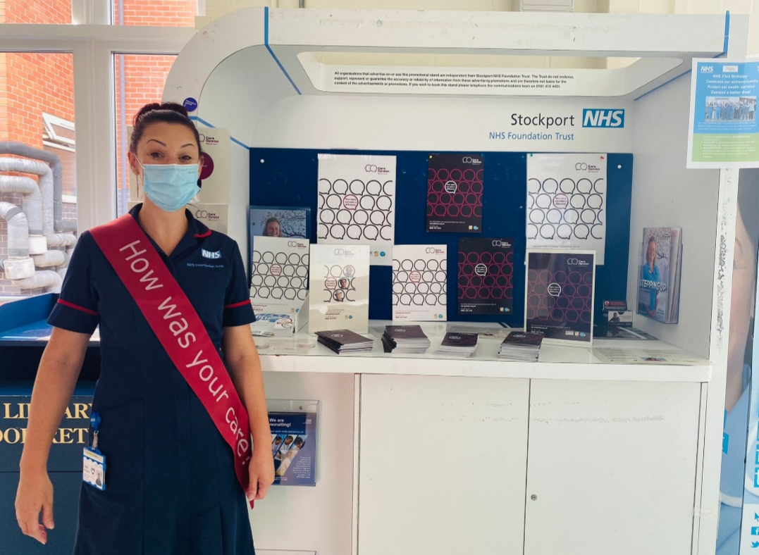
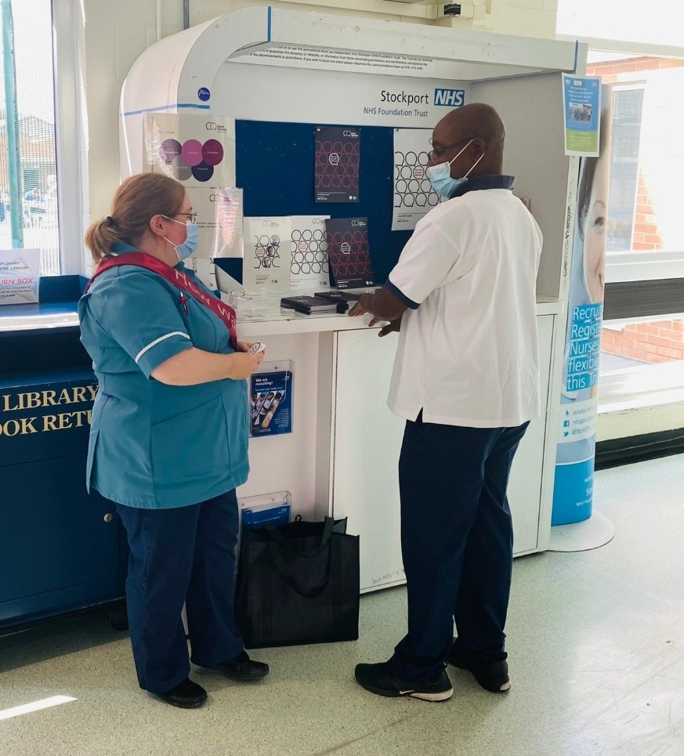
Care Opinion Promotion
Monthly Information Stalls
Veteran Project
As part of our ongoing commitment to promoting Care Opinion, we are holding information stalls within the hospital. The aim is to inform staff, patients and visitors about the role of Care Opinion and share the impact the feedback has had on the services we provide.

Slide 9
Any Questions..?

