Slide 1
How to Respond Well
Notes:
Tracy

Slide 2
In this session, we’ll help you...
Learn how to respond using the Care Opinion site
Understand what makes a good response
Think about what the author might want from a response
Think strategically about responding and how it can create change in services
Notes:
Tracy

Slide 3
Notes:
Poll

Slide 4
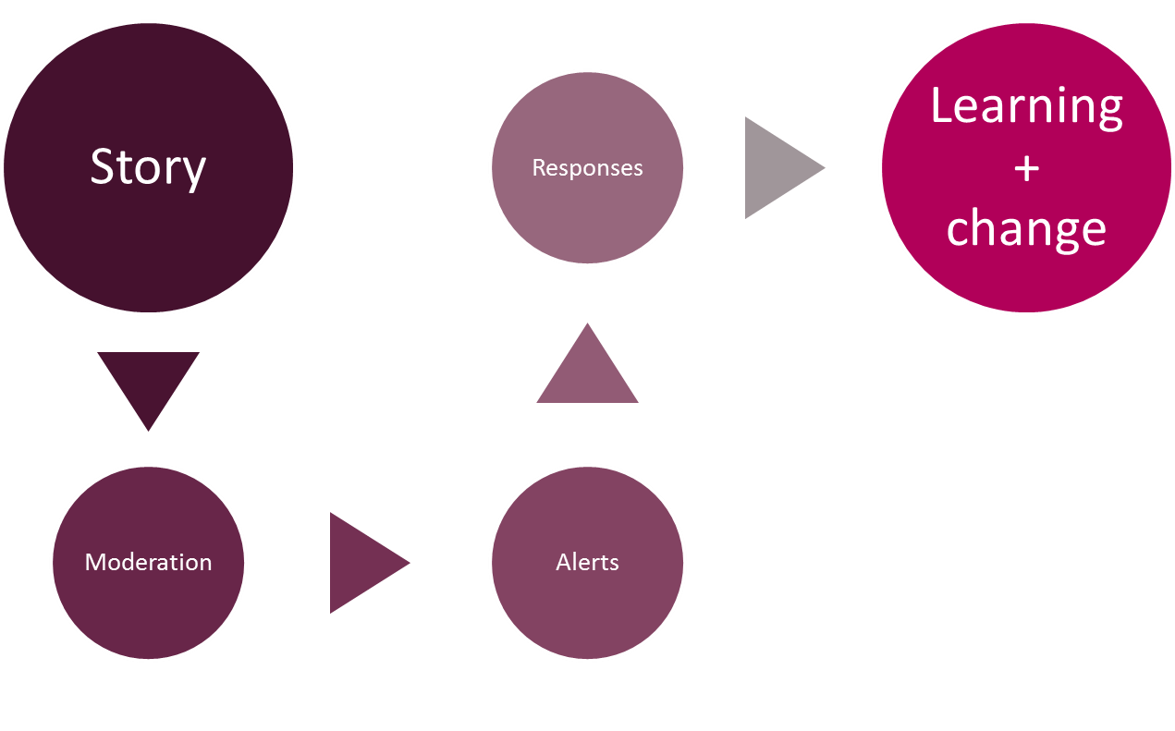
Stories – it’s about the conversation
Notes:
Tracy

Slide 5
Points before we start!
You, other responders and the author can respond to each other as many times as you wish
Never ask an author to disclose their personal information publicly – All responses are public once published on the website
By having a transparent, honest and safe conversation on Care Opinion, you can demonstrate to the public, how your service listens to feedback, resolves problems and works towards positive change
Notes:
Lisa

Slide 6
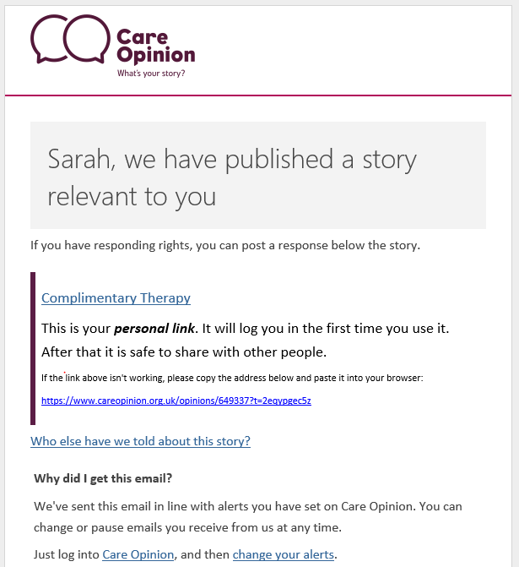
Practical Tip!
The link only log’s you into the site the 1st time
Notes:
Lisa

Slide 7
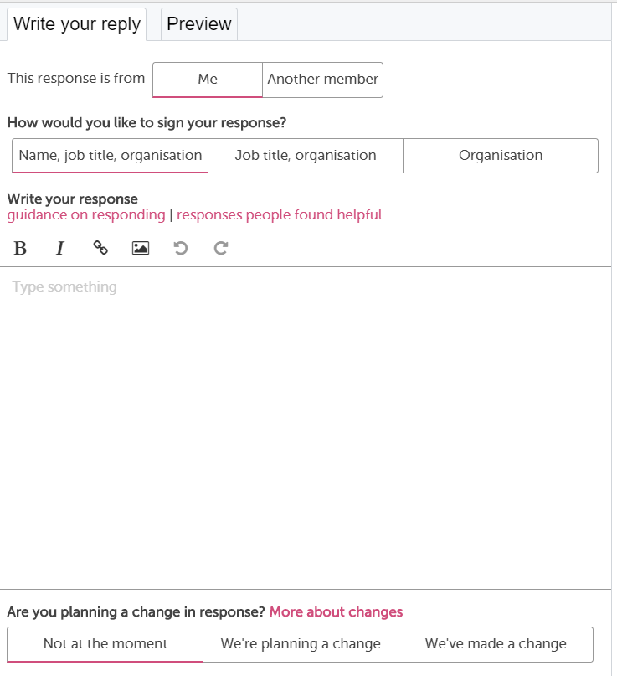
Notes:
Lisa

Slide 8
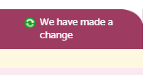
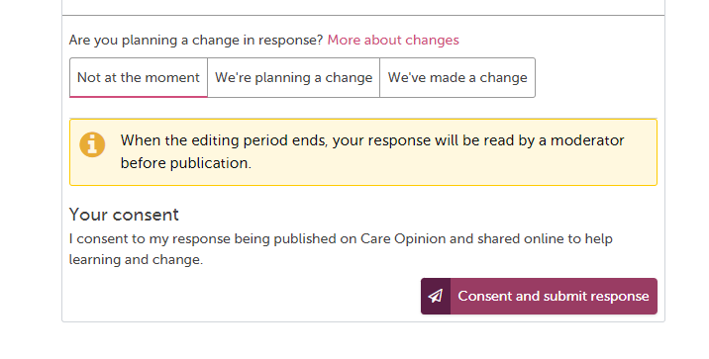
Demonstrating you’ve made a change!
30 minutes editing time once submitted
Notes:
Lisa

Slide 9
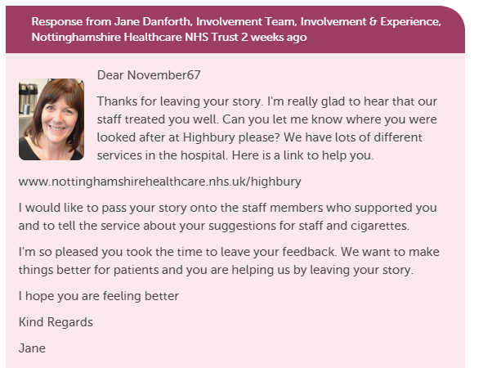
What does a Response look like on Care Opinion?
Include a profile picture
Add links and images
Invite the author to reply to
you or offer a method of contacting you/service
Notes:
Lisa

Slide 10
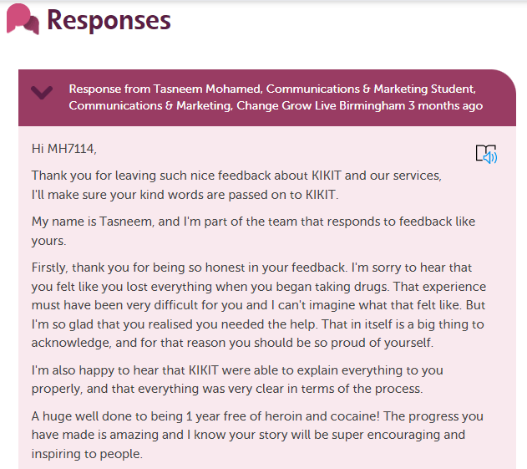
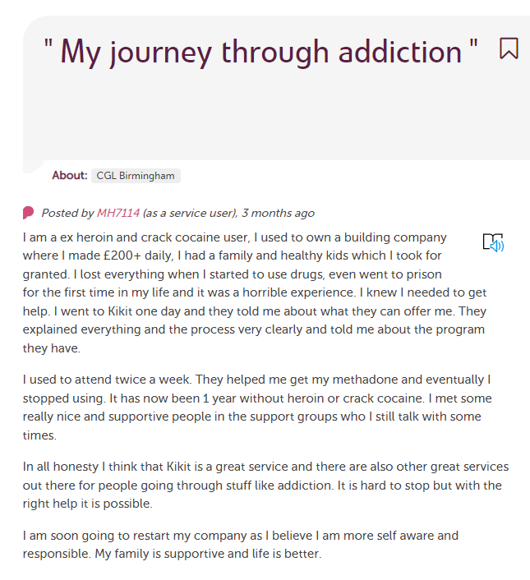
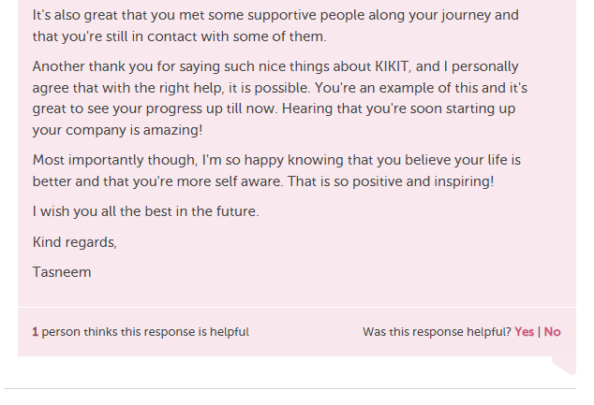
What does a really great Response look like on Care Opinion?
Click here to read full story
Notes:
Tracy

Slide 11
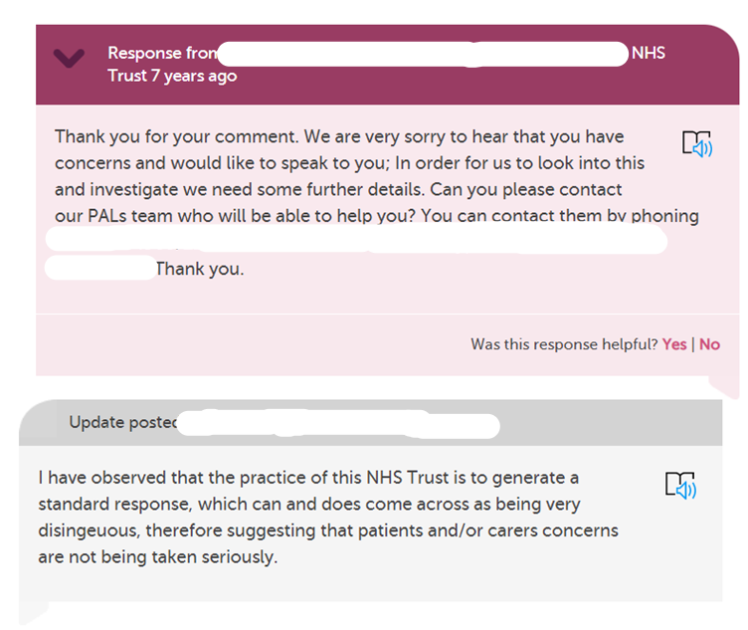
How would you feel if you got this response?
Notes:
Tracy

Slide 12
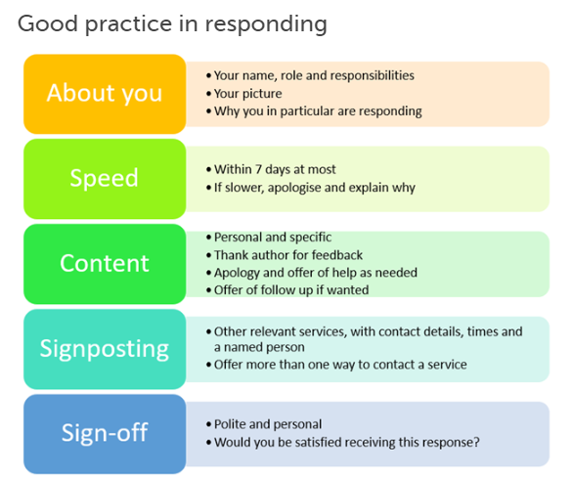
Blog post : Link to ‘What makes a good response’
Notes:
Tracy

Slide 13
Examples of good responses
Empathy and understanding
Apologising
Explaining what normally happens or why things happen
Saying what you will do with the feedback
Saying what you will do to make an improvement
Notes:
Lisa

Slide 14
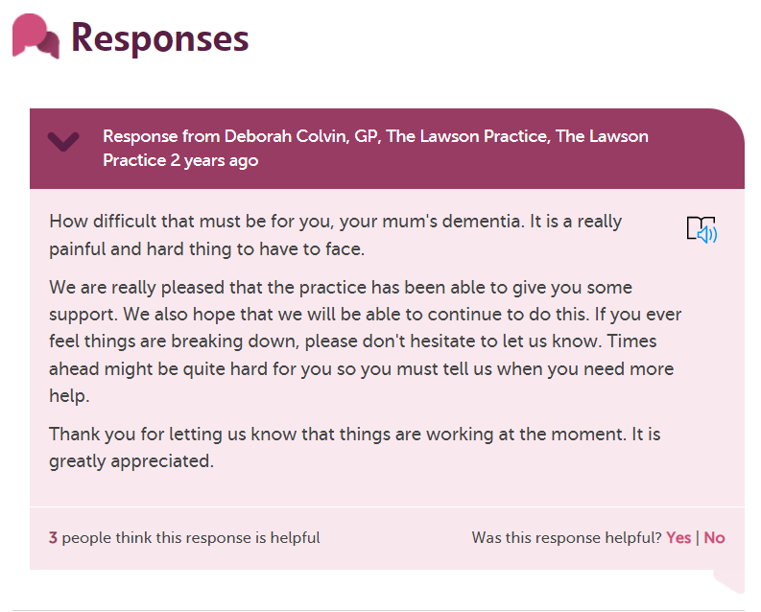
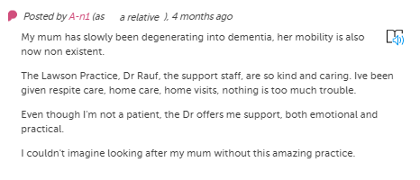
Empathy and understanding
Click here to read full story
Notes:
Lisa

Slide 15
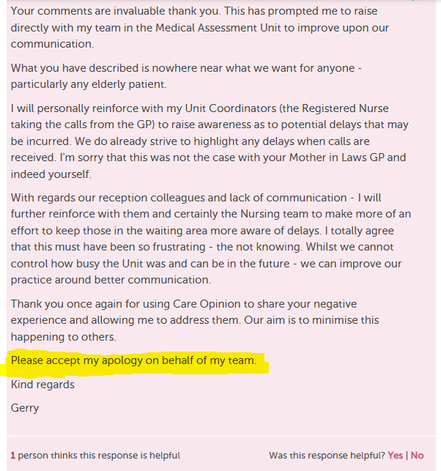
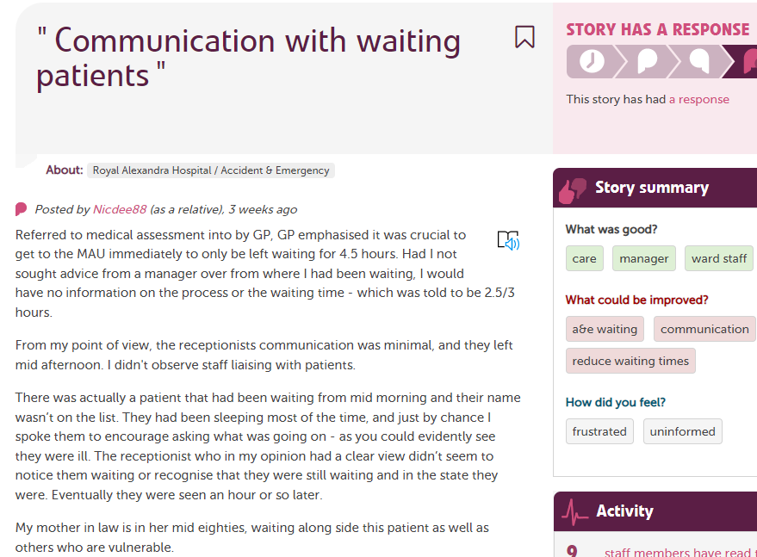
Apologising
Click here to read full story
Notes:
Tracy

Slide 16
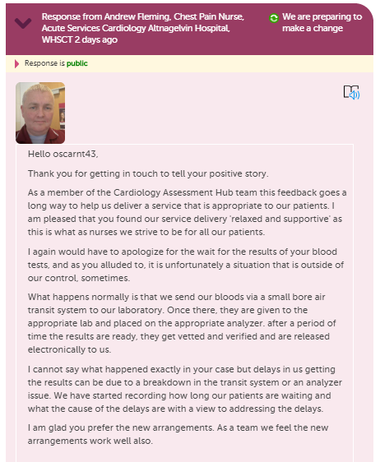
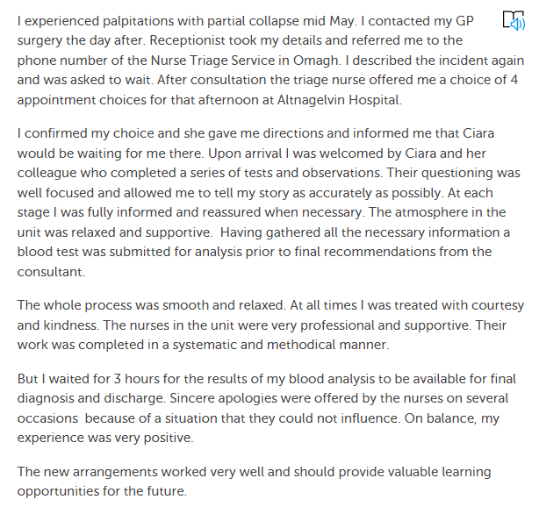
Explaining what normally happens or why things happen
Click here to read full story
Notes:
Lisa
Great example of how to respond thoughtfully.

Slide 17
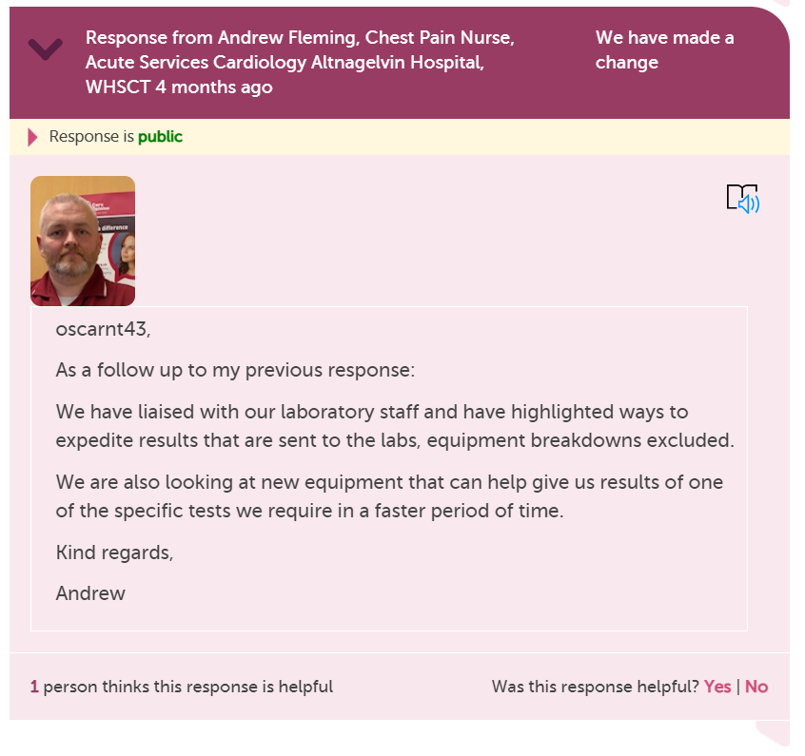
Making that ‘Planned Change’
into a
‘Change made’
Notes:
Lisa

Slide 18
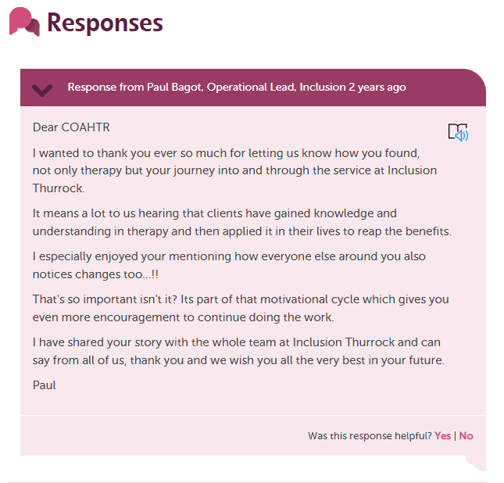
Saying what
you will do
with the
feedback
Click here to read full story
Notes:
Lisa

Slide 19
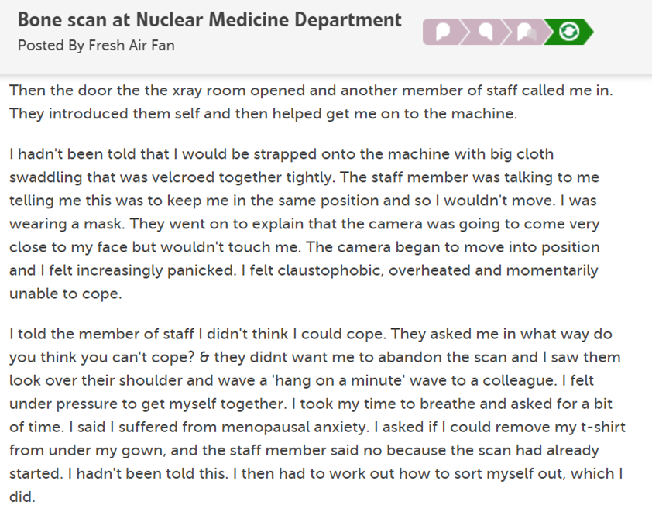
Saying what you will do to make an improvement
Notes:
Tracy

Slide 20
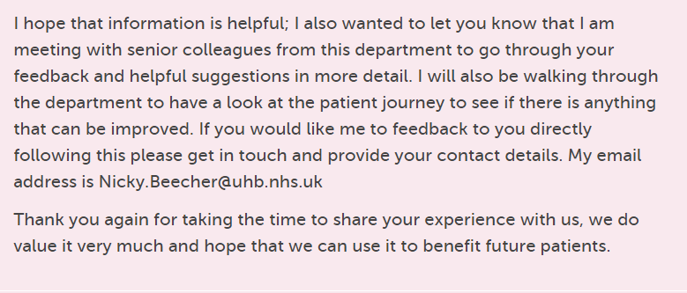
Initial responses from people in the department about what should have happened and offering follow up, ending with….
Click here to read full story
Notes:
Tracy

Slide 21
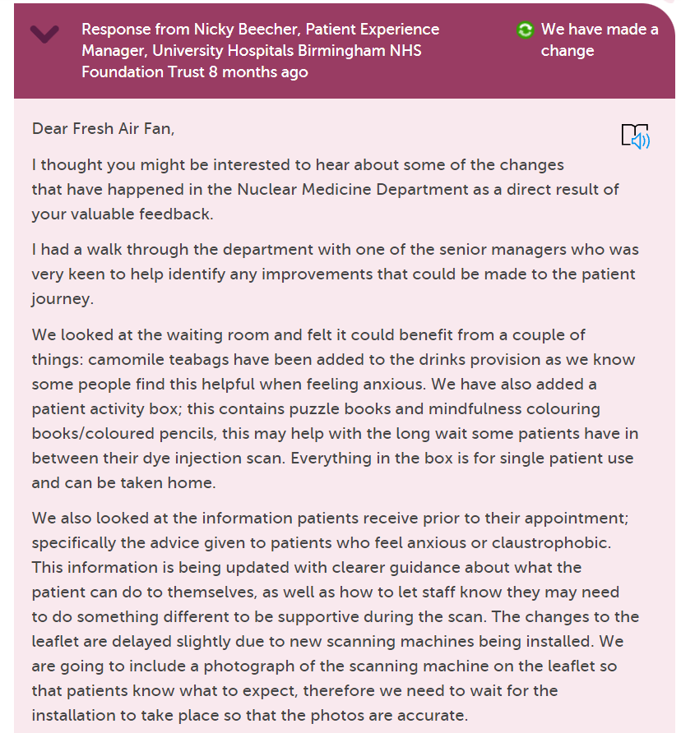
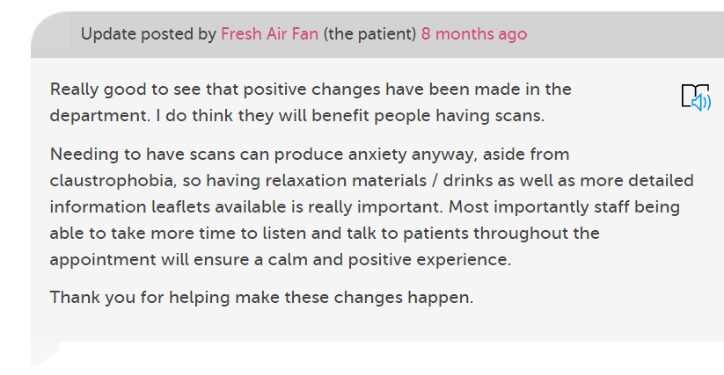
Several changes made from a walk through
Blog: Being a critical friend
Notes:
Tracy

Slide 22
Responding Re-cap
Prepare yourself for the feedback, don’t rush, ask for support from other staff if you need a 2nd opinion
Take your professional hat off, put yourself in the authors shoes, what response would I be happy with?
Try not to be defensive & apologise sincerely
Use the ‘Change’ logos in your responses
Sign off with full signature as often if you can
Be personal but polite, no cut & paste generic responses
Notes:
Tracy

Slide 23
Notes:
Poll

Slide 24
Discussion/Questions/Comments?

Slide 25
Thank
you

