Slide 1


How to Respond Well
Notes:
Tracy

Slide 2
In this session, we’ll help you...
Learn how to respond using the Care Opinion site
Understand what makes a good response
Think about what the author might want from a response
Think strategically about responding and how it can create change in services
Notes:
Tracy

Slide 3



Slide 4
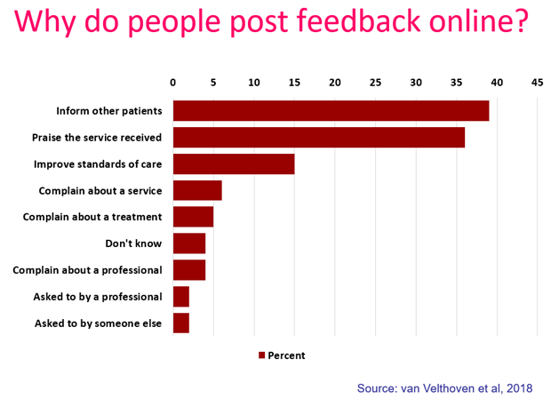
“It was therapeutic in healing my soul.”
“It was a difficult time for me to go through and Care Opinion allowed me to control the speed
and words rather than be rushed through Q&As or tick box scenario where things don't quite fit.”
“The fact I did not have to give my name made it a lot easier to provide feedback. I find it hard to do it in person.
I would like it to make changes.”

Slide 5
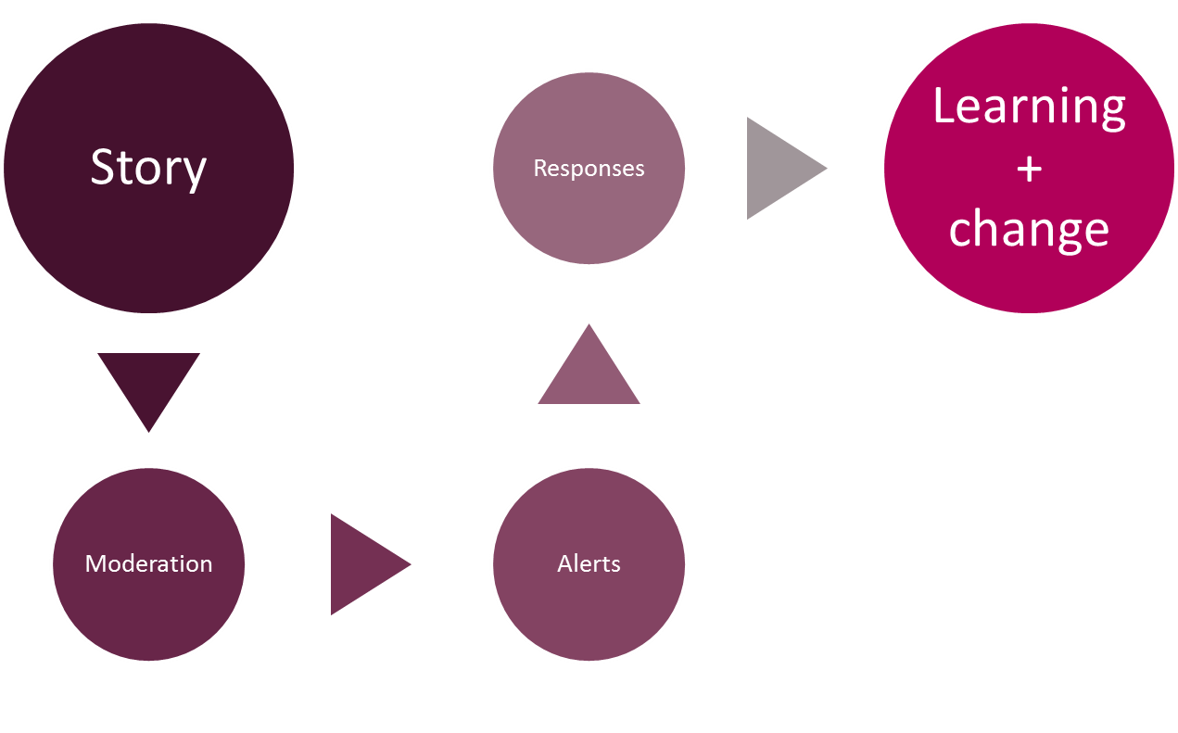
Stories – it’s about the conversation
Notes:
Tracy

Slide 6



Points before we start!
You, other responders and the author can respond to each other as many times as you wish
Never ask an author to disclose their personal information publicly – All responses are public once published on the website
By having a transparent, honest and safe conversation on Care Opinion, you can demonstrate to the public, how your service listens to feedback, resolves problems and works towards positive change
Notes:
Lisa

Slide 7
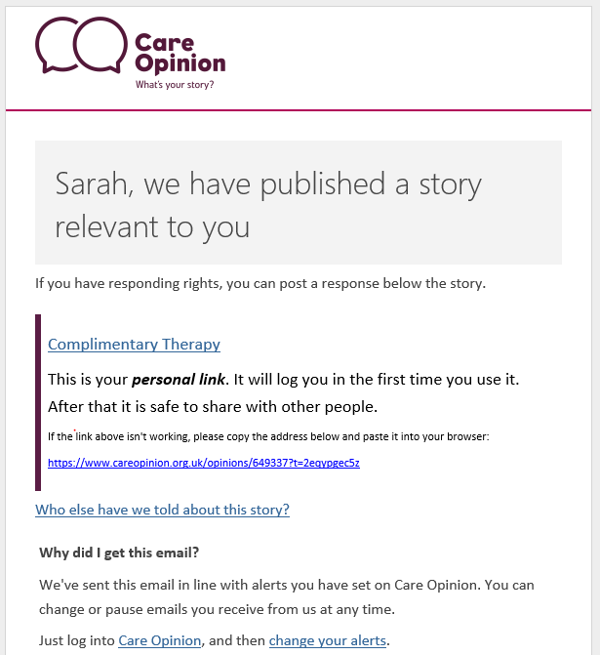

Practical Tip!
The link only log’s you into the site the 1st time
Notes:
Lisa

Slide 8
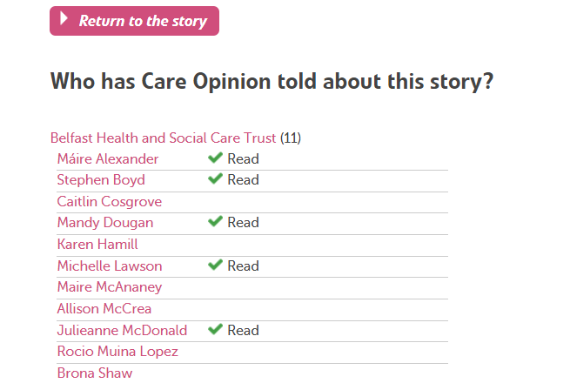
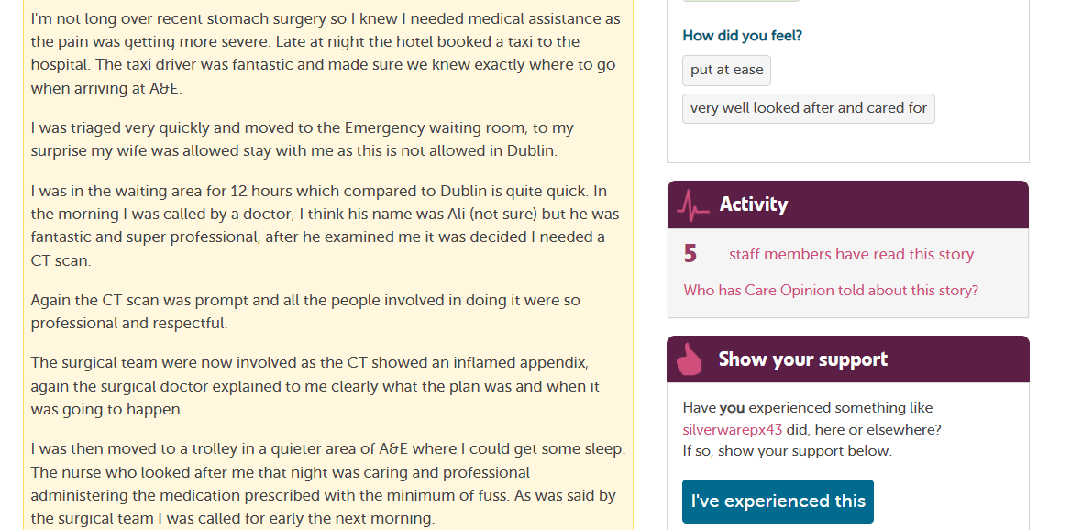
Who else received an email alert?

Slide 9
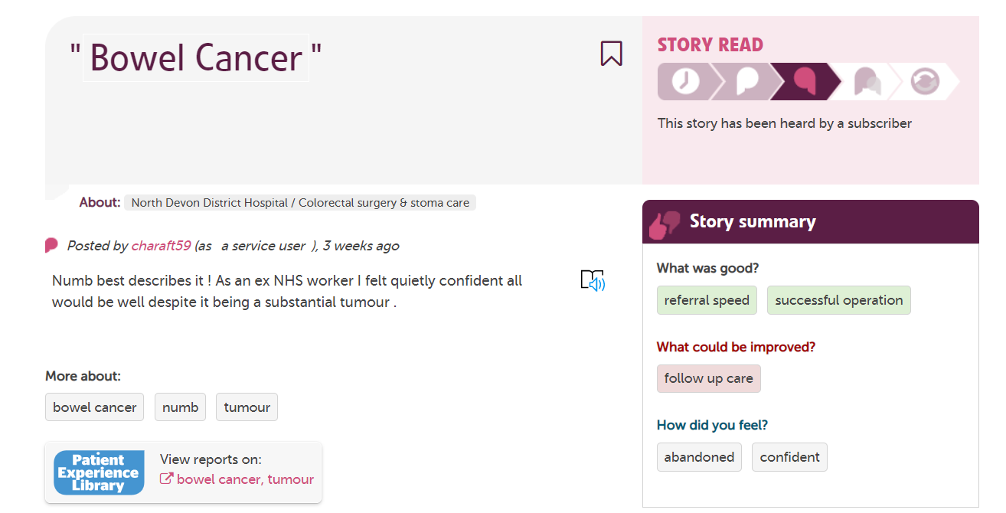
Pay attention to the ‘How did you feel?’ tags
The link only log’s you into the site the ^{st} time

Slide 10
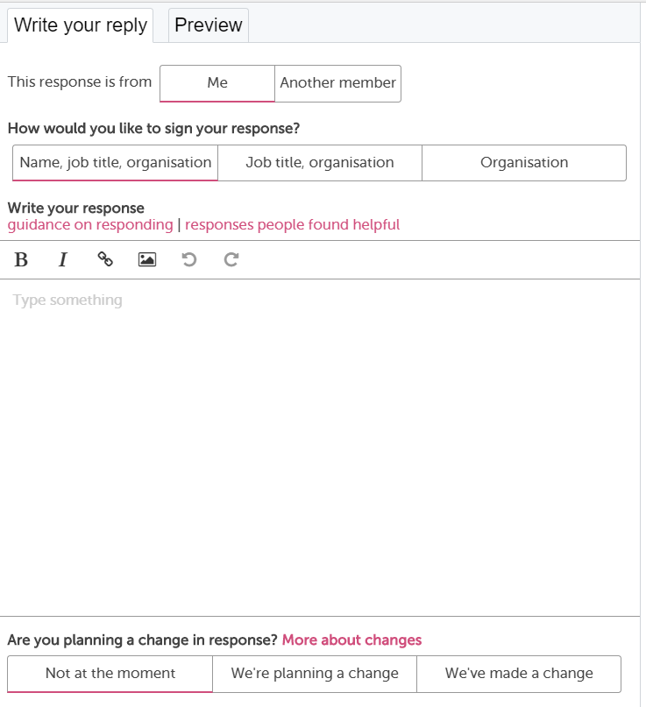
Notes:
Lisa

Slide 11

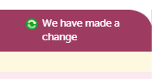
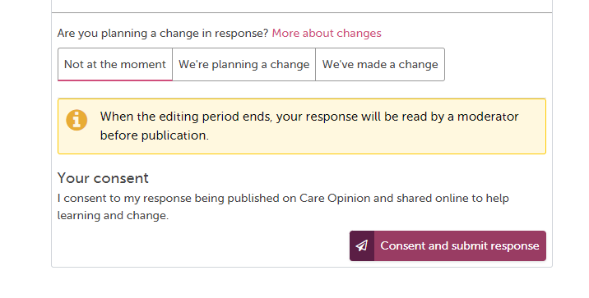
Demonstrating you’ve made a change!
30 minutes editing time once submitted
Notes:
Lisa

Slide 12
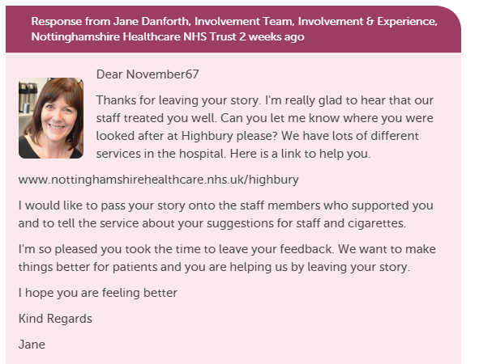
What does a Response look like on Care Opinion?
Include a profile picture
Add links and images
Invite the author to reply to
you or offer a method of contacting you/service
Notes:
Lisa

Slide 13

Preparing yourself for feedback…
Take a deep breath
Take your professional hat off
Imagine it’s you, what response would you expect?
Try to understand and connect with the motivation
Control any inclination to defensiveness
Walk away, reflect, get someone else’s viewpoint
Examine your own motivation –to learn, to improve, to protect, to defend

Slide 14
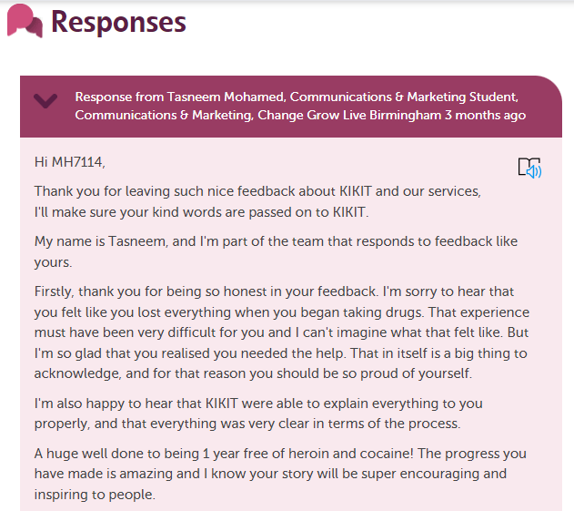
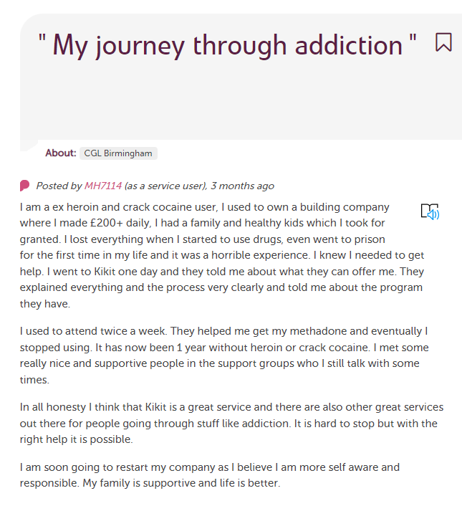
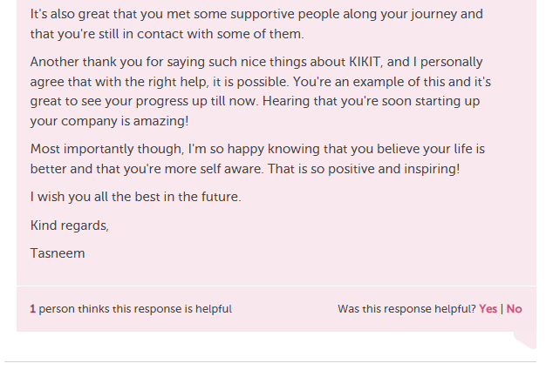
What does a really great Response look like on Care Opinion?
Click here to read full story
Notes:
Tracy

Slide 15
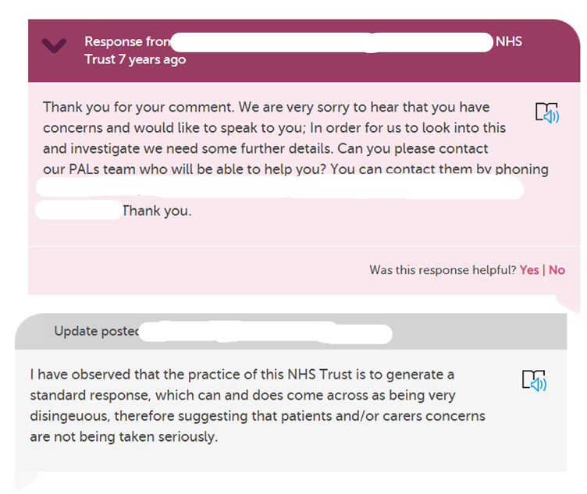
How would you feel if you got this response?
Notes:
Tracy

Slide 16
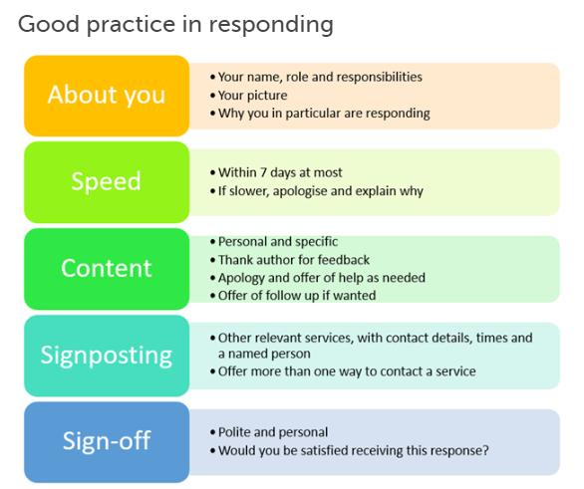
Blog post : Link to ‘What makes a good response’
Notes:
Tracy

Slide 17
Examples of good responses
Empathy and understanding
Apologising
Explaining what normally happens or why things happen
Saying what you will do with the feedback
Saying what you will do to make an improvement
Notes:
Lisa

Slide 18
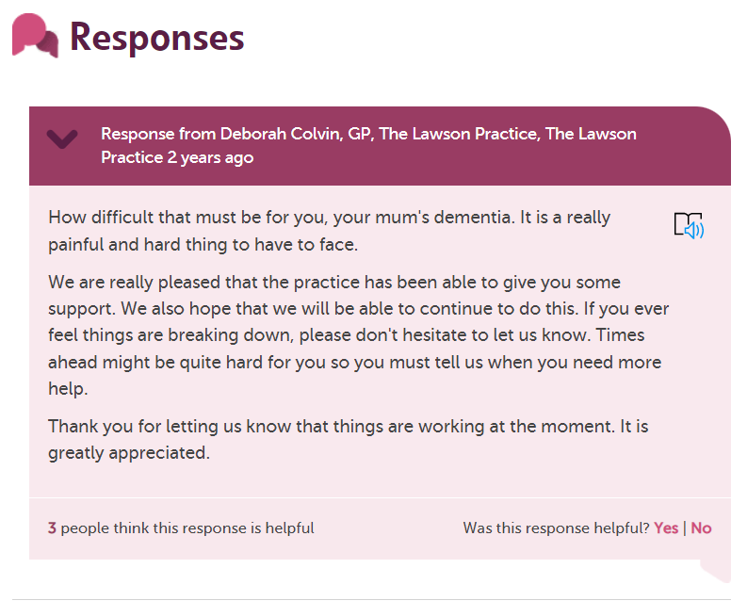
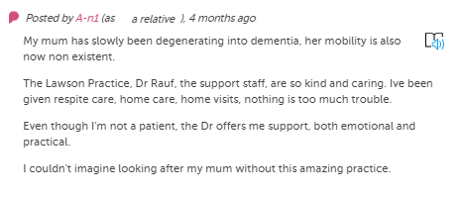
Empathy and understanding
Click here to read full story
Notes:
Lisa

Slide 19
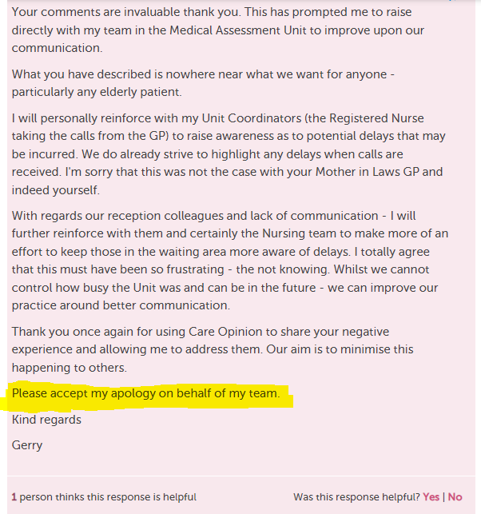
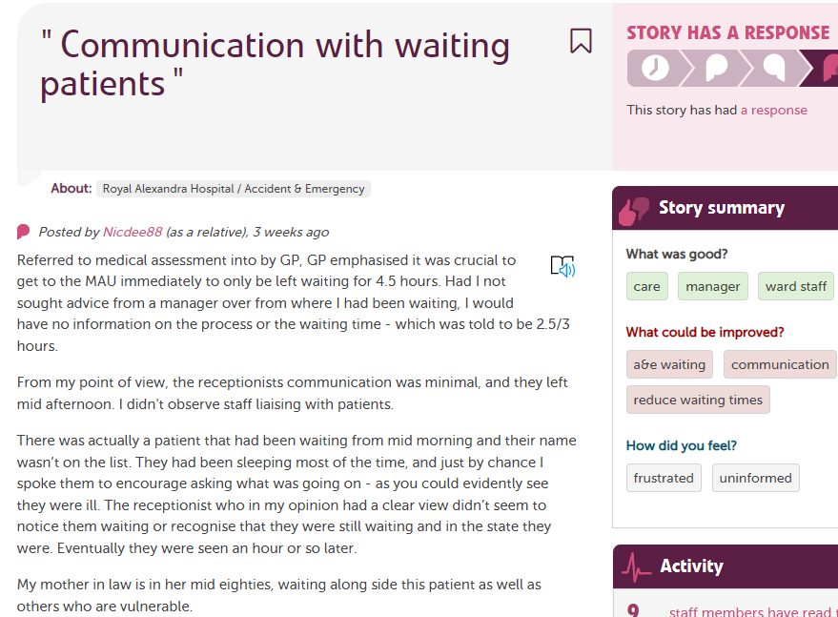
Apologising
Click here to read full story
Notes:
Tracy

Slide 20
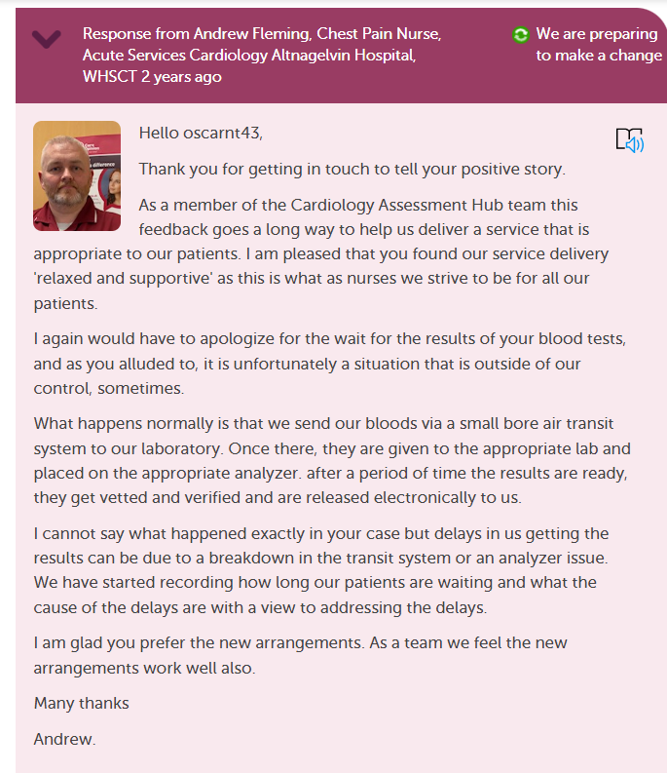
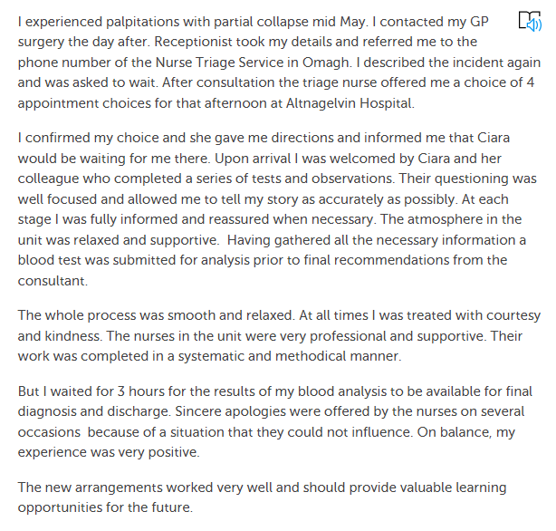
Explaining what normally happens or why things happen
Click here to read full story
Notes:
Lisa
Great example of how to respond thoughtfully.

Slide 21

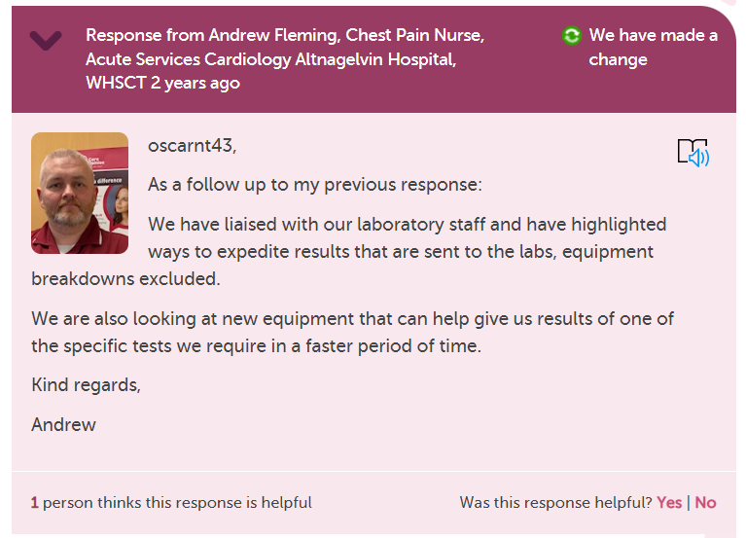
Making that ‘Planned Change’
into a
‘Change made’
Notes:
Lisa

Slide 22
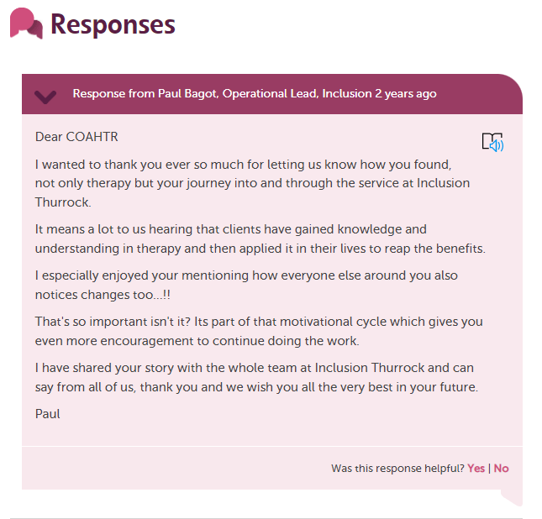
Saying what
you will do
with the
feedback
Click here to read full story
Notes:
Lisa

Slide 23
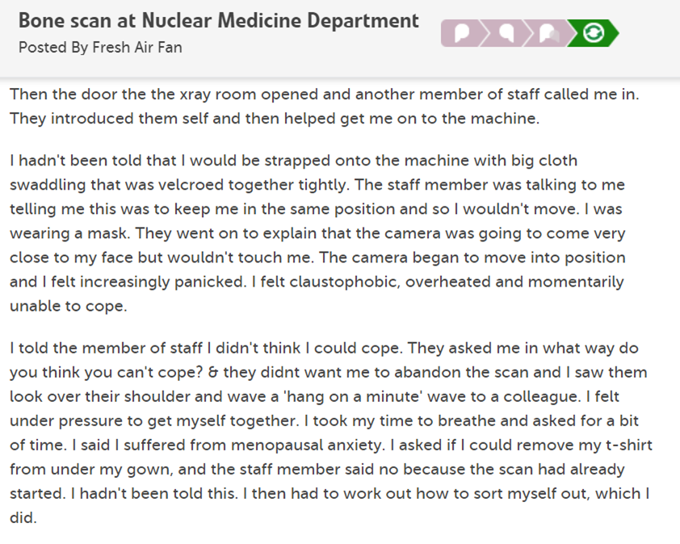
Saying what you will do to make an improvement
Notes:
Tracy

Slide 24
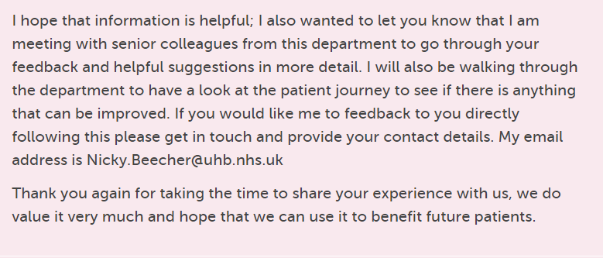
Initial responses from people in the department about what should have happened and offering follow up, ending with….
Click here to read full story
Notes:
Tracy

Slide 25
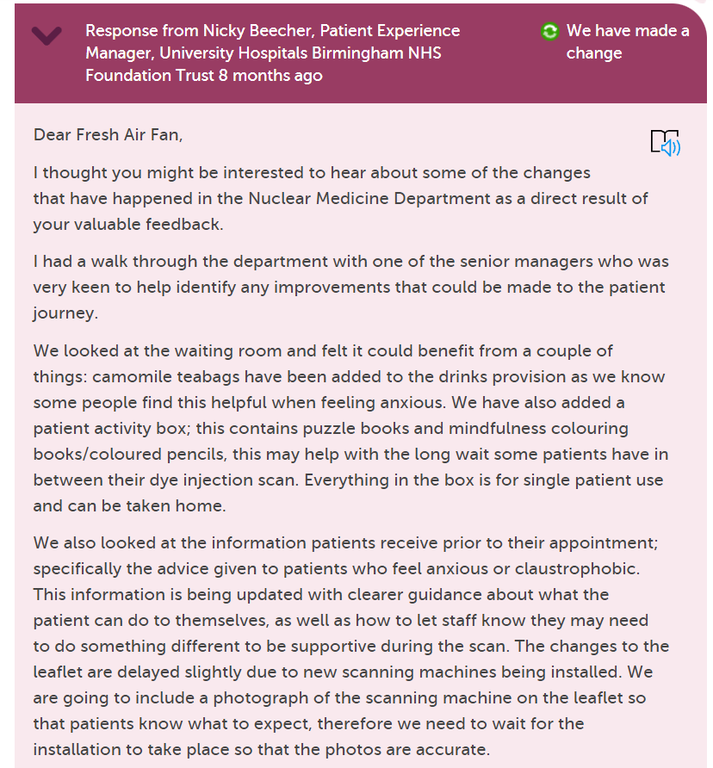
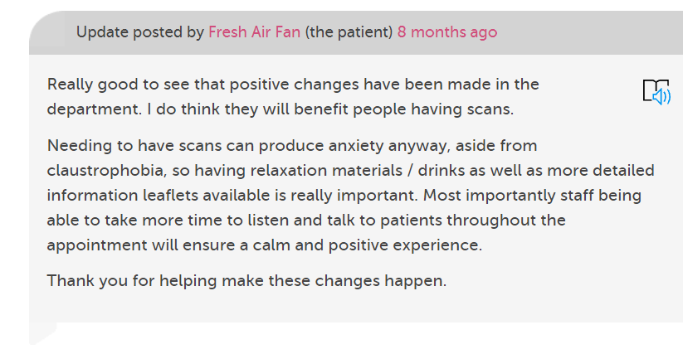
Several changes made from a walk through
Blog: Being a critical friend
Notes:
Tracy

Slide 26
Responding Re-cap
Prepare yourself for the feedback, don’t rush, ask for support from other staff if you need a 2nd opinion
Take your professional hat off, put yourself in the authors shoes, what response would I be happy with?
Try not to be defensive & apologise sincerely
Use the ‘Change’ logos in your responses
Sign off with full signature as often if you can
Be personal but polite, no cut & paste generic responses
Notes:
Tracy

Slide 28
Questions/Comments?
info@careopinion.org.uk

Slide 29
Thank
you

