Slide 1
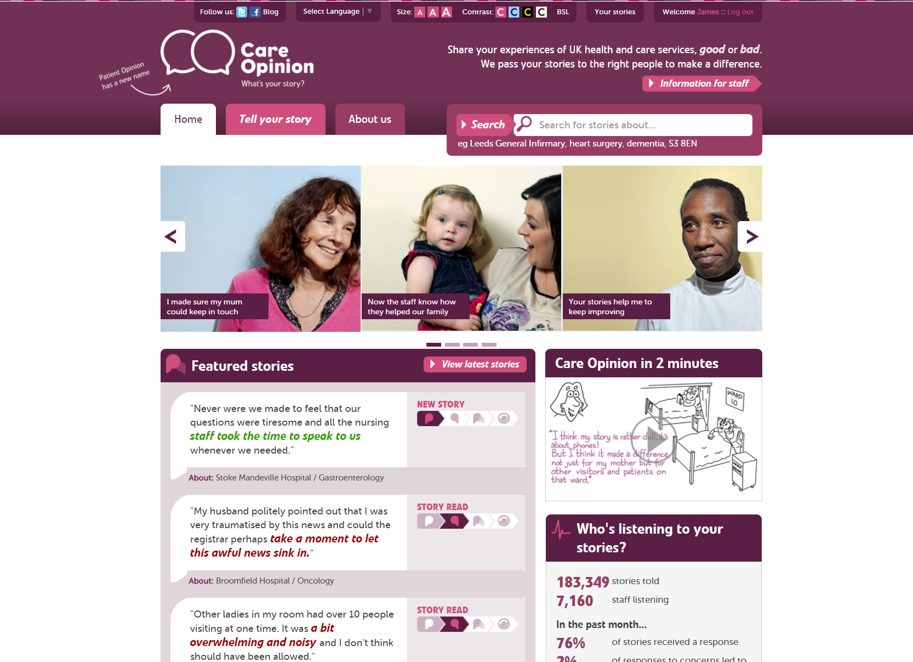

Slide 2
Mission
Our mission is to provide an online platform so that:
people can share honest feedback easily and without fear
stories are directed to wherever they can help make a difference, and
everyone can see how and where services are listening and changing in response

Slide 3
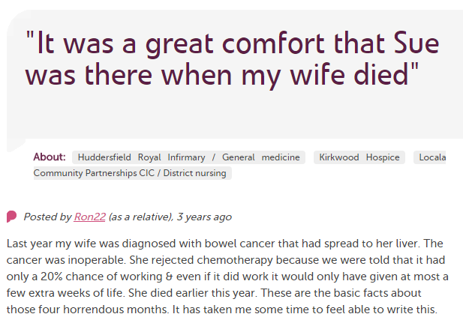
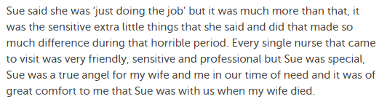
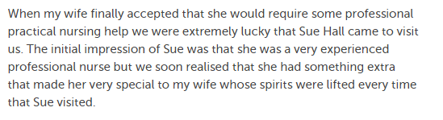
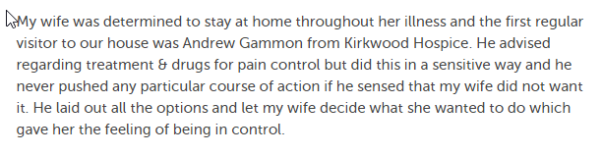

Slide 4
Our values
Innovation
Transparency
Inclusivity
Positivity
Humanity

Slide 5
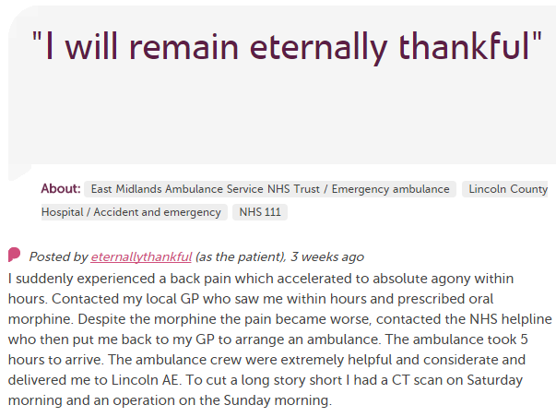











In each provider
Moderation
Clinical staff
Porters, reception, catering…
Pt exp, comms, complaints…
Alerting
CEO
Commissioners
Nursing, AHP students
Healthwatch
Researchers
Patient groups
CQC
Local authority

Slide 6
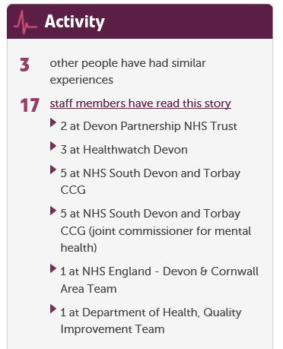

Slide 7
190,000
stories
7,000
staff + students listening
stories read
90 million
times
100,000
visitors per week

Slide 8
Benefits
For patients and families
  Safe, simple, transparent feedback loop
  Issues resolved, service changes
For staff teams
  Learning, QI, morale, culture
For the wider organisation
  Transparency, reputation, complaints

Slide 9
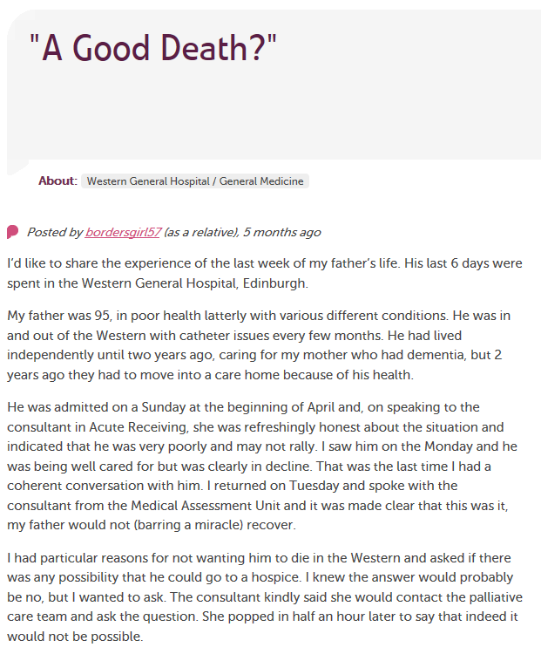
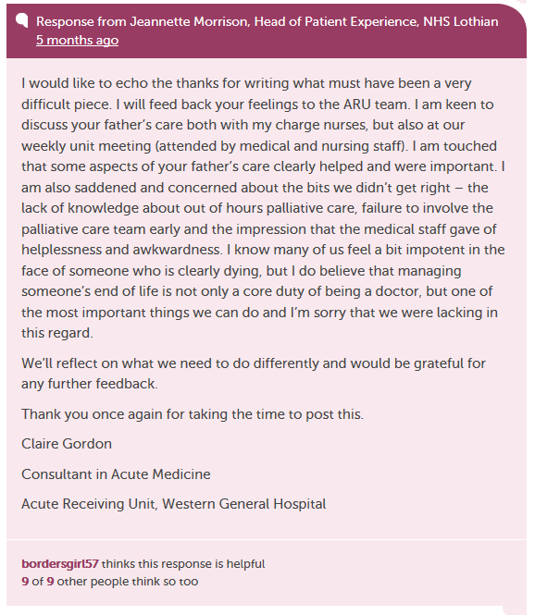
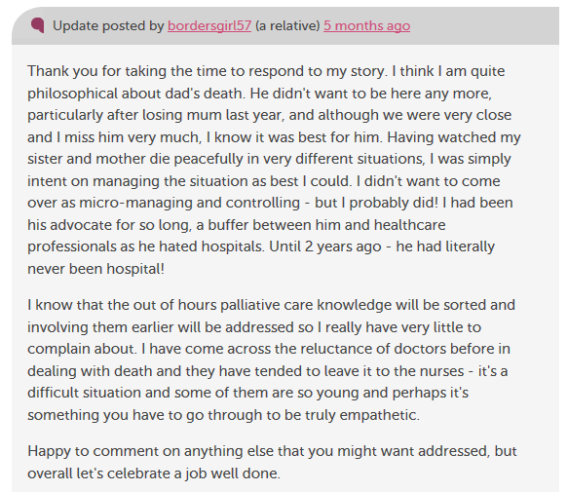

Slide 10
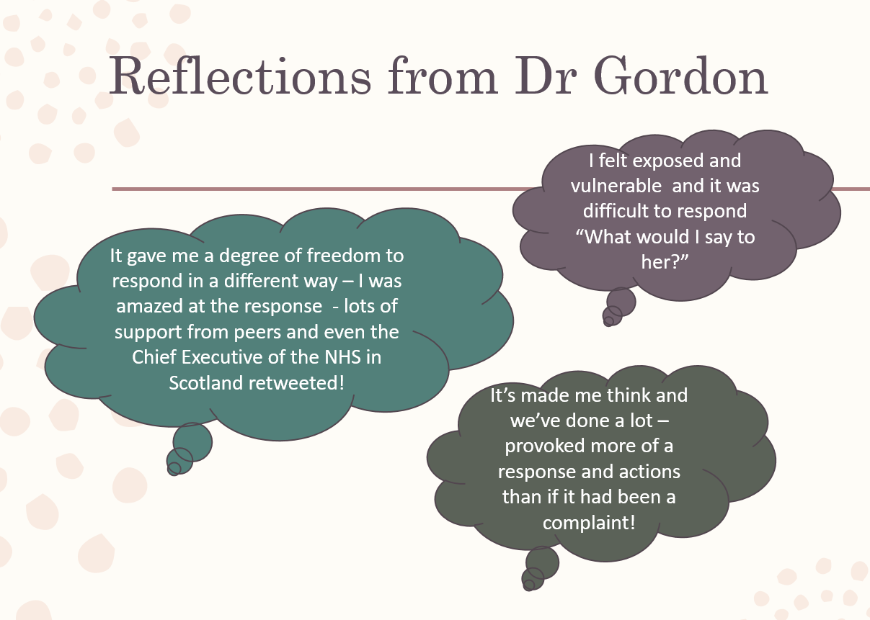

Slide 11
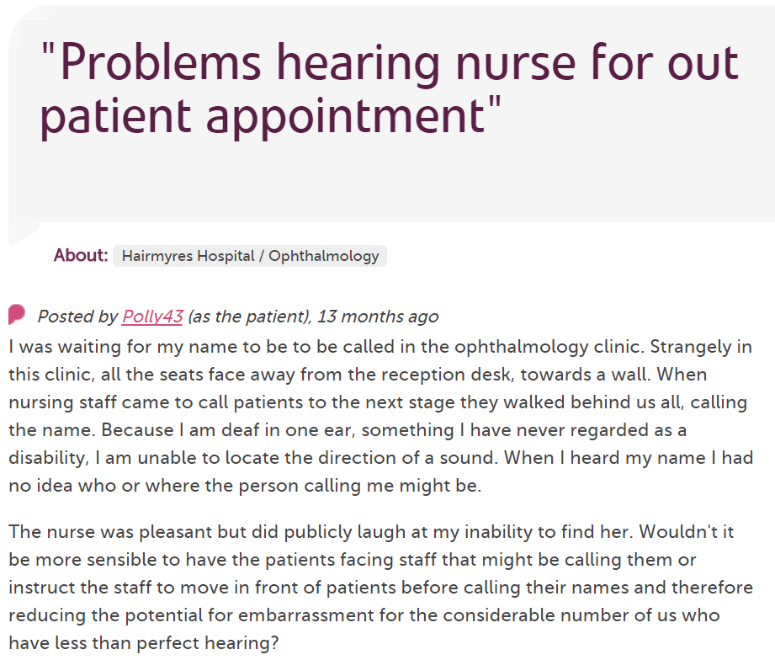
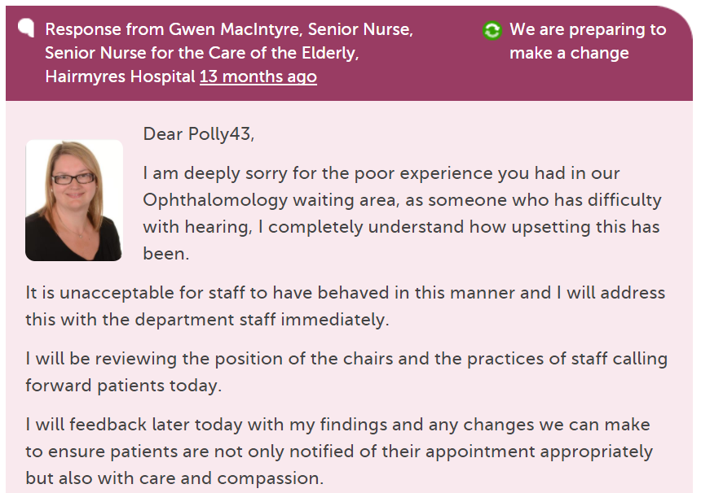
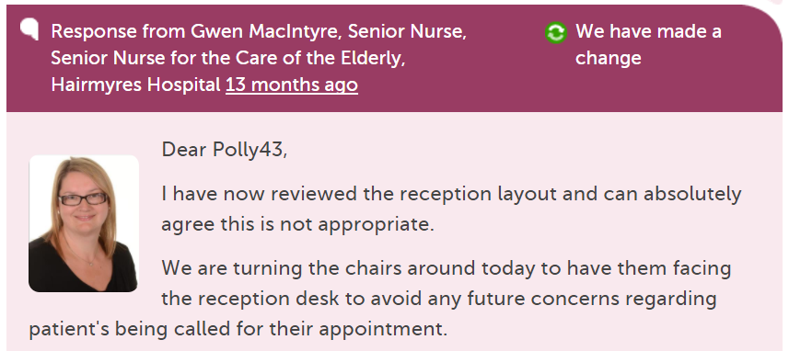

Slide 12
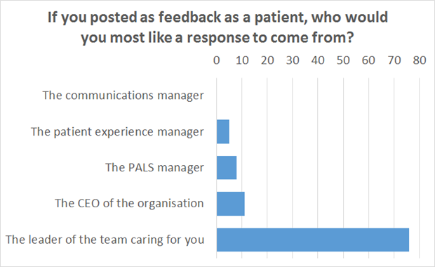

Slide 13
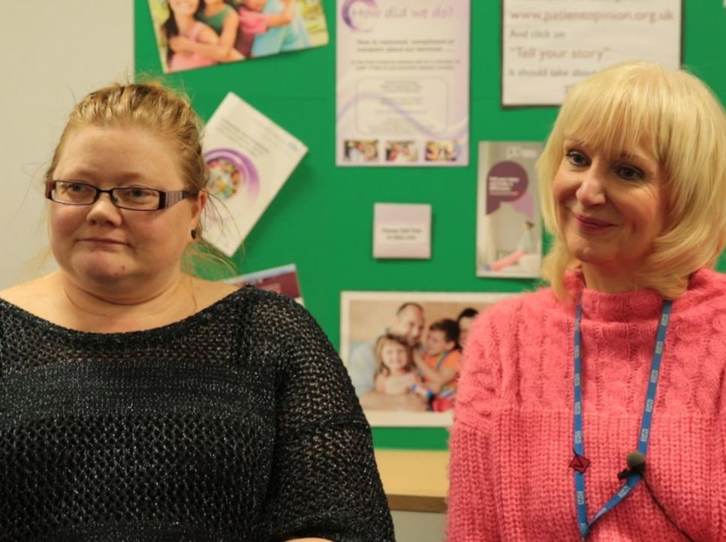
“As we’ve been on a journey, so have the users and carers been on a journey. They now have trust in us, to know that we do want to hear it, warts and all, and that we will work on what the issue is.”
Jenny Newman and Sue Dyke, public engagement

Slide 14
The world is changing – fast
Old world | New world
Hierarchy | Network
Broadcast | Conversation
Hiding | Sharing
Few | Many
Closed | Open
Passive recipients | Active participants

Slide 15
The plural of “story” isn’t “data”.
Lots of people
2017

Slide 16
The plural of story is culture.
Me
2017

