Slide 1
Hearing, Listening and Responding to Patient Stories - the Plymouth experience
Ray Jones, Kim Young and Pam Nelmes - Plymouth University

Slide 2
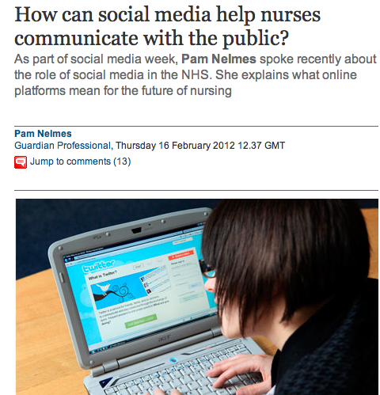

Slide 4
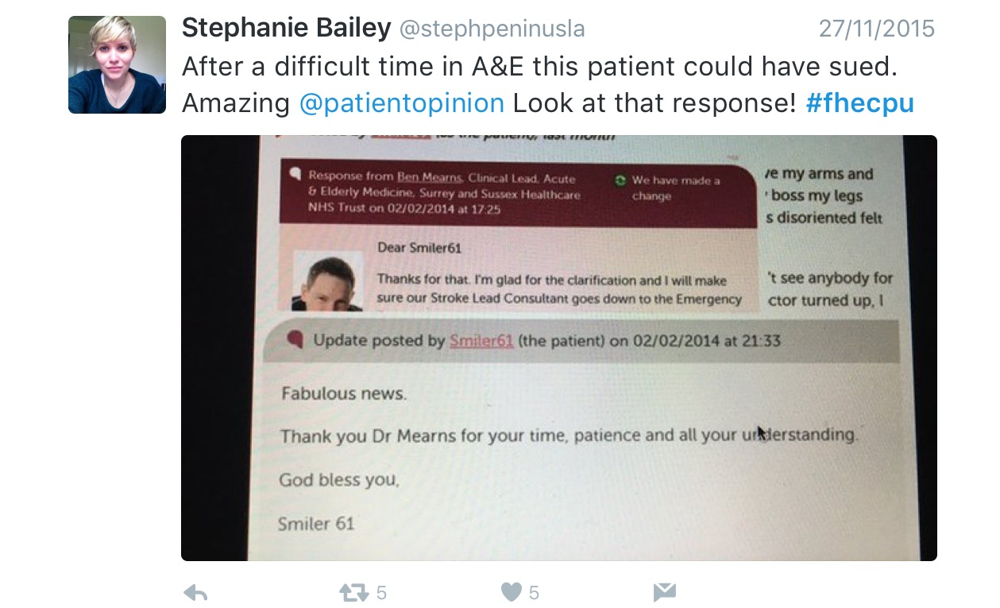
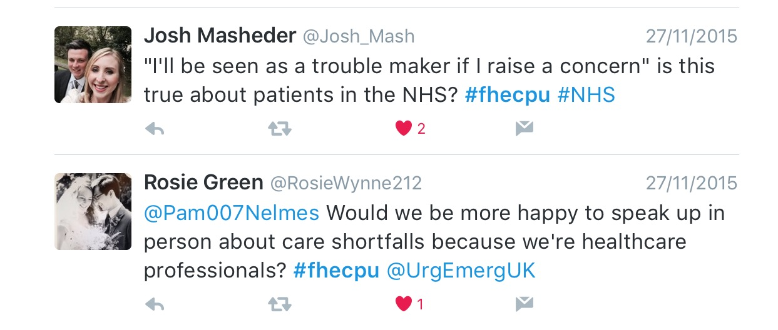
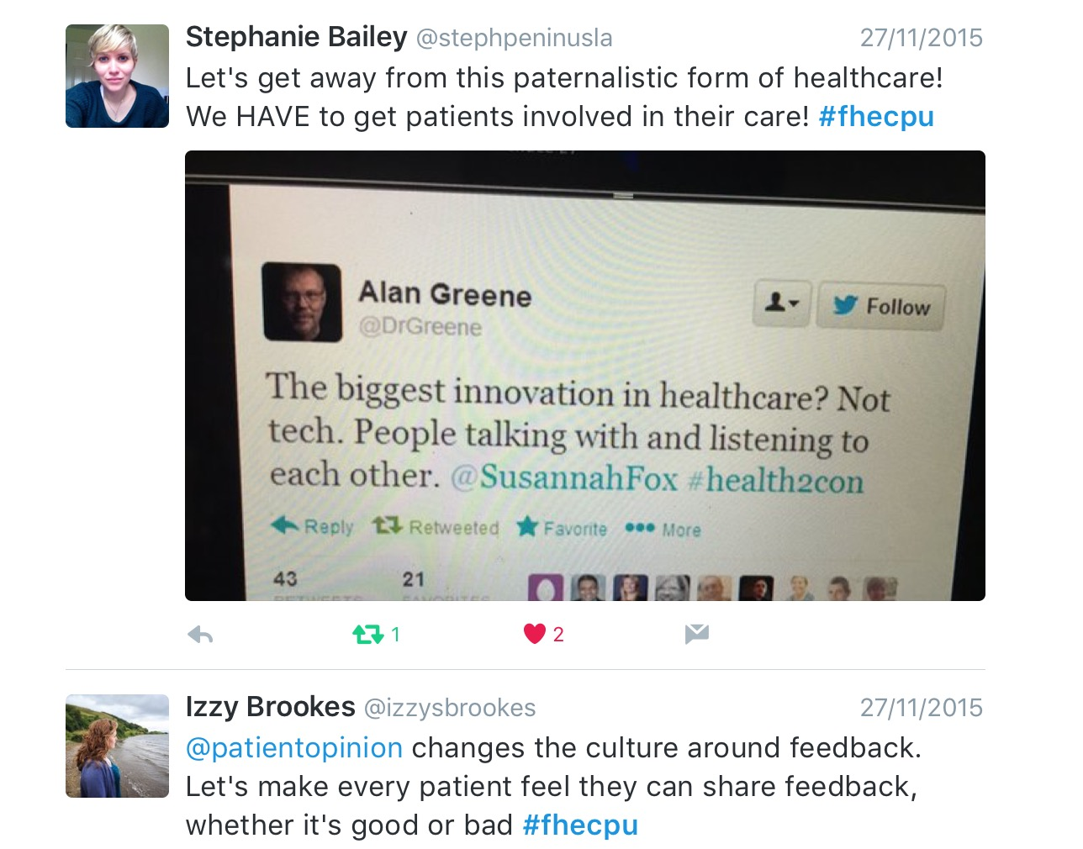

Slide 6
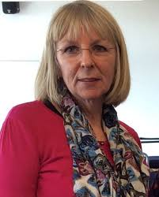
Patient Opinion in the Nursing Curriculum
Kim Young, James Munro, Heather Miller, Stephanie Brelsford, Jennie Aronsson, Benny Goodman, Jane Peters, and Ray Jones.
School of Nursing and Midwifery, Plymouth University
kim.young@plymouth.ac.uk
We explored 5 ways of including the feedback site Patient Opinion into the nursing curriculum:
1. Timetabled webinars
2. Video-linked lectures
3. Twitter and Tweetchat about Patient Opinion
4. Enhanced access to Patient Opinion data for self-study
5. Audit of patient comments for two local hospitals

Slide 7
Research questions
Can we
ensure that all nursing students have a basic understanding of patient feedback sites?
encourage some students to reinforce the impact of patient feedback to improve local services?
1. Live ‘video lecture’: James Munro presented to 2nd year students in lecture theatres in Truro & Plymouth as part of Public Health programme
2. Live webinars for 1st & 3rd year students, participating at home, and ‘voting’ on questions during the webinar.
3. Students asked to follow @patientopinion on Twitter and to participate in a one-hour #punc14 Tweetchat about Patient Opinion.
4. All students had full access to search comments on Patient Opinion.
5. Two students (HM, SB) reviewed comments for two local hospitals (Derriford and Treliske). A summary was sent to the Directors of Nursing to gauge the utility of the exercise.

Slide 8
Some data from webinars
Question | Possible answers | October 2015 (n=407, 82%)
As a health professional, would you want to see feedback about your service (not you personally) online? | No probably not | 2 (0.5%)
 | Not sure, no answer | 53 (13.0%)
 | Probably would | 85 (20.9%)
 | Definitely would | 267 (65.6%)
Do you feel that reading stories from patients and carers will help you become a better nurse? | Not sure or no answer | 51 (12.5%)
 | Probably yes | 79 (19.4%)
 | Definitely yes | 277 (68.1%)
Have you ever posted feedback about anything online? | Not sure or no answer | 34 (8.4%)
 | No | 68 (16.7%)
 | Yes | 305 (74.9%)
If a family member was in hospital & you were unhappy about their care would you feel able to say so in person | Not sure or no answer | 53 (13.0%)
 | Not able to say | 36 (8.8%)
 | Probably able to say | 112 (27.5%)
 | Definitely able to say | 206 (50.6%)
If a family member was in hospital & you were unhappy about their care, would you consider posting feedback on Patient Opinion | Not sure or no answer | 45 (11.0%)
 | Would not | 8 (2.0%)
 | Probably | 91 (22.2%)
 | Definitely | 266 (64.9%)
Different responses to Patient Opinion by Derriford & Treliske Hospitals
Derriford responded to fewer comments than Treliske (30% Vs 48%)
but responses were from different named and relevant people. Treliske responses were all (but one) from the ‘hospital’.

Slide 9
Online discussion forum over one week between 19 students. In total 56 replies were made in response to the ‘seed’ posting. Most replies 150-250 words long (11,000 words in total).
General consensus: worth including Patient Opinion in some way in curriculum; beneficial, helping to bridge theory and practice.
The use of patient opinion has been valuable during the past year in forming a bridge between service users and service givers
We can often lose sight of the fact that a patient's interaction with healthcare can be some of the most important moments of their lives. Patient opinion is a critical and helpful reminder of this fact- Nursing is not just a conventional 'job'.
I feel it has been very beneficial to be aware of what information is available for both patients, so they have somewhere to express their views and for us as student nurses to recognise where things have gone wrong and what could be done to prevent/make their experience better.
Overall, I feel that patient opinion has definitely helped me (especially before starting my first placement).

Slide 10
Students aware of types of posts and their possible role in increasing input
…what I have noticed is that the majority are either glowing praise or angry venting, there doesn't seem to be many opinions pertaining to "an average episode of care.
..perhaps utilising students to explain the purpose of the site more clearly, to as many patients as possible, may also be effective in getting a truer reflection of all levels of care.

Slide 11
5 methods
Little commentary on ‘Skyped’ lectures
Webinars thought useful (with qualification) but suggestion that one is enough
Twitter – useful for those who like it (specific audience)
Little commentary on full user registration
Little commentary on exercise carried out by two students BUT lots of discussion and ideas on how Patient Opinion could be integrated into the curriculum

Slide 12
.., may identify areas to look at during the placement.
…having something to do ..in our OAR documents would be good
…perhaps part of the skills module as well as the progression point
.. Majority.. .. engage more if ..practically based and could be integrated within our placement time and OAR document
..an introduction ..in <introductory> module, followed up with something in the OARS document for the first year would embed this into all students practice. Hopefully, this would give students an insight to the value of this work & then they may promote it to the patients and service users they encounter as well as with mentors & wider team members throughout their training. By adding this to the OARS, it avoids the need for an additional piece of work, but also engages students whilst they are usually most enthusiastic about their training as they are out in placement & are making the links between theory & practice become stronger.

