Slide 1
Conversations about Care patients’ and their family members’ perspectives of ratings, reviews and feedback about NHS healthcare services
HSRUK Conference 2018
The rise and rise of online patient feedback
perspectives from patients and platform providers
Fadhila Mazanderani
University of Edinburgh
f.mazanderani@ed.ac.uk
Susan Kirkpatrick
Primary Care Health Sciences
University of Oxford
Sue Ziebland
Primary Care Health Sciences
University of Oxford
John Powell
Primary Care Health Sciences
University of Oxford

Slide 2



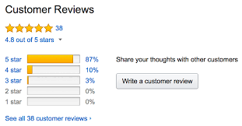


Slide 3


IMPROVING NHS QUALITY USING
INTERNET RATINGS and EXPERIENCE
www.inquireuk.org

Slide 4
Project 1: Literature review and stakeholder consultation
Project 2: Survey of the general public
Project 3: Qualitative interviews with patients and carers
Project 4: Survey of health professionals
Project 5: Organisational case studies in 4 NHS Trusts

Slide 5
Overview of interviewees
 | Age | Male | Female | Ethnicity: White British | Ethnicity: Other
 | 20-35 | 0 | 7 | 7 | 0
 | 36-50 | 2 | 9 | 9 | 2
 | 51-65 | 4 | 8 | 10 | 2
 | 66+ | 6 | 1 | 4 | 3
 |  | 12 | 25 | 30 | 7
TOTAL |  |  |  |  | 37

Slide 6
Who provides feedback online feedback?
42% of general public had read online feedback in the last year
  Younger; female; higher income bracket; health condition; urban area; frequent internet user
8% had provided the feedback in the same period
  Frequent internet user

Slide 7
Some key participant characteristics
Regular internet users (including social media)
Long term investment in the NHS (chronic, complex conditions)
Intense and emotive experience (positive and negative)
Other forms of communication had failed to achieve a response
Rarely prompted by NHS staff (94% of survey participants never asked)

Slide 8


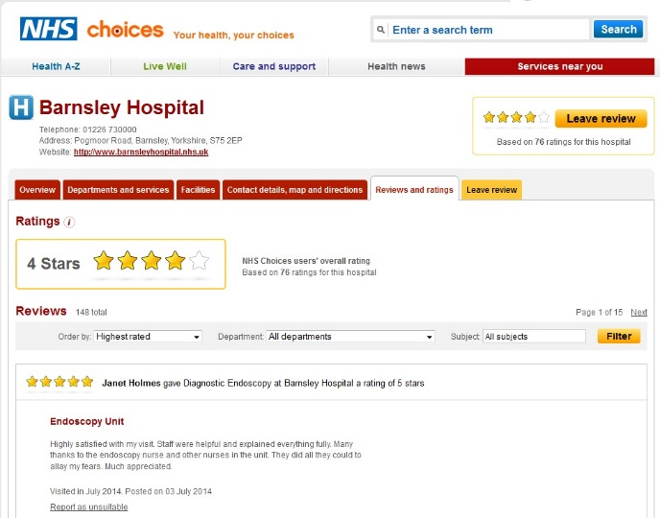
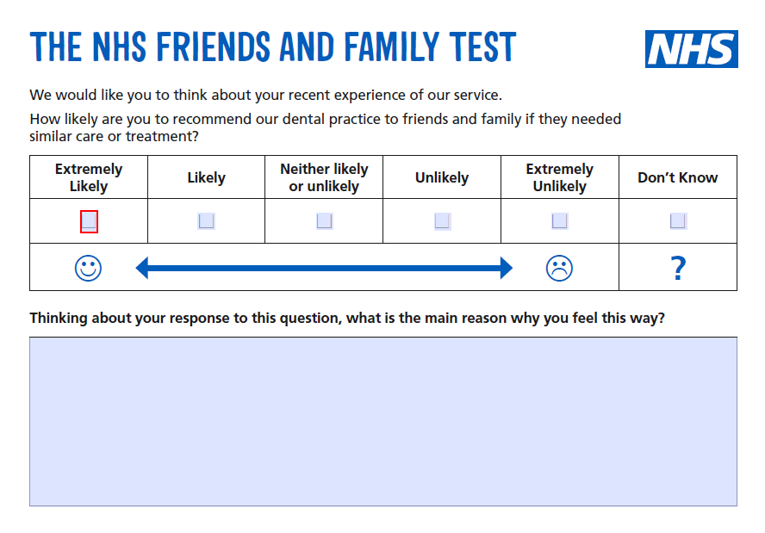







How people provide feedback online

Slide 9
Why people provide feedback online
[..] there’s lots of reasons why I do it [provide online feedback]. It’s not just one. There have, in the situation that I described at the start, that was first and foremost to try and get a bloody answer out of them as about what was going to happen here next but, underlying all of this, was the sharing it with other people, letting other people know that they’re not alone and, hopefully, leading to change. But there’s been other times where my post has been purely to highlight good practice or to instigate change in some way.
[INQ36: female, thirties, mental health]

Slide 10
Improving (not complaining about) the NHS
And I think, when something isn’t right, I think it’s more about you just want them to improve. [INQ23: female, mid-thirties, maternity services]
[…] unless people speak out and the people who are in an influential position don’t know things are happening so, you know, when, where we realise I realise that, you know, the NHS is under such huge demands and everything else but, unless we tell them what’s wrong, they can’t put things right. [INQ11: female, 60, dementia services]
The NHS fails, we fail, like we need the NHS to not only survive but to thrive and keep going and any feedback, certainly I’m giving and I know a lot of people in my position are, it’s constructive, not because we’re being critical but because need this to work. [INQ16: female, mid-thirties, multiple long term conditions]
I firmly believe that in a subtle and perhaps longer term way, I am contributing to change. [INQ19: female, early thirties, mental health]

Slide 11
Caring for care [the NHS, services, staff, patients]
I wanted to say thank you to the GP that, who’d been really, really good with me. And the way I did that was by emailing the practice manager and just saying I’ve had this good experience, thank you. Because I was hoping, I guess, that they could use that somehow with the CQC or something. [INQ22: female, mid-thirties, mental health and eating disorders]
I suppose for our own sanity, we wanted to feel that, well, we felt that we couldn’t walk away. We felt that we could not walk away knowing what we knew. And letting other people go through that. [INQ35: female, early fifties, elderly care]

Slide 12
Experiences of providing feedback online
Fragmented landscape:
  Do not know where to go; where the feedback goes; who reads it; who responds; what changes are made
It’s very difficult to find the right person and then, when, whether, when you find the right person, whether they give you a straight response because of worries about litigation and all this kind of thing, I’m not at all interested in litigation. That’s not at all my concern. It’s to say, you should be learning from the experience. [INQ 33: male, late fifties, carer]

Slide 13
Feedback as ‘conversation’
And so the reason that I blogged about the NHS, is because I felt that the NHS was not listening, that there was no way for me to talk to the NHS. I can’t get the NHS in for a cup of coffee and say, “Now look here NHS.” [INQ02: female, mid-forties, chronic pain condition]
Interlocutor/audience: who is being communicated with?
Form: structured vs. free-text
Response: little or no response; generic versus individual; ‘genuine’ versus tokenistic

Slide 14
Participant recommendations
Invite and acknowledge feedback
Be clear about where and how it can be given
Indicate who receives it and what will be done with it
Make and communicate appropriate changes
Engage with comments and feedback provided on social media (esp. blogs and twitter)

Slide 15
Conclusions: conversations about care
What is the significance of conceptualising ‘feedback’ as conversations about care? (rather than ‘choice’, ‘voice’, or ‘complaint’)
  Values emotions, particular relationships, moral commitments
  Blurs private and public (anonymity)
  Digital technologies as part of care
The mutuality of care (patients and publics caring for…)
Communication as service improvement

Slide 16
Acknowledgements and thanks
Research participants
INQUIRE project team
The NIHR
This presentation summarises independent research funded by the National Institute for Health Research (NIHR) under its Health Services and Delivery Research Programme (Grant Reference Number 14/04/48). The views expressed are those of the authors, and not necessarily those of the NHS, the NIHR or the Department of Health.

