Slide 1


Managing your Subscription
Notes:
Welcome to the ‘How to Generate Stories’ Webinar
We tend to run these every 2 weeks throughout the year, on a rolling programme
This particular Webinar looks at the different ways to promote Care Opinion and talks through some various ways of implementing this.
Every service is different so hopefully there is something for everyone, that suits your service – whether that be using materials or opting for on-line promotion.
I expect this session to run for approx. 20 mins
Please feel free to ask any questions through out the session, I will be happy to answer any question you have.

Slide 2
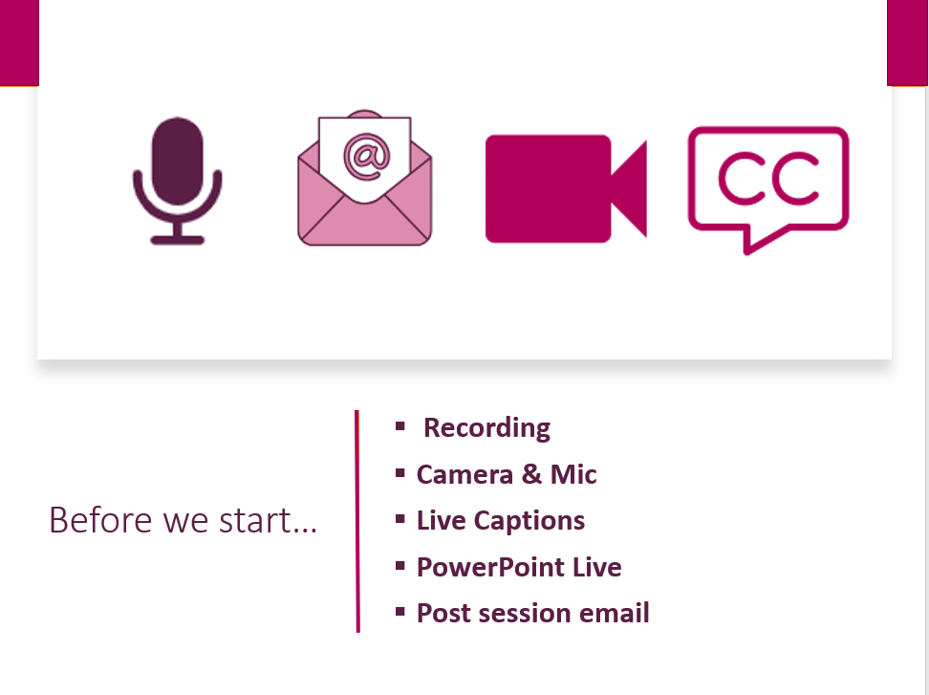

Slide 3

In this session we will help you to:-
Understand your subscription and the features of your role – as an Administrator!
Add people to your subscription, allocate and change member roles
Use Member Reports
Manage alerts/set up member alerts
Set up Invitation Links for services
Request service tree changes

Slide 4
Understanding member roles
Browse, search and view stories and responses
Manage their own email alerts/assets
Create, export and schedule reports
Create, share and schedule data visualisations
Add private and shared story tags
Respond to stories and show changes
Create and publish blog posts
Create Invitation Links
Add public story tags
Add and remove subscription members
Freeze and unfreeze subscription members
Change the role of a member
Edit member profile details
View, edit & amend members assets
Respond on behalf of another member
Manage assets/alerts for other members
Create Invitation Links & transfer ownership
Customise service pages
Access API keys
Member
Responder
Administrator

Slide 5
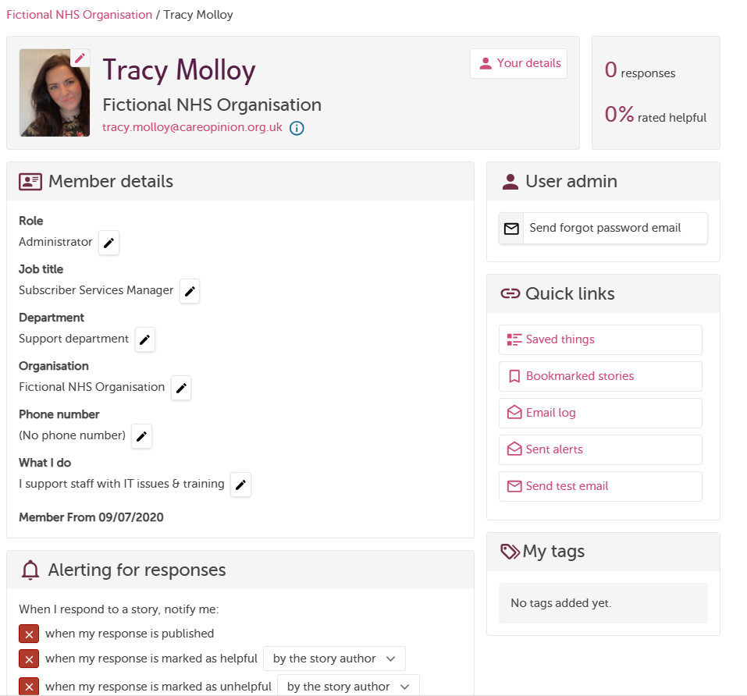
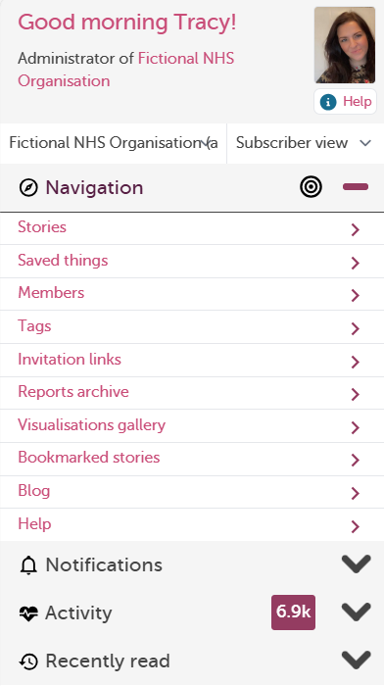
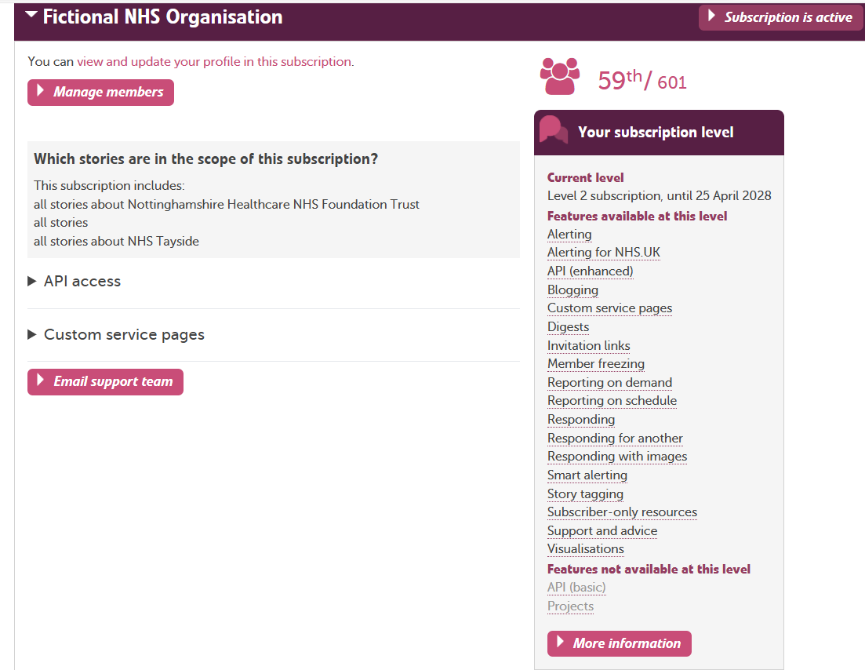

Slide 6
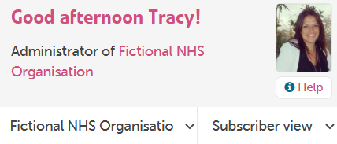
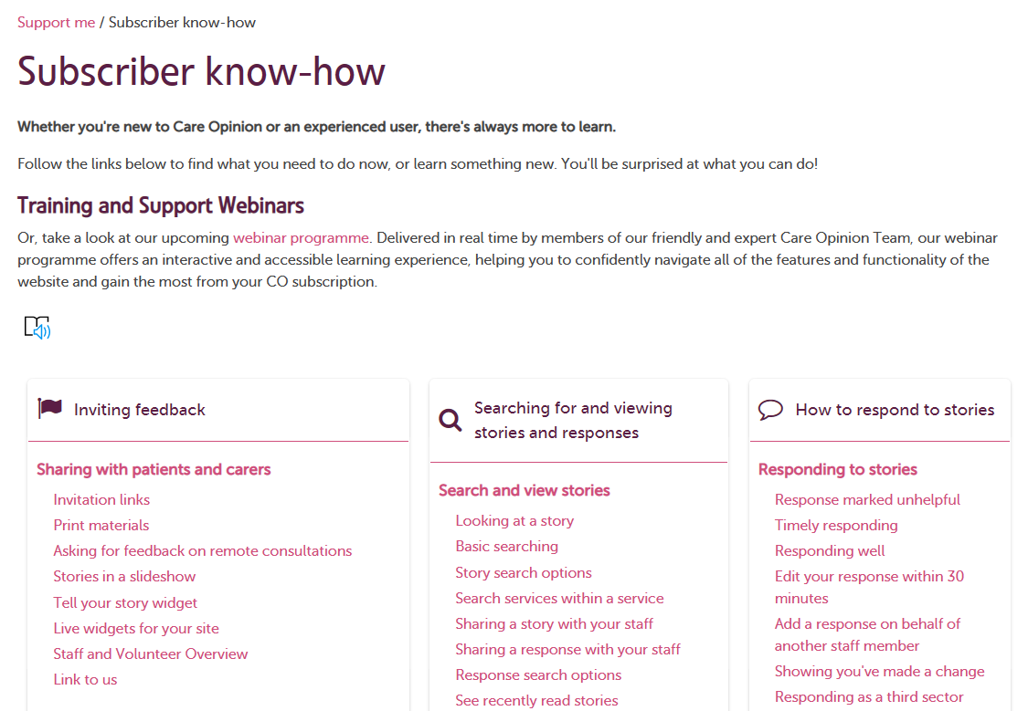
https://www.careopinion.org.uk/info/subscriber-know-how
Notes:
FB

Slide 7
Managing subscription members
Notes:
FB

Slide 8
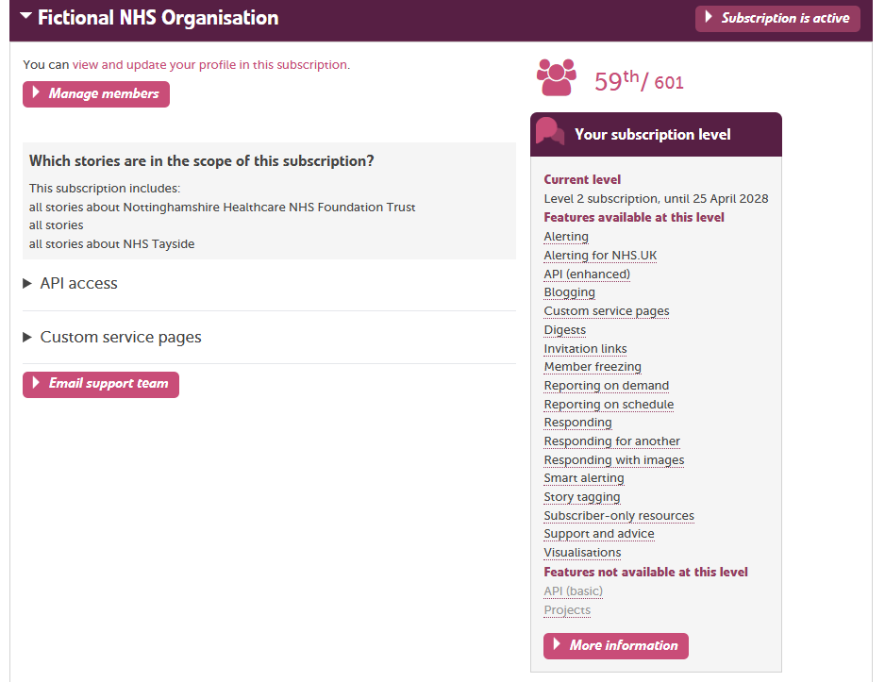
Managing subscription members:-

Slide 9
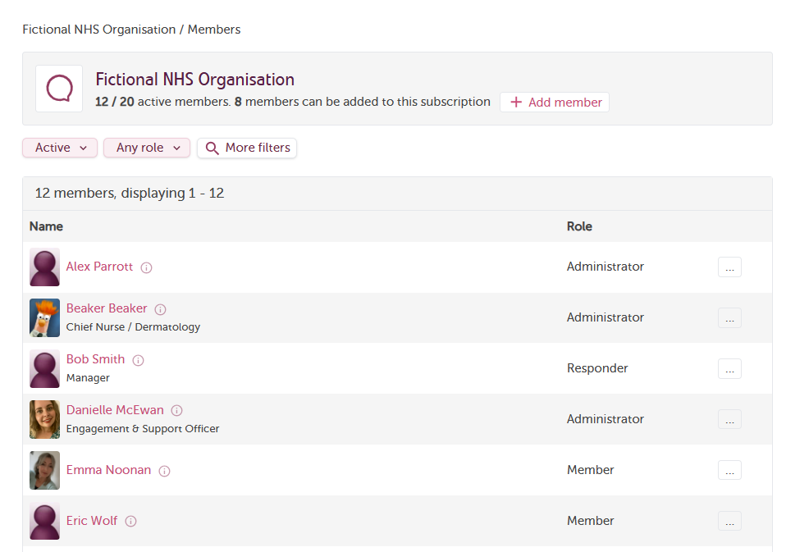

To edit a member's details
Click on the member’s name
Filter by ‘Active or frozen or ALL’
Filter by role or change role
Promote/
Demote/
Remove/Freeze
By clicking on the 3 dot’s, you can either freeze or remove a member
Notes:
FB

Slide 10
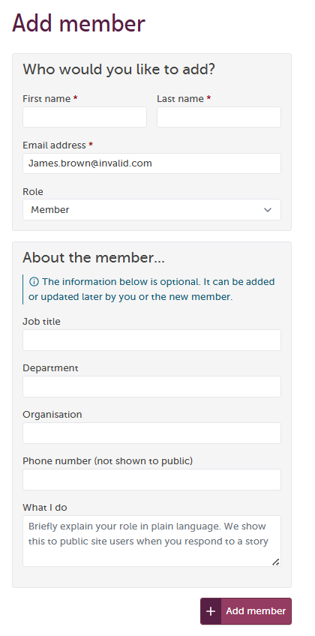
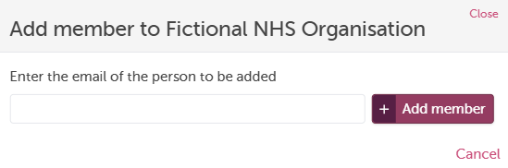
Adding a member:-

Slide 11

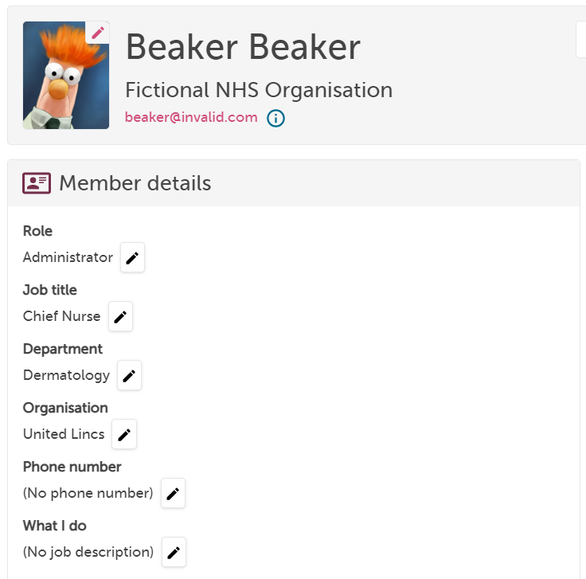

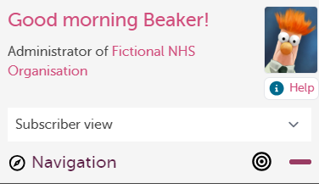
Updating member profile details
It’s really important as an administrator to encourage responders to update and maintain their profile details.
The information from here is pulled over into responses and invitation links, so it saves a lot of confusion when these things don’t quite look right later on.
Anyone can update their own profile at any time (this doesn’t have to be done by administrators).
Access your profile by clicking the greeting above the navigation panel, e.g. “Good morning…”

Slide 12
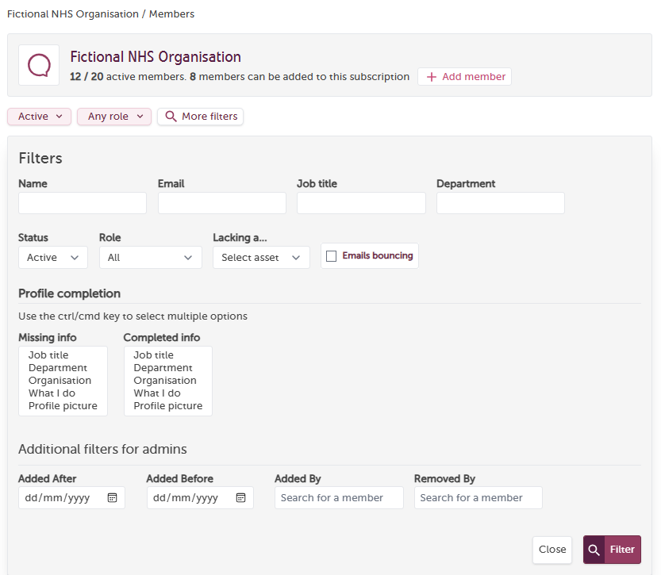
Filtering member’s:-
By name, email, job title or dept
Search by status or role
Filter by ‘date’
Added by or removed by
Search for missing info

Slide 13
Member Reports
Notes:
FB

Slide 14
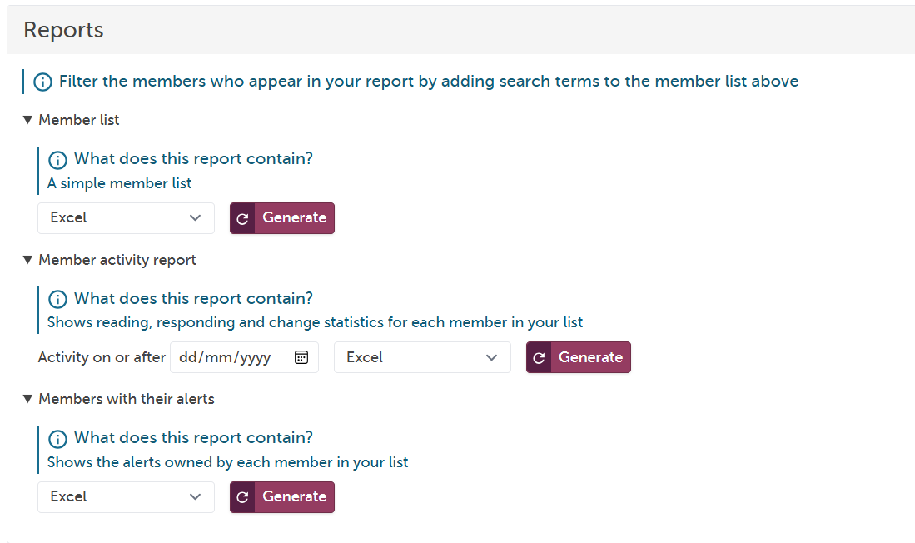

Slide 15
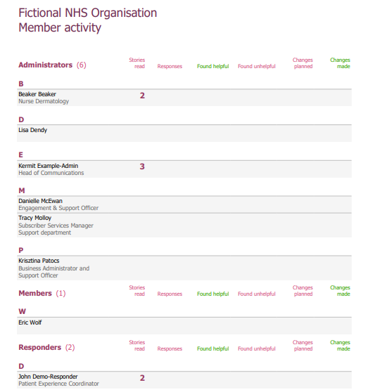
Member Activity Report:-
This report is interactive,
you can click on the numbers,
this will direct you to view those stories!

Slide 16
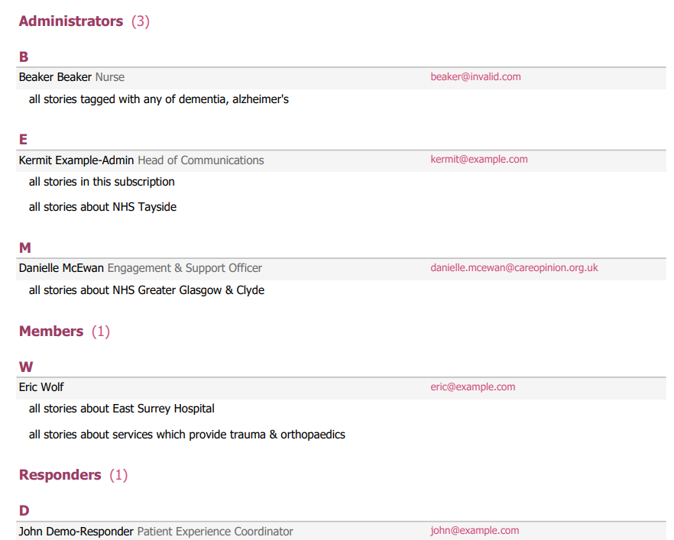
Member Alert Report:-
This report only list’s members that have an alert set up.
To view all member on subscription use the Member List Report

Slide 17
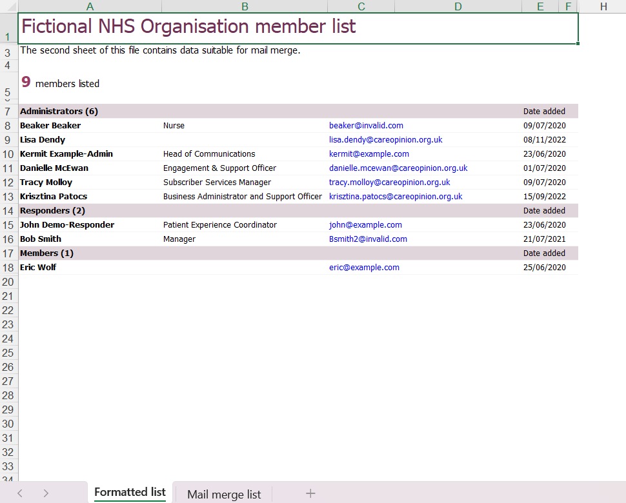
Member List Report:-
Download in
Excel!

Slide 18
Member Alerts
Notes:
FB

Slide 19
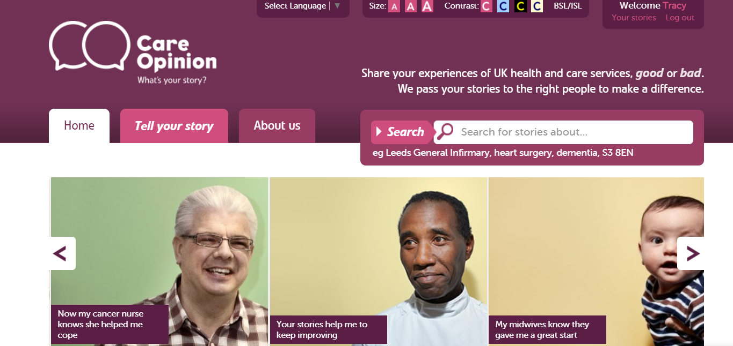
Setting an alerts for a member:
Always start with the name of your Organisation!

Slide 20


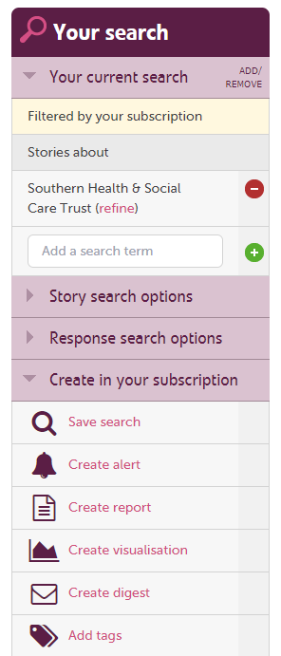
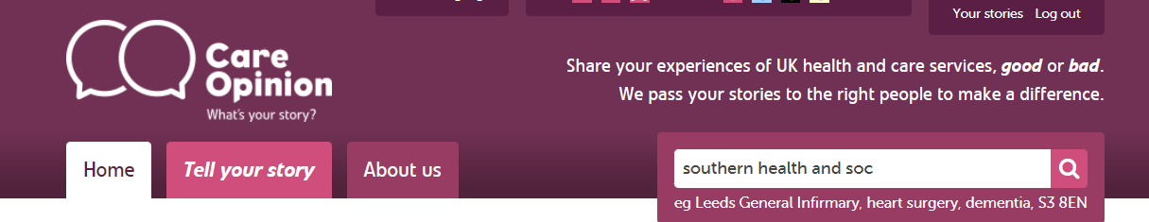
Start from the main search box
Any member role can create their own alerts
Any member role can adjust their ‘Alerts’ by using Smart alerts
‘Administrators’ can create alerts for ‘Members/Responders’
https://www.careopinion.org.uk/info/subscriber-help-reporting

Slide 21
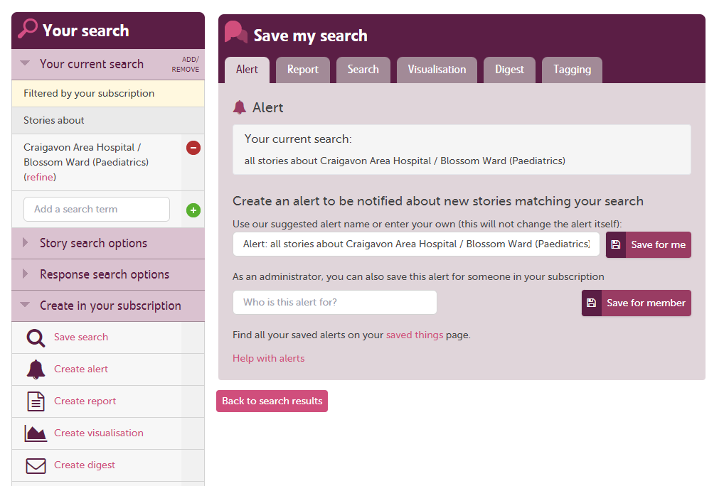
Save an alert for another member:-
Start to type the name of the staff member – It will auto populate
Check the members alerts by going to ‘members’ and clicking on their name

Slide 22









Adding new members/responders
Add the person to your subscription. You will need to give them one of the following permissions:
- Member
- Responder
- Administrator
Set up an alert for the service(s) that the person wishes to be notified about.
N.b. Users can set up, manage and delete their own alerts too!
Think about what training new users may need. You can find out what’s available using the link below:
Training and support webinars | Care Opinion
Find out if any Care Opinion materials are required and supply what you can.
If the service is new to using CO, have a chat about promoting stories and how you can support this.

Slide 23
Setting up an Invitation Link for a service
Notes:
FB

Slide 24
Inviting online feedback with an invitation link
The simplest way to invite people to share their experiences on Care Opinion is just to provide a link to the site.
Another way is to make an "invitation link“ and provide that instead. They look like this https://www.careopinion.org.uk/49/aah-ed
What does an invitation link do?
An invitation link allows you to:
customise various aspects of our story-telling workflow
easily access widget codes, kiosk links or QR codes to share with people using services
keep track of which stories came via which invitation links, and run reports and visualisations easily
Notes:
The simplest way to invite people to share their experiences on Care Opinion is just to provide a link to the site.
Another way is to make an "invitation link“ and provide that instead. They look like this https://www.careopinion.org.uk/49/aah-ed
What does an invitation link do?
An invitation link allows you to:
customise various aspects of our story-telling workflow
easily access widget codes, kiosk links or QR codes to share with people using services
keep track of which stories came via which invitation links, and run reports and visualisations easily

Slide 25

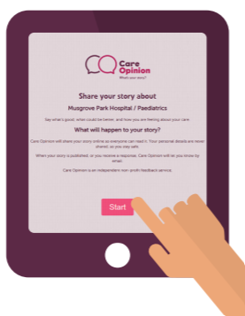

Slide 26
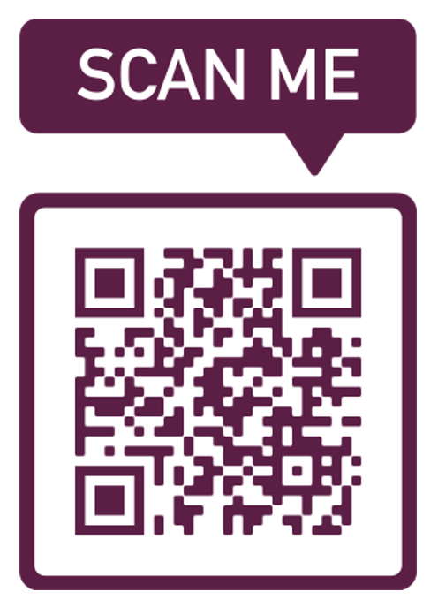

How can I use an invitation link?
Invitation links can be added to most correspondence
that you have with patients and/or service users.
Here are some ideas:
Emails
Texts – appointment reminders etc
Letters
On staff email footers
As a QR code on posters & leaflets
Social Media
On a tablet or Ipad
Notes:
Invitation links can be added to most correspondence
that you have with patients and/or service users.
Here are some ideas:
Emails
Texts – appointment reminders etc
Letters
On staff email footers
As a QR code on posters & leaflets
Social Media
On a tablet or Ipad

Slide 27
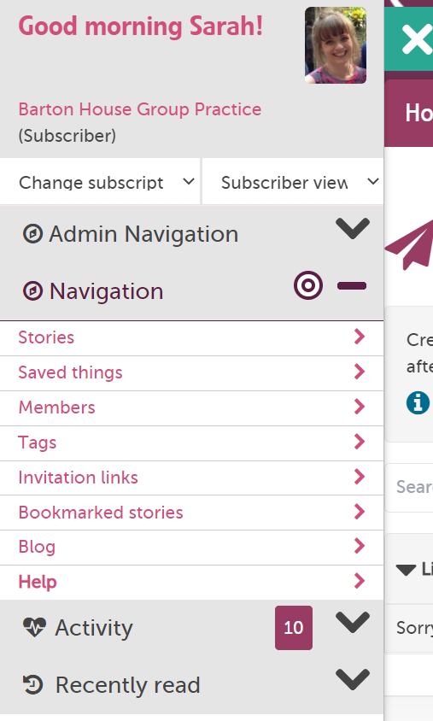
How to create an invitation Link
Example: I am a GP practice manager and I want to get feedback on our nursing services. I plan to text patients after their appointment and/or ask them to scan a QR code on the way out.
1: I need to be logged in and go to “invitation links” in the drawer

Slide 28
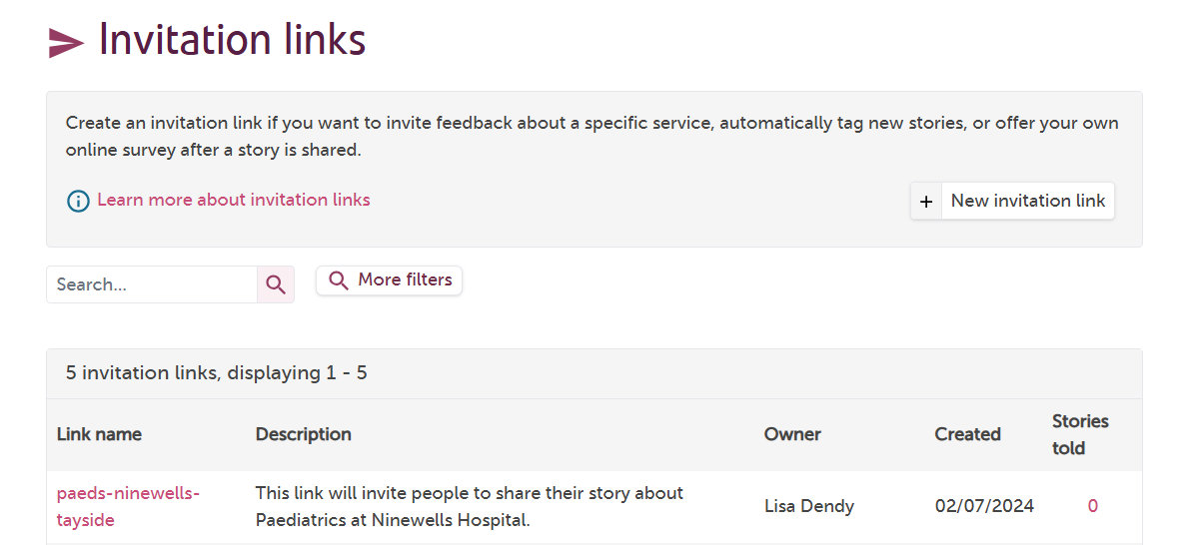
This takes me to the invite link page for my subscription. I can see if any of my colleagues have created links previously (no links in this case)
2: I need to click “new invitation link”

Slide 29
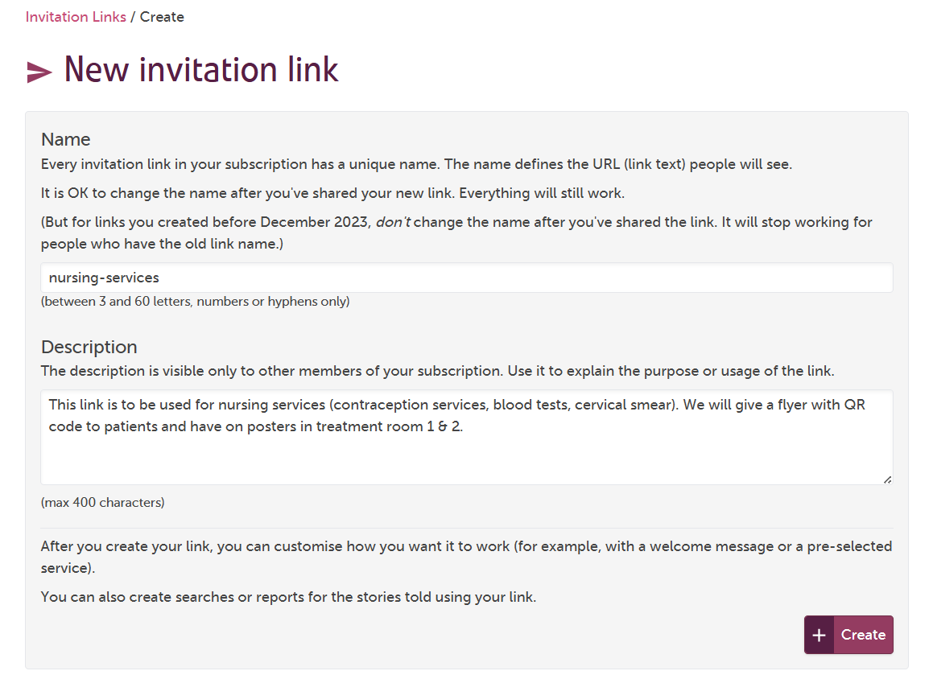
3: I give my link a name
4: I give the link a description so me and my colleagues know what it is to be used for.
Notes:
Name should be short and contain no spaces or capital letters

Slide 30
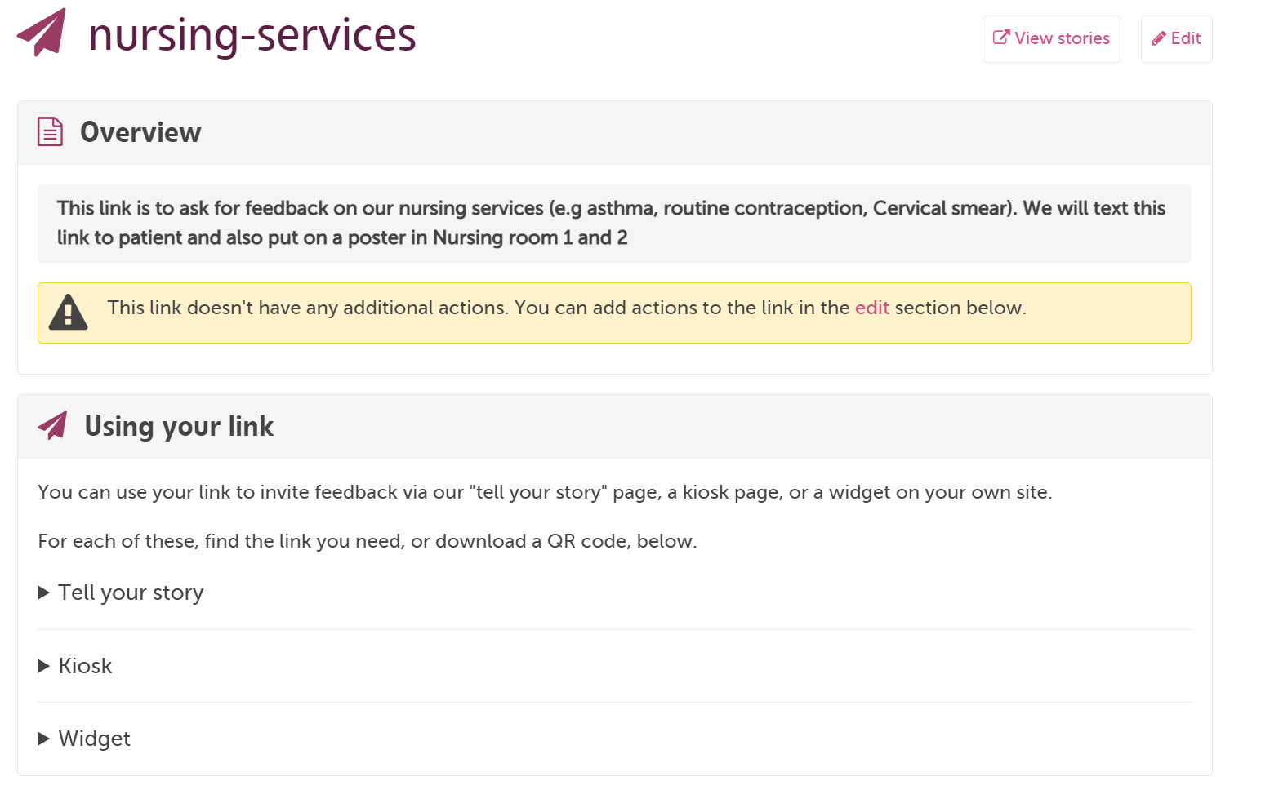

Slide 31
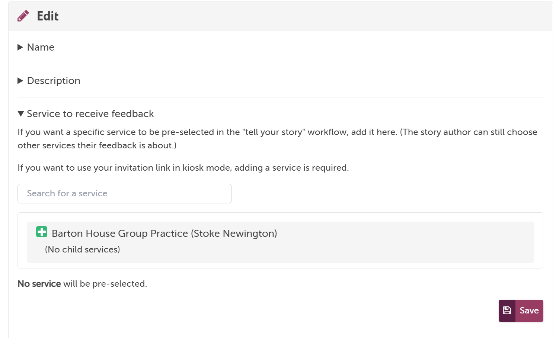
5: Important! If you want the feedback to be linked to a service, In this case my GP practice, you need scroll done the page and add it in the “edit” section
6: click the green plus then save.
Notes:
5: Important! If you want the feedback to be linked to a service, In this case my GP practice, you need scroll done the page and add it in the “edit” section
6: click the green plus then save.

Slide 32
Now you are ready to share your link create your own material or use ours https://www.careopinion.org.uk/info/new-materials

Slide 33
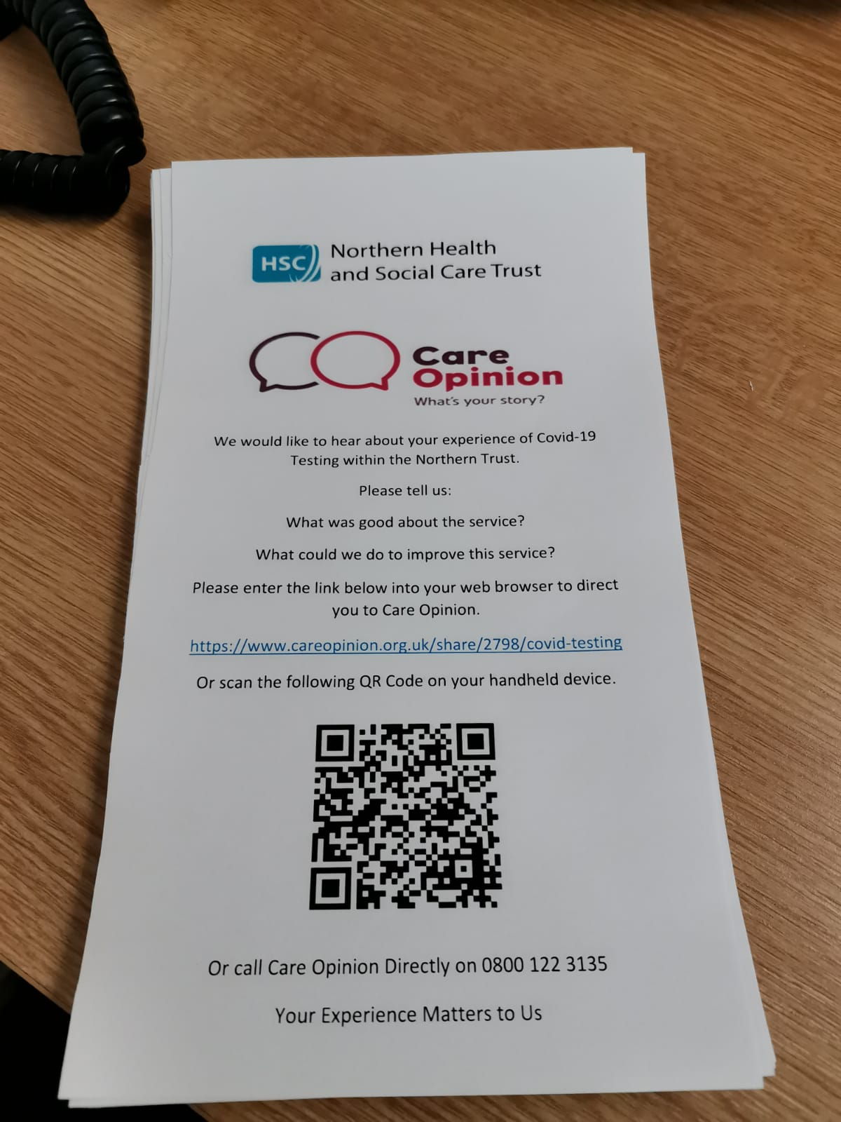
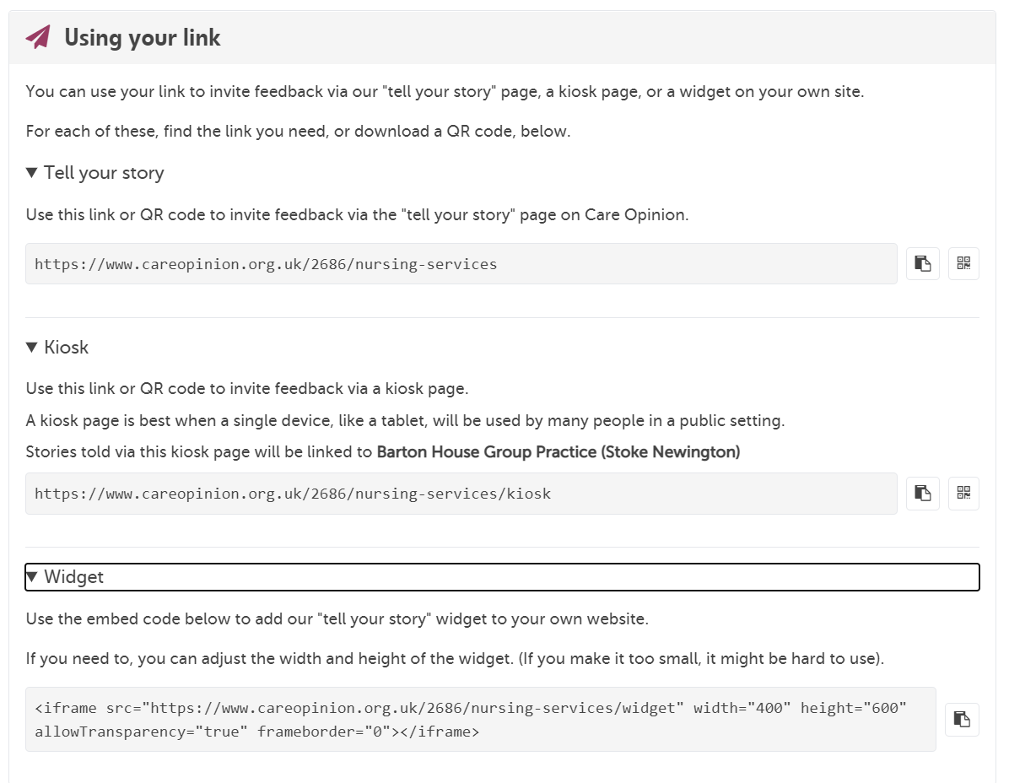
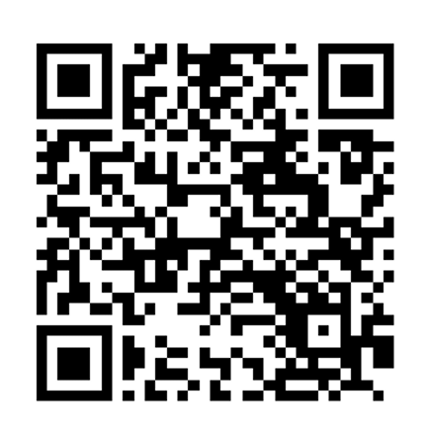

Create QR code
Copy link

Slide 34
Requesting Service tree changes/edits
Notes:
FB

Slide 35
The service tree
Almost all stories shared on Care Opinion are linked to one or more local health/care services which the story is about. In turn, each of these services has its own page on Care Opinion.
Services are organised in a hierarchy, a bit like a family tree, so when we talk about all the services listed on Care Opinion, we call it "the service tree".
For a story to be published on Care Opinion it must be linked to one or more services on the service tree.
This shows other site users where the story is about, and many staff on subscriptions are only alerted to stories linked to certain services
https://www.careopinion.org.uk/info/setting-up-your-tree
Notes:
FB

Slide 36
SOME THINGS TO CONSIDER BEFORE YOU START
A single service cannot be listed multiple times
Service trees should be as simple as possible to help authors (and moderators) link stories to the right service
Service names and locations should be recognised by the service user
We strongly recommend not listing services by directorates - these can change often, are not understood by the public and can be managed via reporting instead
prioritise services rolling out Care Opinion. The only reason to add a service to your service tree is if they are promoting Care Opinion and are expecting feedback*
*If we receive a story about a service not on your tree, we will link it to your organisation so you can still respond immediately and once the service is added we can link the story to it.
Not having the service on the service tree is not a barrier to stories being shared or responded to.
https://www.careopinion.org.uk/info/setting-up-your-tree
Notes:
FB

Slide 37
Changes to a service tree
A service tree may need to change over time, to best reflect the services provided by the organisation at the present moment. There may be different reasons for a service tree to change:
There may be mistakes to be corrected
New services may open
Old services may close
A service may change its name or function
A service may move from one location or grouping to another
A service may not have been added to you service tree yet but is ready to collect feedback
Request changes to a service tree (including adding single services)
https://www.careopinion.org.uk/info/request-service-tree-changes
How long does it take?
Making changes to service trees is quite complicated. Especially if the service tree already have stories linked to it. We process spreadsheets in date order. We aim to complete service tree requests within two weeks.
https://www.careopinion.org.uk/info/understanding-treatment-functions
Notes:
FB

Slide 38
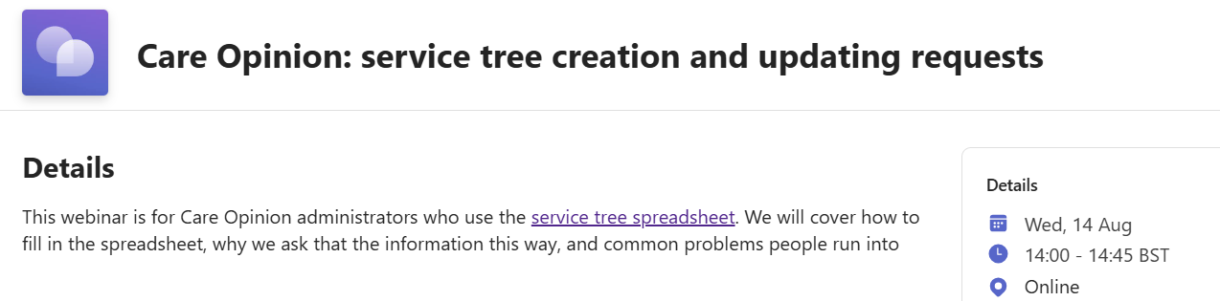
Care Opinion Training: Forthcoming!
Register now: HERE
Notes:
FB

Slide 39
Re-cap – what have we learnt?
How to view our subscription details & what the role of the ‘Administrator’ is on Care Opinion
How to view subscription members, add/remove & edit their roles
How to use the Member reports
How to set up an alert for a member
How to set up an Invitation link
How to make service tree requests (Changes/additions/removals)
Notes:
Now I will move on to using on-line promotion to gain more feedback.
CO Logo on website – linked to your stories
Widgets, we have several widget options available:
Latest Stories
Story telling, or embed the CO video that tells people who we are and what we do.
Any CO logos are available in many shapes and sizes, think outside the box!
If you have an idea to promote CO within your service and we don’t already offer that particular resource, speak to us at CO about it and we will be more than happy to support you with it, always open to new ideas ☺

Slide 40

Tell Your Story with Bear

Slide 41

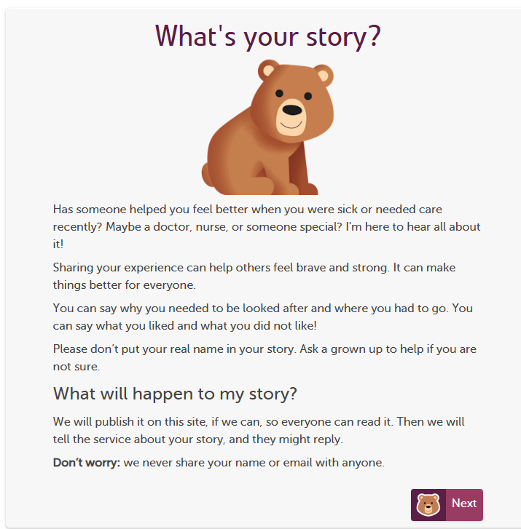
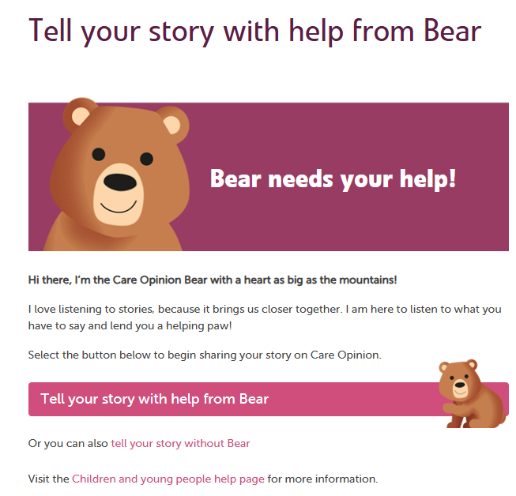
Children can share their story with help from Bear…
https://www.careopinion.org.uk/go/3425/tell-bear-your-story

Slide 42


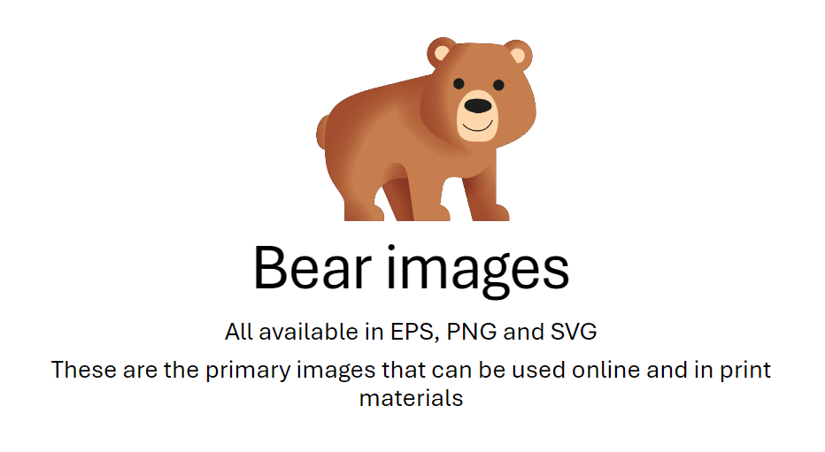
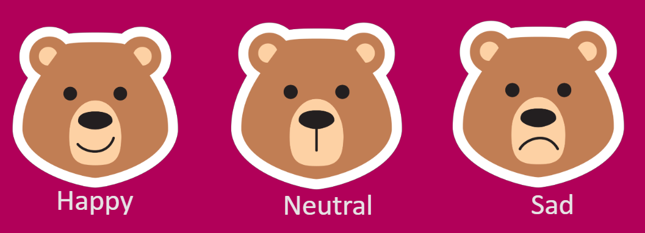
We can provide you an image suite with Guidance to create Bear Materials…..
IMPORTANT! Please read the guidance sent with the image suit and use CO Logo in all material designs.

Slide 43


We are developing Bear Promotional Print Materials for you to use to encourage feedback…these will be ready in the very near future…watch this space!

Slide 44
Thank you
Notes:
So thank you for joining in this session today, I hop[e you have found it useful
Does anyone have any questions?
Other ideas:
Involve Volunteers
No internet connection – Forensic services – Vols go in and take the story using the ‘Taking a story form’ then in put on their behalf.
I will share all links and presentations.

