Slide 1


Managing your Subscription
Notes:
Welcome to the ‘Managing your subscription’ Webinar, This webinar is designed for the Administrator on the Care Opinion subscription. This is a new session with some updates which hopefully will make it easier for you to manage members and stories across your subscription.
This particular Webinar looks at the different ways to promote Care Opinion and talks through some various ways of implementing this.

Slide 2
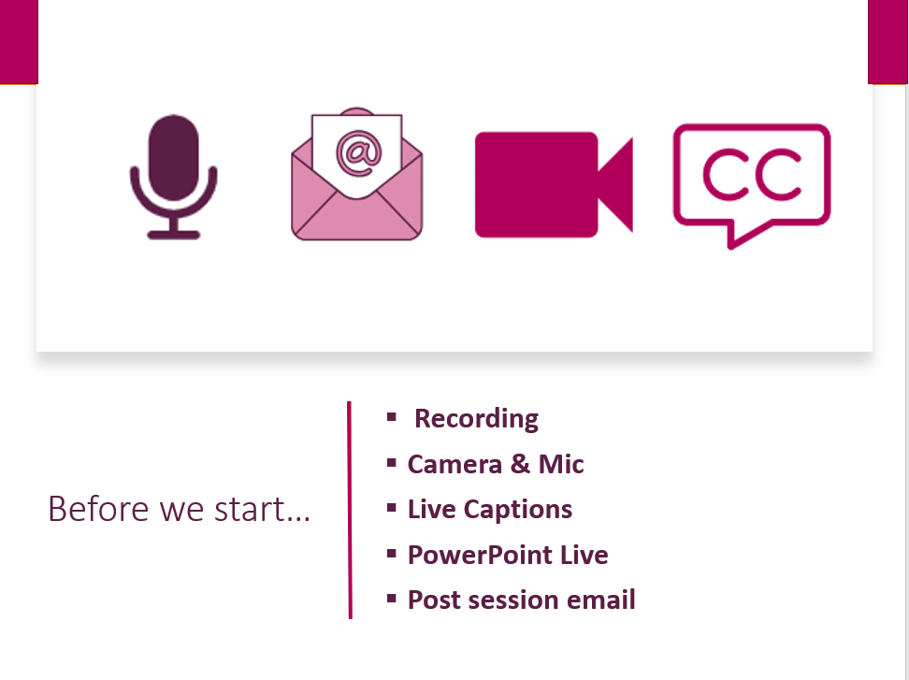

Slide 3

In this session we will help you to:-
Understand your subscription and the features of your role – as an Administrator on the Care Opinion subscription
Manage the ‘members’ on your subscription, including adding/removing & freezing members (Including *new Member Filtering)
Setting up an alert for another member
Accessing ‘Member’ reports

Slide 4
Understanding member roles
Browse, search and view stories and responses
Manage their own email alerts/assets
Create, export and schedule reports
Create, share and schedule data visualisations
Add private and shared story tags
Respond to stories and show changes
Create and publish blog posts
Create Invitation Links
Add public story tags
Add and remove subscription members
Freeze and unfreeze subscription members
Change the role of a member
Edit member profile details
View, edit & amend members assets
Respond on behalf of another member
Manage assets/alerts for other members
Create Invitation Links & transfer ownership
Customise service pages
Access API keys
Member
Responder
Administrator

Slide 5
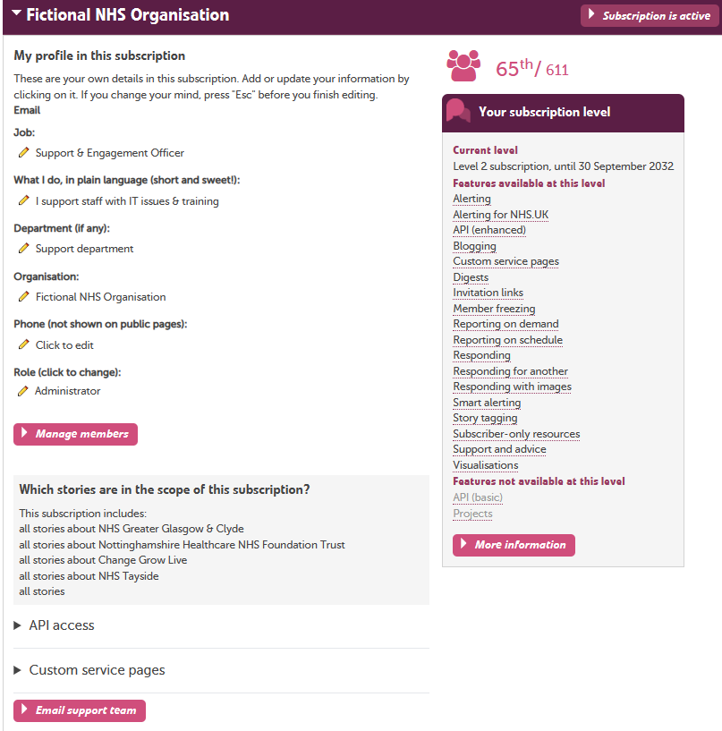
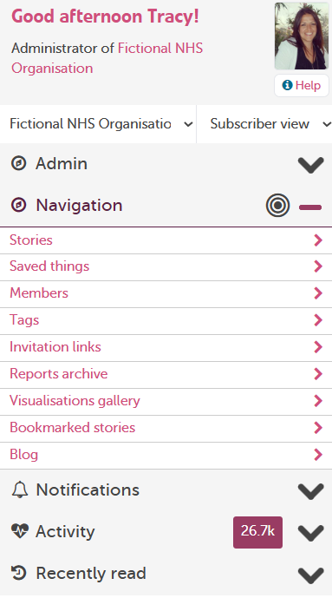

Slide 6
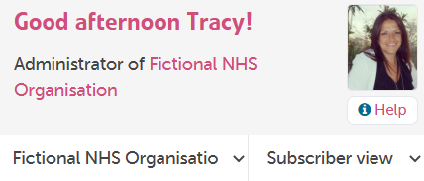
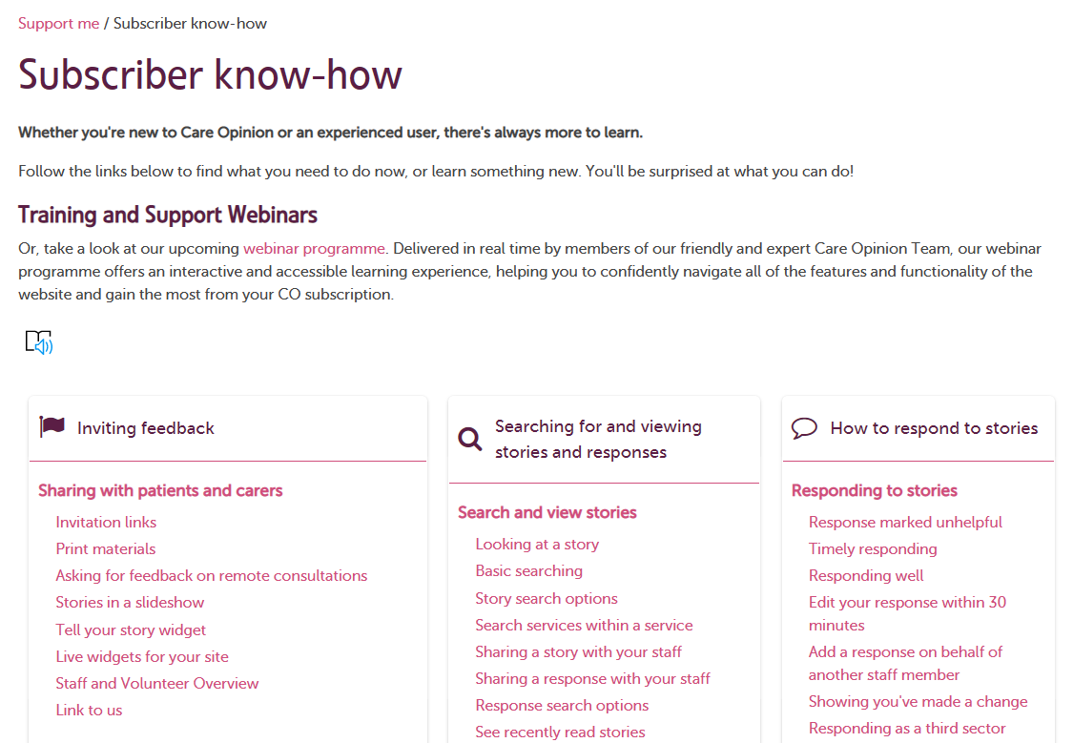
https://www.careopinion.org.uk/info/subscriber-know-how
Notes:
FB

Slide 7
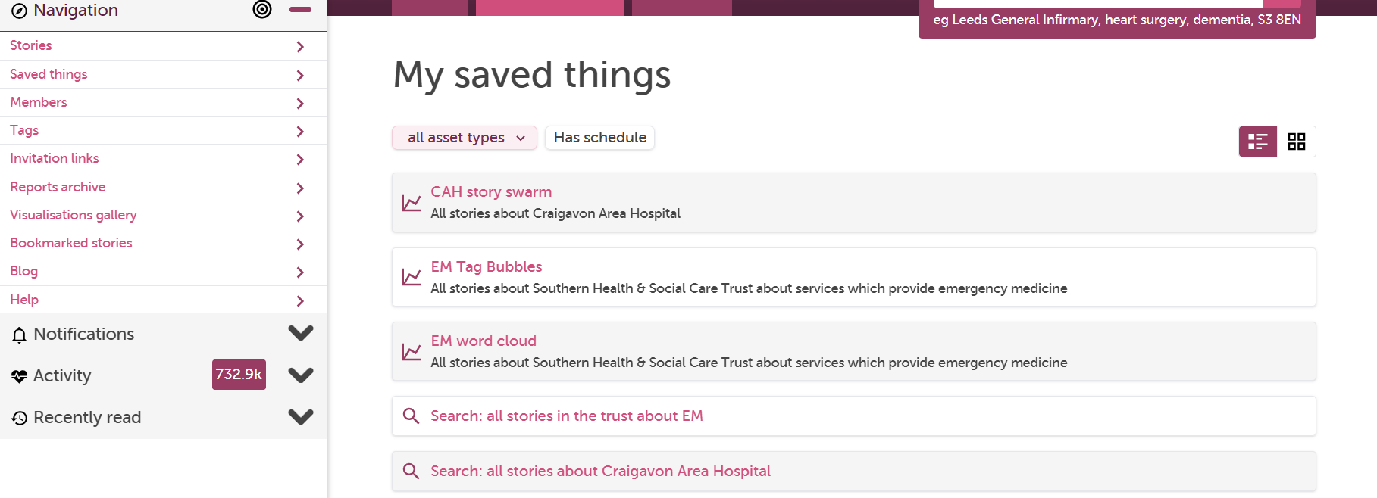
Terminology: Saved things = Member assets
Notes:
FB

Slide 8
Managing subscription members
Notes:
FB

Slide 9
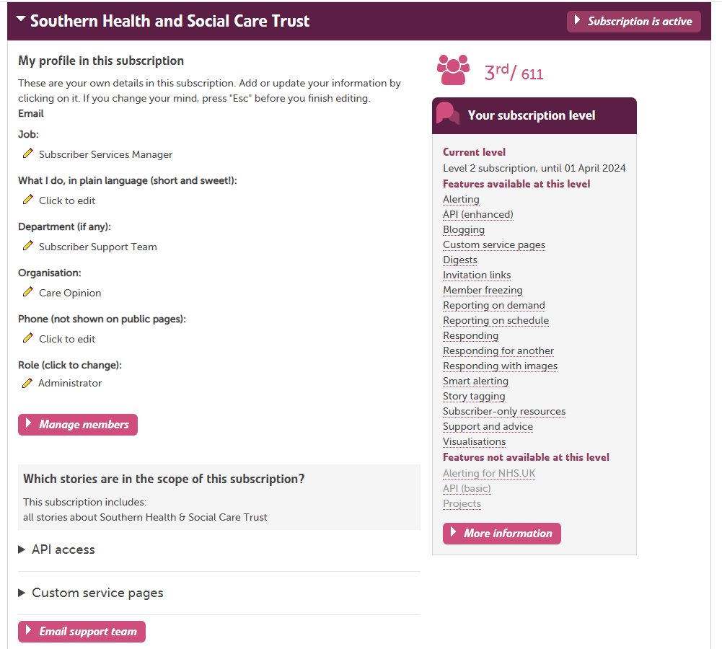
Managing subscription members:-

Slide 10
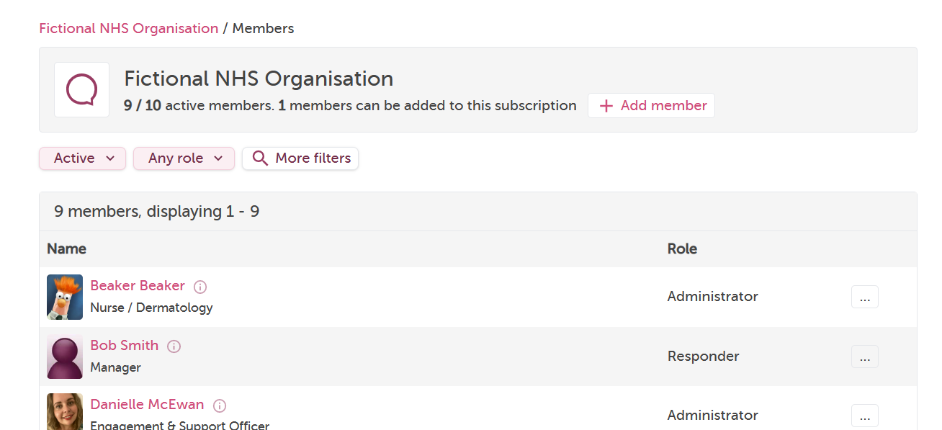
Notes:
FB

Slide 11
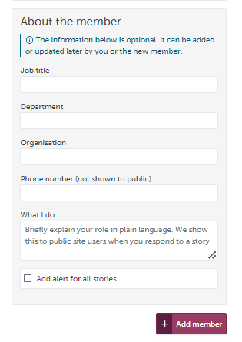
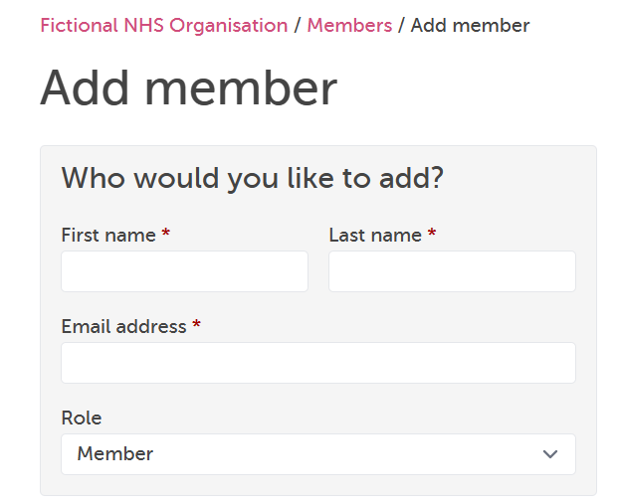
Adding a member:-
Only tick this box if you want the member to receive an alert for ALL stories in the subscription!

Slide 12
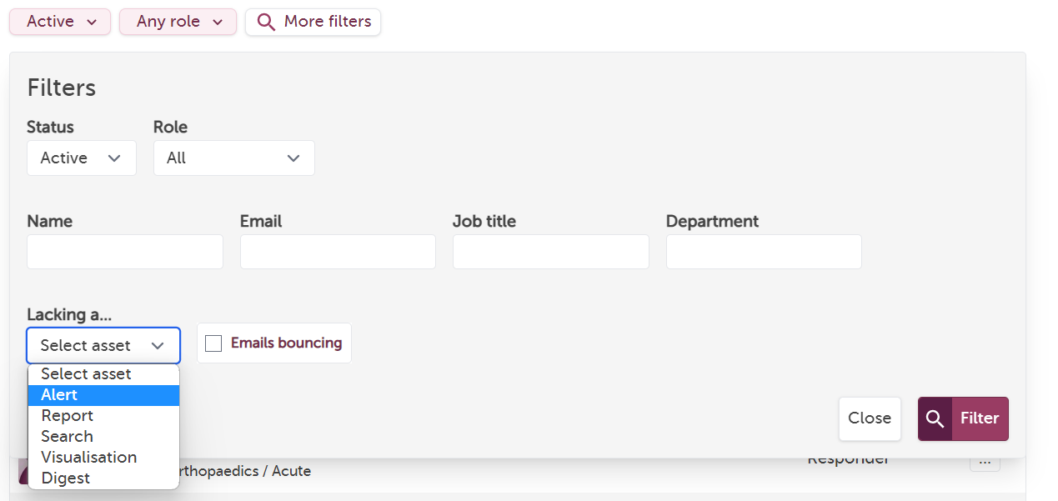
Filtering by Members

Slide 13

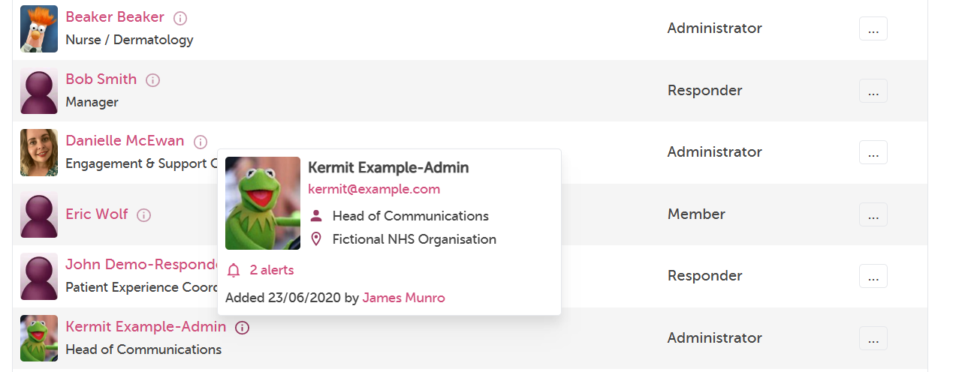
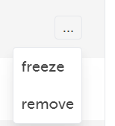
Extra information on each member by hovering over the
By clicking on the 3 dots you can either freeze or remove a member

Slide 14
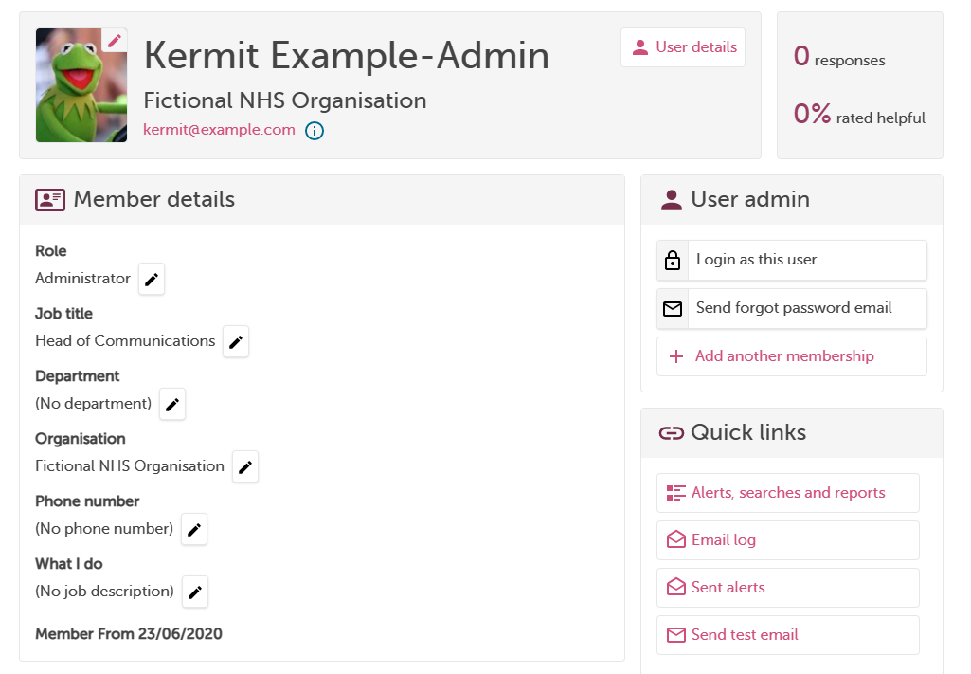
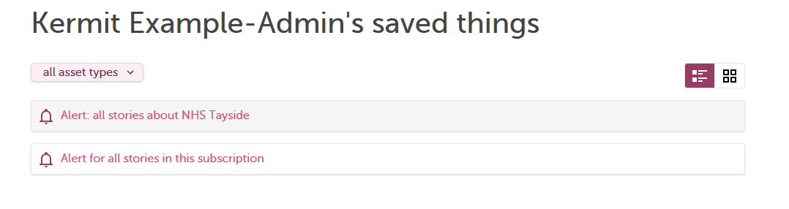
Editing ‘member’ details and quick links
To edit a members details
Click on the member’s name
You can edit their profile in ‘User details’
You can change their role is ‘member details’
Promote or demote!
View their saved assets e.g. Alerts, Reports and Visualisations

Slide 15
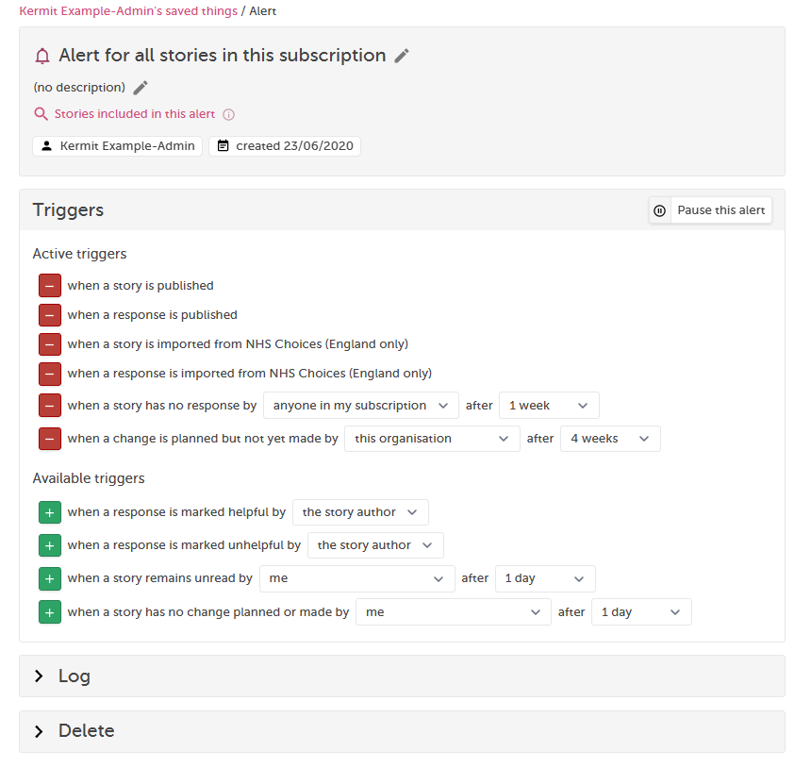
Editing/deleting ‘member’s’ alerts and adding in ‘Triggers’
To remove ‘active triggers’ select the red –
To add in ‘available triggers’ select the green +

Slide 16
Setting up an alert for a member/responder
Notes:
FB

Slide 17


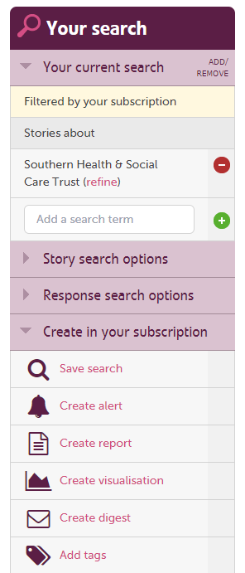
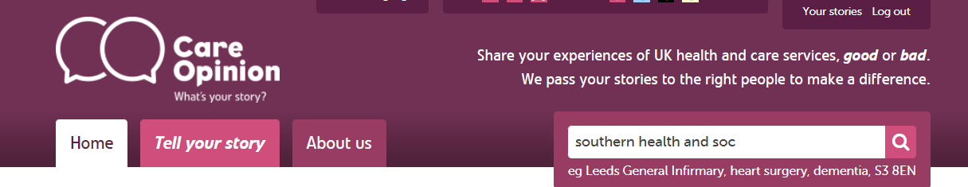
Start from the main search box
Any member role can create their own alerts
Any member role can adjust their ‘Alerts’ by using Smart alerts
‘Administrators’ can create alerts for ‘Members/Responders’
https://www.careopinion.org.uk/info/subscriber-help-reporting

Slide 18
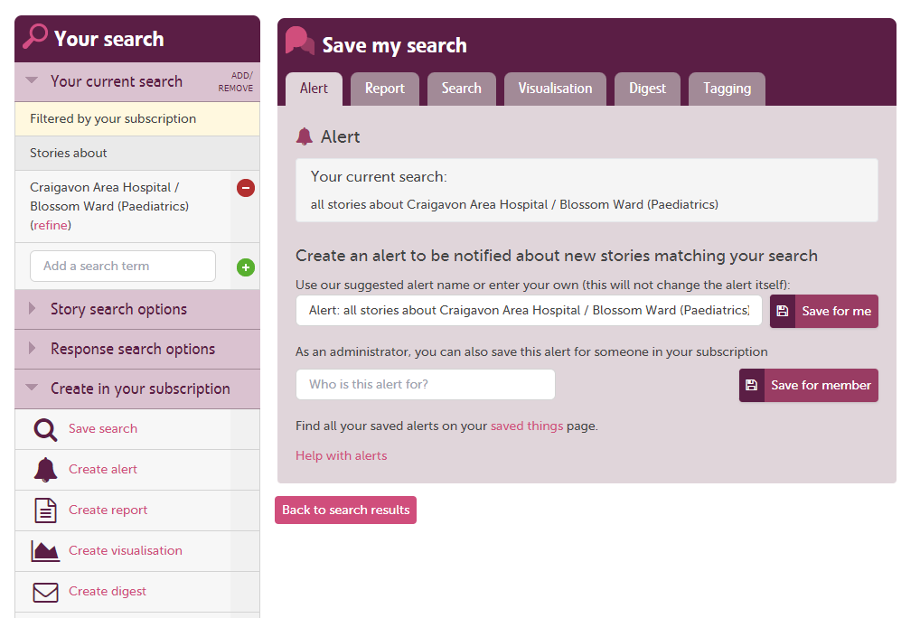
Save an alert for another member:-
Start to type the name of the staff member – It will auto populate
Check the members alerts by going to ‘members’ and clicking on their name

Slide 19
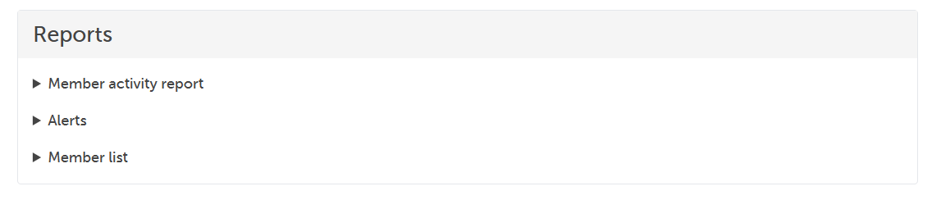
Member reports
Notes:
FB

Slide 20
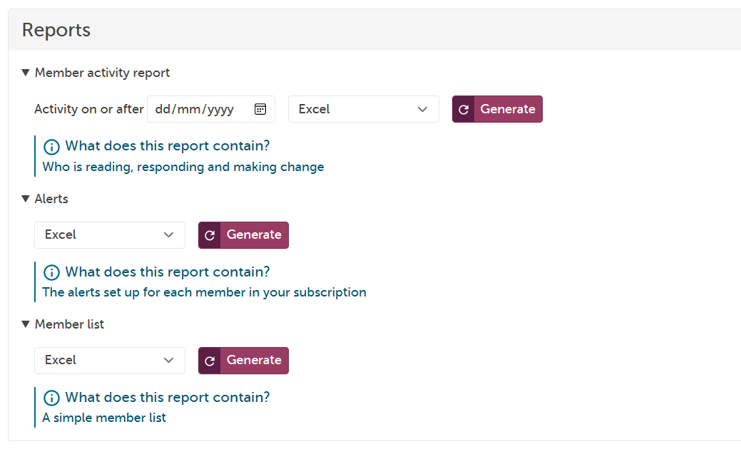
Member reports
Notes:
FB

Slide 21
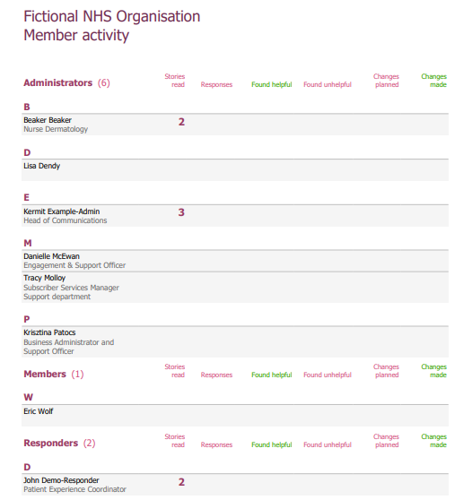
Member Activity Report:-
This report is interactive,
you can click on the numbers,
this will direct you to view those stories!

Slide 22
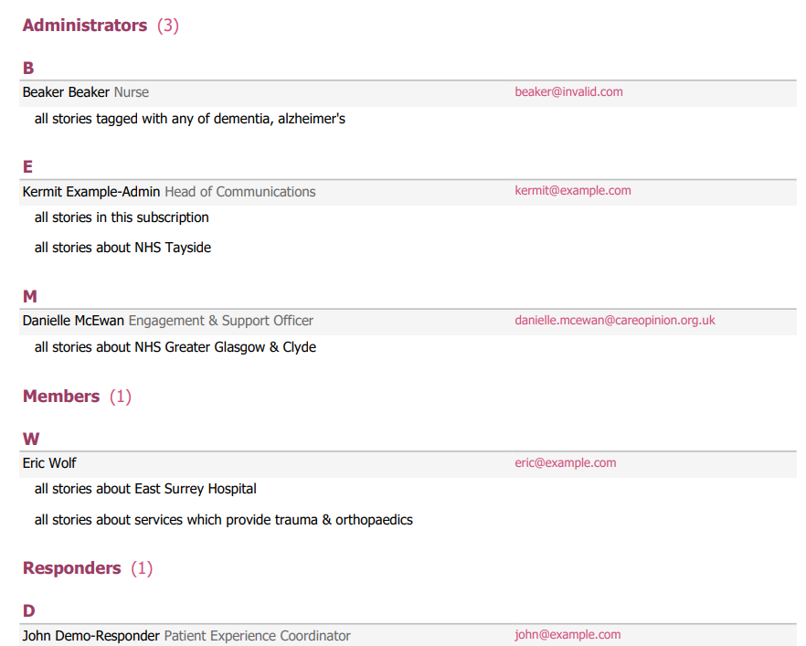
Member Alert Report:-
This report only list’s members that have an alert set up.
To view all member on subscription use the Member List Report

Slide 23
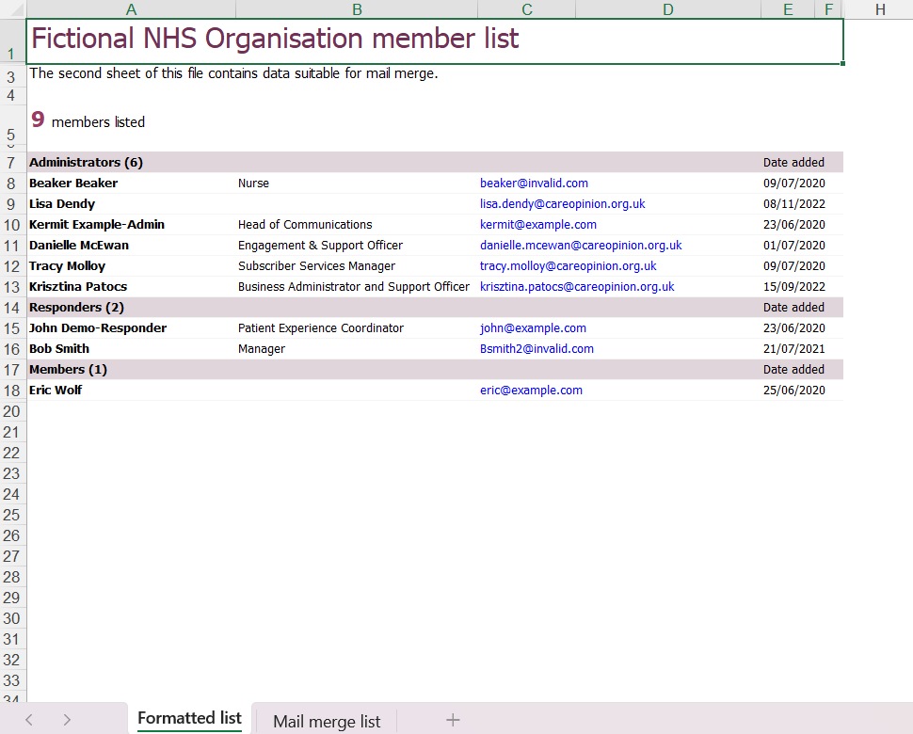
Member List Report:-
Download in
Excel!

Slide 24
Re-cap – what have we learnt?
How to view our subscription details & what the role of the ‘Administrator’ is on Care Opinion
How to view subscription members, add/remove, edit their roles & use the new filtering
How to set up an alert for another member
How to access the ‘member’ reports
Notes:
Now I will move on to using on-line promotion to gain more feedback.
CO Logo on website – linked to your stories
Widgets, we have several widget options available:
Latest Stories
Story telling, or embed the CO video that tells people who we are and what we do.
Any CO logos are available in many shapes and sizes, think outside the box!
If you have an idea to promote CO within your service and we don’t already offer that particular resource, speak to us at CO about it and we will be more than happy to support you with it, always open to new ideas ☺

Slide 25
Other online ‘How to’ sessions available:-
Encouraging stories on Care Opinion
Responding well & demonstrating impact
Reports and visualisations
Subscriber tagging & Invitation Links
Responding to critical stories
Managing your stories with alerts
https://www.careopinion.org.uk/info/support-webinars
Notes:
Advice on widgets here: https://www. careopinion.org.uk/info/latest-postings-widget
Here is an example of the ‘Latest Stories’ widget, it can go on a home page or on a page of its own. It stays fully up date in real time.
So again very labour un-intensive, once its on your page it is there and you don’t have to do anything with it.

Slide 26
Thank you
Notes:
So thank you for joining in this session today, I hop[e you have found it useful
Does anyone have any questions?
Other ideas:
Involve Volunteers
No internet connection – Forensic services – Vols go in and take the story using the ‘Taking a story form’ then in put on their behalf.
I will share all links and presentations.

