Slide 1
CareOpinion: My Story Leslie Robinson
Academic (educator/researcher)
Health Care Professional (advisor to College of Radiographers)
Daughter/wife (carer/service user)
Patient Representative (PPG member)

Slide 2
1. Academic

Slide 3
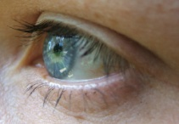
Using Care Opinion as Educator
Exploring the story
Exploring the ‘interaction’

Slide 4
Plan for using Care Opinion in 2017/18
Module/learner/Profession | Level | Activities
“Introduction to Collaborative Professional Practice” Radiography; physiotherapy; OT; podiatry; P&O | 4 | Scenarios for learning Summative assessment
“Fundamentals of Patient Centred Care” Radiography | 4 | Scenarios as PBL triggers Source material for summative assignment
“Into Employment” Radiography; physiotherapy; OT; podiatry; P&O | 6 | Classroom Discussions Summative assessment – service re-design
“Psychology and Health” Psychology, Psychology and Counselling and Psychology and Criminology | 6 | Classroom discussions: this group do not have access to real clinical cases
“Fundamentals of Mammography Practice” Mammographers | 7 | Scenarios for learning
“MSc Occupational Therapy” Development of communication and empathy | 7 | Scenarios for learning Skills for online interaction
“Research Methods” OT Advanced Practice, distance learners | 7 | Qualitative data analysis exercise
“Nuclear Medicine” | 7 | Scenarios for learning Summative reflective assessment

Slide 5
Divide into groups
Take one story for each group
E.g. “unprofessional" & “I am still in pain”
What are your thoughts?
How does the patient feel and why?
Was there a response?
Was it helpful?
Was change made?
Would you have done something different ?

Slide 6
Example level 4: Summative Assessment
Using CO identify story of good quality healthcare provision
‘Communication’ or ‘Team working’.
Introduction (approximately 200 words)
Overview, summarise the story, including responses
Identify two key points that are raised in the ‘story’.
Main body (approximately 1100 words)
Discuss the two points raised using academic evidence
Conclusion (approximately 200 words)
Summarise discussion/themes together in a conclusion
Reference list
Read, and reference, a minimum 10 sources

Slide 7
“The CO site breathed new life into the module. It is very hard to teach IPE , and almost impossible to find case studies which students from all professions can identify with . The CO site gave us this”
“We use the CO site as the basis of the assignment...it helped the students write their essay, in that it gave them something real to relate to”
Year 4 IPE module leader

Slide 8
Perspective of CareOpinion as academic
Authentic clinical scenarios
Model for communication skills
Research data

Slide 9
2. Health Care Professional
Chair of Patient, Public and Practitioner Partnership Working Group
Develop a strategy to ensure patient’s voice central, not only throughout College and Society business but also throughout the practices of radiography.

Slide 10
“a set of core values which are expanded upon using authentic patient stories to illustrate the impact such values have on patients, carers and the public. These stories have been garnered from a number of sources including: statements from patient members of the PPPP task and finish group, quotes from research participants, and stories from CareOpinion.org.uk”

Slide 11
During my imaging or therapy procedure I would like it if you could...
Ensure that I understand your role and make me feel confident and safe in your care:
“I was extremely apprehensive about the MRI scan fearing that I would not be able to cope with the very claustrophobic environment. The staff were amazing!!! At all times my dignity was respected guiding me through the whole process in a calming, caring and professional manner. Thank you very much” (CareOpinion.org.uk)
Consider patient centred approaches to booking and appointment systems:
“I went to the radiology dept. for an MRI on May 28th and was told the scanner was broken. I asked when it had broken down and was told the night before. No one had bothered to phone me until 12.00 noon the next day when I had just arrived in your parking lot for my appointment so I made an un-necessary journey. I could understand if it had only just happened” (CareOpinion.org.uk)

Slide 12
Perspective of CareOpinion as Health Care Professional
Provides salient examples of when the service works and does not work

Slide 13
3. Carer/Service User

Slide 14
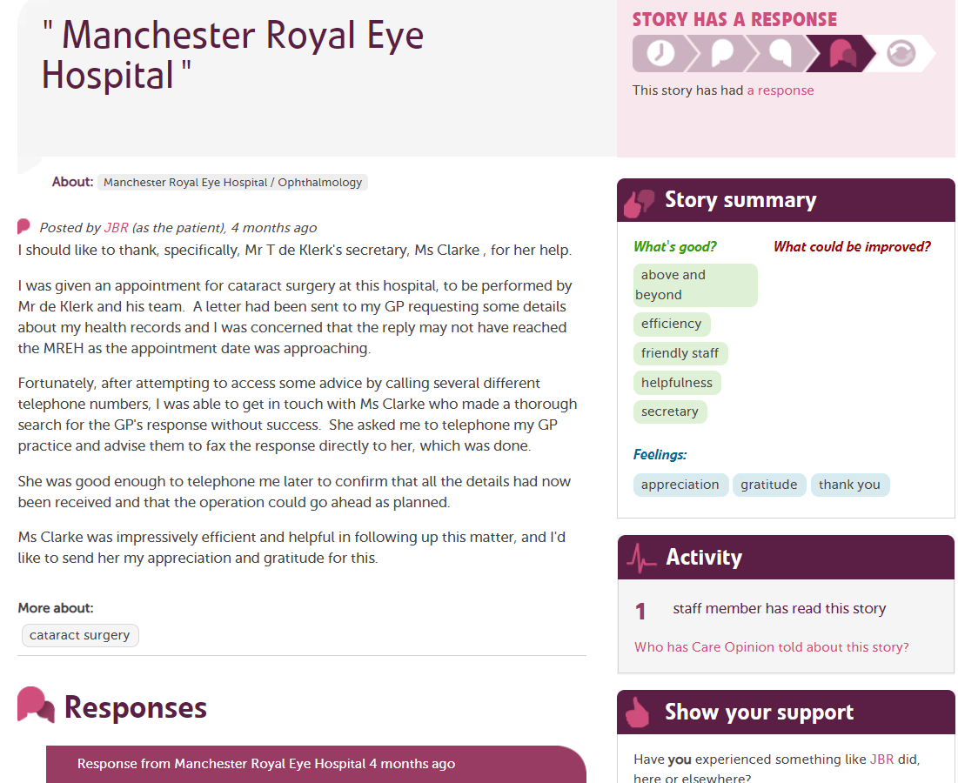
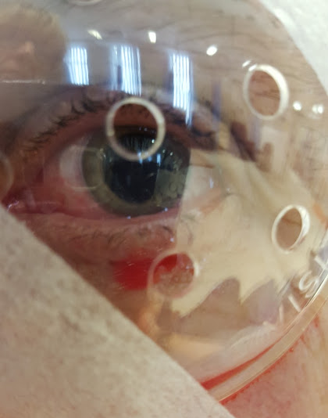

Slide 15
Perspective of CareOpinion as carer/service user
Gives patient a voice/empowers
Open for others to view
“Credit where credit is due”
Prompts a response
Can see impact of sharing experience

Slide 16
4. Patient Representative: PPG
PPG Meeting
Monday 17th September 2018
Present PPG: JH, JH, LR, TC, JA, GG, TP, JK, BT, JC, AG, KP, IB.
C*** Medical Practice: Dr Wilson & Chloe Chesters
Chair: JGT
Apologies: LI, AM, MR

Slide 17
Raising patient awareness and gathering feedback
Identifying key themes in feedback
Making improvement suggestions based on feedback
Reviewing practice responses from a patient perspective
Responding to feedback online
Sharing practice responses/improvements with patients

Slide 18
CO: a multifaceted tool
Teaching and learning
Research
Patient and public empowerment
Staff/service recognition
Improvement tool
Space for collaboration and partnership working

