Slide 1






Care Opinion
‘The Ripple Effect’
How Sexual Health Services are using
Care Opinion to Encourage Feedback and use it for
Learning and Change
Julia Barraclough – Operational Service Manager
Midlands Partnership University Foundation NHS Trust

Slide 2
Content
Introduction and background
How we encourage feedback from patients within our sexual health services
How we use feedback from Care Opinion to support learning and change
How we get staff involved in promoting feedback and responding well
How we use Care Opinion to positively affect staff culture
Notes:
Summary of content

Slide 3
Introduction and Background
  MPFT runs sexual health services that cover Stoke-on-Trent, Staffordshire, Telford & Wrekin, Shropshire, Leicester, Leicestershire and Rutland.
  Prior to 2021, the Trust used their own surveys to gather patient feedback, incorporating the NHS ‘Friends and Family’ questions. However, not always appropriate for sexual health service users and uptake was low.
  Care Opinion was being used in other MPFT services so in April 2021, Care Opinion was adopted in Stoke-on-Trent, Staffordshire, Telford & Wrekin and Shropshire.
  It has gone from strength to strength!
Notes:
Background to MPFT – MPFT is a foundation Trust offering a wide range of physical and mental health services across the country.

Slide 4
Background
  Open Clinic is the branding for the sexual health services that cover Stoke, Staffordshire, Telford and Shropshire clinics
  We offer the full range of sexual health services:
    Fully integrated GUM (Genito-Urinary Medicine) and Contraception services
    Comprehensive HIV treatment and care services
    Psychosexual Therapy, PrEP and complex GUM treatment
    Complex contraception
    Mpox and HPV Vaccinations
    Opportunistic cervical screening
    Prevention and Promotion services
    Access to online STI testing via SH:24
Notes:
The full range of sexual health services commissioned by local authorities and NHSE

Slide 5
Introduction and Background
  Since we started Care Opinion in April 2021:
  Stoke/North Staffordshire:
  – 582 stories published, 22 led to change
  South Staffordshire:
  – 582 stories published, 5 led to change
  Telford:
  – 236 stories published, 14 led to change
  Shropshire:
  – 285 stories published, 3 led to change
  Total:
  – 1,685 stories published, 44 led to change
Notes:
I mentioned it had gone from strength to strength and these are the numbers as of last week, representing just over 2 years of stories

Slide 6
How we encourage feedback from Service Users
Promoted in clinic by reception and clinical staff
Advertised on our Website and via Social Media
Use of QR codes for easy access
Patients are sent text messages after their appointment with a link direct to Care Opinion to encourage them to provide feedback
Notes:
We have looked at a wide range of tools to help us promote Care Opinion and encourage feedback.
As well as advertising on social media, we use Twitter and Instagram to feedback some of our key positive stories

Slide 7
Poster in Clinic with QR Code
Notes:
This is an example of a poster we use in clinic with the QR code for easy access (the QR code is specific to each clinic)

Slide 8
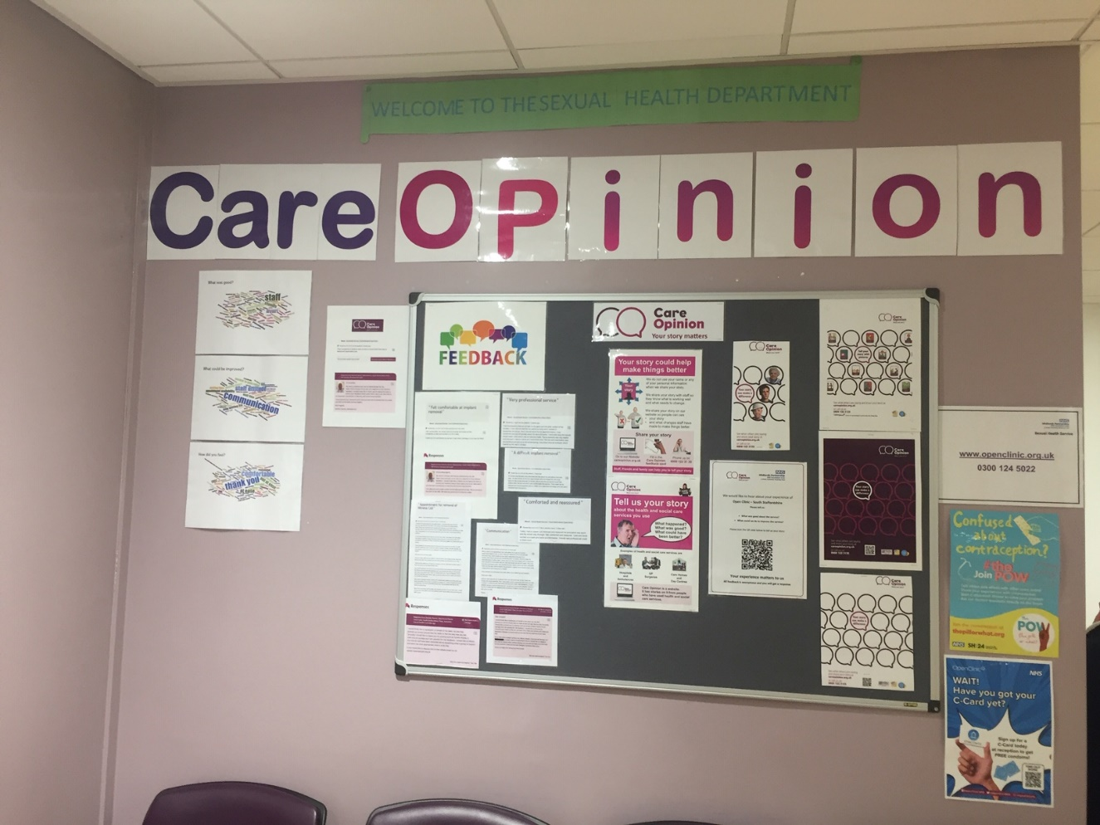
Noticeboard in Clinic
Notes:
Thanks to Andrew, who has joined this conference today as he was instrumental in putting this display board together in our Stafford clinic!

Slide 9
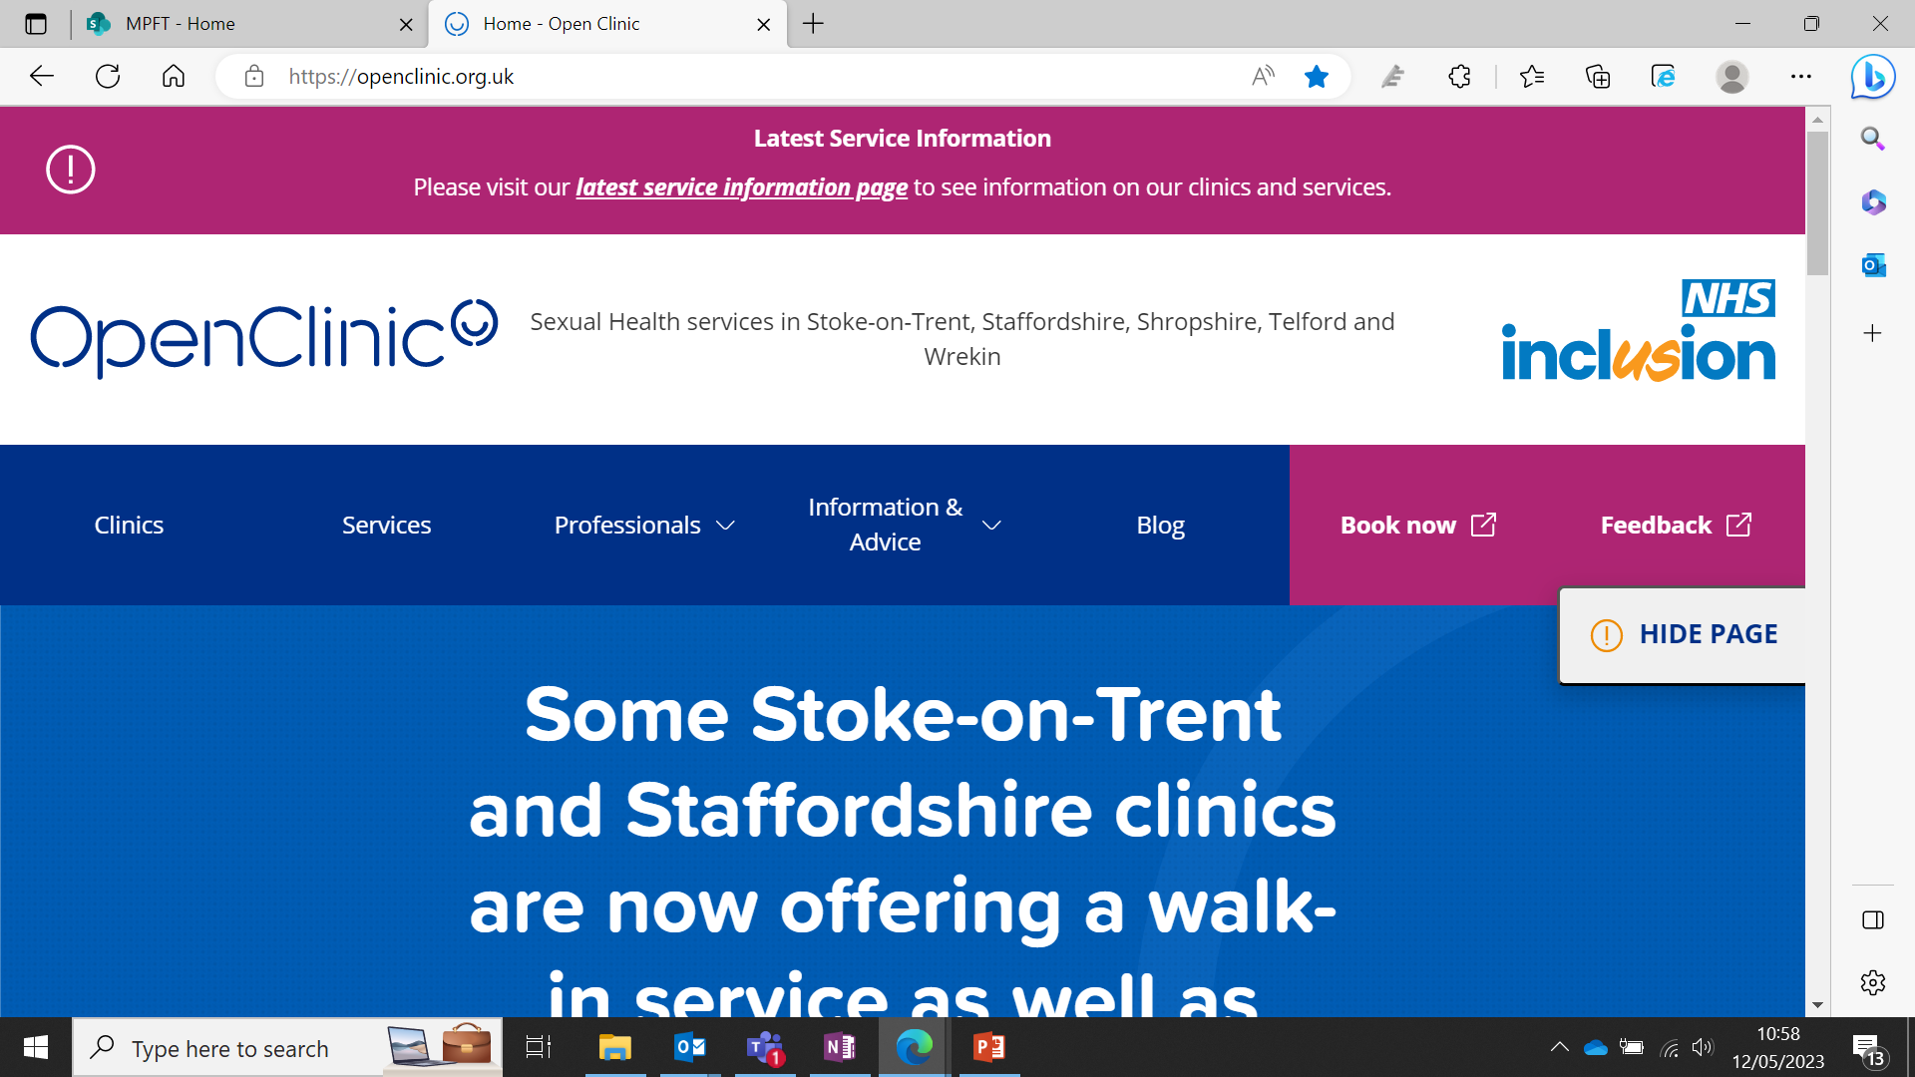
How our Website is used to Promote and Encourage feedback
Feedback Section

Slide 10
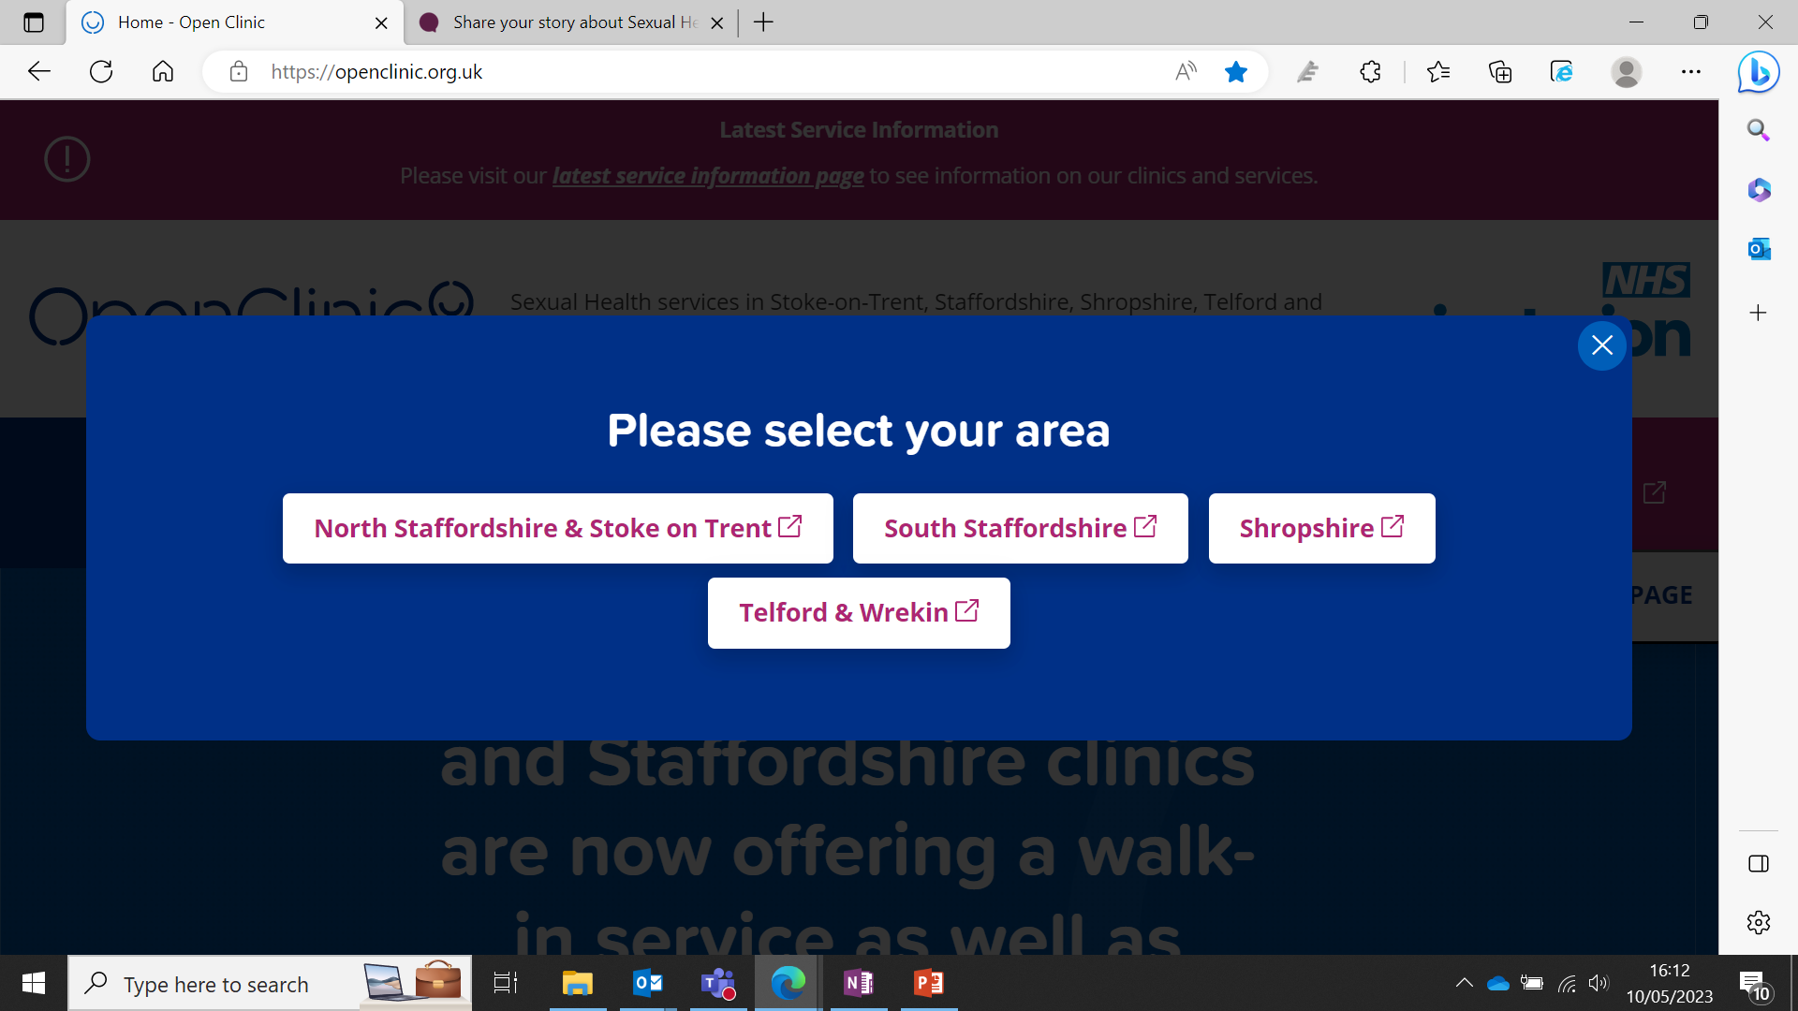
How our Website is used to Promote and Encourage feedback
Service Users select which area they have attended clinic in

Slide 11
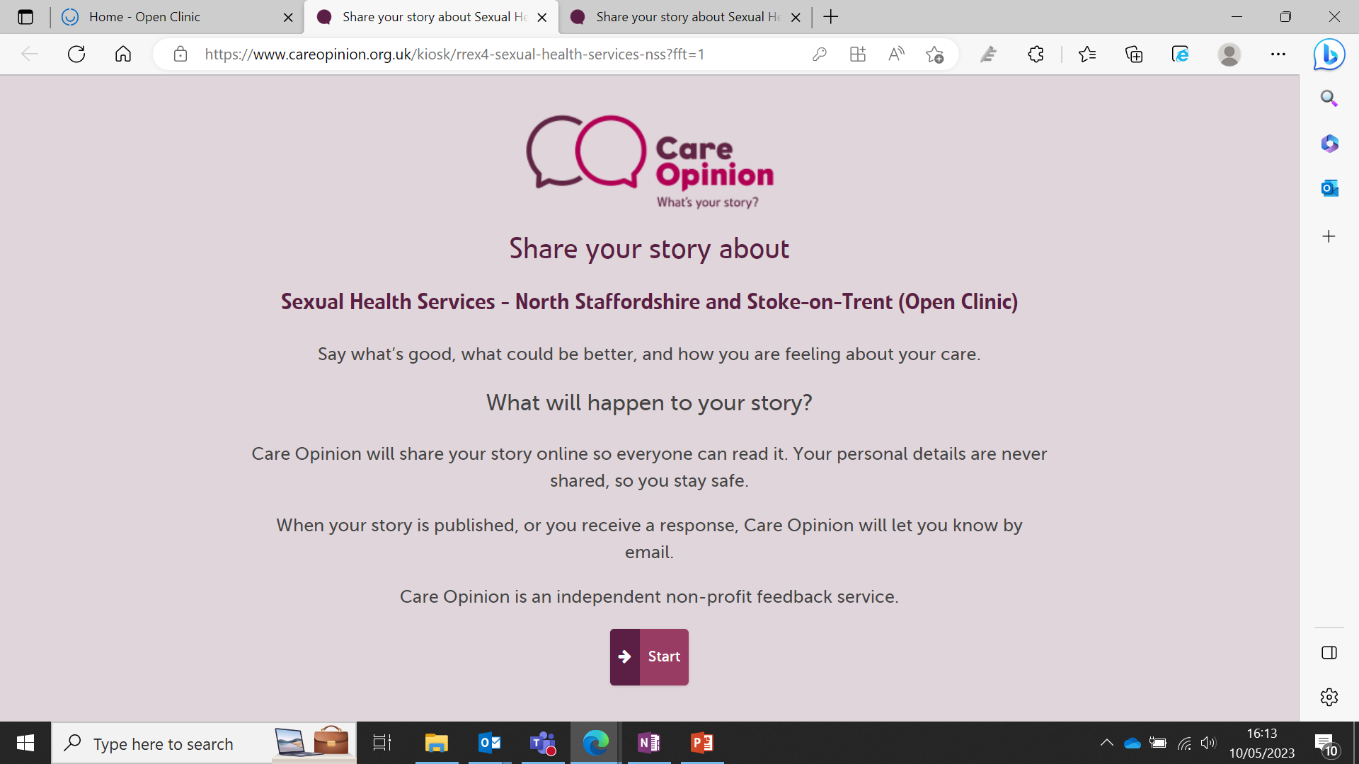
How our website is used to promote and encourage feedback
Service Users have Care Opinion explained with a link to Care Opinion’s website

Slide 12
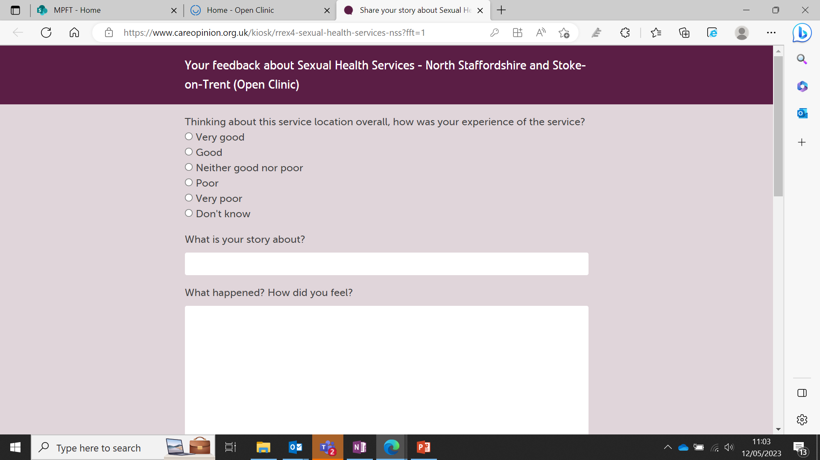
How our website is used to promote and encourage feedback
Service Users are taken to a simple form to complete to share their experiences

Slide 13
Text Message sent to Service Users
‘We care about your opinion! We would really appreciate your anonymous feedback regarding your visit at Cobridge SHS, staff will receive this and you will get a response if requested. Please click the link below. https://www.careopinion.org.uk/kiosk/rrex4-sexual-health-services-nss?fft=1’
Notes:
This message is set up for each individual clinic

Slide 14
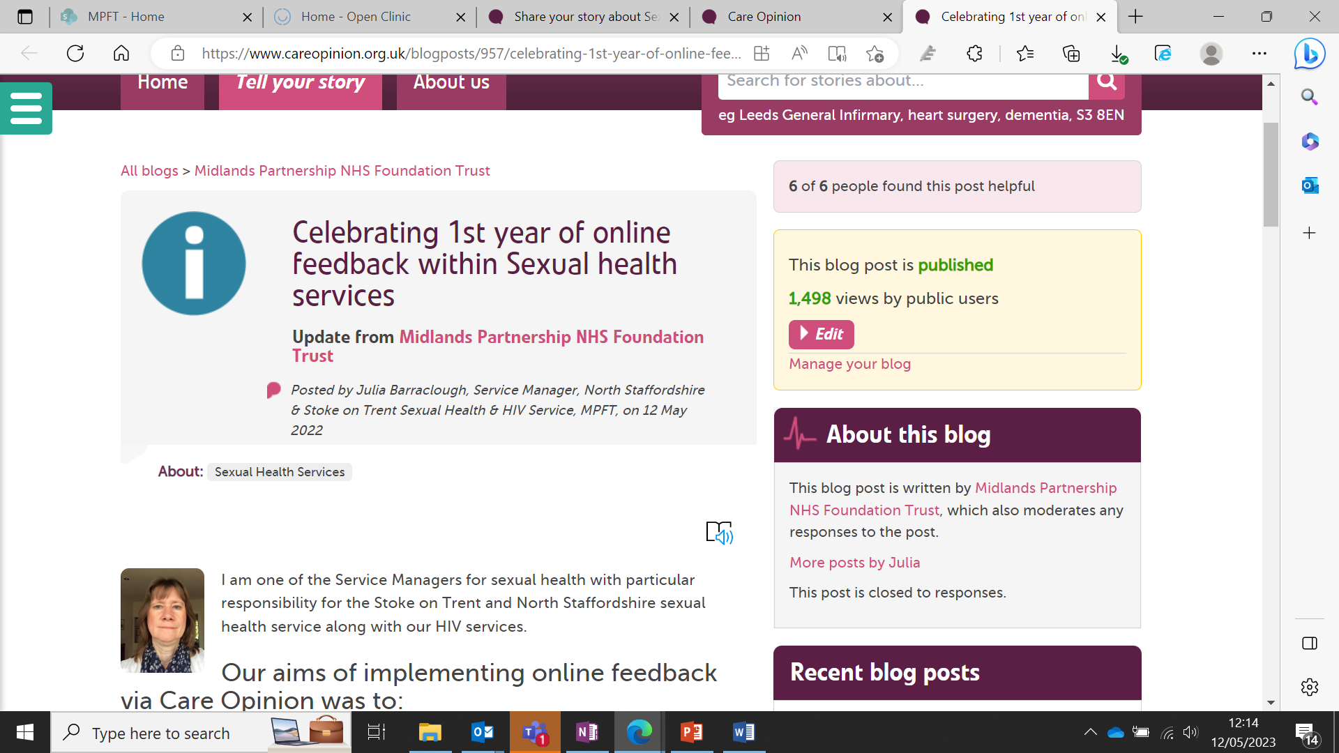
Blog Published after 12 Months:
Notes:
1,498 views! (The link to the blog is at the end of this presentation with my contact details)

Slide 15
How we use Feedback for Learning and Change
All feedback is given an individual response
Reports are produced monthly and quarterly which allow key themes to be identified and discussed with teams
Staff look at Care Opinion regularly and help identify any specific issues to support responses
Notes:
Reports are shared in meetings and with commissioners
Although it is anonymous, individual staff can often identify scenarios they were involved in and will discuss these with the manager before a response is submitted

Slide 16
How we use Feedback for Learning and Change - Examples
Negative feedback about the telephone system – calls taking too long to answer
  Outcome – new telephone system implemented and a Single Point of Access set up so that call handlers from across the services work as a team to answer each call in turn. This has reduced call waiting times.
Negative feedback about appointment availability
  Outcome – services have recently re-introduced walk-in services back into clinics, to increase patient choice. Less phone consultation appointments and more face to face appointments available, improving service quality.
Notes:
Telephone system – we can now see how many calls are waiting, how long calls are taking to answer, and patients are told which queue position they are in. Significantly reduced the number of complaints and negative Care Opinion feedback over the past 9 months.
Covid – massive impact on services changing the way we structured our clinics. Moved away from face to face appointments to everyone having a triage phone call first and only patients who need to come into clinic had face to face follow up appointments. Worked well in the first couple of years of covid but recognised that we needed to move back to pre-covid service levels. Appointment availability is improving (but demand is increasing!) – comment around contraception activity in particular. Walk in has taken pressure of the phone system which also benefits point one above.
One further change proposed is around the text messages we send to our HIV positive service users who have a separate text message to identify feedback from this group – they have asked that reference to their HIV status in a text message isn’t appropriate, so we are looking at ways to improve this. Also, because their care is lifelong, we have identified that this group of service users are less inclined to ‘tell their story’ so we want to look at ways to encourage feedback in different ways.

Slide 17
How we get Staff involved in Promoting Feedback and Responding Well
Staff have responded extremely positively to Care Opinion and see the benefits of receiving feedback – Service Users often name individual clinicians/other staff members, and clinical staff in particular use this as part of their re-validation evidence.
Admin staff involved in responding to positive Care Opinion feedback. Any negative feedback is passed to a Manager to respond to. Managers offer personal contact with the Service User (as initial feedback is anonymous)
Notes:
One of the team, Andrew, is with us today – he does a really good job to make responses individual to the service user and pertinent to the comments being made.
Where staff members are named specifically, this is passed onto the staff members concerned.

Slide 18
How we are using Care Opinion to Positively Affect Staff Culture
Feedback shared in team meetings
  Staff take an active interest in feedback and regularly look on the website themselves
Personalised feedback is shared with individuals and copied into their line manager – particularly useful for appraisals and clinical re-validation
Any concerns raised by Service Users are given a personal response by a Manager and any learning shared with teams

Slide 19
How we are using Care Opinion to Positively Affect Staff Culture
‘Word Cloud’ produced quarterly and shared with teams showing a summary of the positive words used by Service Users
Many staff look regularly at Care Opinion and discuss it among themselves
Notes:
See next slide

Slide 20
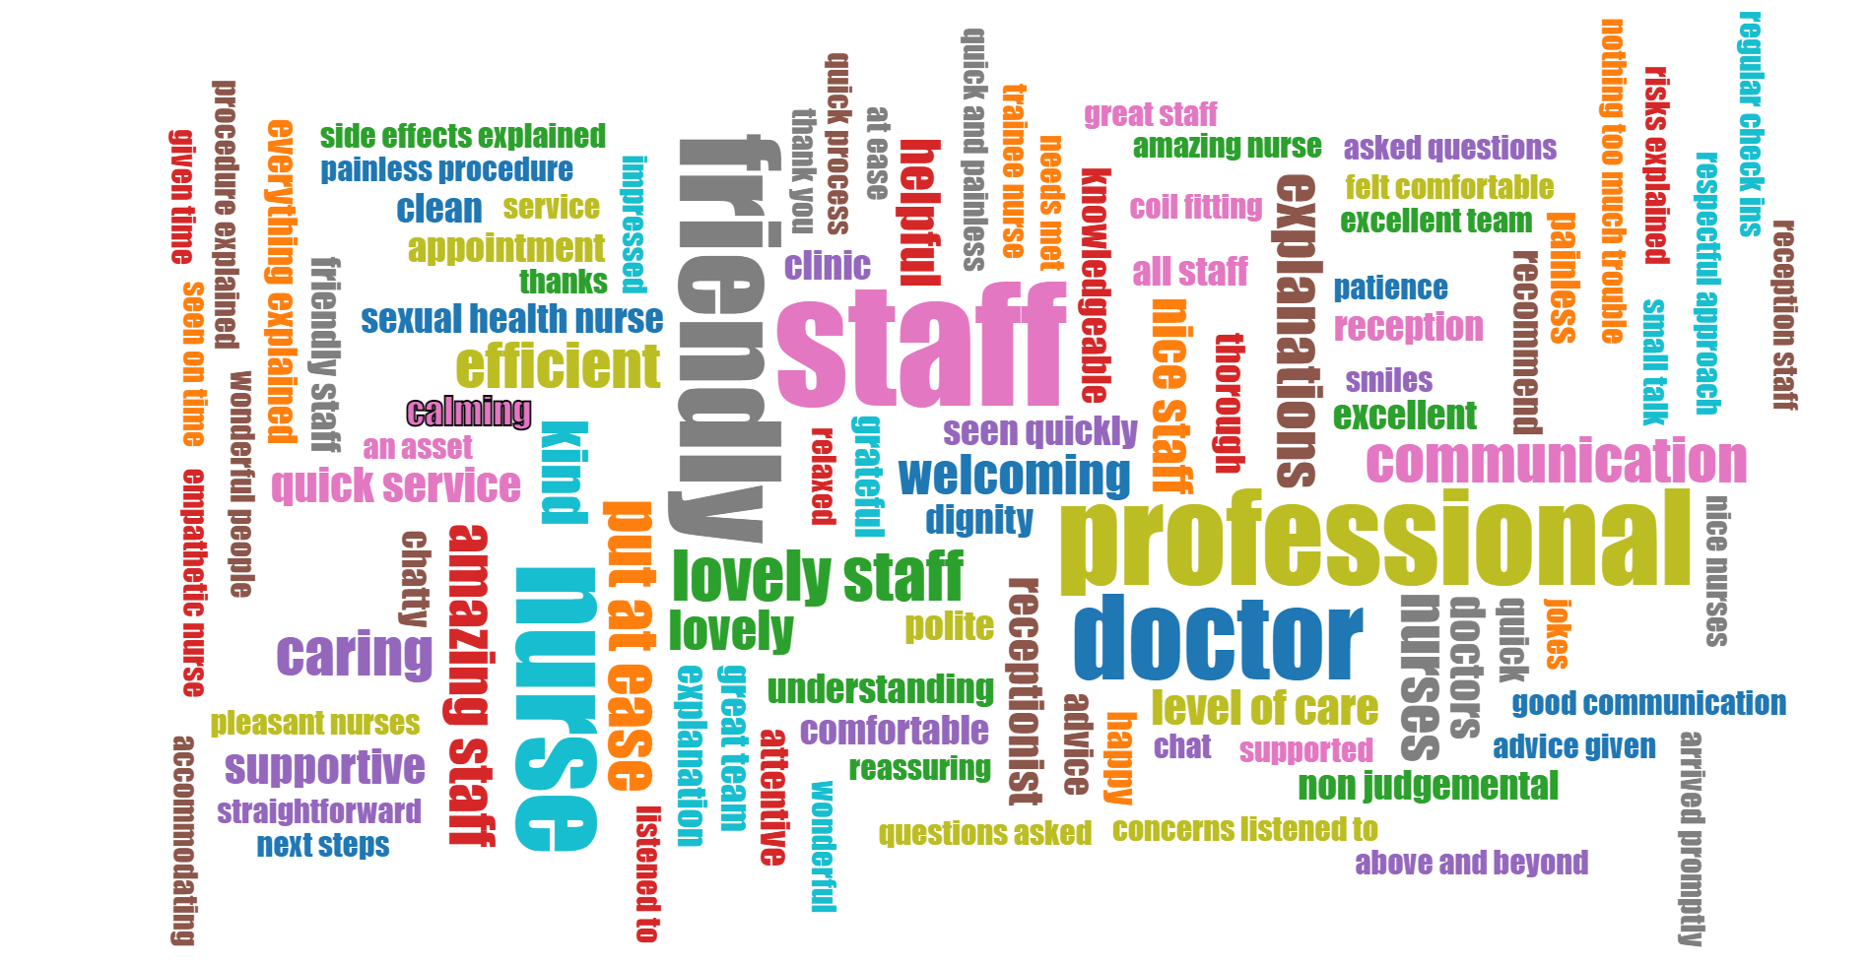
Positive Staff Culture – Word Cloud
Notes:
Quarterly summary of key words used by service users – shared with staff and commissioners, put on noticeboards.

Slide 21

What our Service Users say
  ☺“The staff here are excellent”
  ☺“Staff great, friendly and professional”
  ☺“Professional, caring service”
  ☺“Supportive contraception care”
  ☺“A fabulous group of nurses”
  ☺“I felt very supported and listened to”
  ☺“Very satisfactory service”
  ☺“I felt like I mattered”
  ☺“Thank you and please keep up your excellent work!”
Notes:
A final endorsement of how positive Care Opinion makes us all feel!!

Slide 22



Thank you! Any questions??
Julia Barraclough, Operational Service Manager, Sexual Health Services, MPFT
JuliaC.Barraclough@mpft,nhs.uk
Website
www.openclinic.org.uk
Follow us
Open Clinic NHS
@OpenClinicNHS
@OpenClinicNHS
Celebrating 1st year of online feedback within Sexual health services | Care Opinion
Blog:
Notes:
I’ve included the link to my blog, if anyone is interested in reading it!

