Slide 1
Patient Opinion in Education Birmingham 20 July 2016

Slide 2
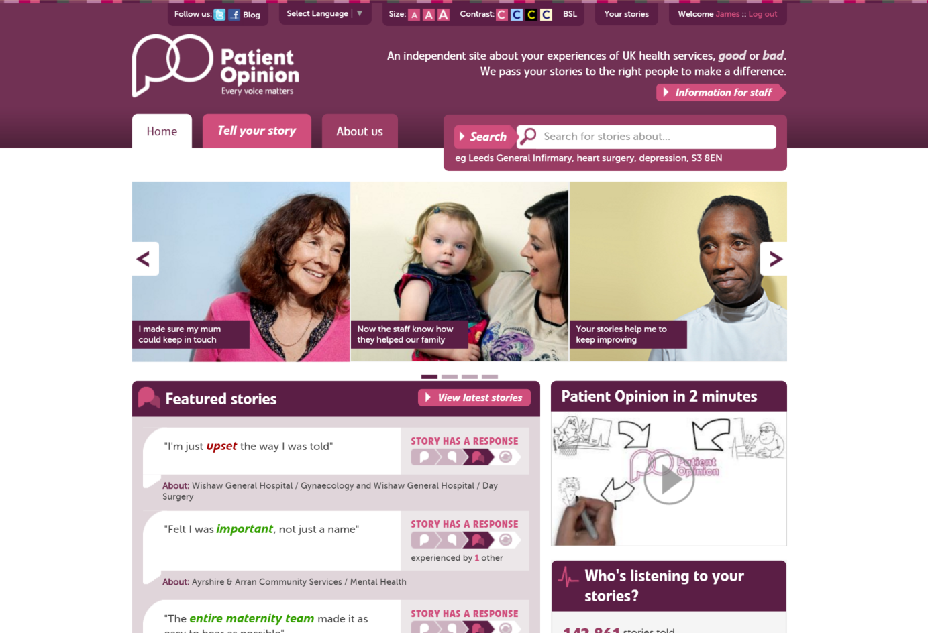

Slide 3
Vision
A world in which people can share their experiences of care, knowing they will be heard and used to improve care for everyone.

Slide 4
Mission
To make it safe and simple for everyone to share their experiences of health and care services in ways which connect people together for change

Slide 5
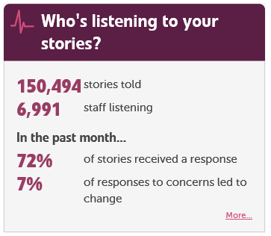

Slide 7
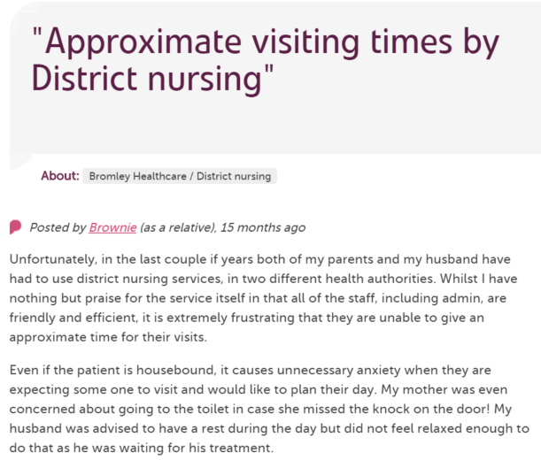
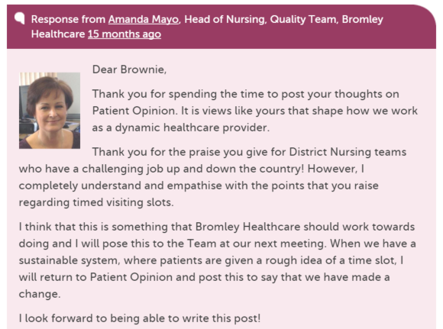
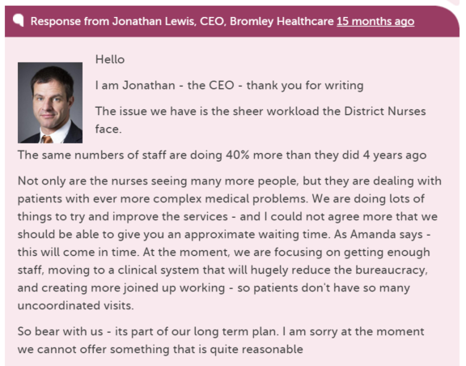
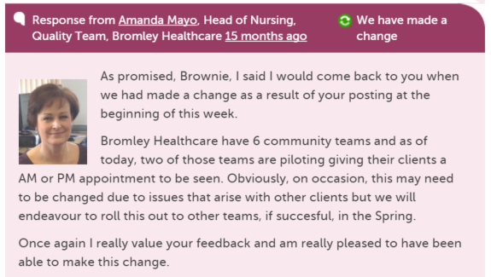
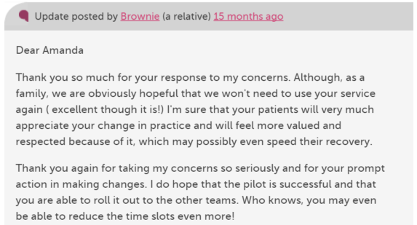
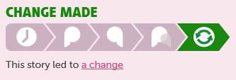

Slide 8
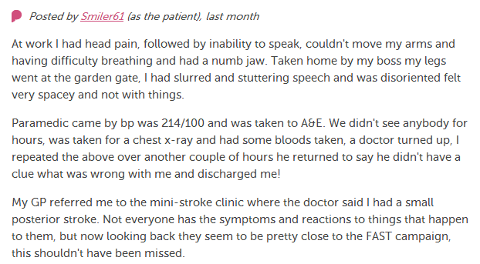
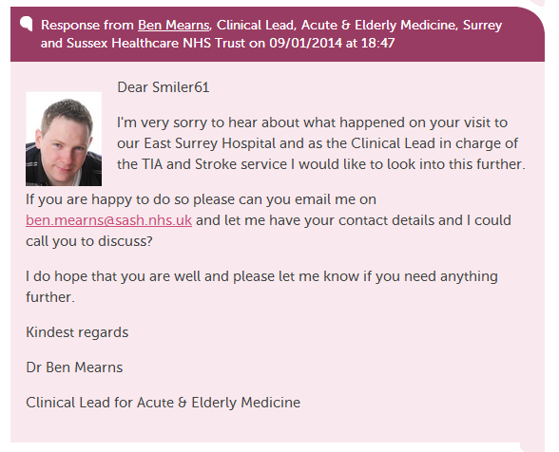
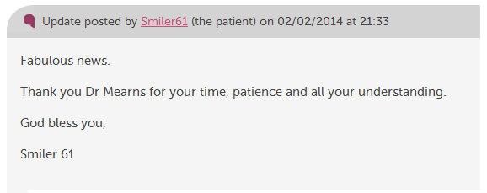

Slide 9
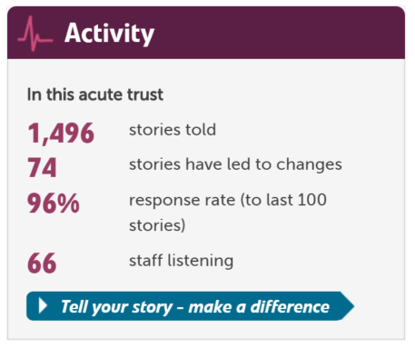

Slide 10
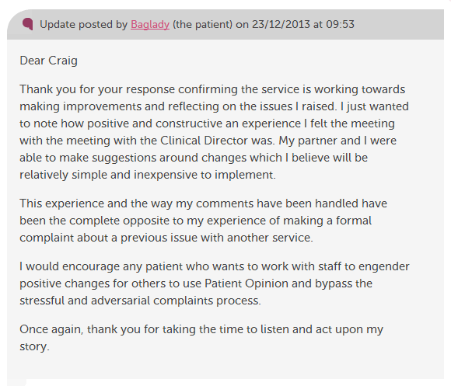

Slide 11
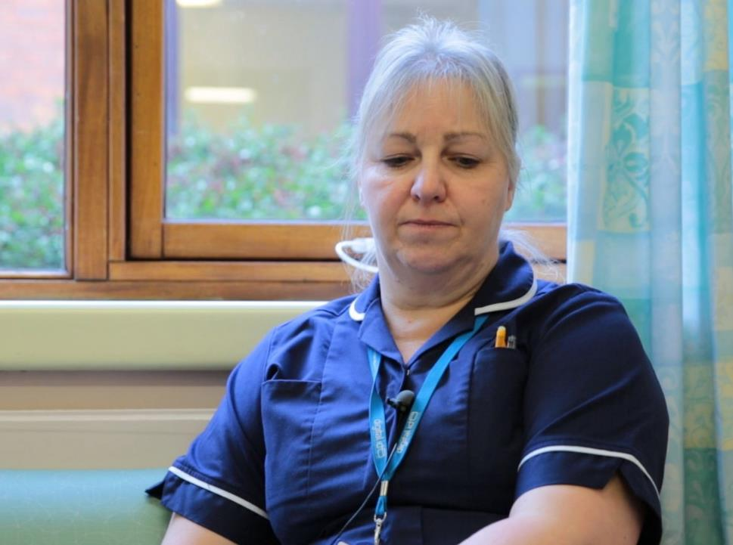
“I get an email to say we've had an opinion posted.
I can respond that day and it’s back on the website for the patient or relative to read.
I think that’s an excellent service for people.”
Karen Hansord A&E sister

Slide 12
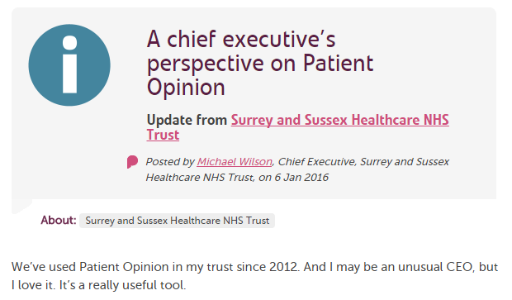

Slide 13
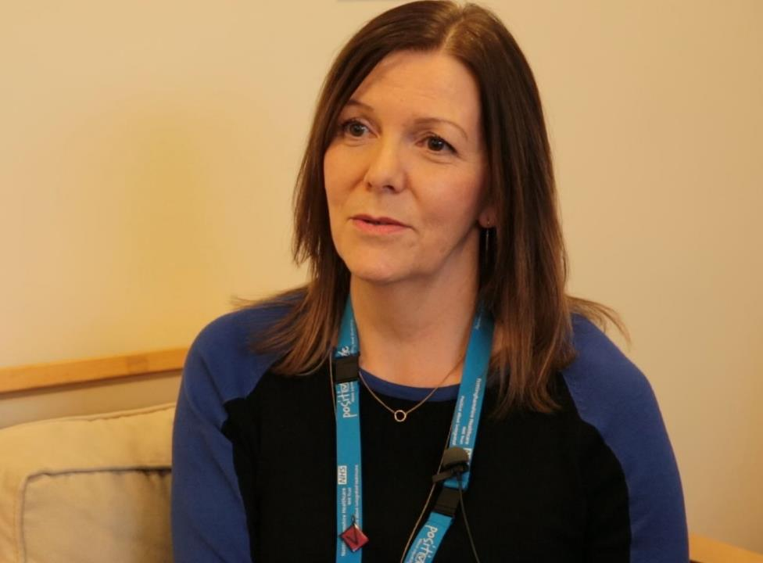
“I think Patient Opinion has given us much more of a connection with service users, carers and families and that’s because we can actually work directly with people.”
Jane Danforth involvement officer

Slide 14
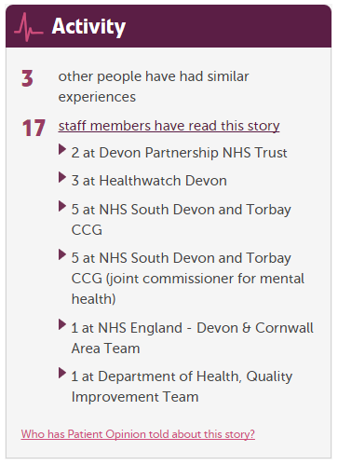

Slide 15
Why does this matter to professional education?
Healthcare is changing
Professionals are changing
Patients are changing

Slide 16
Berwick on culture
“Culture will trump rules, standards and control strategies every single time, and achieving a vastly safer NHS will depend far more on major cultural change than on a new regulatory regime.”

Slide 17
Keogh Report, July 2013
“Patients, carers and members of the public… should be confident that their feedback is being listened to and see how this is impacting on their own care and the care of others.”

Slide 18
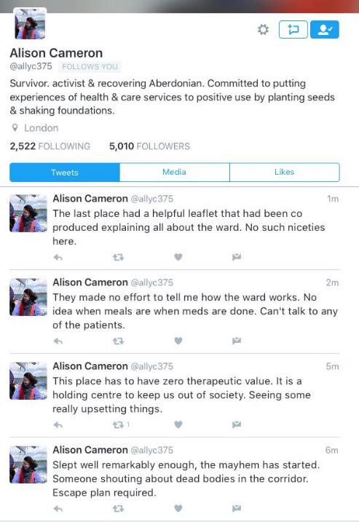

Slide 19
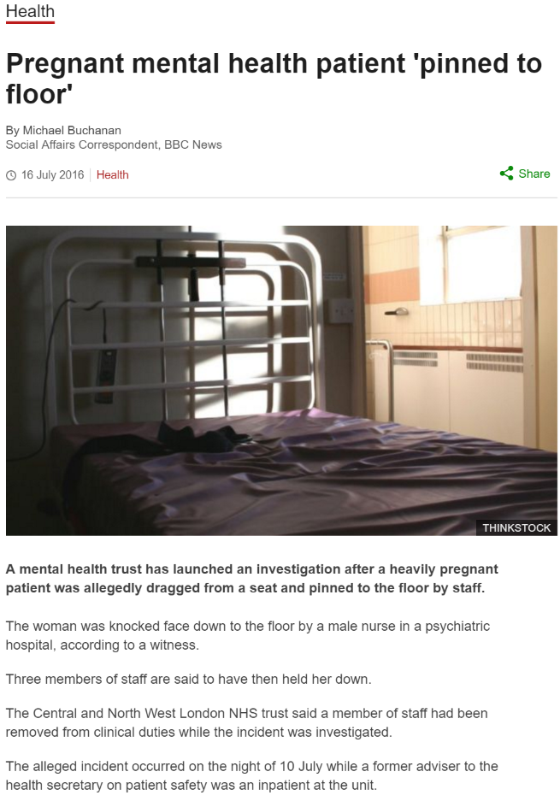

Slide 20
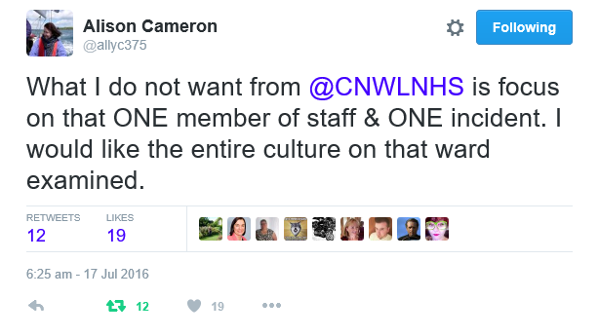

Slide 21
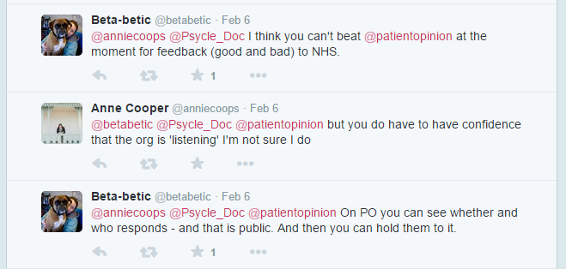

Slide 22
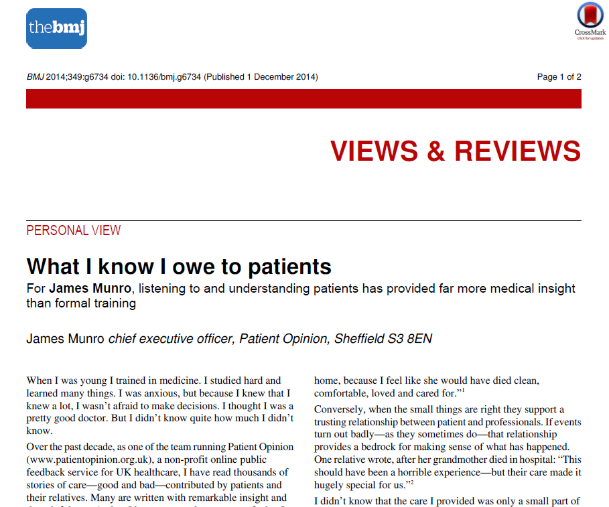

Slide 23
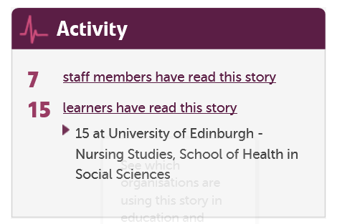

Slide 24
The world is changing – fast
Old world | New world
Hierarchy | Network
Broadcast | Conversation
Hiding | Sharing
Few | Many
Closed | Open
Passive recipients | Active participants

Slide 25
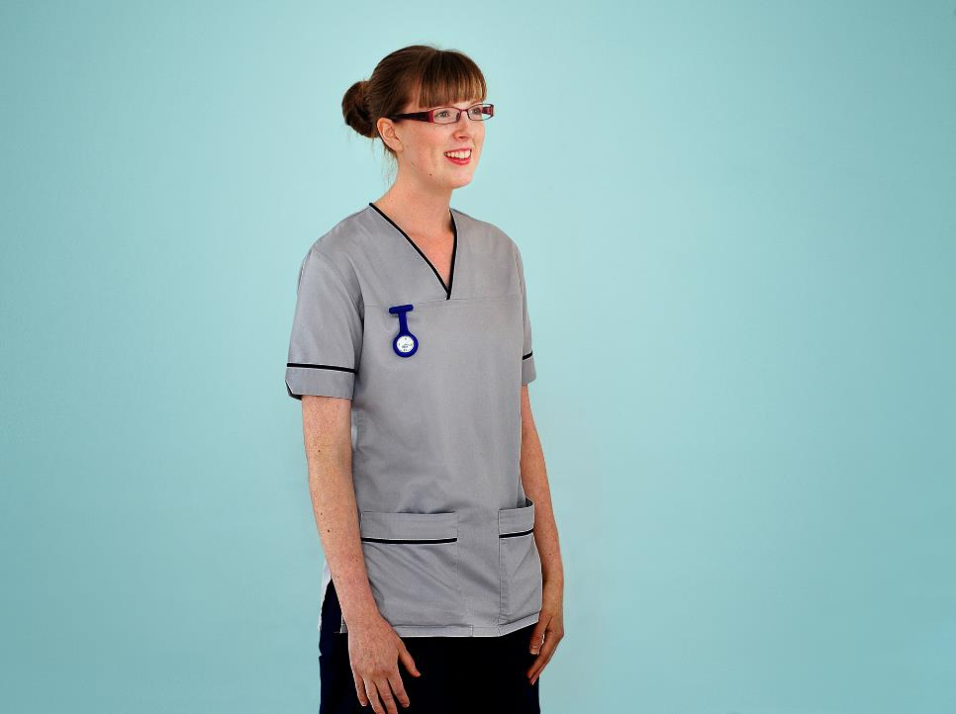
“We’re often told the NHS must be patient-centred.
Patient Opinion helps us understand what that means in practice.”
Fiona Tevendale
Student nurse
Edinburgh

