Slide 1

Education workshop, Bristol, July 2017
#coEducate
James Munro, CEO
@jamesfm55

Slide 2
Mission
Our mission is to provide an online platform so that:
people can share honest feedback easily and without fear
stories are directed to wherever they can help make a difference, and
everyone can see how and where services are listening and changing in response

Slide 3
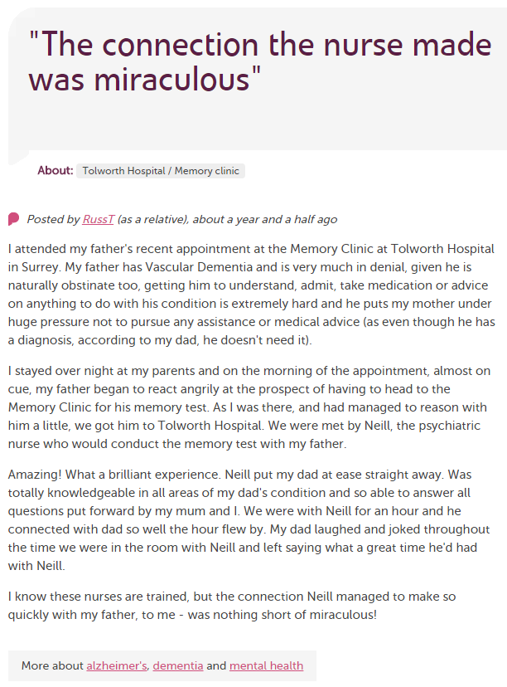
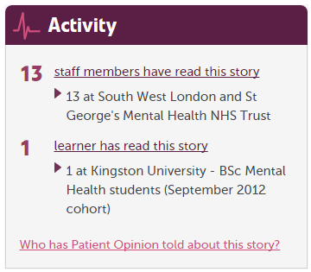
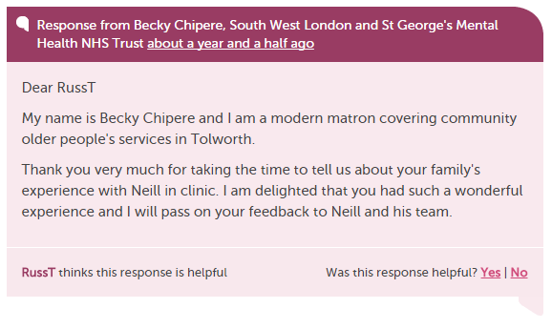

Slide 4
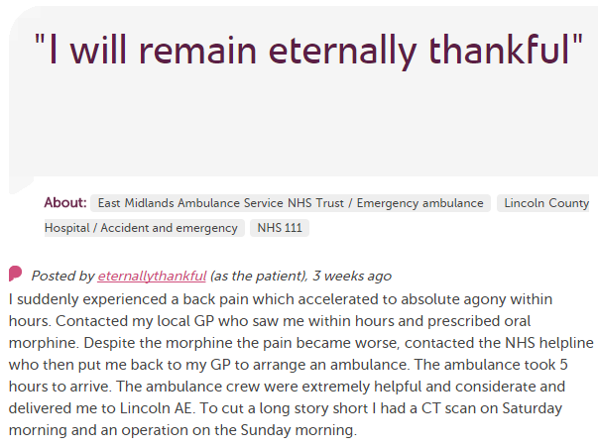











In each provider
Moderation
Clinical staff
Porters, reception, catering…
Pt exp, comms, complaints…
Alerting
CEO
Commissioners
Nursing, AHP students
Healthwatch
Researchers
Patient groups
CQC
Local authority

Slide 5
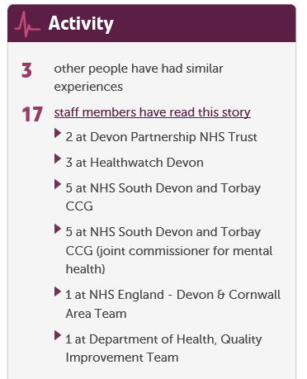

Slide 6
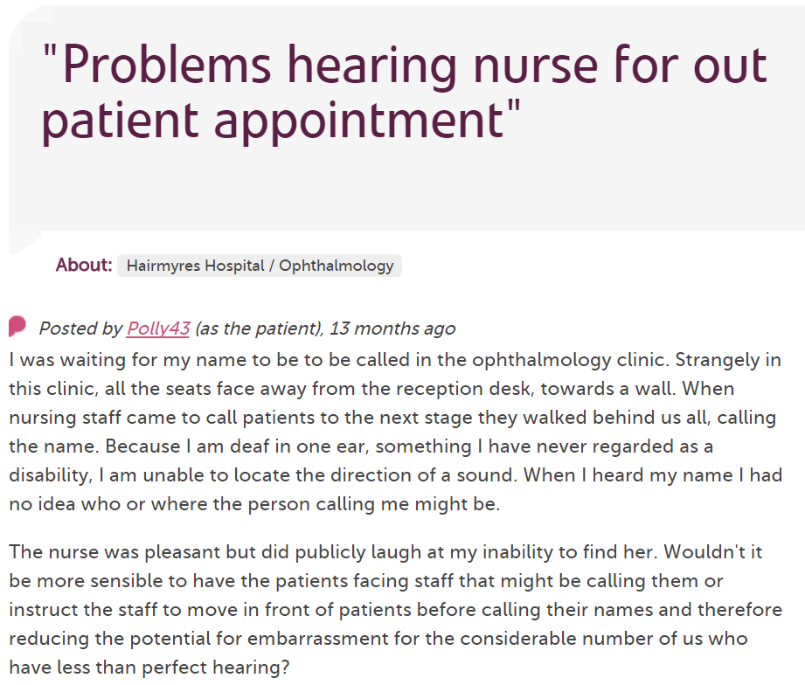
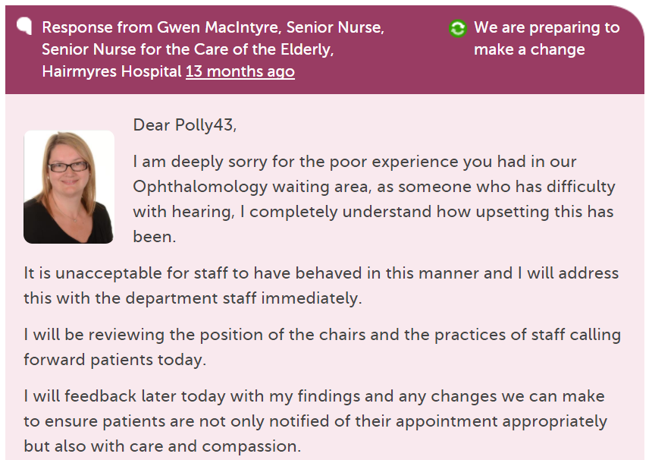
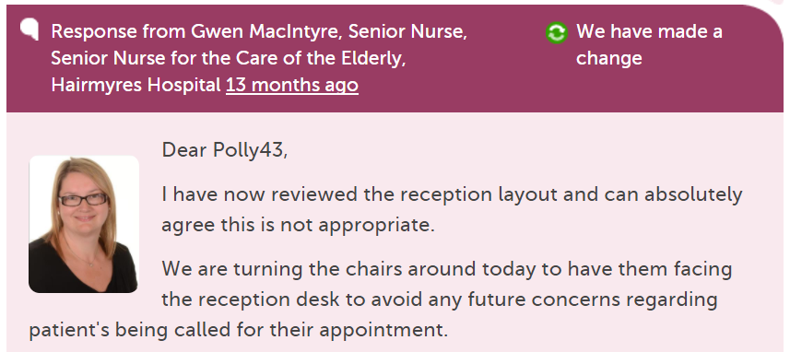

Slide 7
190,000
stories
7,000
staff + students listening
stories read
89 million
times
100,000
visitors per week

Slide 8
Benefits
For patients and families
  Safe, simple, transparent feedback loop
  Issues resolved, service changes
For staff teams
  Learning, QI, morale, culture
For the wider organisation
  Transparency, reputation, complaints

Slide 9
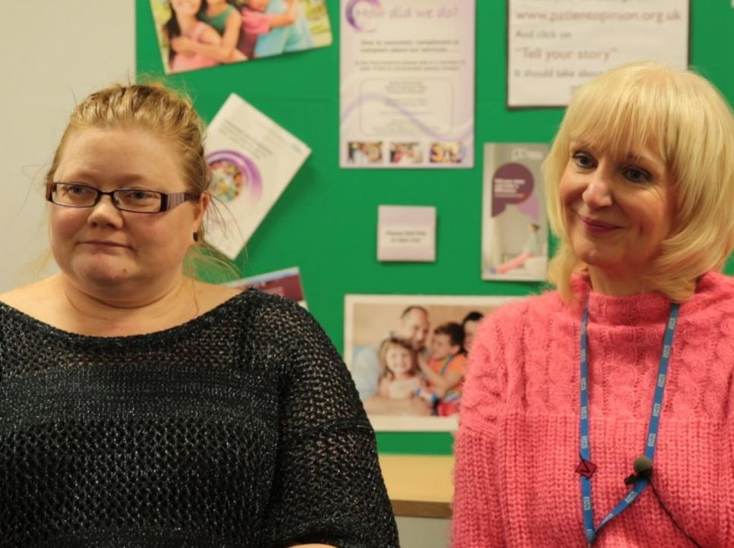
“As we’ve been on a journey, so have the users and carers been on a journey. They now have trust in us, to know that we do want to hear it, warts and all, and that we will work on what the issue is.”
Jenny Newman and Sue Dyke, public engagement

Slide 10
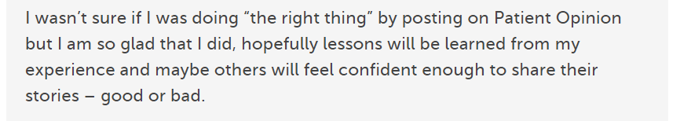
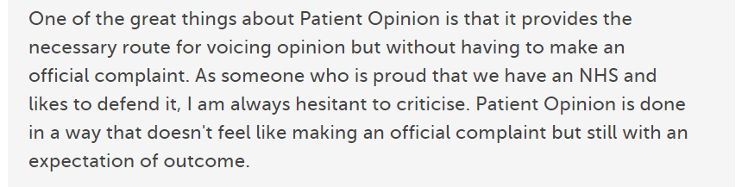
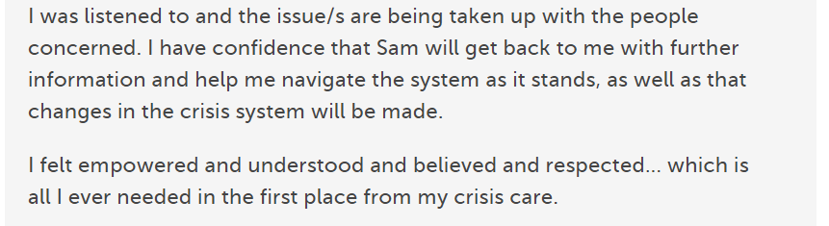

Slide 11
Why does this matter to professional education?
Healthcare is changing
Professionals are changing
Patients are changing

Slide 12
The world is changing – fast
Old world | New world
Hierarchy | Network
Broadcast | Conversation
Hiding | Sharing
Few | Many
Closed | Open
Passive recipients | Active participants

Slide 13
Michelle Cullen, Salford Uni
I have always avoided social media. I don't use Facebook, I don't tweet. I could only see the trouble social media caused...
Until Leslie introduced me to the Care Opinion website. I think it is brilliant. By using this site in our teaching, we can show students how to use social media in a positive, proactive way, to engage with our patients.
I can honestly say that your website has helped us breathe new life into our teaching.

Slide 14
Keogh Report, July 2013
“Patients, carers and members of the public… should be confident that their feedback is being listened to and see how this is impacting on their own care and the care of others.”

Slide 15
So what’s new for learners?

Slide 16
New for learners
Visualisations
  Tag bubbles, story swarms, word clouds…
Weekly digests
New search options
Talking Mats integration
Coming soon
  Member tagging
  Stories I’ve read

Slide 17
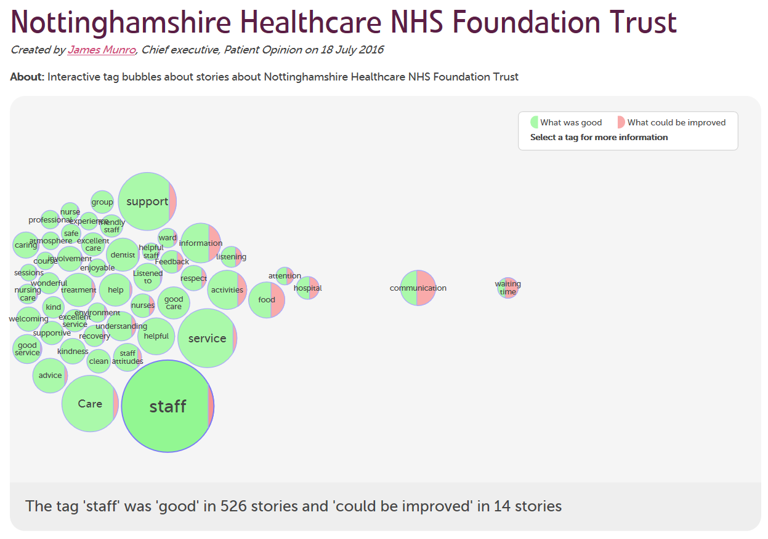

Slide 18
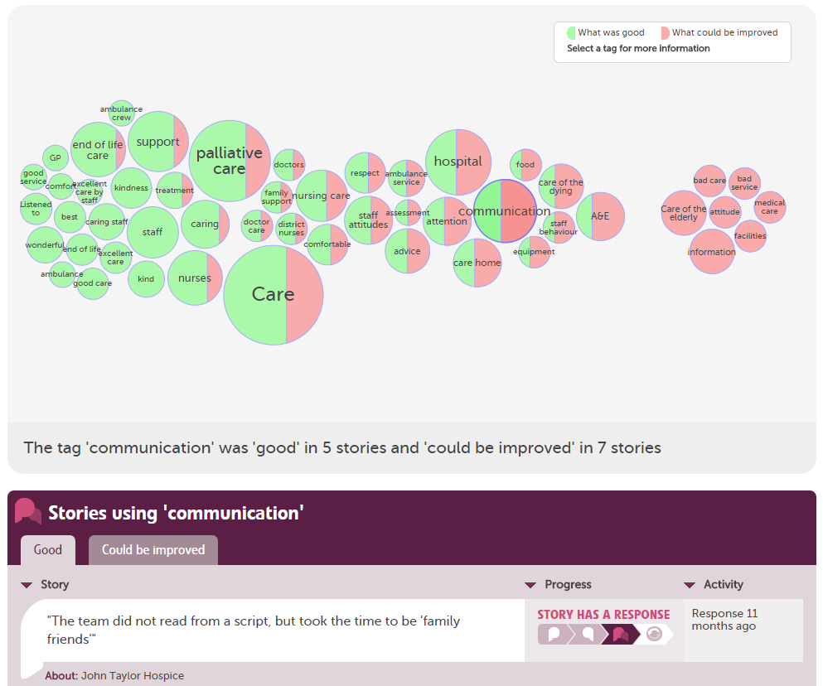

Slide 19
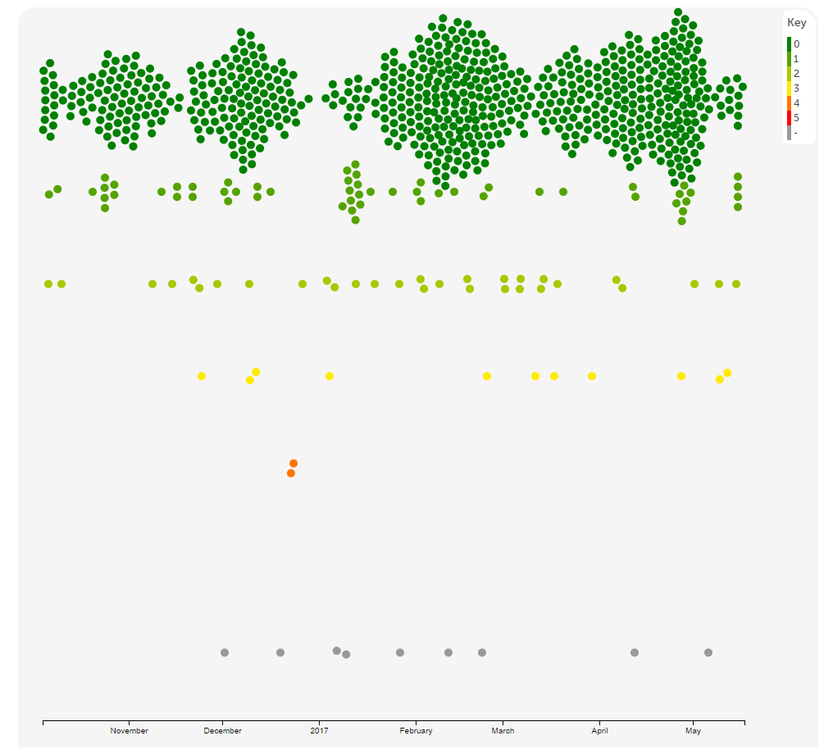

Slide 20
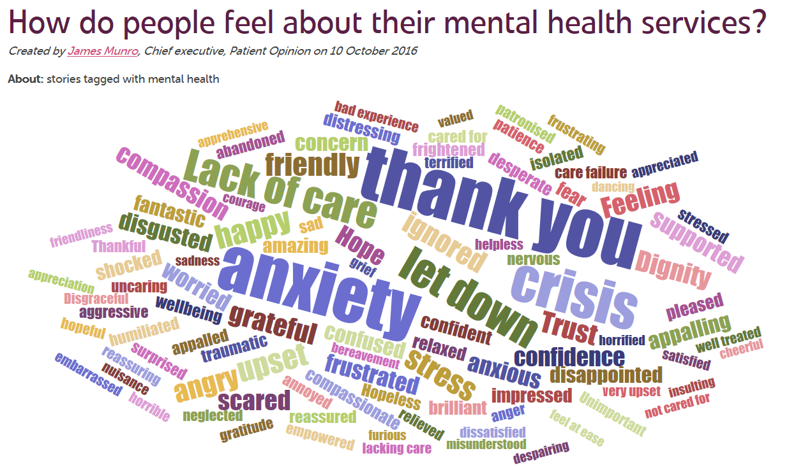

Slide 21
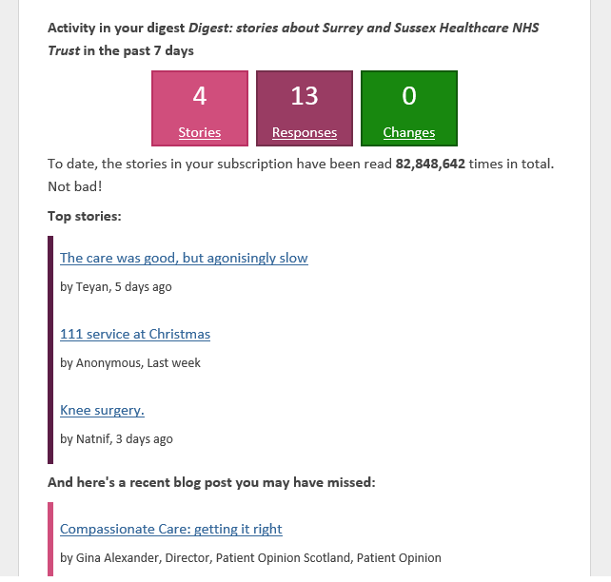

Slide 22
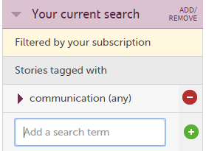
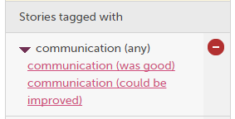
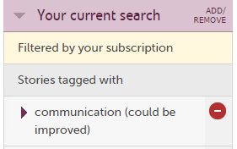

Slide 23
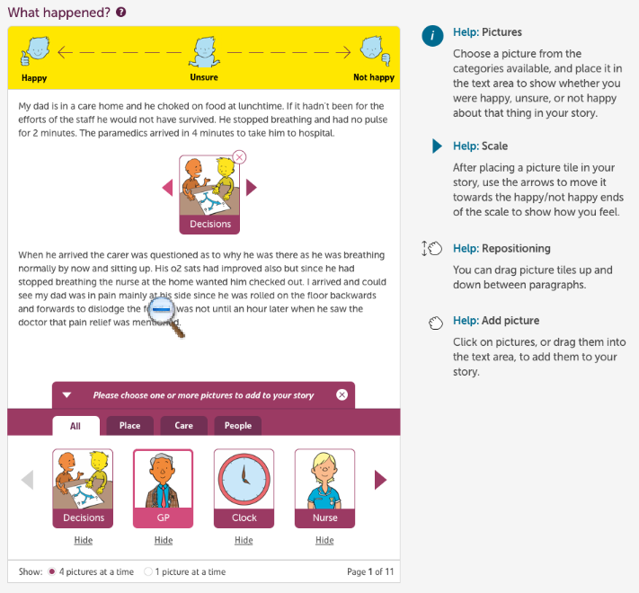

Slide 24
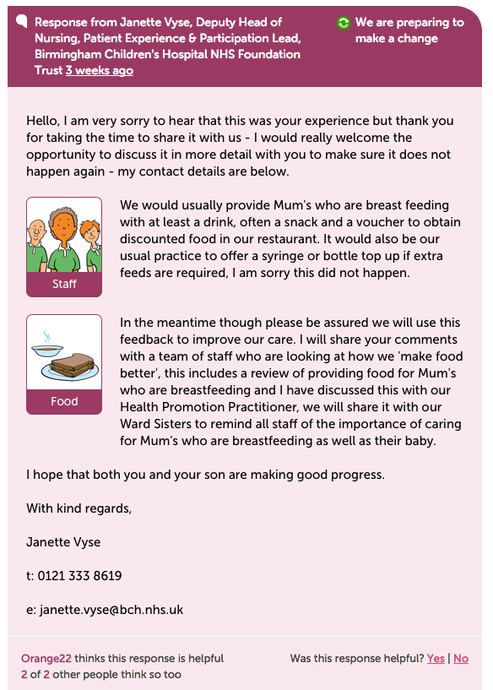

Slide 25
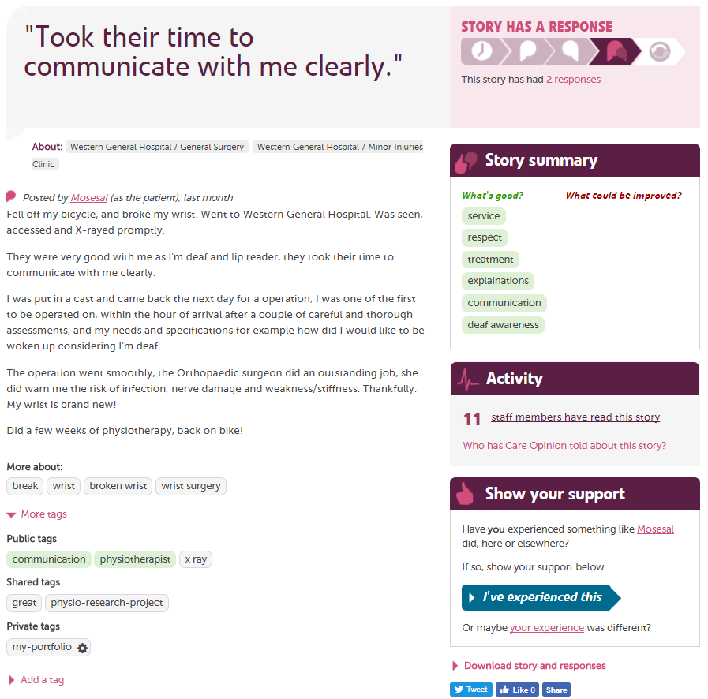

Slide 26
Hear the patient voice at every level – even when that voice is a whisper.
Don Berwick
August 2013

