Slide 1
Introduction to Care Opinion – The Basics

Slide 2
Aims
Who is Care Opinion?
The ‘Story Telling Process’
Managing your log in – Updating your profile
Finding the service you work in and your ‘Saved things’
How to find help?
Q&A

Slide 3
Who are we?
Care Opinion is a non-profit social enterprise, based in Sheffield and Stirling.
We have been sharing people’s experiences of health and care services online since 2005, and we have built a national and international reputation for our innovative and value-led approach to online feedback.
At Care Opinion we make it safe and simple to share your story online and see other people's stories too. You can see how stories are leading to change.
How is Care Opinion funded? | Care Opinion
Meet the Care Opinion team | Care Opinion

Slide 4
Care Opinion in 2 minute
Watch this short video to find out more about Care Opinion.

Slide 5
Mission, Vision & Values
Our vision
What do we want to see?
We want people to be able to share their experiences of health and care in ways which are safe, simple, and lead to learning and change.
Our mission
What do we do?
Our mission is to provide an online platform so that:
people can share honest feedback easily and without fear
Our values
How will we pursue our mission?
Innovation Transparency Inclusivity Positivity Humanity

Slide 6
Understanding member roles

Slide 8
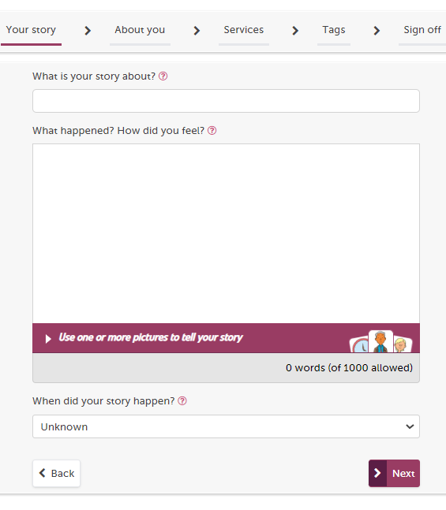
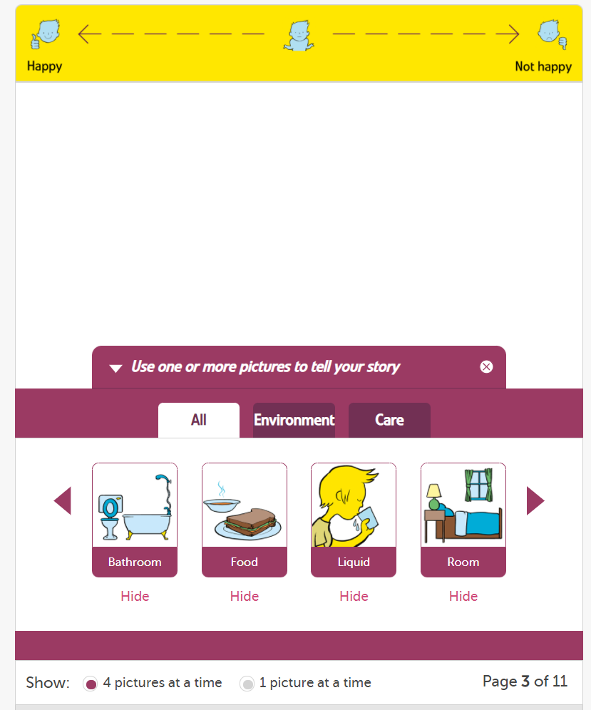

Slide 9
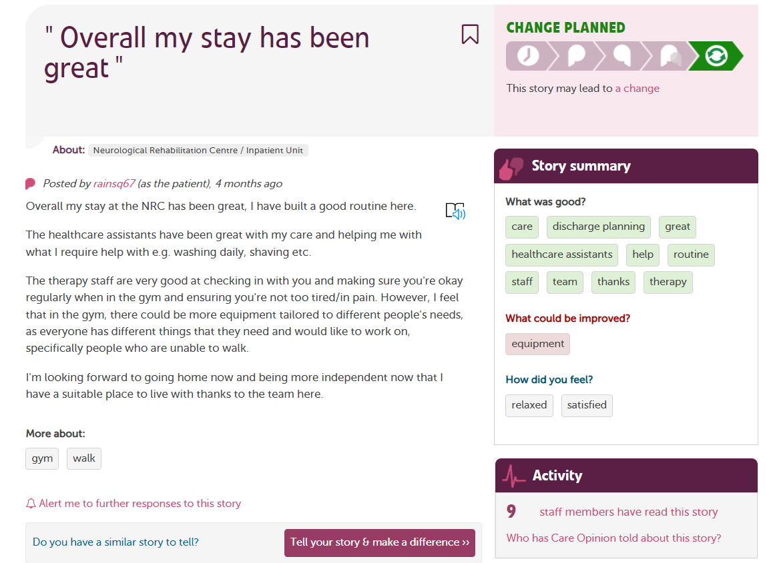
Tags are added by the author to show key themes
Stories by the same person are linked by a username
See which organisations are reading feedback

Slide 10
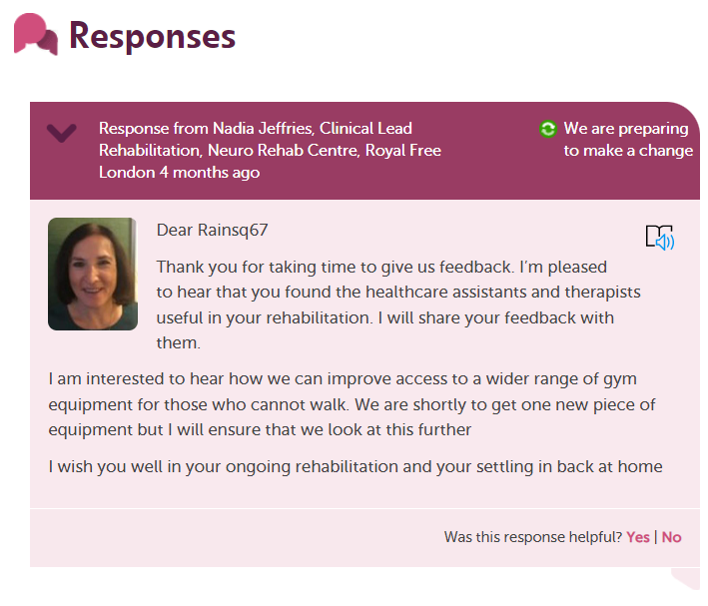

Slide 11
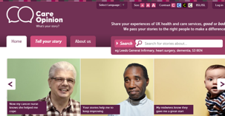
Ways to share a story with Care Opinion
Online careopinion.org.uk or careopinion.ie
Freephone 0800 122 3135 (UK only)
Freepost leaflets
From an invitation link
With support from Volunteers
Using picture tiles
All stories are subject to moderation and are uploaded to the website

Slide 12
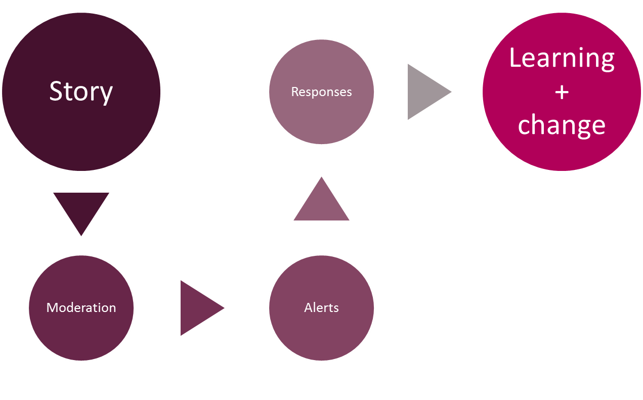
Stories – it’s about the conversation

Slide 13
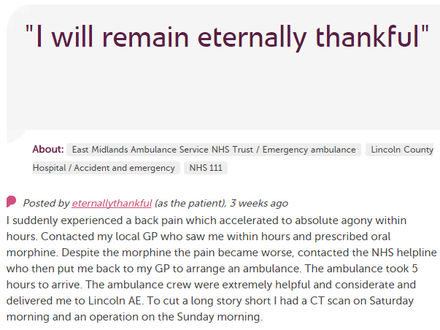
In each provider
Moderation
Service staff
Different Staff Teams
User exp, comms, complaints…
Alerting
CEO
Commissioners
Nursing, AHP students
Healthwatch
Researchers
Other Stakeholders
CQC

Slide 14
Accessing the site

Slide 15
Here’s what we hope you’ll have more knowledge of after this session (don’t worry it takes practice and we are here to support):
Logging in to the Care Opinion site
Updating your profile details – upload a profile picture and a brief summary of your role in plain language
Searching for your service/ward
Saving your service/ward
Creating an alert for stories about your service/ward
Checking these in your ‘Saved things’
https://www.careopinion.org.uk/info/subscriber-know-how
The above link is to the Subscriber ‘Know how’ page where you can find helpful support pages on things you might need to know-how to do on the site.

Slide 17
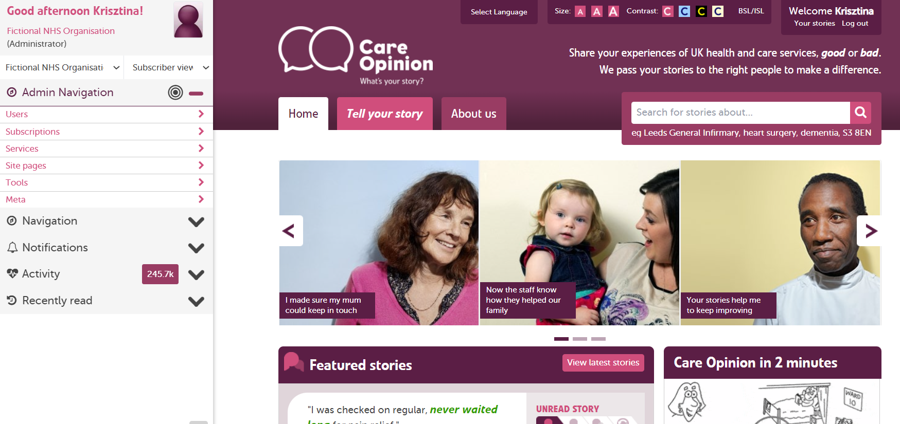
Notes:
Change this to sub admin

Slide 18
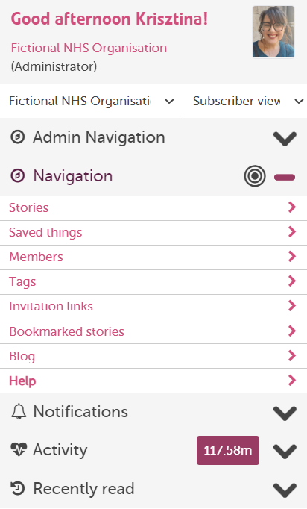
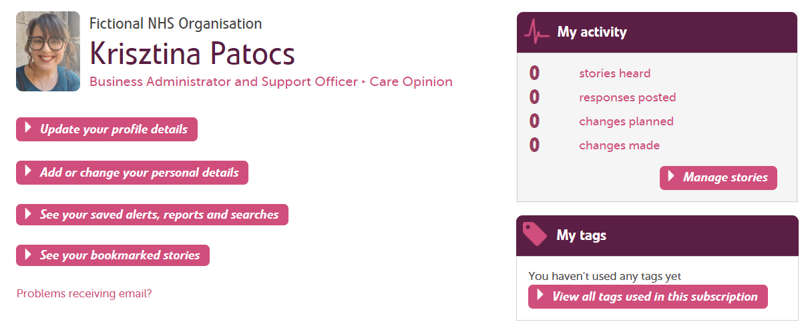

Slide 19
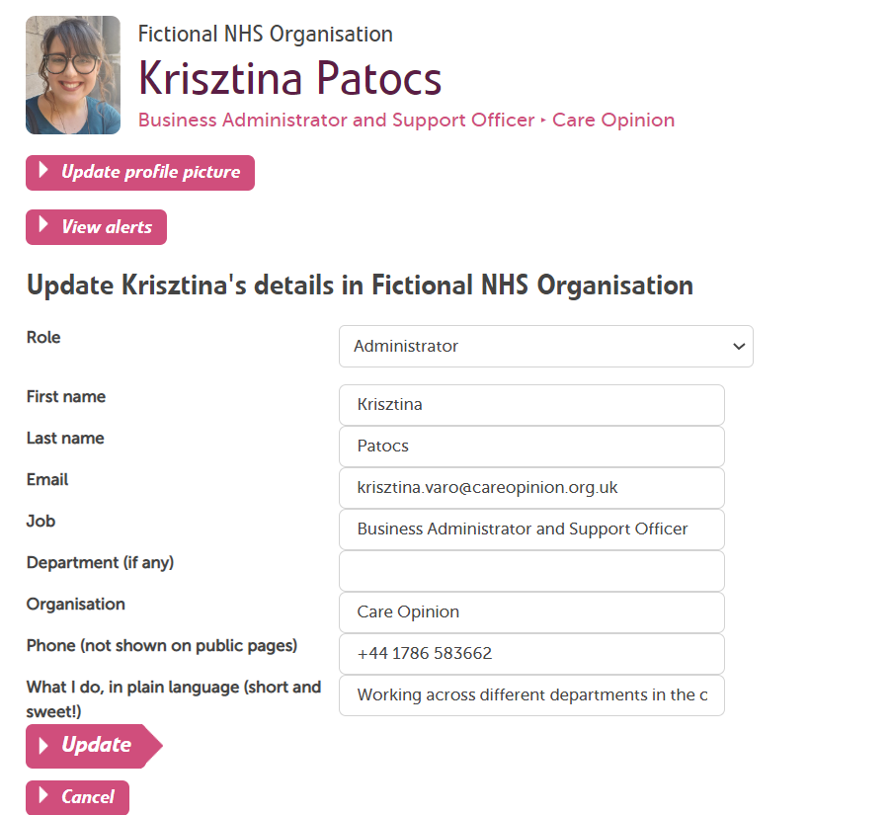

Slide 20
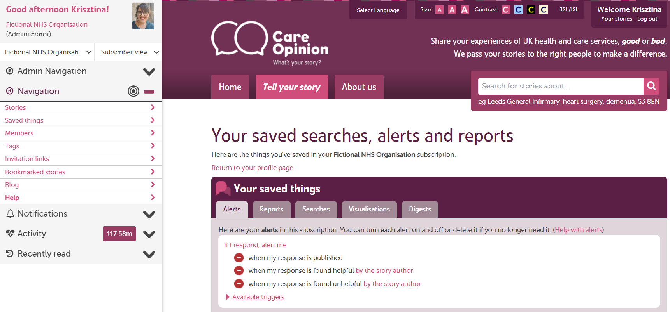
Saved things

Slide 21
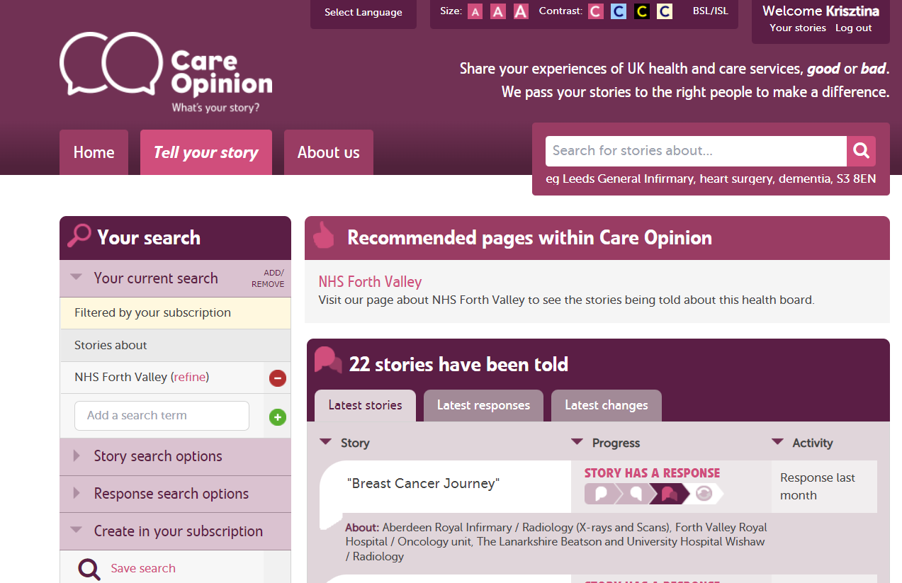

Slide 22
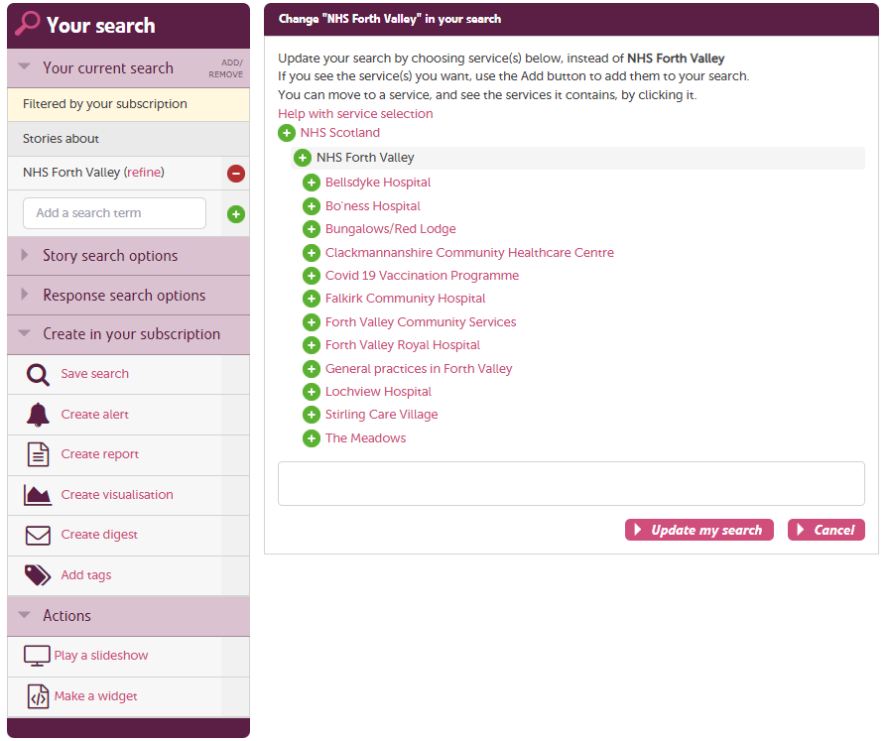

Slide 23
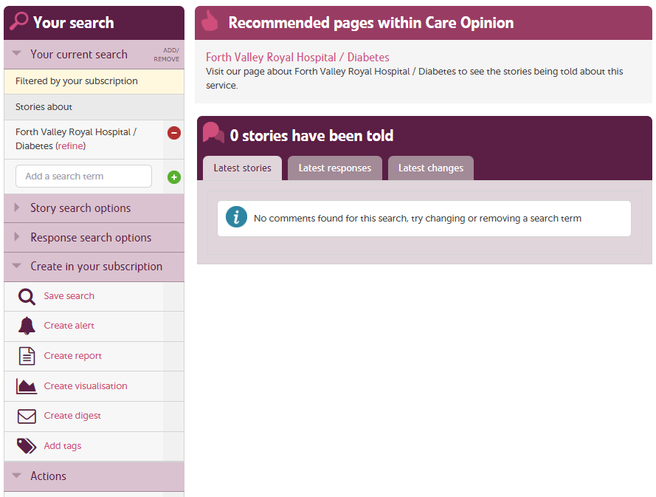

Slide 24
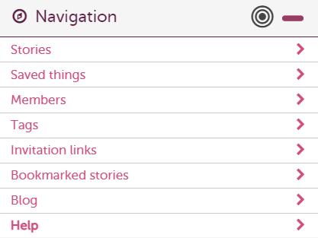
How to find help?
Help button
Support page
Contacting your support lead
Emailing info@careopinion.org.uk

Slide 25
Future ‘How to’ sessions-The recordings
Encouraging feedback – Thursday 2nd February, 2.00pm-3.00pm
How to respond and demonstrate impact – Tuesday 7th February, 10.00am-11.00pm
Framing the ask to patients and service users – Wednesday 15th February, 2.00pm-3.00pm
Invitation links and Subscriber Tagging – Thursday 23rd February, 10.00am-11.00pm
Involving staff and volunteers in encouraging feedback – Wednesday 3rd March, 2.00pm-3.00pm
Alerts, Reporting and Visualisations Webinar – Tuesday 7th March, 2.00pm-3.00pm

Slide 26
Any questions?

Slide 27
Thank
you

