Slide 1


Introduction to Care Opinion

Slide 2


Slide 3

Today we will have a look at:
Who we are
The process of a story and response
Accessing the Care Opinion website
Searching
Where to find help
Notes:
What do we mean by ‘Framing the Ask’. We know it can be difficult to ask for honest feedback and to ask for people to share their stories of their personal care experiences.
There are many different ways we might invite a patient, family member or carer to share their experiences through Care Opinion so that it feels more natural and comfortable for us as staff and supports the teller of the story to feel helpful and that they are doing something meaningful.
Hopefully this webinar will help with some of this and give you the confidence to know how best to ‘frame the ask’.

Slide 4
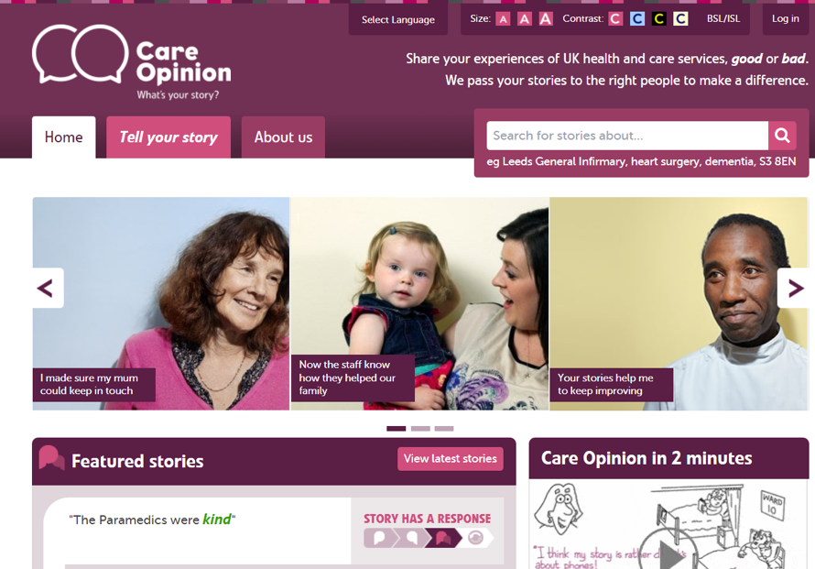

Slide 5

Who are we?
Care Opinion is a non-profit social enterprise, based in Sheffield and Stirling.
We have been sharing people’s experiences of health and care services online since 2005, and we have built a national and international reputation for our innovative and value-led approach to online feedback.
At Care Opinion we make it safe and simple to share your story online and see other people's stories too. You can see how stories are leading to change.
How is Care Opinion funded? | Care Opinion
Meet the Care Opinion team | Care Opinion

Slide 6

Mission, Vision & Values
Our vision
What do we want to see?
We want people to be able to share their experiences of health and care in ways which are safe, simple, and lead to learning and change.
Our mission
Our mission, in a nutshell, is to provide an online platform so that people can share honest feedback easily and without fear
Our values
How will we pursue our mission?
Innovation Transparency Inclusivity Positivity Humanity

Slide 7
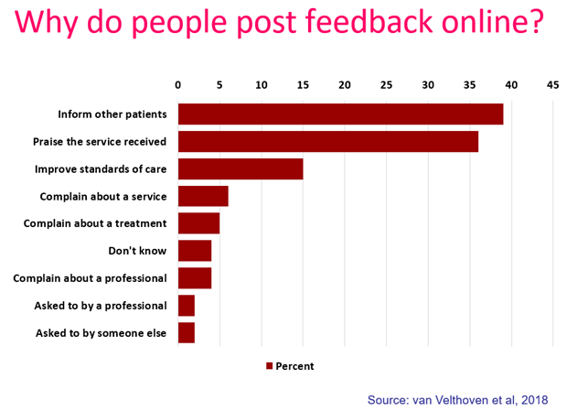

Slide 8
“People need to know how valuable this care is”

Slide 9
“To give people a chance to read what I went through and maybe give them some hope.”

Slide 10
“To highlight the problem without making a formal complaint and to thank the staff for excellent care”

Slide 11
“It was a difficult time for me to go through and Care Opinion allowed me to control the speed
and words rather than be rushed through Q&As or tick box scenario where things don't quite fit.”

Slide 12



Ways to share a story with Care Opinion
Online careopinion.org.uk or careopinion.ie
Freephone 0800 122 3135 (UK only)
Freepost leaflets
From an invitation link
With support from Volunteers
Using picture tiles
All stories are subject to moderation and are uploaded to the website.
All story authors are kept anonymous.

Slide 13
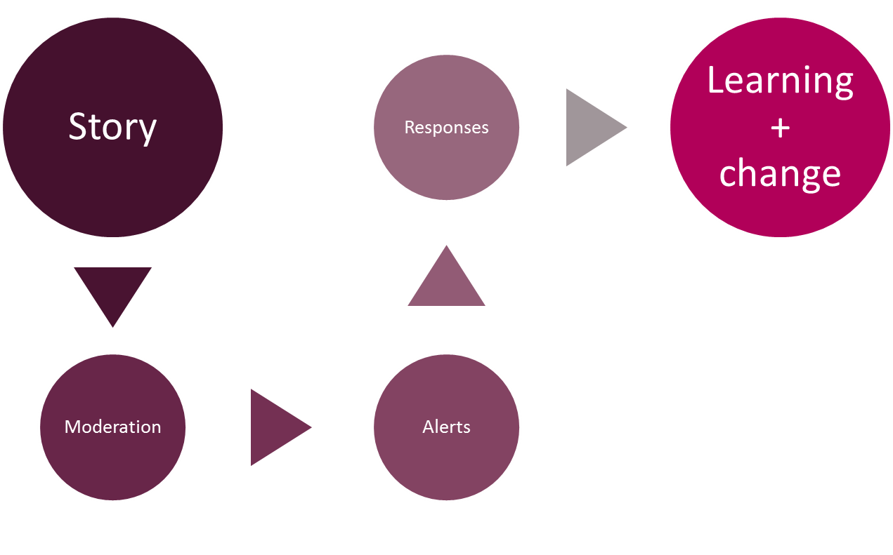
The story-telling flow – it’s about the conversation

Slide 14
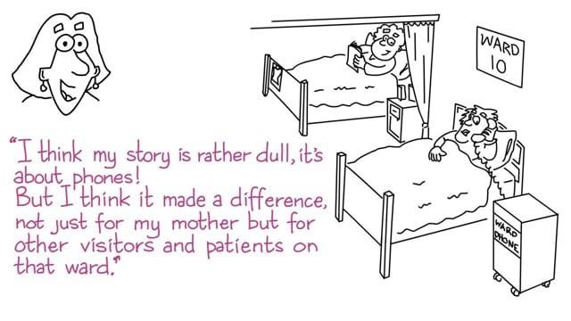
Care Opinion in 2 minutes
Watch this short video to find out more about Care Opinion.
Notes:
Embed code is available for you to use this video on your site.

Slide 15
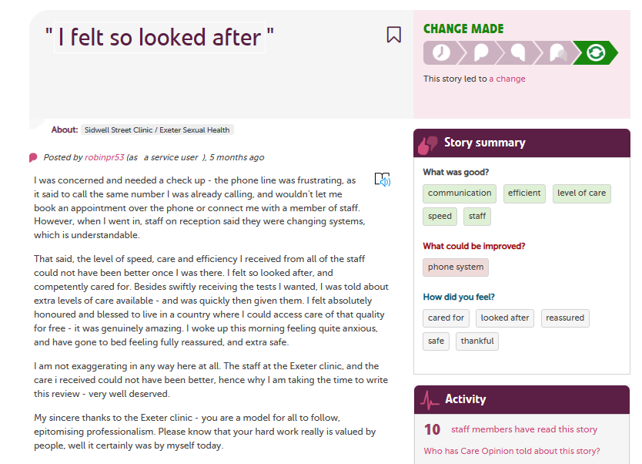

Slide 16
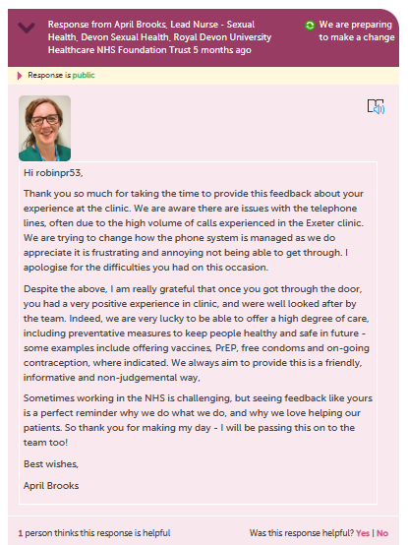

Slide 17
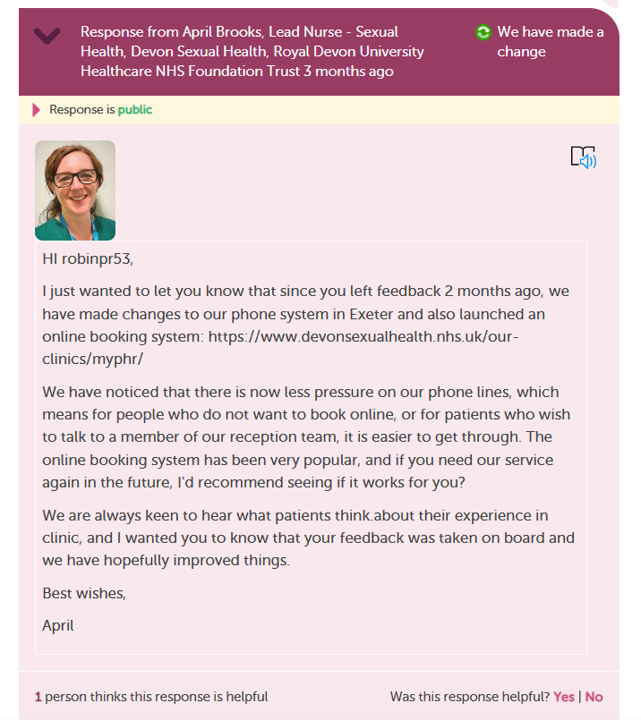

Slide 18
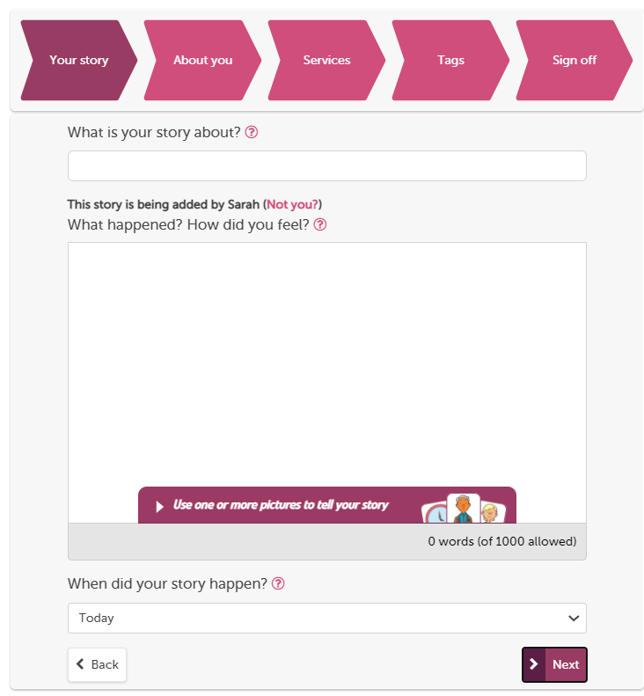
The “tell your story” workflow is our full process on the website
You can use pictures
Give what was good/could be improved tags
Provide optional demographic information, FFT and ratings.
Tag story to multiple providers
Formatted to work on mobile devices
Notes:
You can use pictures
Give what was good/could be improved tags
Provide optional demographic information, FFT and ratings.
Tag story to multiple providers
Formatted to work on mobile devices

Slide 19
Inviting online feedback with an invitation link
The simplest way to invite people to share their experiences on Care Opinion is just to provide a link to the site.
Another way is to make an "invitation link“ and provide that instead. They look like this https://www.careopinion.org.uk/49/aah-ed
What does an invitation link do?
An invitation link allows you to:
customise various aspects of our story-telling workflow
easily access widget codes, kiosk links or QR codes to share with people using services
keep track of which stories came via which invitation links, and run reports and visualisations easily
Add your own survey link at the end
Notes:
The simplest way to invite people to share their experiences on Care Opinion is just to provide a link to the site.
Another way is to make an "invitation link“ and provide that instead. They look like this https://www.careopinion.org.uk/49/aah-ed
What does an invitation link do?
An invitation link allows you to:
customise various aspects of our story-telling workflow
easily access widget codes, kiosk links or QR codes to share with people using services
keep track of which stories came via which invitation links, and run reports and visualisations easily

Slide 20

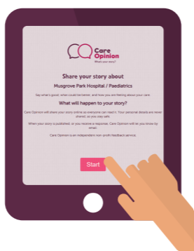

Slide 21


Slide 22
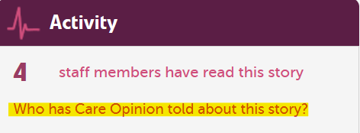

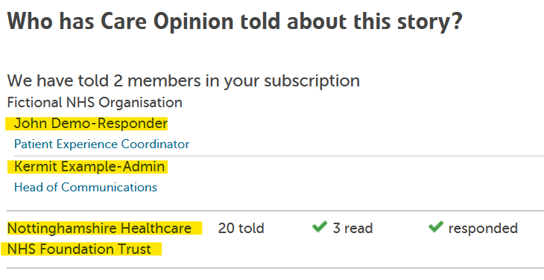

How do I find out who else has been alerted to this story?
You can also find out who else in your subscription has been sent an email alert
Not only can you see who's been notified, but if anyone has read or responded to the story too

Slide 23
Accessing the site

Slide 24





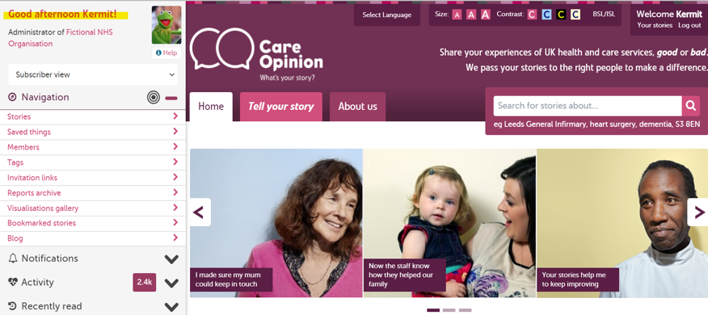
Notes:
Change this to sub admin

Slide 25

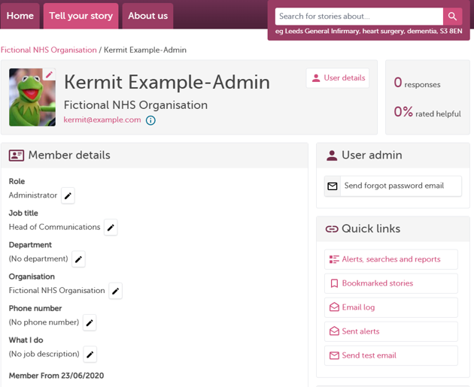





Slide 26

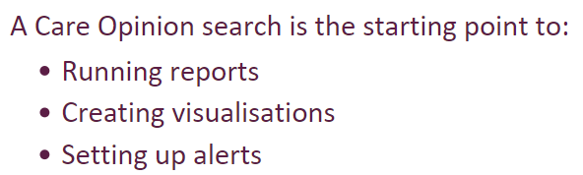
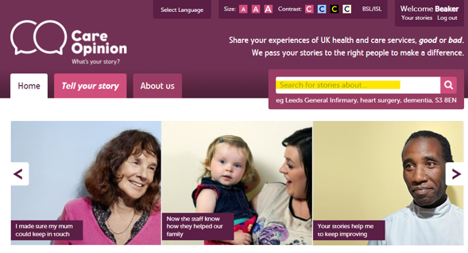


Slide 27
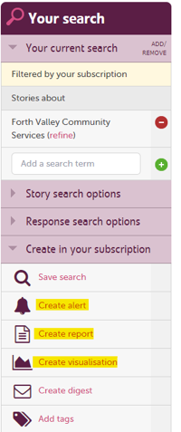






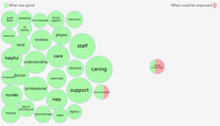

Slide 28
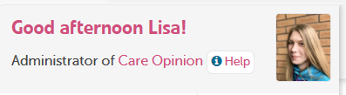

How to find help?
Help button
Support page
Contacting your lead within your organisation
Contacting your Care Opinion support lead
Emailing: info@careopinion.org.uk

Slide 29

Bitesize Videos!!
As some of you may be aware from our recent email teasing this project, our support team have been working incredibly hard to update our suite of Bitesize Videos!
These videos will cover a whole host of topics and will be perfect for explaining how to complete common tasks
Our Bitesize Videos make the perfect training aid, will be great for sharing amongst subscribers for a visual step-by-step on whichever task they are looking to learn how to complete!
These are currently being finalised, and we are looking to release these very soon- so watch this space!

Slide 30

Live Site…

Slide 31


Resources and Care Opinion training webinars/events
Invitation Links
You can watch a short 9 minute video on how to create Invitation Links here: https://vimeo.com/681943773
Other webinars
Sign up for and view webinar recordings on this page: Training and support webinars | Care Opinion
Know How Page
For all your support needs, you can find lots of information at this page: Subscriber know-how | Care Opinion
Events
Find out about our upcoming Care Opinion events here: Care Opinion Events | Care Opinion
Contact us: info@careopinion.org.uk
Notes:
Cally:
Upcoming How to training webinars:
Invitation Links and subscriber tagging
How to use reports and visualisations
How to respond well and demonstrate impact
And many more

Slide 32

Blogs
Royal Devon University Healthcare NHS Foundation Trust
Our journey from single service to trust-wide subscription
Inclusion – Sexual Health Services
Celebrating 1st year f online feedback
Nottinghamshire Healthcare
Blog by MH service user
GP in Hackney – The Lawson Practice
Care Opinion within a GP setting
Southern Health & Social Care Trust
Care Opinion for in-patient mental health & learning disability service | Care Opinion
All blogs on Care Opinion | Care Opinion

Slide 33


Slide 34
Thank
you

