Slide 1
PATIENT OPINION AND Interprofessional Education at Sheffield Hallam University
Helen BYWATER
Head of IPE

Slide 2
What is IPE?
Learning with, from and about each other to improve collaboration and the quality of care (CAIPE, 2002)

Slide 3

WHY - Rationale for interprofessional learning
policy, public inquiry, PSRB requirement comissioners,research
more positive outcomes are attained by collaborative teams
must be supported by education and training that is genuinely interprofessional
Notes:
The rationale for interprofessional learning is consistently being refreshed by successive policy initiatives that underline the needs for more integrated, personalised and cross-agency services that promote better quality care for individuals and their families/carers. There is increasing evidence that better 'patient' outcomes are achieved by collaborative teams and that education that supports the development of collaboration must be in place to support it. Commissioners and quality agencies are increasingly looking for evidence of IP in pre and post registration education. At Hallam, along with most other institutions globally we use the CAIPE definition of IPE.

Slide 4
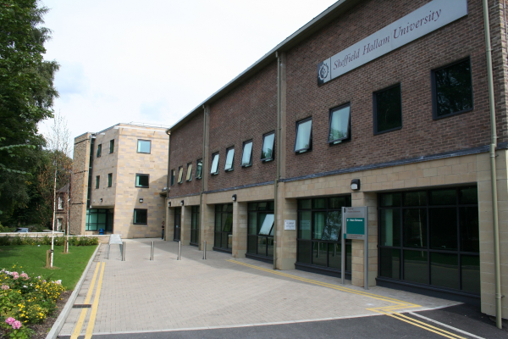
IPE at Sheffield Hallam
Key learning and teaching strategy in SHU in undergraduate and post graduate provision
Has evolved over more than a decade
Leading edge institution with national and international reputation
Several national projects; Forging Ahead (DoH funded); CUILU (DoH funded); CIPeL (HEFCE funded); TUILIP (EMHD funded)
Notes:
Some of the provision is 'common' ie all students take all of part of a module, but not together in multiprofessional groups and not necessarily at the same time; some is 'shared' in that students study the same 'common' module or part of a module together in multiprofessional groups; and half of the provision is 'interprofessional' in that students study a 'common' module, shared in multiprofessional groups with the express purpose of learning to collaborate.

Slide 5
Focus of our IPE
Barr et al (2006) identify three key themes in interprofessional education: preparing individuals, cultivating collaboration and improving services. They propose that personal preparation is the focus of first year pre-registration interprofessional education and that this drives the progressive development of effective team working and improving service and care.

Slide 6
Communication
Service Improvement
Ethics
Collaborative Practice
Service User central
Anti-Oppressive Practice
Policy
Professionalism
Team Working

Slide 7
What are we trying to achieve in our IPE modules?
Develop professionals who are confident in their own knowledge and skills and who are aware of and confident in the knowledge and skills of fellow professionals and who can conduct their practice in a collaborative, non hierarchical way with other members of the working team to benefit the individual accessing services

Slide 8

Complexities
3500 Students
120 Facilitators
600 + seminars
BSc Hons Nursing (Child)
BSc Hons Nursing (Adult )
BSc Hons Nursing (Mental Health)
BSc Applied Nursing Social Work
BSc Hons Midwifery
BSc Hons Social Work
BSc Hons Youth and Community Studies
BSc Hons Working with Children and Young Families
BSc Hons Radiotherapy and Oncology
BSc Hons Occupational Therapy
BSc Hons Physiotherapy
BSc Hons Radiography
Dip HE Paramedic Practice
Dip HE Operating Department Practice
Tech to Paramedic Practice

Slide 9

Key elements of our interprofessional learning and teaching approaches
E-enhancement of the programme – positive impact on logistics and learning approaches - blended
Involve and place the patient/client/service user/carer at the centre of the learning
Authenticity, a focus on the reality of practice in learning opportunities and assessment strategies
Students learning with, from and about each other (Barr, 2002) Learner autonomy
Adult learning, 'constructivist' and active learning approaches to the student experience.
Promotion of interprofessional capability
Content addresses knowledge and skills required by all professional groups
Notes:
The IPE programme follows the imperative to place the person receiving care central to the learning event –
Learning with. from and about each other – supports constructivist approaches where students bring their uniprofessional knowledge to the learning 'table' to solve problems etc together – this sharing of perspective drives the construction of new knowledge generated between the students – learning that they could not achieve through uniprofessional experience. adult learning – the notion that adults are motivated to learn what they need to learn for day to day engagement in the world of work (congruent with employability concepts) – this is related to the authenticity of learning materials dealt with later in presentation – also supported by e-enhancement (bringing 'hard to reach' people into the classroom). Acknowledge that first years can have difficulties with IPE – but evidence suggests students become more orientated as they become more experienced.
The thrust of IPE is to promote interprofessional capability (CUILU Capability Framework) to foster the skills, knowledge and attitudes that promote collaborative working

Slide 10
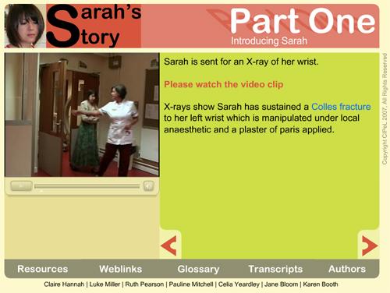
Ensuring relevant, authentic learning

Slide 11
Integration of patient opinion
Level 5 Initially - self directed and group learning
Collaborative practice, team working, trust, service environment, decision making, active listening.
Focus on both positive and negative experiences highlighted
Act as trigger for sharing of experiences - looking at similarities - relate to policy
Level 6 - Service improvement - what is a quality service?

Slide 12
Impact on learning
Discussions in class/reflective journal
Challenges faced by professions in practice
Impact of our behaviour on the service user
How this and the service environment impacts on effective collaborative practice
What matters?

