Slide 1
Care Opinion-Our Work with HWs looking to the future

Slide 2
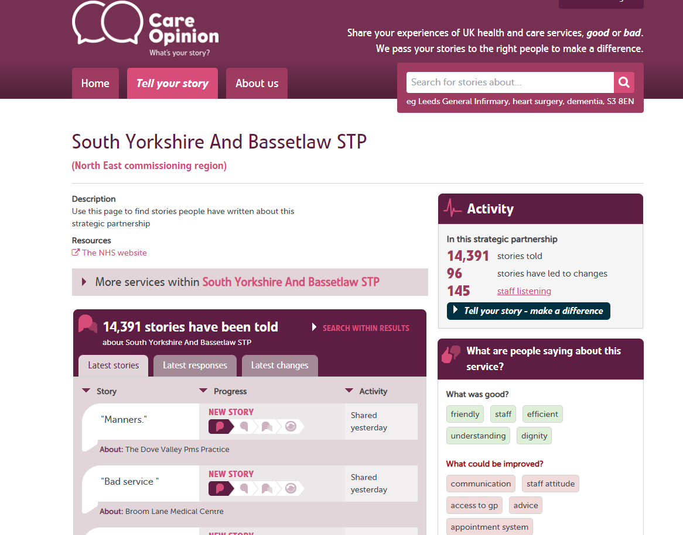

Slide 3
Aligns with Healthwatch
Social Value
Public Interest
Access to Data supports local intelligence
As well as not instead of
Care Opinion/NHS.uk Stories
Functionality-Digests, Reports, Visualisations

Slide 4
Current Subscription Offer
Free Subscription for qualifying HWs
£499 per annum for paid for subscriptions
Access to comprehensive Online support-Webinars etc
Access to Subscriber Support Team
Monitoring plus Feedback Focus via Inv Links
Responding to Postings

Slide 5
Integrated Care Systems
Public Feedback Accessible to all
Feedback about multiple providers
Commissioning Teams as well as Providers
Focus on particular teams ie Cancer Care
Various discussions happening around the UK

Slide 6
Moderation-Taking the Strain
All stories and responses are read by an expert team of moderators before they are made public
Care Opinion have robust moderation and safeguarding processes in place: https://www.careopinion.ie/info/uk/safeguarding-process
Care Opinion is separate from formal Complaints
Extra measures in place for Primary Care, Care Homes, Private Providers
Notes:
Care Opinion has a highly evolved moderation policy that is informed by legal advice.
6

Slide 7
Thank you for listening
Email: tim.hunt@careopinion.org.uk

