Slide 1


Introduction to Care Opinion for Healthwatch

Slide 2
Aims from this session
Introduction to Care Opinion
Value to Healthwatch
Live Care Opinion Site Tour
Reflections from HWs about local activity – Case Study
Ideas for Partnership working in these new landscapes

Slide 3


Slide 4

Mission, Vision & Values
Our vision
What do we want to see?
We want people to be able to share their experiences of health and care in ways which are safe, simple, and lead to learning and change.
Our mission
Our mission, in a nutshell, is to provide an online platform so that people can share honest feedback easily and without fear
Our values
How will we pursue our mission?
Innovation Transparency Inclusivity Positivity Humanity
How is Care Opinion funded? | Care Opinion
Meet the Care Opinion team | Care Opinion

Slide 5
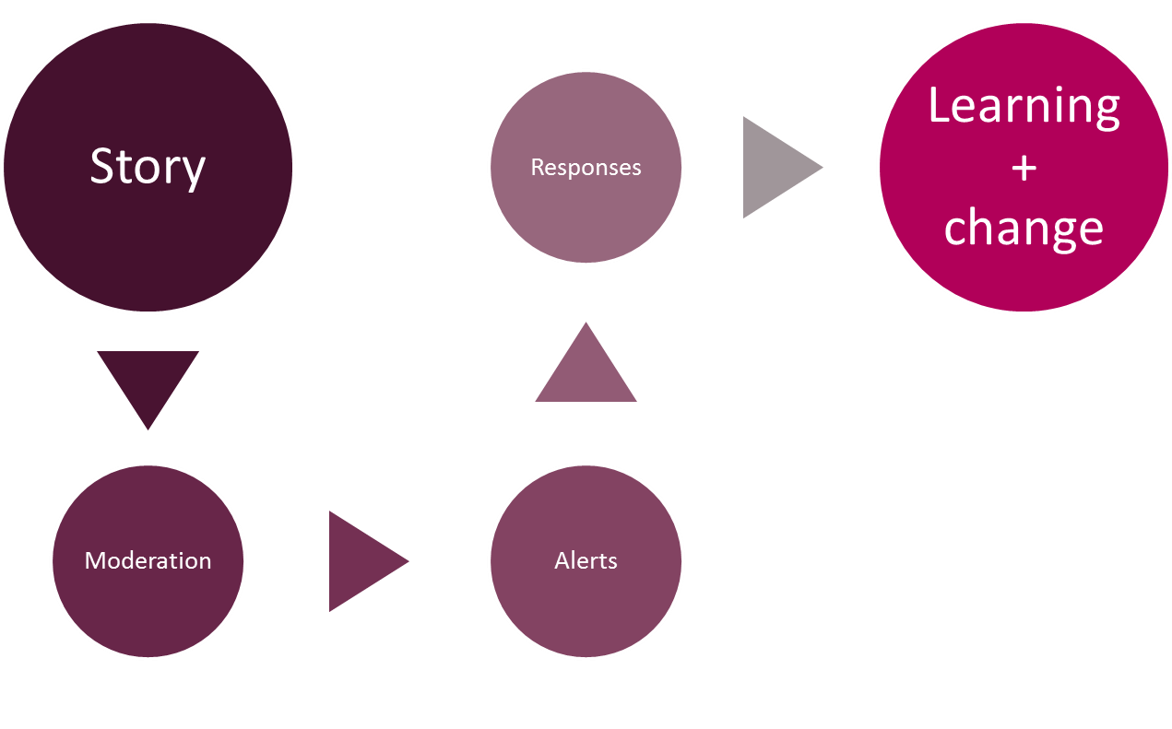
The story-telling flow – it’s about the conversation

Slide 6
Value of Care Opinion
All Postings are independently moderated (includes Safeguarding)
Includes all NHS.UK Postings
Care Opinion covers all Health and Social Care Providers including Care Homes, domiciliary care etc.
Data filtered by provider, geographical area, themes, treatment functions etc.
Public able to post about multiple providers in one posting
Public, transparent, encourages learning and improvements
Social Media Friendly

Slide 7
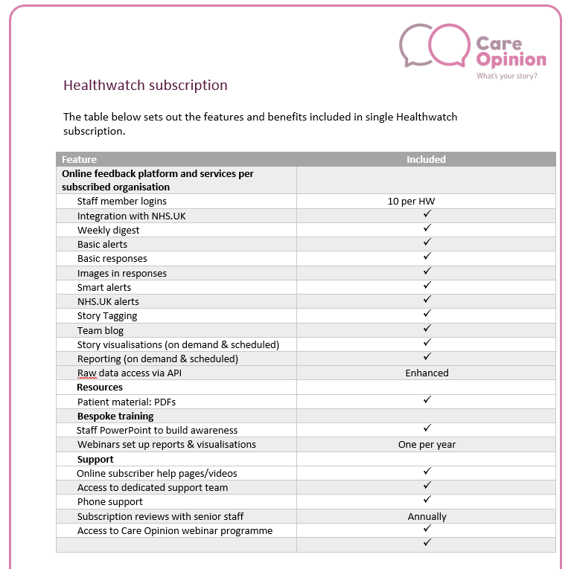
Structure of a Healthwatch Subscription

Slide 8

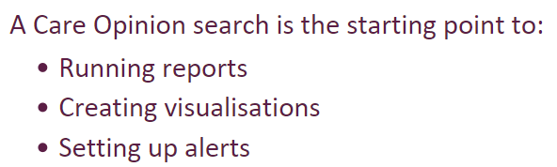
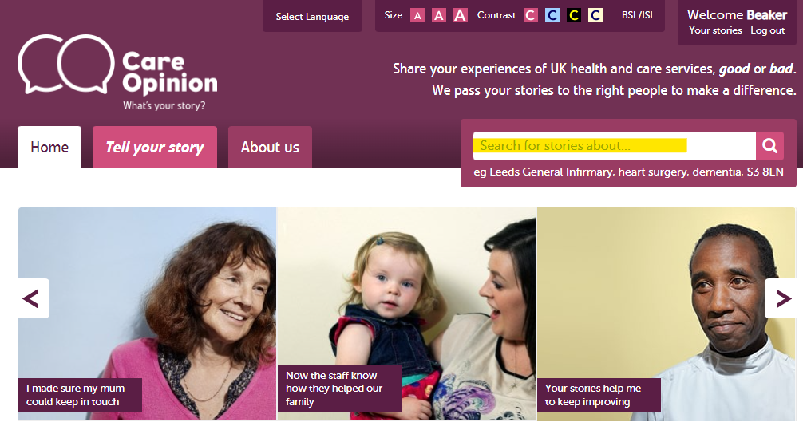



Slide 9
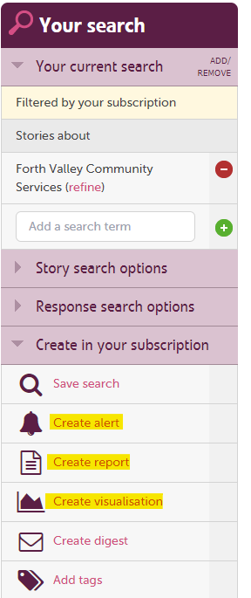




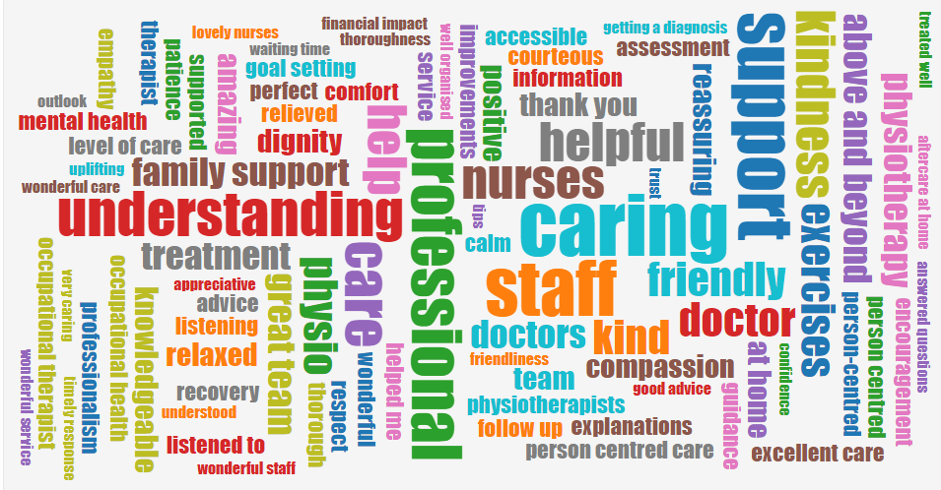

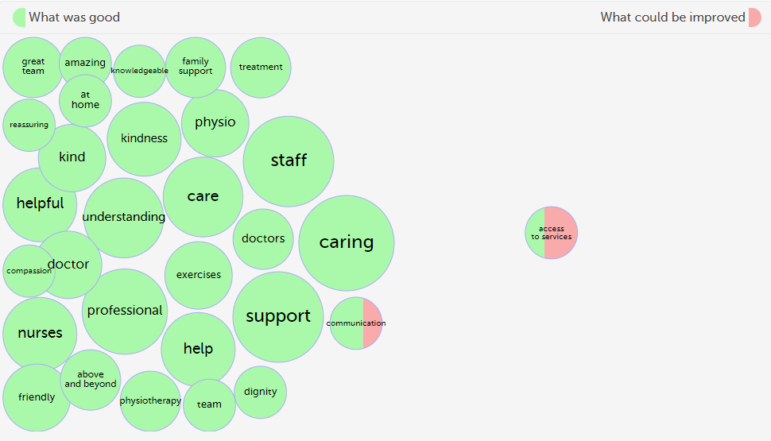


Slide 10
Stories and responses
Use Care Opinion search options to…
Find stories about specific services
Save searches
Create alerts/weekly digests
Create and schedule reports
Run/schedule visualisations
I'll now show you some live examples of visualisations and reports
Smart
Alerting
Searching
Subscriber tagging
Reporting
Visualisations

Slide 11
Searching on Care Opinion
What can I search by?.......
Service eg hospital, care home
  Services within services – your friend (refine), e.g. endoscopy
Speciality/Type of Care (treatment function) e.g. cardiology, ENT,
Tag e.g. nurse, compassion, staff
Phrase e.g. “scan” “blood transfusion” etc
Advanced search blog

Slide 12
Live site tour

Slide 13
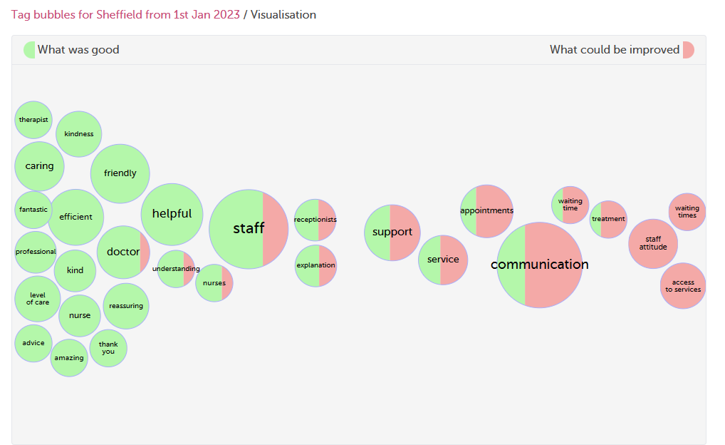
Interactive tag bubbles about All stories about Sheffield Services from 1st Jan 2023
Your visualisation is now available here

Slide 14
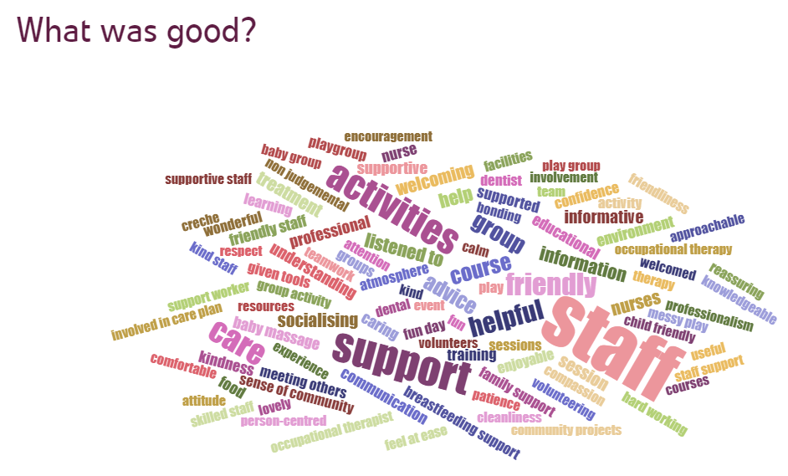
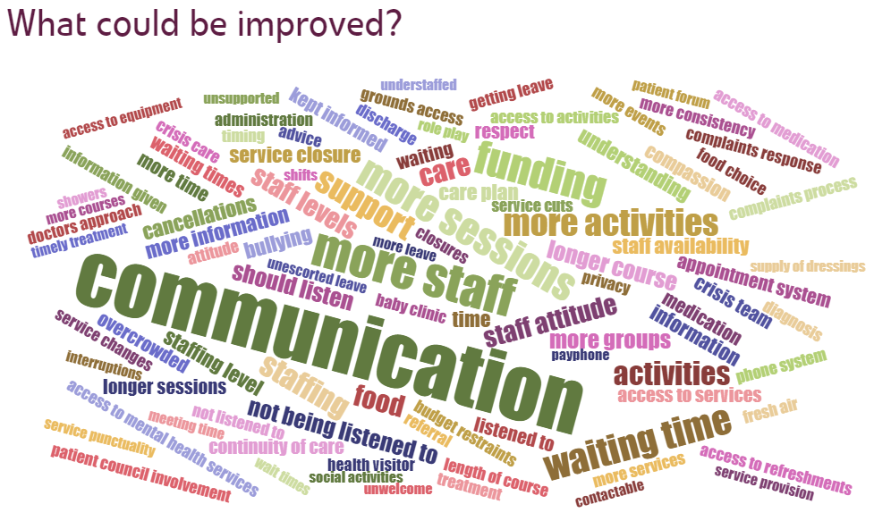
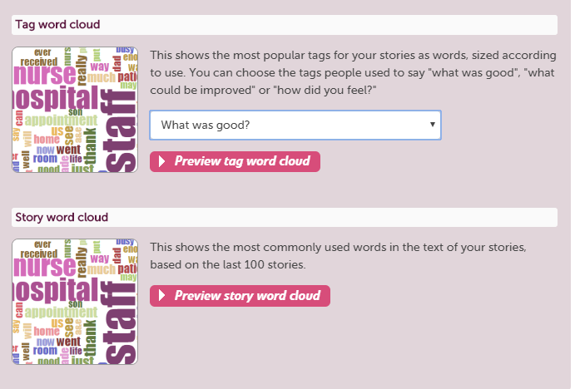

Slide 15
All reports:
Can be saved for later
Downloaded in different formats
Be tailored to specific services
Be set on a schedule (weekly, monthly etc)

Slide 16
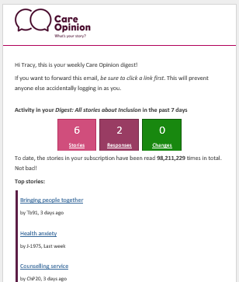
Weekly Digest

Slide 17
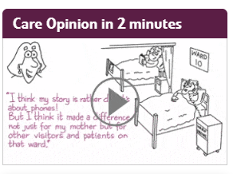
On-line promotion CO Widgets
Latest stories Widget on front page - Stays up to date with most recent stories e.g. Sheffield
People can share feedback with Care Opinion about your local providers without leaving your site – Tell your story Widget
Embed the Care Opinion video so people can watch how Care Opinion works

Slide 18
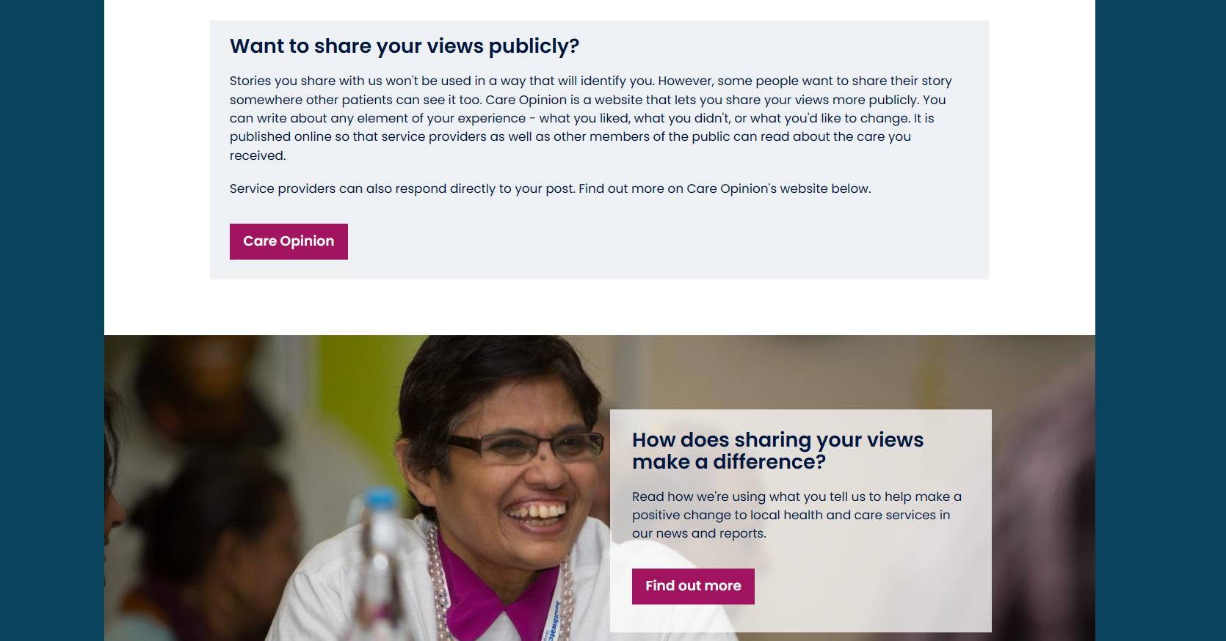
Healthwatch Sheffield using Care Opinion
https://www.healthwatchsheffield.co.uk/share-your-views

Slide 19

Healthwatch Sheffield
Key issues from Dec to Jan - Sheffield

Slide 20
HW Generating Postings
Different Ways for Staff/Volunteers to generate postings
You’re able to track postings that you help to generate
You can focus on a service area or theme
Fits integrated care agenda

Slide 21
Building local partnerships
Share stories and reports at local meetings with providers and commissioners
Integrate with other data to monitor the quality of services
Sent reports on particular areas to key local people ie GP feedback to Primary Care Leads
Share feedback with other HWs within local ICB/ICS to identify issues and gaps in service

Slide 22


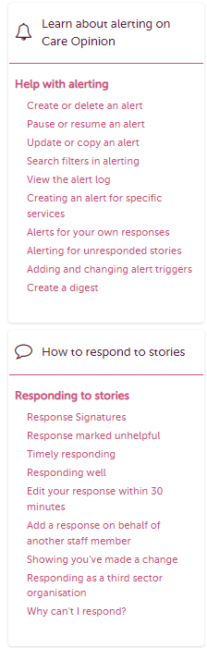
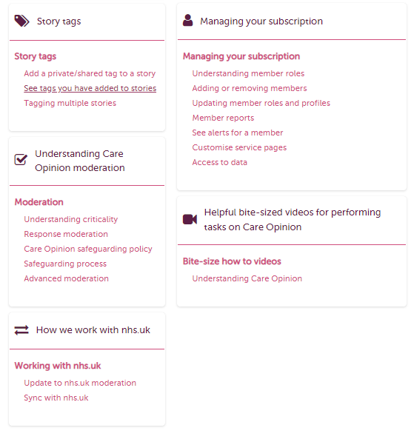
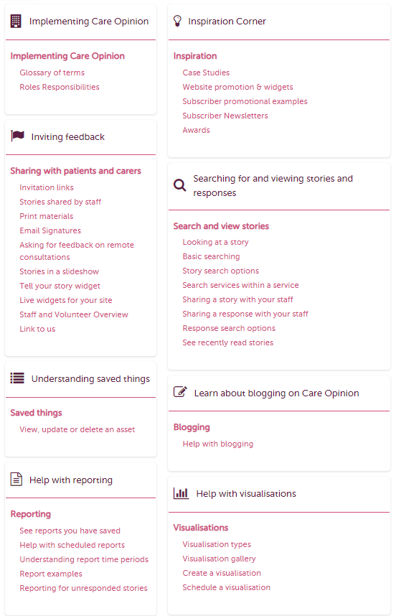
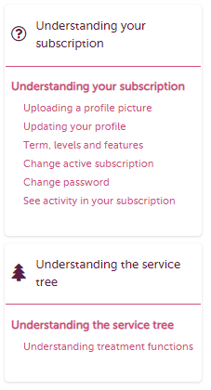
https://www.careopinion.org.uk/info/subscriber-know-how

Slide 23
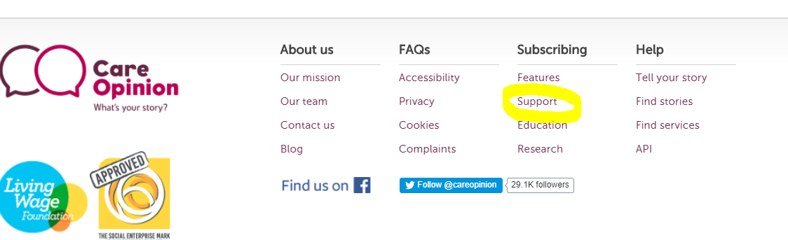
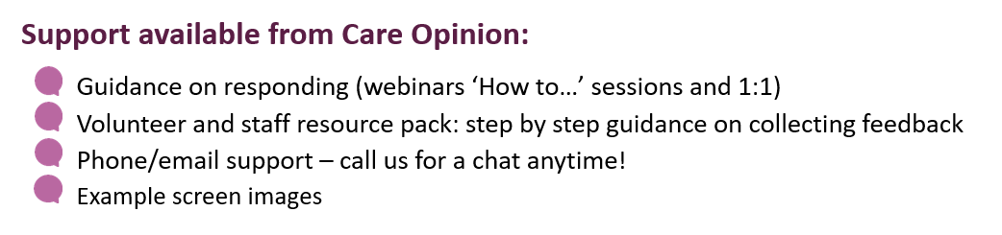
Support from Care Opinion
https://www.careopinion.org.uk/info/support-webinars
Info@careopinion.org.uk
0114 281 6256

